Slide 1
Suggesting Stations for the Silver Line project, Kerala
May, 2020

Slide 2
Why minimise the number of Stations?
Low commute time
Low implementation cost
Low operational cost

Slide 3
How to select Stations?
Optimal connectivity across the state
Feasibility of construction
Optimal separation between stations

Slide 4
Data acquisition
Districts through which the railway corridor runs - (collected from https://keralarail.com)
Main venues around the district which should have good connectivity to the Silver Line project - (collected from foursquare places api)

Slide 5
Data Cleaning
Missing values manually added
Duplicate entries dropped off
Highly correlated data - treated based distance

Slide 6
Data Weights
Airport, Seaport, Railway Stations.etc are given appropriate weightage
Weight of each record calculated using formula
  weight_of_location = weight_of_category * (100000.0 / distance) * (x + 0.01)
x = (longitude < min_logitude + 1) ? 1 : 0

Slide 7
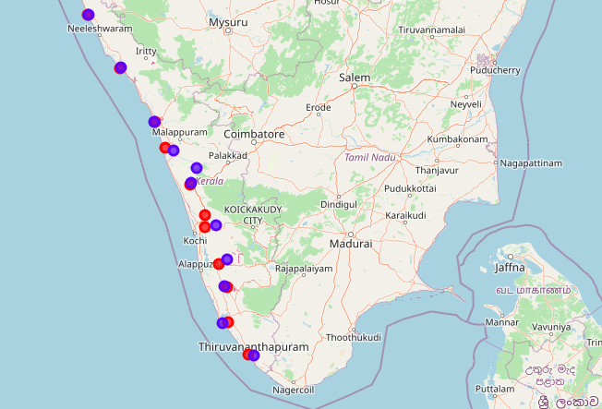
Plot of Current Stations vs District Centres
Red: Current Station
Blue: District Centre

Slide 8
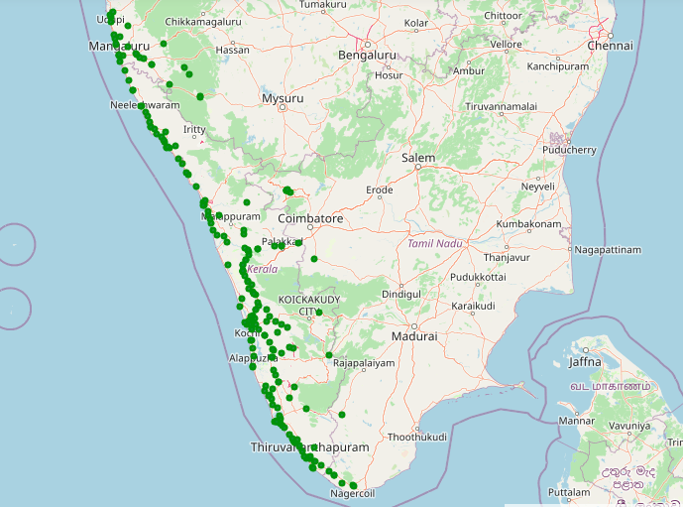
Plot of popular sites

Slide 9
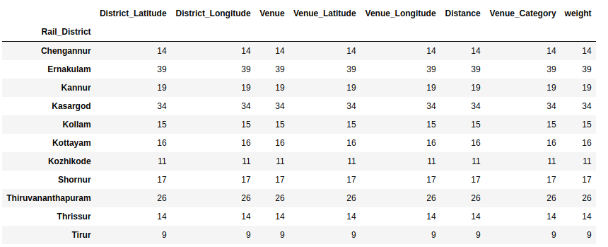
Explore Districts through which K-Rail runs

Slide 10
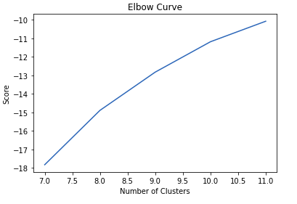
Determining the number of Stations
Number of clusters, k = 10

Slide 11
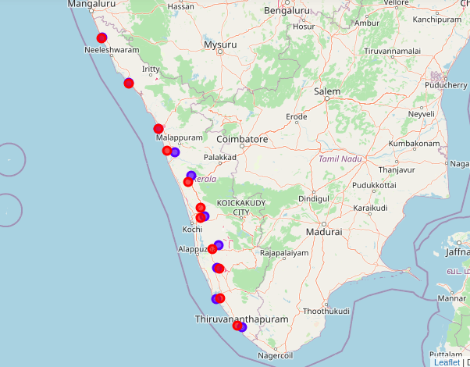
Results of K-means Clustering

Slide 12
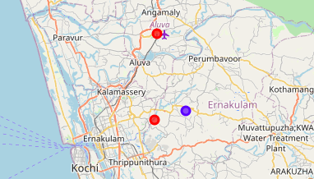
Discussions
Red: Current Station
Blue: Suggested Station
2 stations at very close distance in the district Ernakulam (stations by K-Rail team)
This project correcs it by a single station (blue circle)

Slide 13
Conclusions
Popular locations across the state grouped into 10 clusters
Each cluster with optimal connectivity
No two stations in the same district

