Slide 1
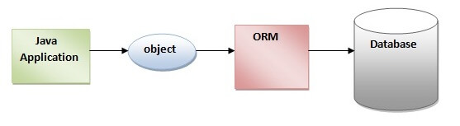
Hibernate
Hibernate is a Java framework that simplifies the development of Java application to interact with the database. It is an open source, lightweight, ORM (Object Relational Mapping) tool. Hibernate implements the specifications of JPA (Java Persistence API) for data persistence.
ORM Tool:
An ORM tool simplifies the data creation, data manipulation and data access. It is a programming technique that maps the object to the data stored in the database.

Slide 2
JPA:
Java Persistence API (JPA) is a Java specification that provides certain functionality and standard to ORM tools. The javax.persistence package contains the JPA classes and interfaces.
Advantages of Hibernate Framework:
Open Source and Lightweight
Fast Performance
Database Independent Query
Automatic Table Creation
Simplifies Complex Join-Fetching data from multiple tables is easy in hibernate framework.
Provides Query Statistics and Database Status

Slide 3
Hibernate Architecture:
The Hibernate architecture includes many objects such as persistent object, session factory, transaction factory, connection factory, session, transaction etc.
The Hibernate architecture is categorized in four layers,
Java application layer
Hibernate framework layer
Backhand api layer
Database layer

Slide 4
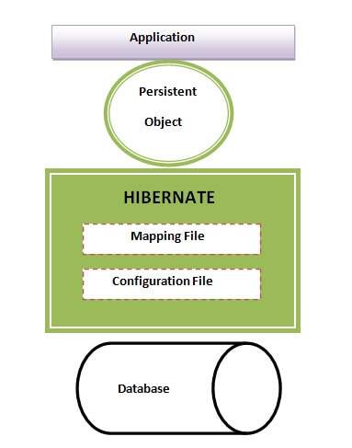
Let's see the diagram of hibernate architecture:

Slide 5
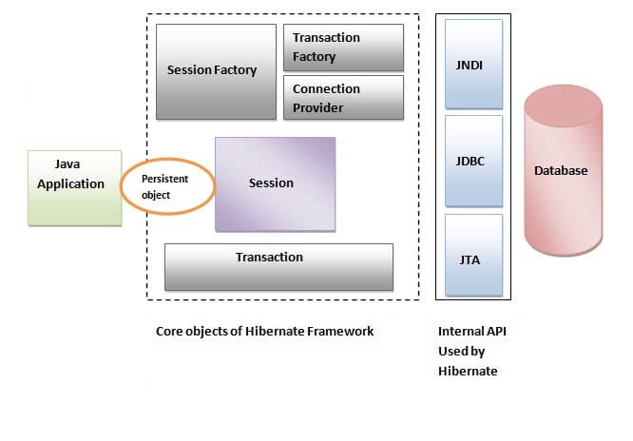

Slide 6
Elements of Hibernate Architecture:
SessionFactory:
The SessionFactory is a factory of session and client of ConnectionProvider. It holds second level cache (optional) of data. The org.hibernate.SessionFactory interface provides factory method to get the object of Session.
Session:
The session object provides an interface between the application and data stored in the database. It is a short-lived object and wraps the JDBC connection. It is factory of Transaction, Query and Criteria. It holds a first-level cache (mandatory) of data. The org.hibernate.Session interface provides methods to insert, update and delete the object. It also provides factory methods for Transaction, Query and Criteria.
Transaction:
The transaction object specifies the atomic unit of work. It is optional. The org.hibernate.Transaction interface provides methods for transaction management.

Slide 7
ConnectionProvider:
It is a factory of JDBC connections. It abstracts the application from DriverManager or DataSource. It is optional.
TransactionFactory:
It is a factory of Transaction. It is optional.
First Hibernate Example without IDE:
Create the Persistent class
Create the mapping file for Persistent class
Create the Configuration file
Create the class that retrieves or stores the persistent object
Load the jar file
Run the first hibernate application by using command prompt

Slide 8
Web Application with Hibernate (using XML):
we are going to create a web application with hibernate. For creating the web application, we are using JSP for presentation logic, Bean class for representing data and DAO class for database codes.
Hibernate Logging by Log4j using xml file:
Logging enables the programmer to write the log details into a file permanently. Log4j and Logback frameworks can be used in hibernate framework to support logging.
There are two ways to perform logging using log4j:
By log4j.xml file (or)
By log4j.properties file

Slide 9
Collection Mapping in Hibernate:
We can map collection elements of Persistent class in Hibernate. You need to declare the type of collection in Persistent class from one of the following types:
java.util.List
java.util.Set
java.util.SortedSet
java.util.Map
java.util.SortedMap
java.util.Collection

Slide 10
Hibernate Mapping:
One to one - Each student has exactly one student card, and each student card belongs to only one student.
One to many - Each course has multiple students, but each student can enroll in multiple courses.
Many to one - Each student belongs to one department, but multiple students can belong to the same department.
Many to many - Each student can enroll in multiple courses, and each course can have multiple students enrolled.
Bidirectional Association:
Employee and Address, if Employee class has-a reference of Address and Address has a reference of Employee. Additionally, you have applied one-to-one or one-to-many relationship for the classes in mapping file as well, it is known as bidirectional association.

Slide 11
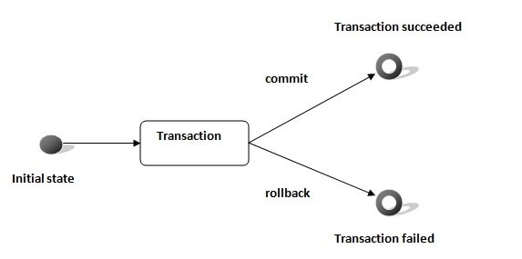
Hibernate Transaction Management Example:
A transaction simply represents a unit of work. In such case, if one step fails, the whole transaction fails (which is termed as atomicity). A transaction can be described by ACID properties (Atomicity, Consistency, Isolation and Durability).

Slide 12
Hibernate Query Language (HQL):
Hibernate Query Language (HQL) is same as SQL (Structured Query Language) but it doesn't depends on the table of the database. Instead of table name, we use class name in HQL. So it is database independent query language.
Query Interface:
It is an object oriented representation of Hibernate Query. The object of Query can be obtained by calling the createQuery() method Session interface.
Example of HQL to get all the records:
Query query=session.createQuery("from Emp");//here persistent class name is Emp
List list=query.list();

Slide 13
Example of HQL update query:
Transaction tx=session.beginTransaction();
Query q=session.createQuery("update User set name=:n where id=:i");
q.setParameter("n","Udit Kumar");
q.setParameter("i",111);
int status=q.executeUpdate();
System.out.println(status);
tx.commit();

Slide 14
Example of HQL delete query:
Query query=session.createQuery("delete from Emp where id=100");
//specifying class name (Emp) not tablename
query.executeUpdate();
HQL with Aggregate functions:
You may call avg(), min(), max() etc. aggregate functions by HQL. Let's see some common examples:
(Eg):
Query q=session.createQuery("select max(salary) from Emp");

Slide 15
Hibernate Named query:
The hibernate named query is way to use any query by some meaningful name. It is like using alias names. The Hibernate framework provides the concept of named queries so that application programmer need not to scatter queries to all the java code.
Two Ways:
by annotation
by mapping file.
Hibernate Named Query by annotation:
@NameQueries annotation is used to define the multiple named queries.
@NameQuery annotation is used to define the single named query.

Slide 16
Caching in Hibernate:
Hibernate caching improves the performance of the application by pooling the object in the cache. It is useful when we have to fetch the same data multiple times.
First Level Cache:
Session object holds the first level cache data. It is enabled by default. The first level cache data will not be available to entire application. An application can use many session object.
Second Level Cache:
SessionFactory object holds the second level cache data. The data stored in the second level cache will be available to entire application. But we need to enable it explicitely.
----------------------------------*---------------------------------------

