Slide 1

Research Paper Summarizer
Automating Scientific Discovery with n8n, Gemini AI & Google Workspace
By Sree Navya

Slide 2

Project Overview
An automated research assistant that seamlessly retrieves papers from arXiv, intelligently summarises them using Gemini AI, and delivers results directly to Google Drive and Gmail. Built entirely on n8n's low-code platform, this workflow eliminates manual effort and scales effortlessly.
Key Advantage
Technical Foundation
Researchers gain instant, AI-generated summaries without switching applications or managing file transfers.
Combines n8n orchestration, arXiv API integration, Gemini generative AI, and Google Workspace automation in one unified workflow.

Slide 3
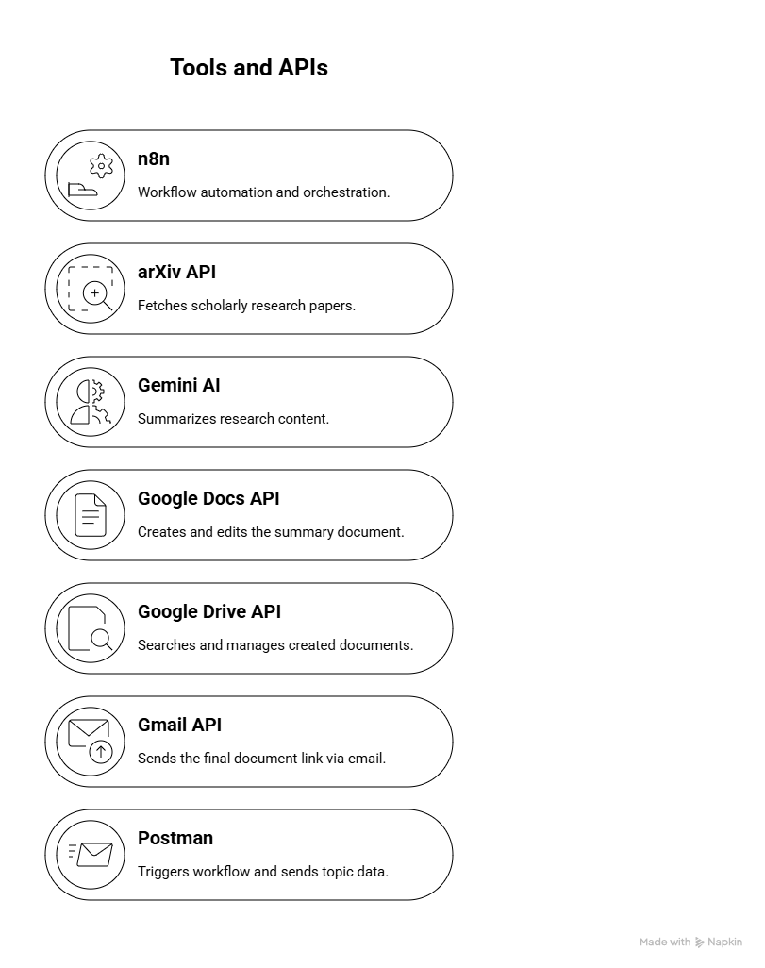
Tools and APIs used

Slide 4
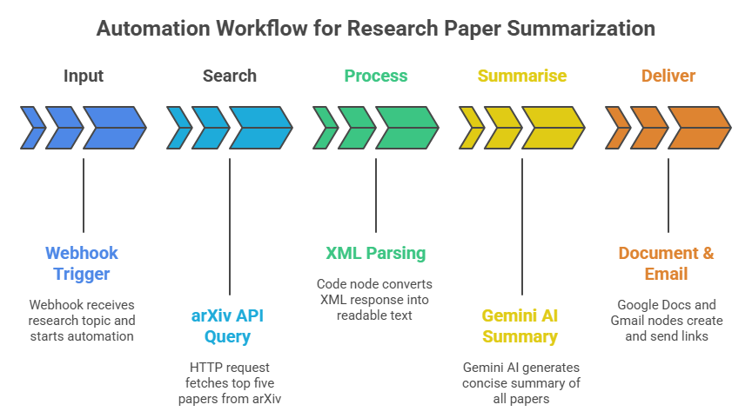

Slide 5
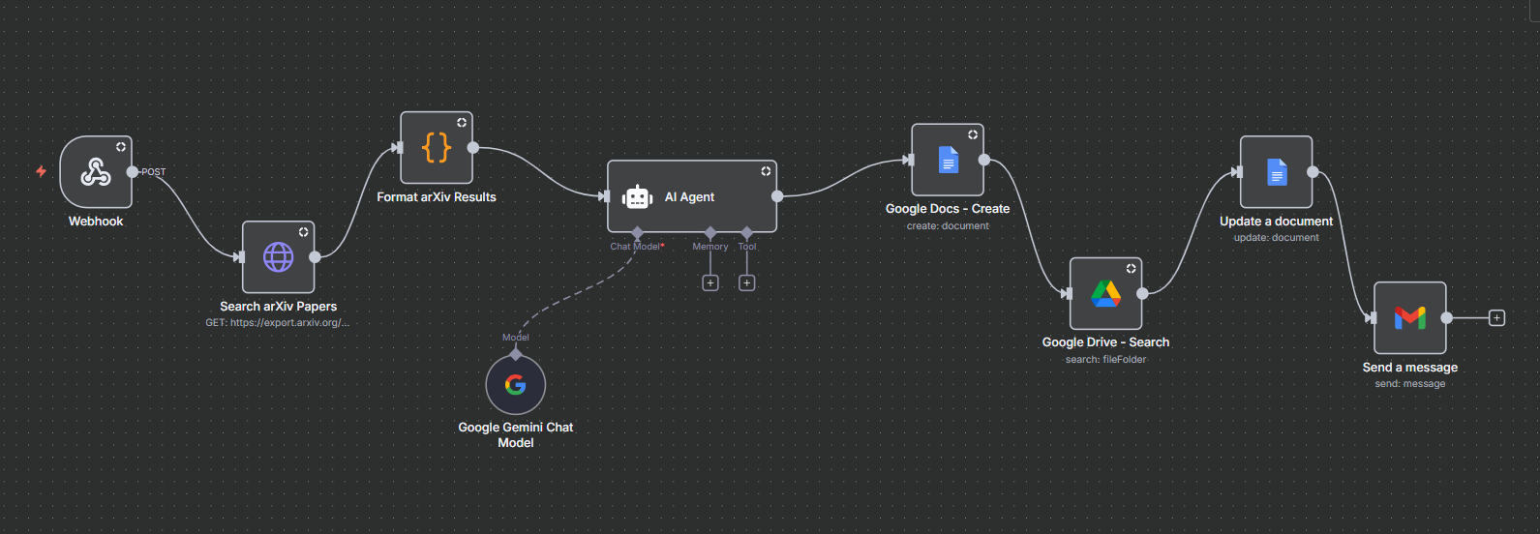

Slide 6
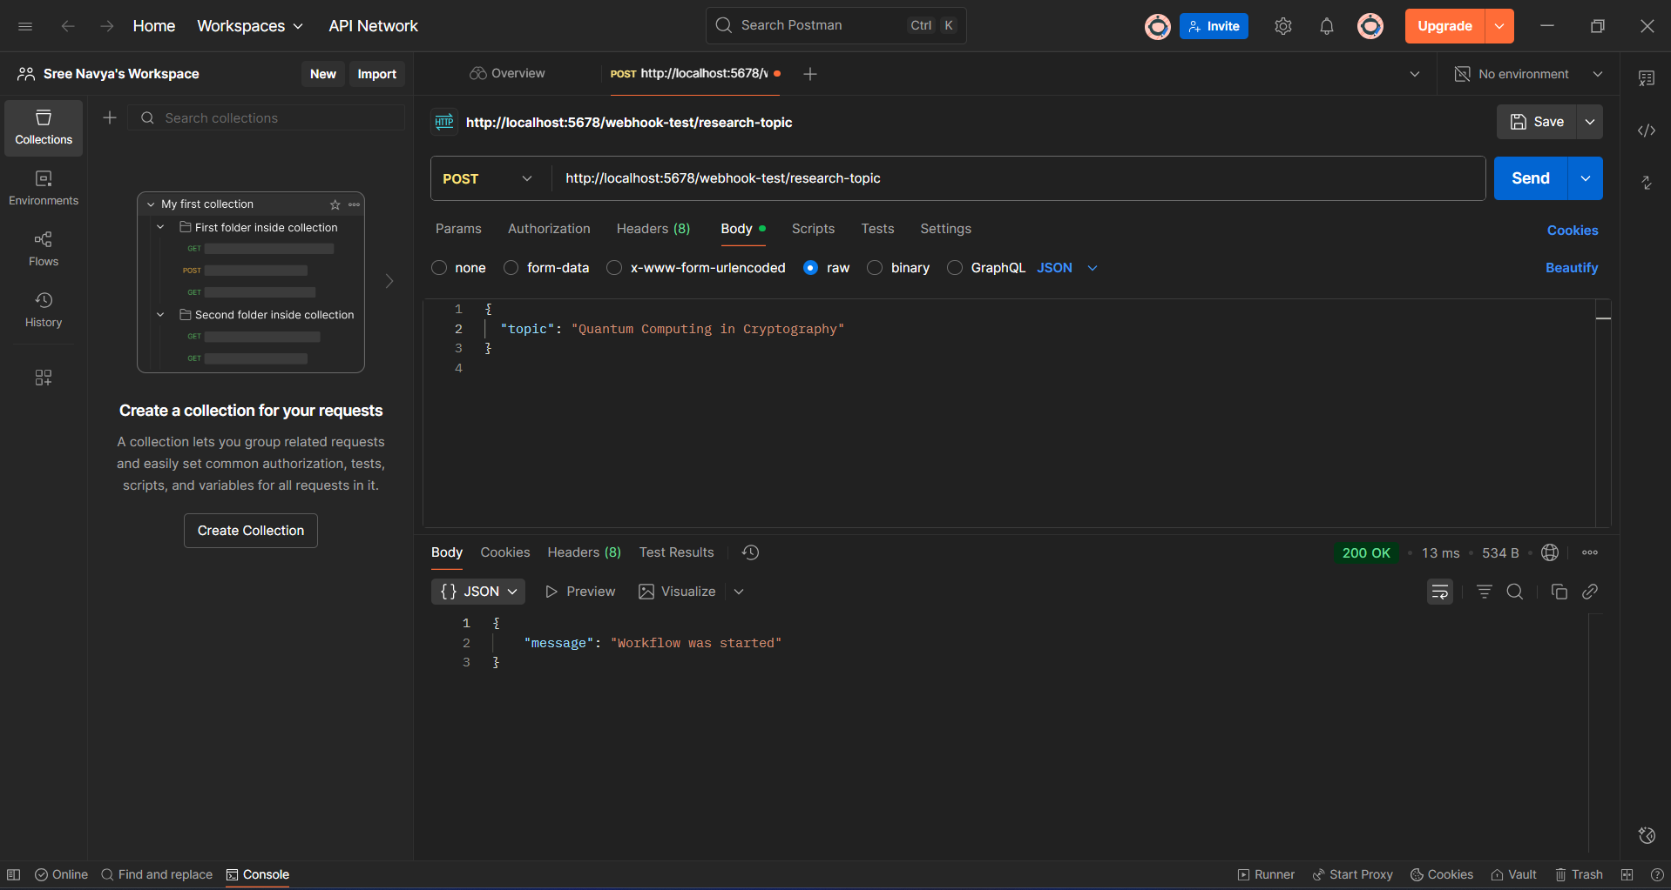

Slide 7
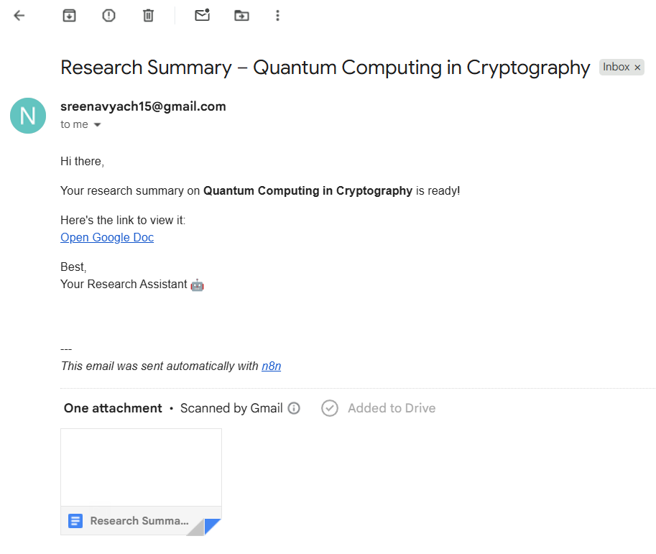
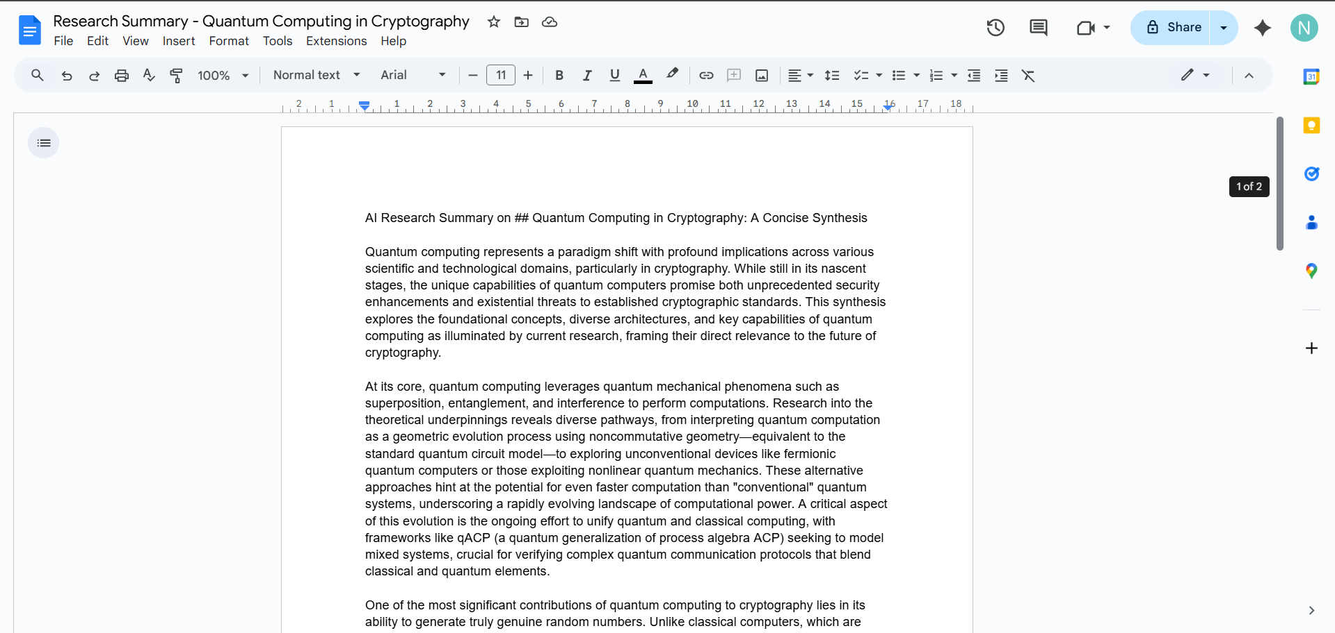
Results

Slide 8

Conclusion
The Research Paper Summarizer demonstrates how modern automation platforms, AI capabilities, and cloud infrastructure converge to solve real research challenges. By combining n8n's orchestration, arXiv's scholarly database, Gemini's summarisation intelligence, and Google Workspace's productivity ecosystem, researchers gain a powerful tool that dramatically accelerates discovery and knowledge synthesis.

