Slide 1




AI-Powered Disease Symptom Prediction System
Team: GROUP-08
Faculty: Dr. Shadab Siddiqui & Dr. Umarani
HEALTHCARE AI
NLP
MACHINE LEARNING

Slide 2

Problem & Motivation: Bridging the Healthcare Information Gap
Access to immediate, reliable health information is a critical challenge in modern healthcare. Individuals often face delays in obtaining preliminary guidance, leading to anxiety and potentially exacerbating conditions.
Lack of accessible self-help healthcare tools for initial symptom evaluation.
Difficulty in obtaining instant medical guidance without professional consultation.
The pressing need for a preliminary symptom assessment tool to inform and guide users before a doctor's visit.

Slide 3
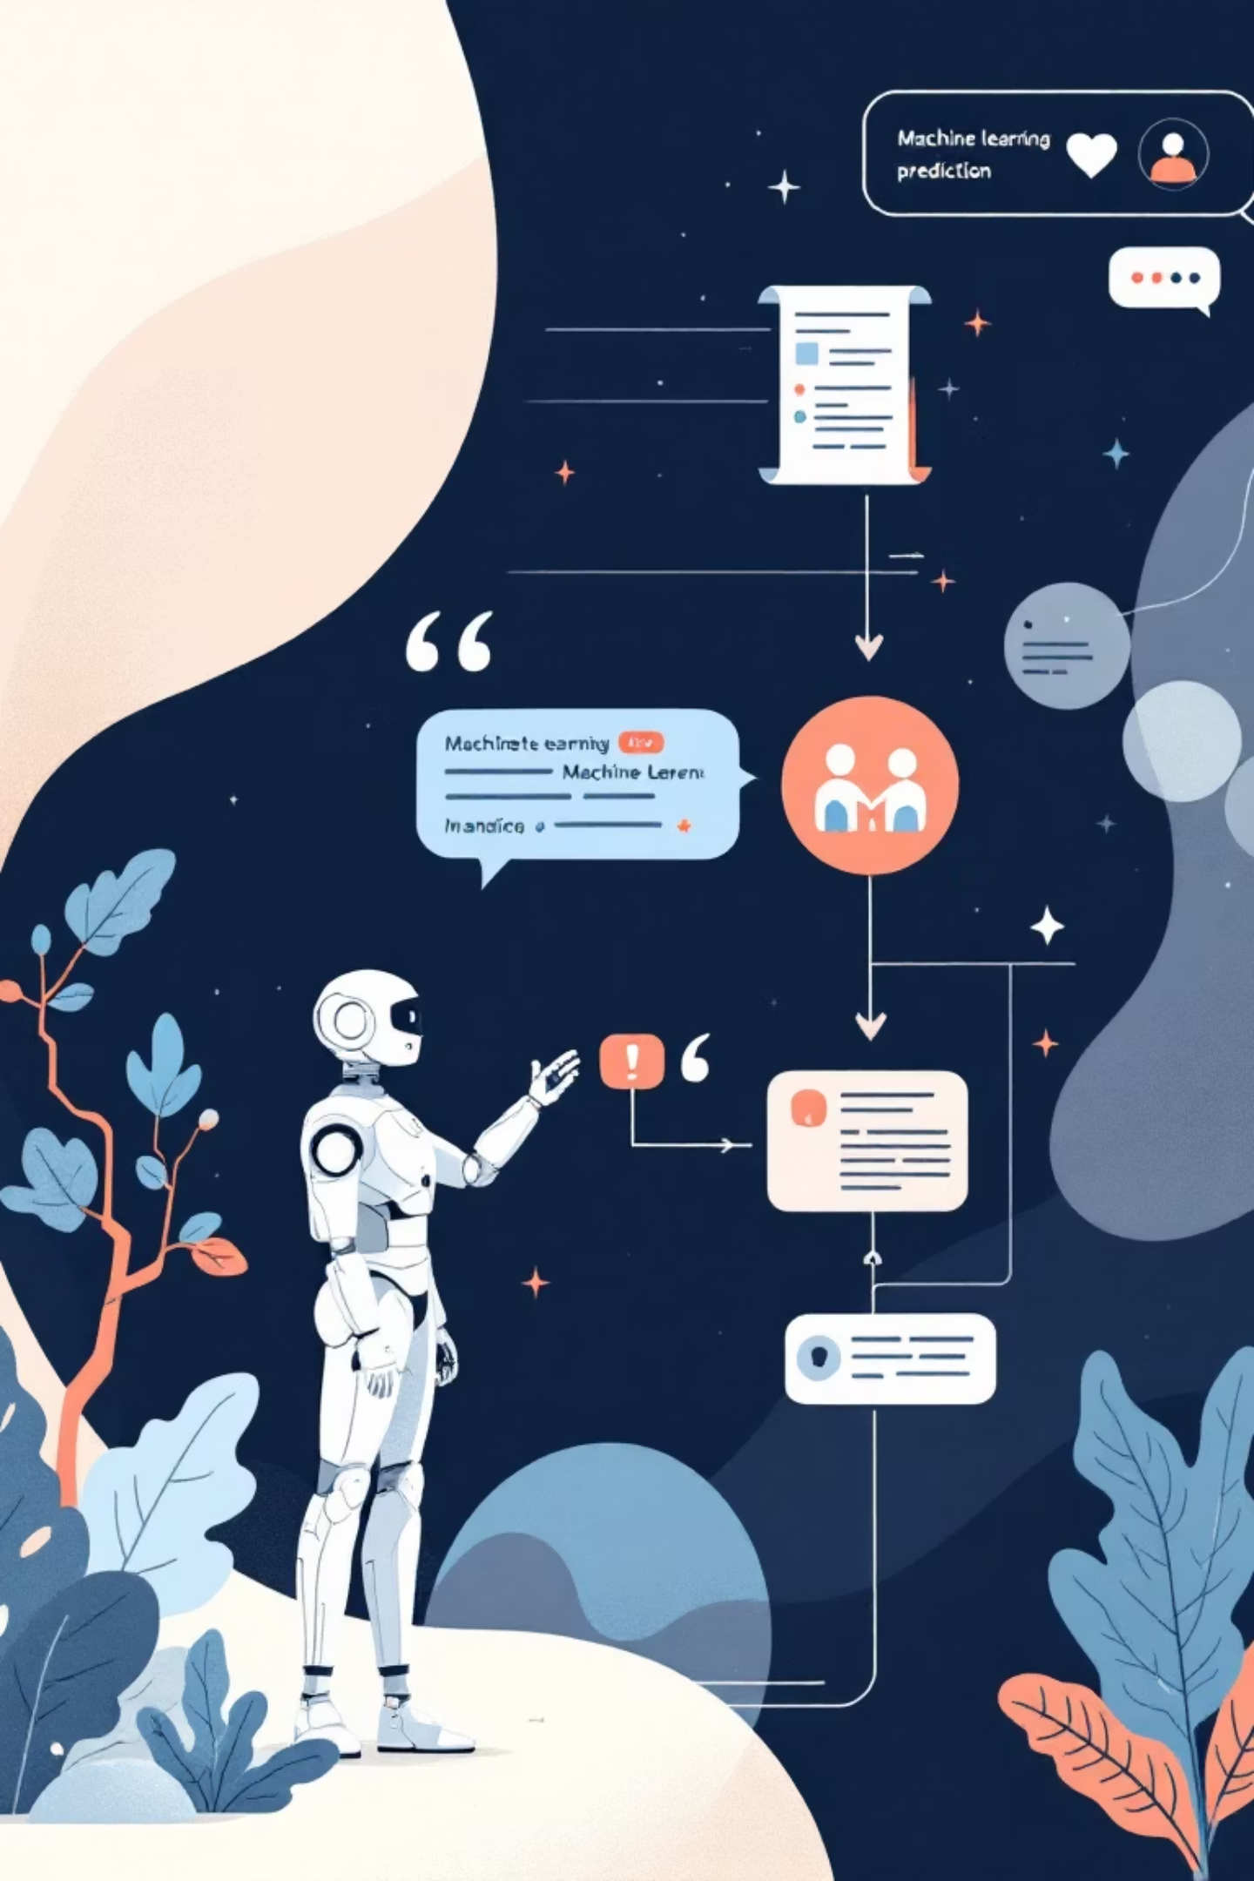




How It Works: An Intuitive Predictive System
User Interaction
Users engage with the system via a familiar chatbot interface, providing symptoms in natural language.
NLP Processing
The system leverages Natural Language Processing to understand and extract key information from the user's input.
ML Prediction
A trained Machine Learning model analyzes the processed data to predict likely diseases or conditions.
Preliminary Guidance
The chatbot provides a user-friendly response, offering predictive insights and recommendations.

Slide 4

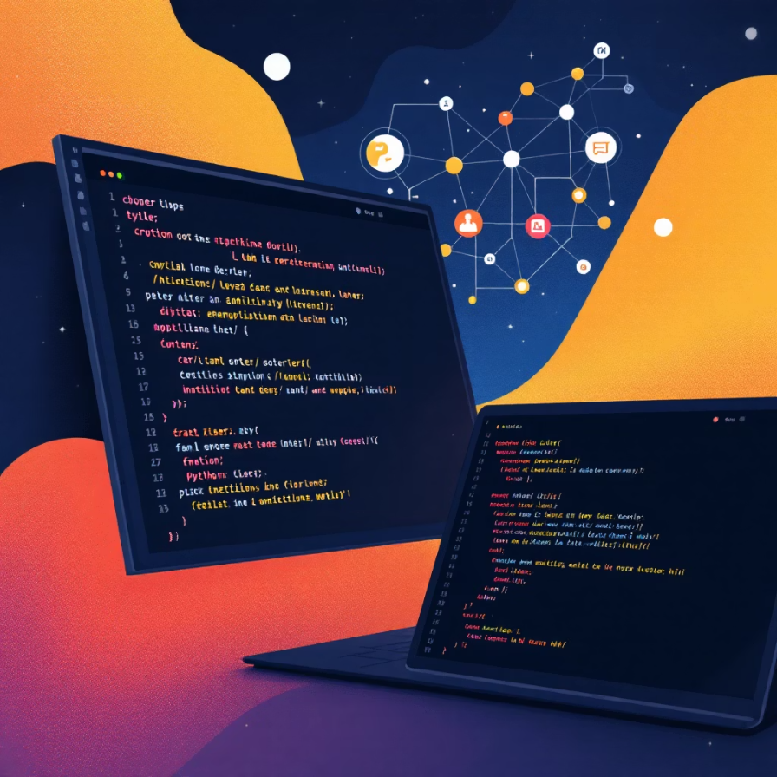

Technology Stack & Architecture
Python Backend
Centralized logic via app.py, handling requests and orchestrating predictions.
NLP Engine
Utilizing spaCy for robust natural language understanding and entity extraction.
Machine Learning Core
Disease prediction powered by a pre-trained model on a curated symptom-disease dataset.
Web Chatbot UI
A lightweight and responsive interface for seamless user interaction.

Slide 5


Key Features & Demo Flow
Real-time Symptom Input
ML-Based Prediction
Accurate disease prediction driven by a well-trained machine learning model.
Immediate processing of user-entered symptoms for rapid feedback.
User-Friendly Responses
Clear, concise, and easy-to-understand preliminary health insights.
Our demo will showcase the full user journey, from typing symptoms to receiving a predictive output, highlighting the seamless integration of our components. All necessary datasets and dependencies are included in the project's requirements for easy replication.

Slide 6
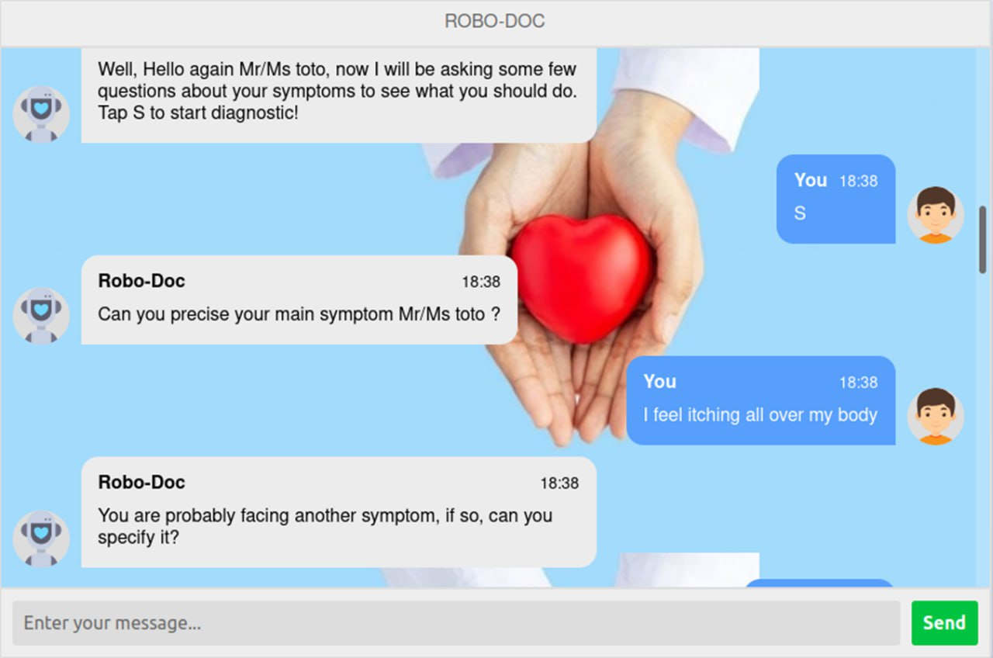
Key Features & Demo Flow

Slide 7

Feasibility & Societal Impact
Technical Feasibility
Simple Python-based Architecture: Ensures ease of deployment and maintenance.
Low Cost & Open-Source: Leverages readily available tools and libraries, making it accessible for wider adoption.
Scalability: Modular design allows for future enhancements and data integration.
Societal Impact
Early Awareness: Facilitates preliminary understanding of potential health issues, encouraging timely medical attention.
Health Education: Empowers users with information about symptoms and associated conditions.
Complementary Tool: Acts as a valuable preliminary resource, not a diagnostic replacement.

Slide 8
Thank You
Presented By: Group-08
Team Members:
S. RAJKUMAR - 2310030041
C. SREENEEL - 2310030065
P. SAI PRANEETH - 2310030250
K. CHARANDEEP - 2310030307
A.RAHUL - 2310030450

