Slide 1
Simulation Software for Smart-Fridge
and Sudoku Solver
by
Mariusz, Jonas and Sreenivas

Slide 2
Overview
Simulation software for rendering images
Smart-Fridge: Fruit(s) with varying stages of decay
Sudoku Solver: Sudoku puzzles with various parameters

Slide 3
Requirements
Feature sets:
Sudoku Solver:
  Difficulties: easy, medium and hard
  Completion stages: unsolved, partially solved and fully solved
  Errors: Apperance of intended errors in puzzle
  Handwritten fonts: Various handwritten fonts and mixtures of them
  Transformations
  Noise: Lighting, coloring

Slide 4
Requirements
Feature sets:
Smart-Fridge:
  Fruits: Banana and tomato model
  Stages of decay: fresh, neutral and rotten
  Number of fruits

Slide 5
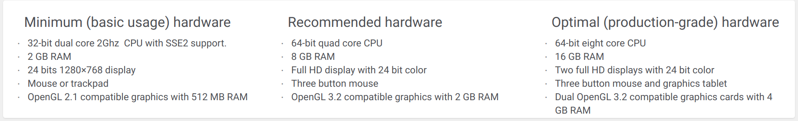
Requirements
GUI:
  User friendly
  Clearly structured User Interface
Performance:
  Non realtime
Environment:
  Linux
  Blender
Reliability:
  Groundtruth labels
Version control and License: GIT, GNU General Public License v2.0
Hardware:
.
source: https://www.blender.org/download/requirements/

Slide 6
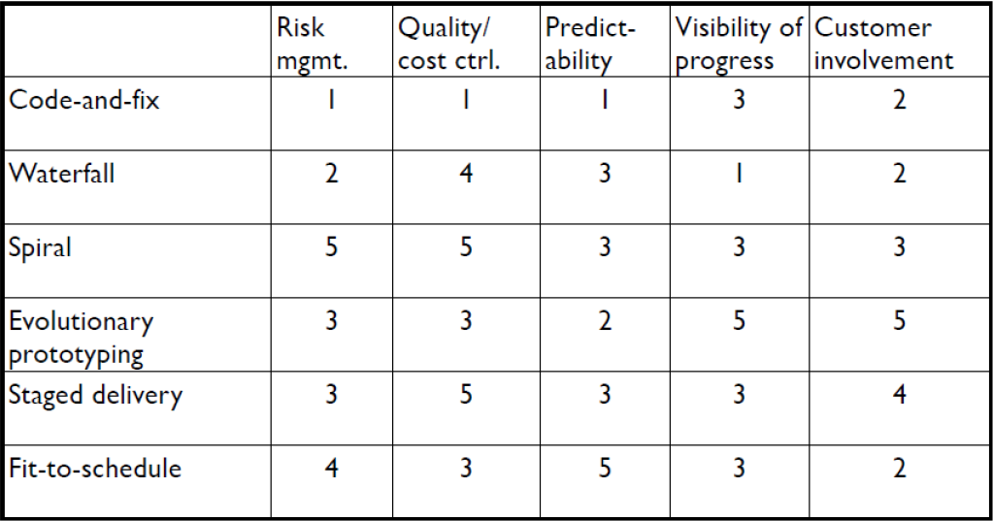
Software Lifecycle
Evolutionary Lifecycle
Selection reasoning:
  Adresses risks early (Risk choice similar to Spiral Model)
  Changing requirements
  Useful feedback loops Customer satisfaction
Fighting timelines: fit to features/quality with time limit

Slide 7
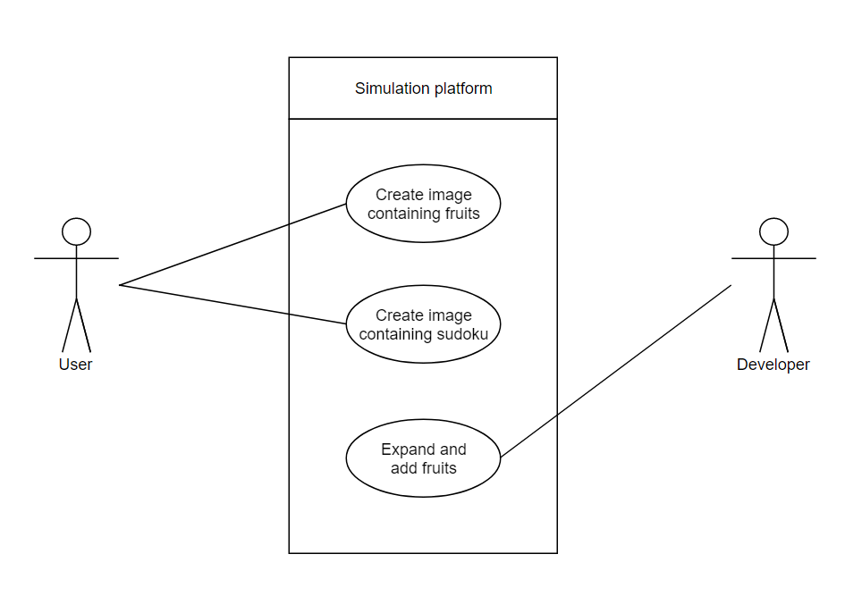
Use cases

Slide 8
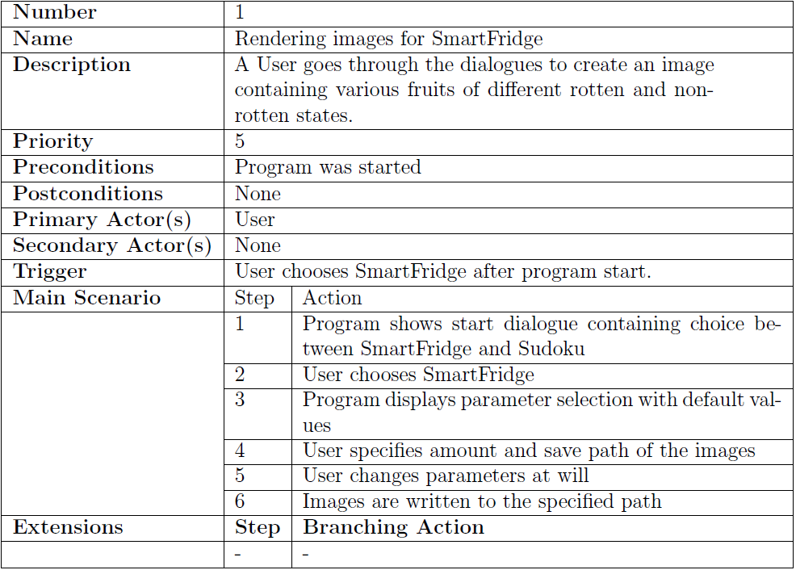
Use cases

Slide 9
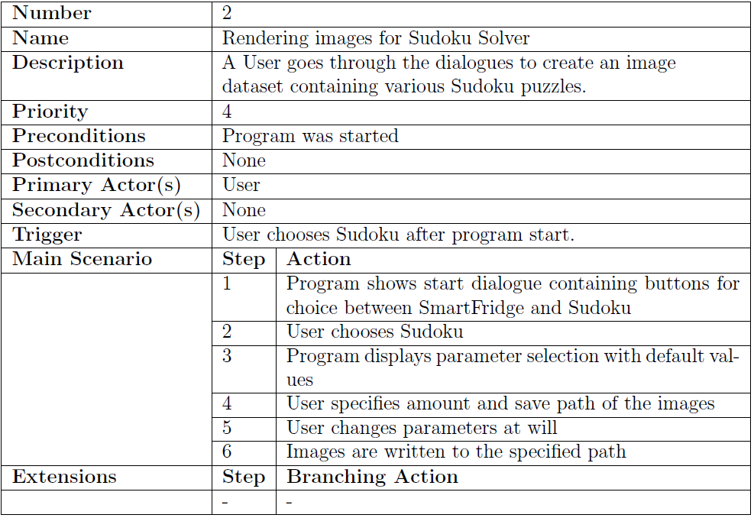
Use cases

Slide 10
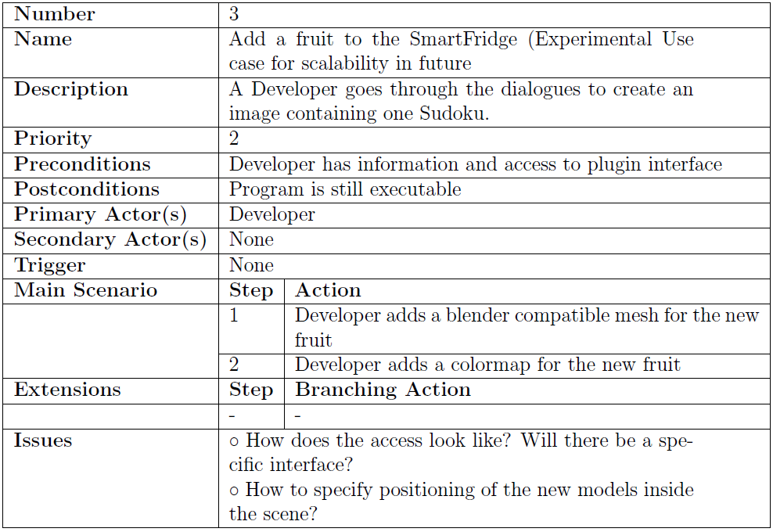
Use cases

Slide 11
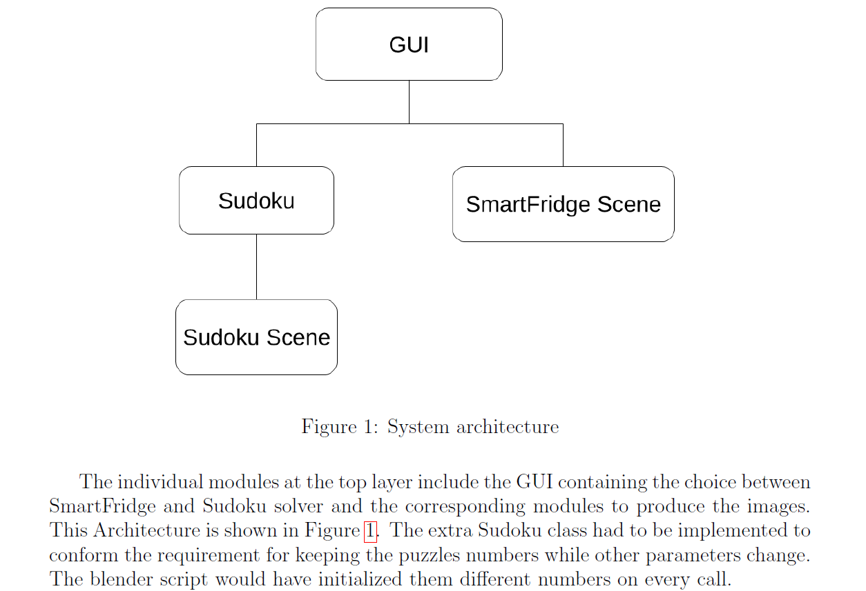
Architecture

Slide 12
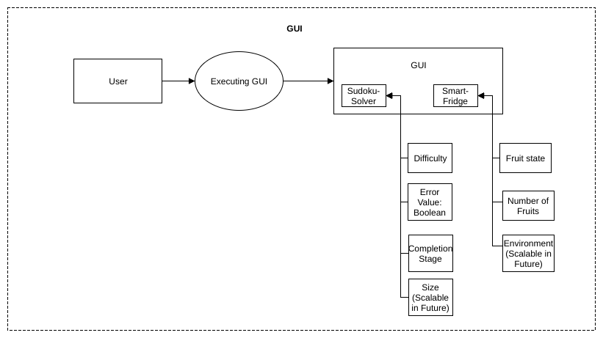
Workflow

Slide 13
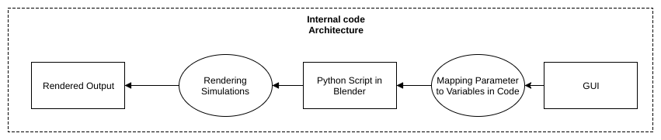

Slide 14
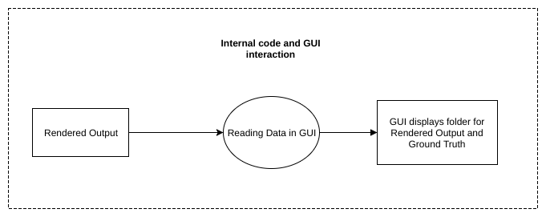

Slide 15
Joel Test
Do you use source control? → git
Can you make a build in one step? → every module does
Do you make daily builds? → for every module
Do you have a bug database? → No
Do you fix bugs before writing new code? → Yes
Do you have an up-to-date schedule? → Yes
Do you have a spec? → Yes
Do you do hallway usability testing? → No
5/8

Slide 16
Testing, Review & Refactoring
Testing
  We Unit tested and Blackbox-tested each other‘s code
Reviews
  We had peer reviews with each other
Refactoring
  No, since we‘re not maintaining yet

Slide 17
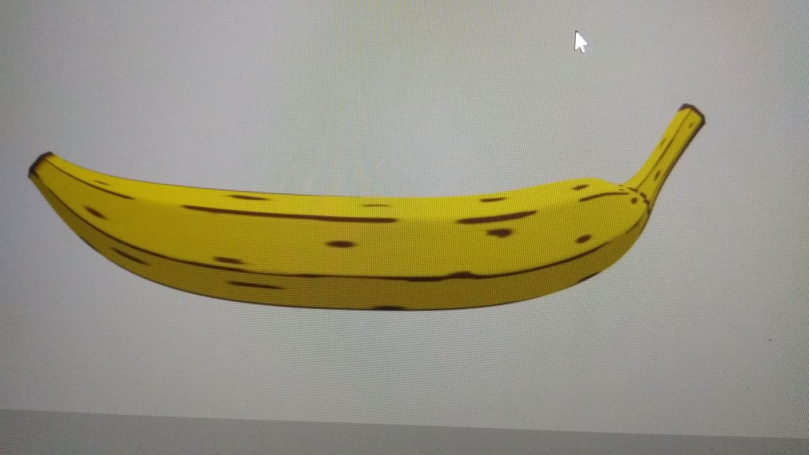

Slide 18
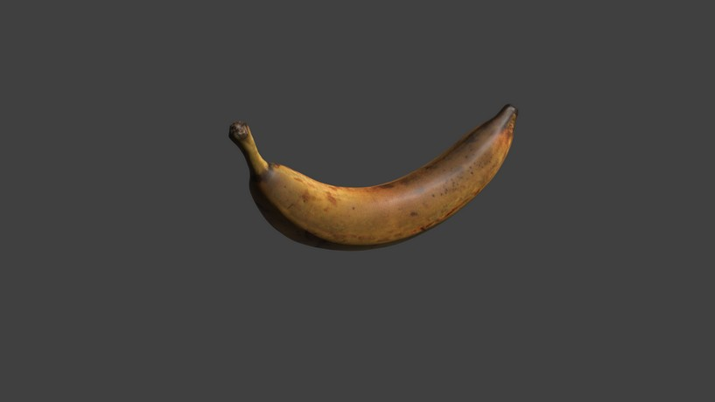

Slide 20
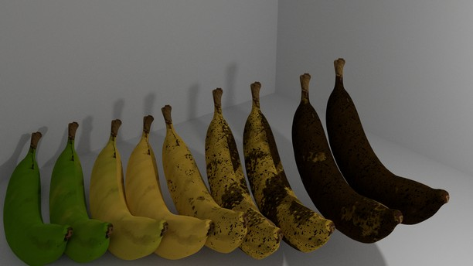

Slide 21
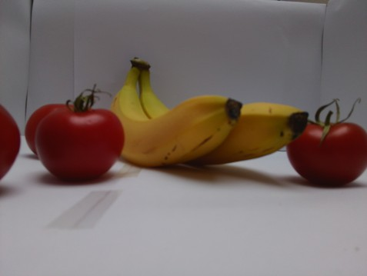
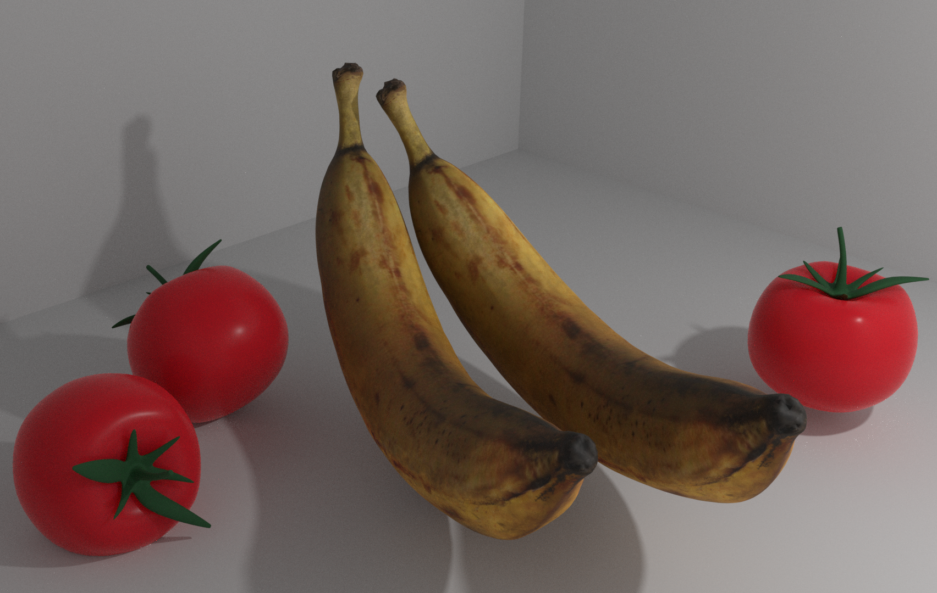
Real vs. rendered

Slide 22
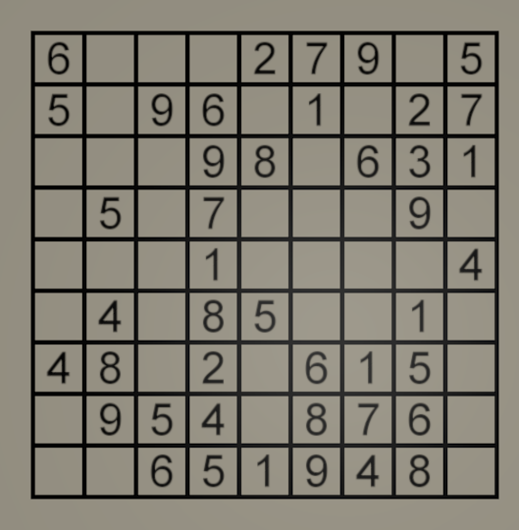
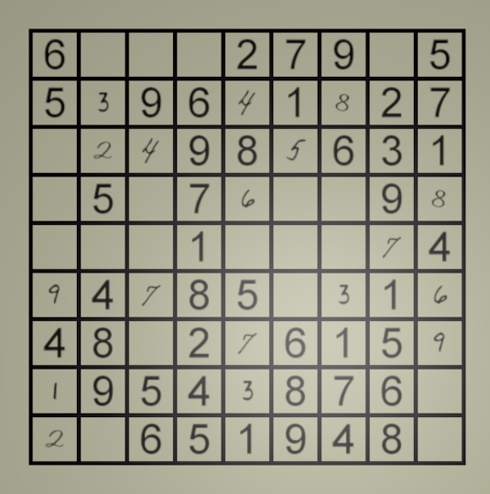
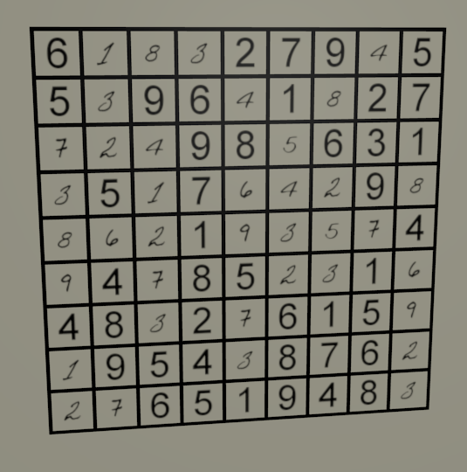
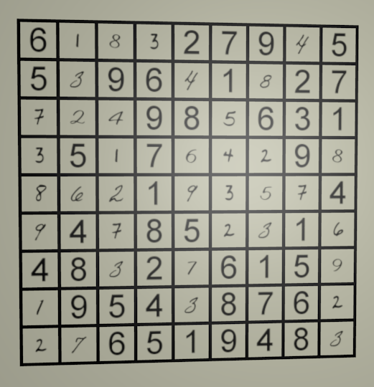

Slide 23
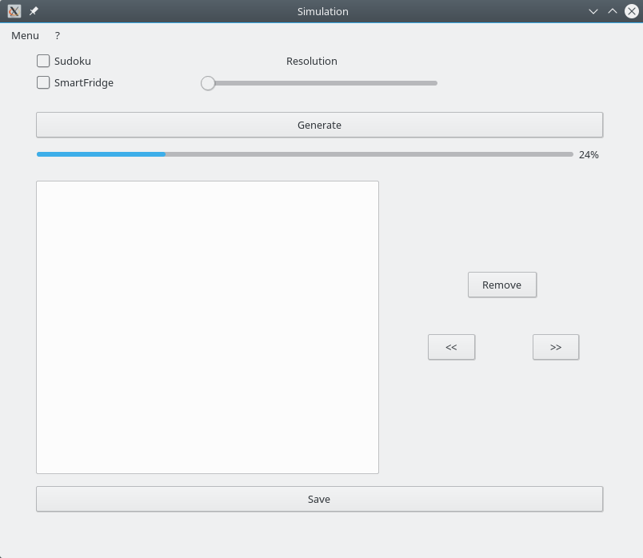
GUI Version 1.0

Slide 24
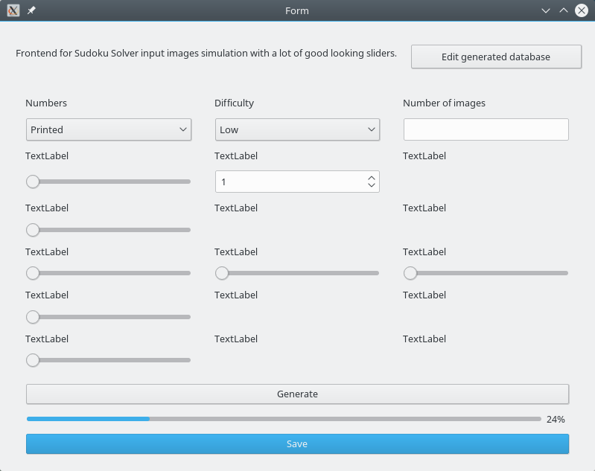
GUI Version 2.0

Slide 25
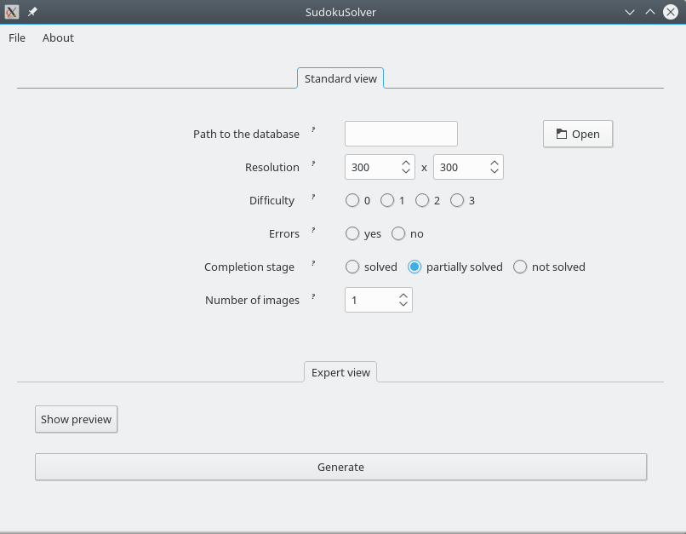
GUI Version 3.0

Slide 26
Summary
Simulation program for rendering Sudoku Puzzles and fruits for Smart-Fridge
Modular with three different modules: Smart-fridge simulation, Sudouku simulations, GUI
Evolutionary Life-cycle followed

