Slide 1


US Aviation Performance & Carrier Reliability Analytics
Data-Driven Storytelling on Delays, Root Causes, and Airline Operational Efficiency
Final Individual Project | Data Visualization
📊 Live Interactive Dashboard: Deployed via Streamlit Community Cloud — explore filters, KPIs, and multi-tab breakdowns in real time.

Slide 2

Dataset & Analytical Scope
Source: US Bureau of Transportation Statistics (BTS) Flight Performance Dataset — 600,000+ flight records analyzed across four analytical dimensions.
Temporal
Spatial
Departure time blocks, day-of-week patterns — identifying when delays compound most severely across the operating day.
Busiest US hub airports — ATL, DFW, ORD, DEN, LAX — ranked by delay burden and ground efficiency.
Airline Models
Performance Metrics
Legacy Carriers (Delta, United, American) vs. Low-Cost Carriers (Southwest, Spirit, JetBlue) — operational reliability benchmarked head-to-head.
Arrival/departure delays, taxi-out times, delay root causes (carrier, late aircraft, weather, NAS, security), and in-flight schedule recovery.
Core Objective: Uncover operational bottlenecks, quantify delay propagation mechanisms, and evaluate carrier reliability across route types and time windows.

Slide 3
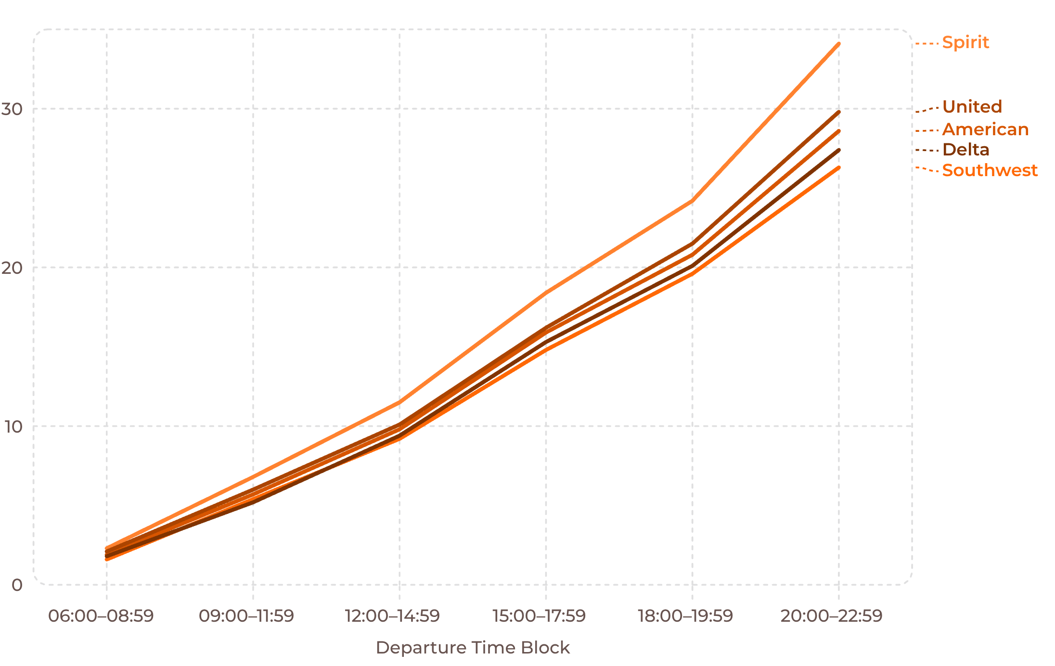
Late Evening Departures Accumulate Peak Delays Across All Major Carriers
Morning Baseline
06:00–08:59 avg under 2 min — fresh rotations, low congestion.
Evening Peak
20:00–22:59 reaches 20–35 min — a 10–17× increase over morning.
Systemic Pattern
Delay curve is uniform across all carriers — airspace & rotation effect, not carrier-specific.
Departure time block is the single most predictable passenger-controllable variable for delay exposure.

Slide 4
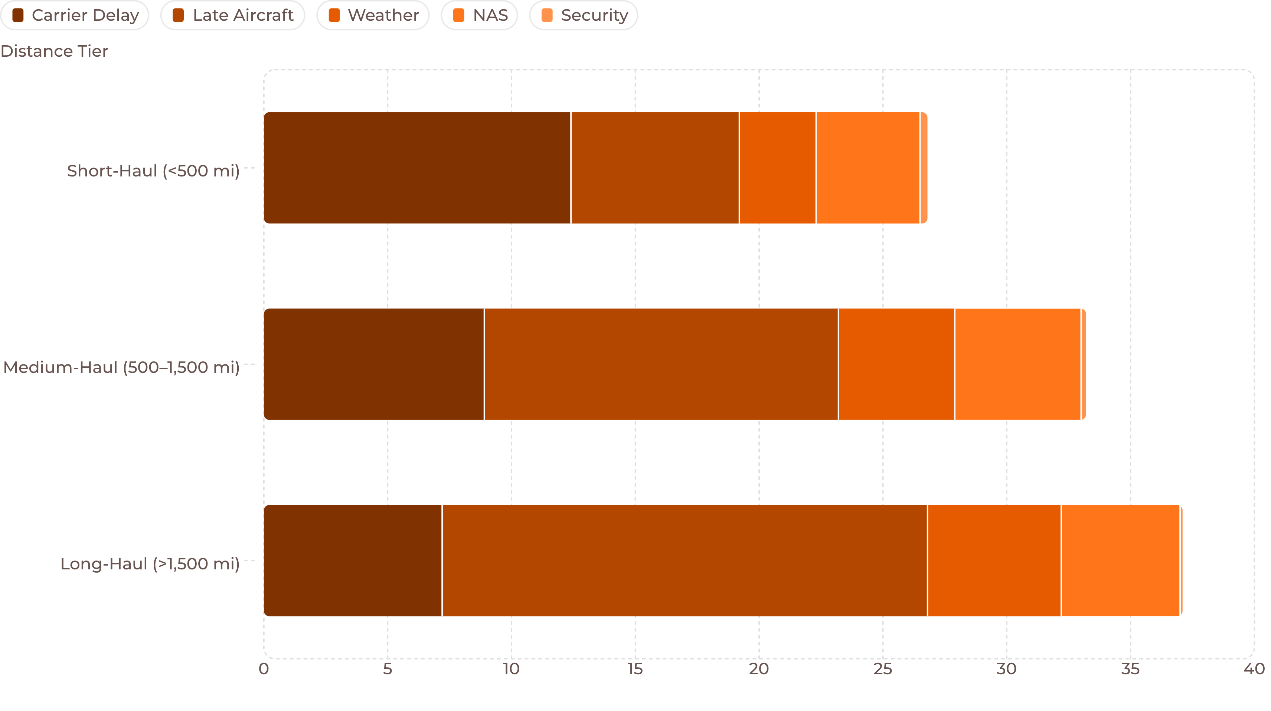

Late Aircraft & Carrier Operations Drive Long-Haul Disruption
Short-Haul
Strategic Implication
Carrier-induced ground delay dominates — gate holds, crew scheduling, and turnaround inefficiencies. Not airspace or weather.
Delay mitigation must be distance-tier-specific:
Medium-Haul
Ground ops reform for short-haul
Rotation buffer scheduling for medium-haul
Upstream cascade breaks for long-haul
Late-arriving aircraft propagation overtakes carrier operations as rotation chains lengthen across the day.
Weather & NAS remain secondary across all tiers — structural patterns dominate over episodic events.
Long-Haul
Late aircraft propagation is dominant — a single upstream delay cascades across multiple downstream flights in the same rotation.

Slide 5
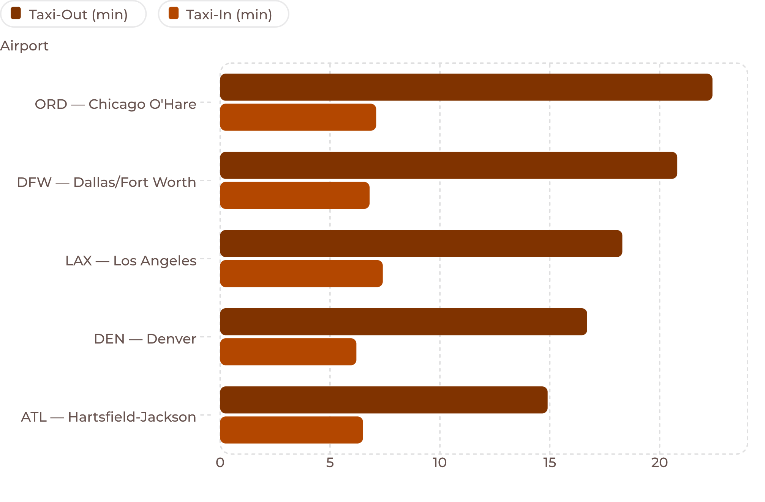


Departure Taxi-Out Congestion Far Outweighs Destination Taxi-In Delays
ORD & DFW Lead Burden
Runway configuration constraints and high departure volume density drive the highest arrival delays among top US hubs.
Taxi-In Stability
Destination taxi-in times are consistent across all airports and time blocks — arrival runway capacity is not the binding constraint.
ATL Efficiency Outlier
Lower taxi-out times despite highest total flight volume — attributed to parallel runway system and optimized gate sequencing.
Key Finding: Departure runway queue management is the highest-leverage intervention point for hub-level delay reduction.

Slide 6
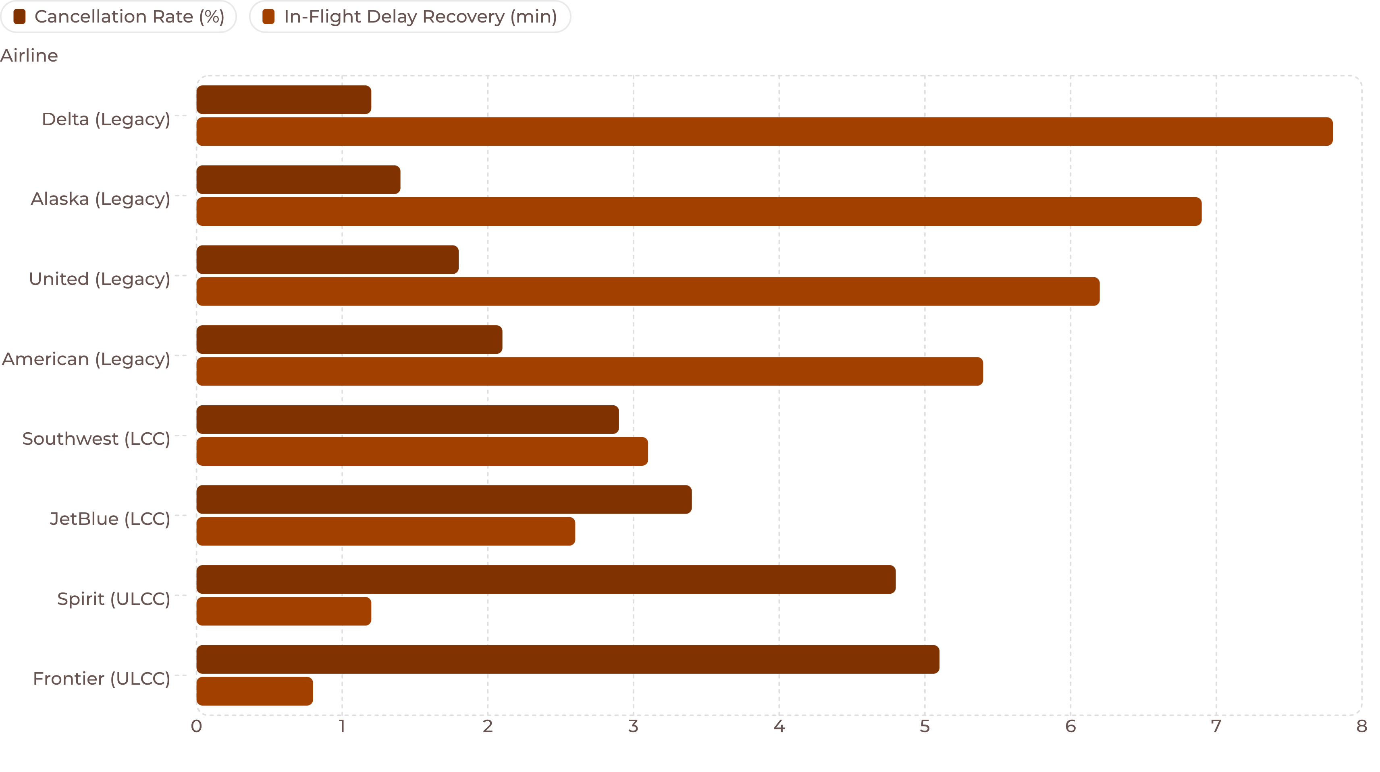
Legacy Carriers Maintain Better On-Time Consistency and Lower Cancellation Rates
Schedule Padding Advantage
LCC Turnaround Risk
ULCC Tradeoff
Legacy airlines absorb up to 8 minutes of departure delay in-flight on long-haul routes through built-in schedule buffers — arriving on time despite late pushbacks.
Low-cost carriers operate turnaround windows often <30 min — a single late arrival triggers a cascade across the full day's rotation. Budget carriers show significantly higher cancellation rates Tuesday–Thursday when load factors peak.
Spirit & Frontier exhibit the steepest delay propagation curves — operational efficiency maximized at the direct cost of schedule resilience. Legacy carrier premium pricing reflects a quantifiable operational advantage.

Slide 7




Explore the Data Interactively
The deployed Streamlit Community Cloud dashboard enables real-time exploration of all 600,000+ flight records with full filter control and live KPI updates.
Dynamic Sidebar Filters
Real-Time KPI Metrics
Custom selections for airline, distance tier, departure time block, origin hub, and date range — instantly recalculates all visualizations on every interaction.
Live tracking of total flight volume, average arrival delay, cancellation rate, and average flight distance — updates on every filter change.
Multi-Tab Breakdown
Carrier Comparison Module
Three dedicated analytical tabs — Carrier Delays, Root Cause Analysis, and Route Performance — each with interactive Plotly charts.
Side-by-side legacy vs. LCC performance benchmarking with drill-down by route type and time window.
🔗 Access the live dashboard: Deployed via Streamlit Community Cloud — link available in project submission.

Slide 8

Three Findings That Should Change How Aviation Operates
1
2
3
For Travelers — Book the Morning
For Airlines — Buffer LCC Turnarounds
For Airport Ops — Manage the Evening Queue
Flights departing 06:00–08:59 average under 2 minutes of arrival delay. Late evening departures average 20–35 minutes. Departure time block is the most actionable, passenger-controlled variable for delay avoidance — and the data proves it decisively.
Low-cost carrier delay propagation is structurally driven by sub-30-minute turnaround windows. Adding 10–15 minutes of rotation buffer on medium-haul routes would break the cascade effect and reduce same-day cancellation risk without major capital investment.
Taxi-out congestion during 17:00–20:00 is the primary ground-level delay trigger at ORD and DFW. Prioritizing departure runway sequencing during this window — not arrival management — is the highest-ROI operational intervention available.
Bottom line: The data is clear — delay is predictable, propagation is structural, and the interventions are specific. The question is execution.

