Slide 1

Guest House Application
Team - 2

Slide 2








Our Team
Sreenitha
Deepika
Jahnavi
Full Stack Developer
Full Stack Developer
Full Stack Developer
Lalitha
Sri lekha
Chandrika
Full Stack Developer
Cloud Engineer
Cloud Engineer

Slide 3
An Overview Of The Project
The Guest House Application this could include room-info , check-in/check-out functionality , DTH services, food Orders, repairs and maintenance.
Utilizing full-stack development technologies for our project development and OCI cloud for deployment . This involve frameworks like NODE.JS for backend , REACTJS framework for frontend, MONGODB for storing the data in the database.
Using cloud services for deployment, we are utilizing platforms like Oracle cloud infrastructure(OCI) . These platforms offer various services such as instance, databases (e.g., RDS, DynamoDB), storage (e.g., S3), and more, which can be leveraged for your application.
Implement security measures to protect user data and ensure the privacy and confidentiality of guest information. This includes secure transmission of data over HTTPS and port number, encryption of sensitive information, and regular security audits.
45%

Slide 4
Technologies Used In Our Project
Full Stack Development
For Creating our website we use FSD
React.js
For our frontend creation we used react
Nodejs, MongoDB
For our backend creation we used Nodejs and MongoDB
Oracle cloud infrastructure
For our project development we used OCI

Slide 5
Advantages
The Guest House Application automates and streamlines various aspects of guest house management, saving time and resources for hosts. It also displays detailed list of available rooms
An administrative dashboard provides hosts with tools for managing room allocation , guest information, and monthly expenditure.
Hosts can generate reports, track performance metrics, and monitor overall guest house operations.
It helps to reduce the manual work and resources .
45%

Slide 6
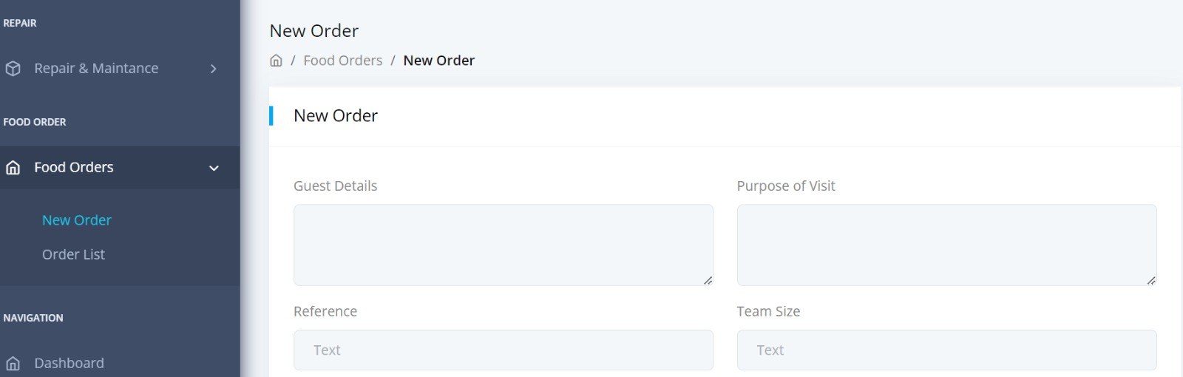
Frontend
We used React.js framework for developing frontend application.
We have used React, React Router , Axios , React Bootstraps for developing
the frontend application .
User Interaction: Users can navigate between different pages using different navigation links provided.
Communication with Backend: Axios Library is used to communicate with API endpoints.
45%

Slide 7
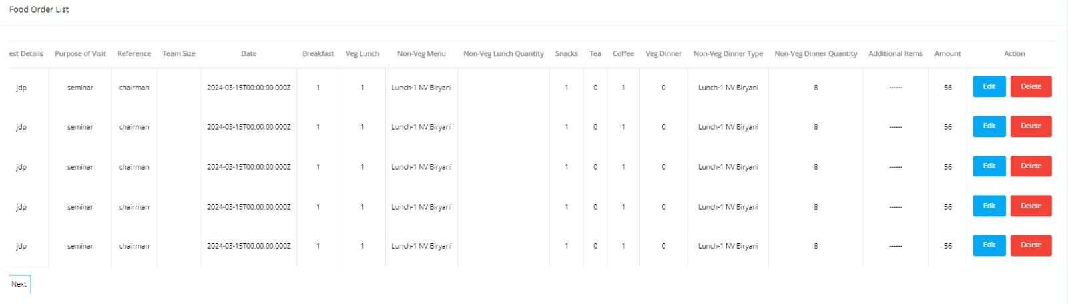
Backend
We used node.js framework for developing backend application.
We have used node.js, Express.js, MongoB, Mongoose for developing the backend application .
API Endpoints: POST, GET, UPDATE, DELETE methods for storing the data in the database.
45%

Slide 8
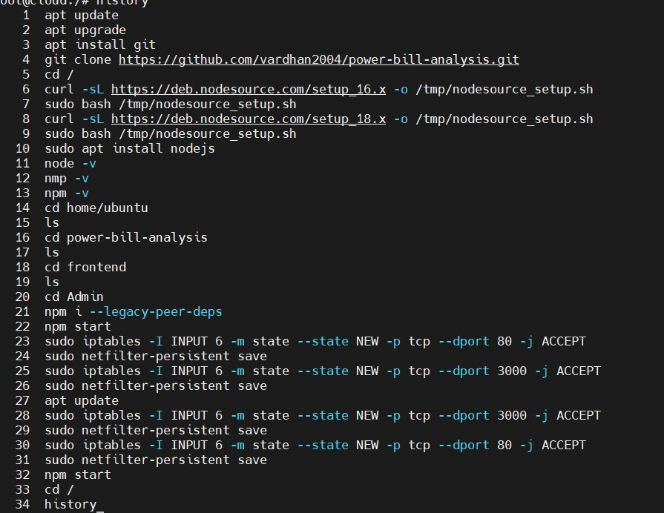
Oracle Cloud
Oracle Cloud Infrastructure provides a flexible data platform to enable you to build Big Data applications at massive scale
The Oracle Cloud Infrastructure (OCI) backbone is a dedicated, secure, and highly available network used to interconnect OCI regions across the globe.
In OCI we created a ubuntu latest machine and we connected to the machine and we installed all our dependencies that are required to our project and we add ports to run our server to deploy our project.
Commands:
45%

Slide 9
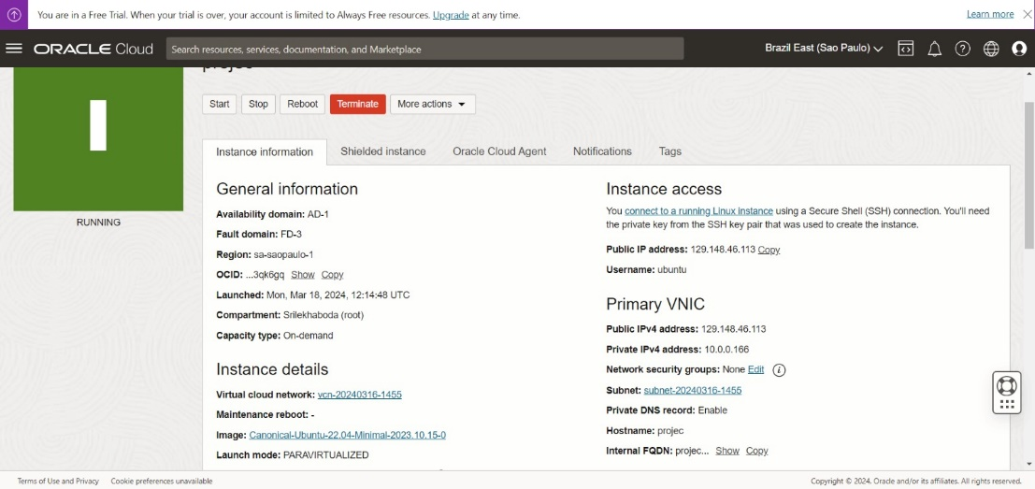
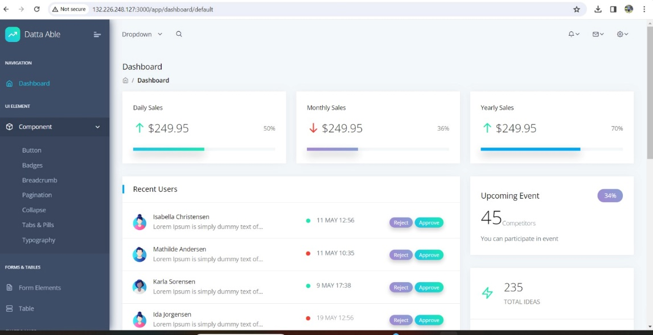
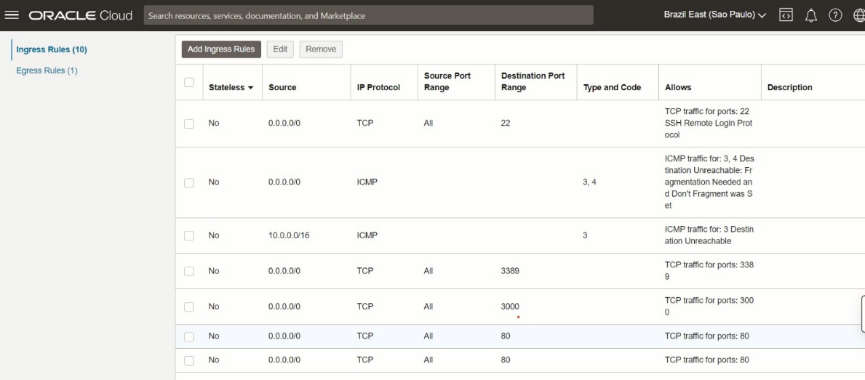
Oracle Cloud Infrastructure
45%

Slide 10
Thank You
45%

