Slide 1
QA CHATBOT FOR RESEARCH PAPERS
TEAM MEMBERS:
NIRANJANI T(21Z326)
SHERIN CHRISTIANA(21Z347)
SREENITHI(21Z356)
GANGASRI(21I316)

Slide 2
TABLE OF CONTENTS
01
02
03
04
ABSTRACT
PROBLEM STATEMENT
OVERVIEW
TECHSTACK

Slide 3
TABLE OF CONTENTS
05
06
07
08
IMPLEMENTATION
ARCHITECTURE & WORKFLOW
CHALLENGES FACED
FUTURE ENHANCEMENTS

Slide 4
01
PROBLEM STATEMENT

Slide 5
In today’s digital age, vast amounts of information are stored in PDF documents, making it challenging for users to extract and understand relevant content quickly. Traditional methods of reading and summarizing text are often time-consuming and inefficient. Additionally, users frequently have specific questions about the content of these documents, requiring effective tools to retrieve precise answers from unstructured text. Therefore, there is a need for an automated solution that can:
Extract text from PDF files effectively.
Summarize lengthy documents for quick comprehension.
Provide accurate answers to user queries based on the extracted content.

Slide 6
02
ABSTRACT

Slide 7
This project presents a web interface that leverages natural language processing (NLP) techniques to enhance the interaction with research papers. The application allows users to upload PDF files, from which it extracts and cleans the text for further processing. Utilizing state-of-the-art models, including T5 for summarization and RoBERTa and Llama for question answering, the application offers a user-friendly interface for obtaining concise summaries and accurate responses to user inquiries. This automated solution significantly improves the efficiency of information retrieval, empowering users to make better-informed decisions based on the content of their documents.

Slide 8
03
PROJECT OVERVIEW

Slide 9
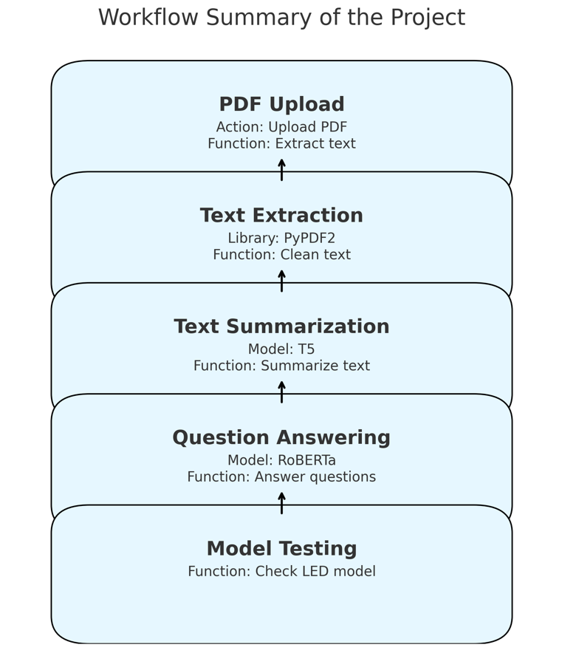

Slide 10
04
TECH STACK

Slide 11
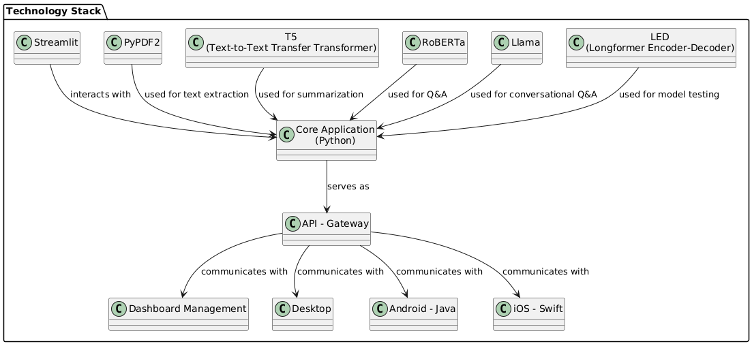

Slide 12
05
ARCHITECTURE &
WORKFLOW

Slide 13
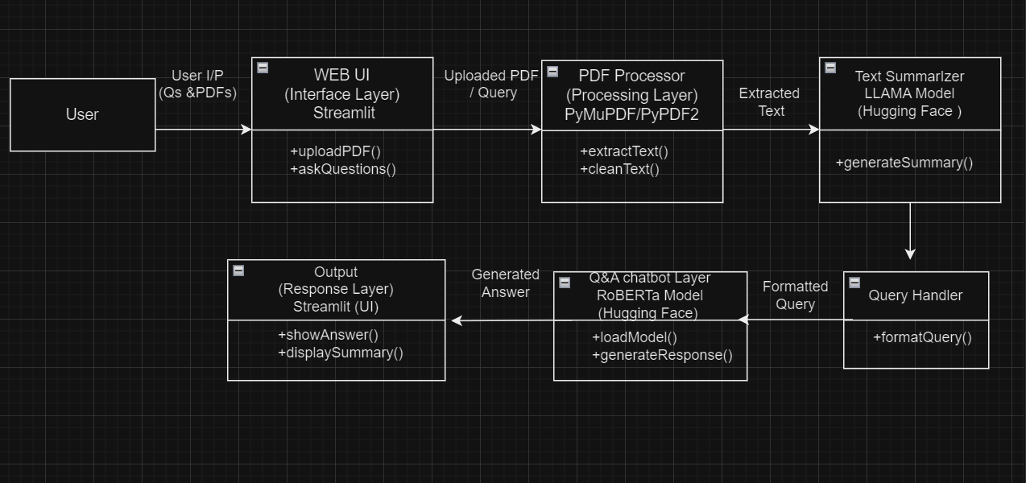

Slide 14
WORKFLOW
User Interaction
Action: User uploads PDF documents and enters questions.
Component: Streamlit UI.
PDF Upload
Action: The system receives the uploaded PDF files.
Component: PDF Processor Layer.
Text Extraction
Action: Extract text from the uploaded PDFs.
Methods: Using PyPDF2 or PyMuPDF.
Output: Raw text data.

Slide 15
Text Cleaning
Action: Clean the extracted text to remove unnecessary characters and formatting.
Output: Cleaned text ready for summarization.
Text Summarization
Action: Generate concise summaries of the cleaned text.
Model: LLaMA (via Hugging Face Transformers).
Output: Summarized text.
Query Submission
Action: User submits questions related to the PDF content.
Component: Query Handler Layer.
Output: Formatted query for processing.

Slide 16
Question Answering
Action: Process the formatted query using the Q&A model.
Model: RoBERTa (via Hugging Face Transformers).
Output: Generated answer based on the PDF content.
Display Results
Action: Display the summarized text and answers in the Streamlit UI.
Output: User receives relevant summaries and answers.

Slide 17
06
Implementation

Slide 18
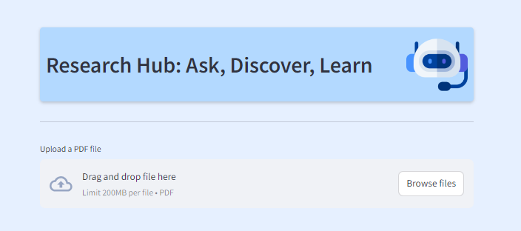
Output Screenshot

Slide 19
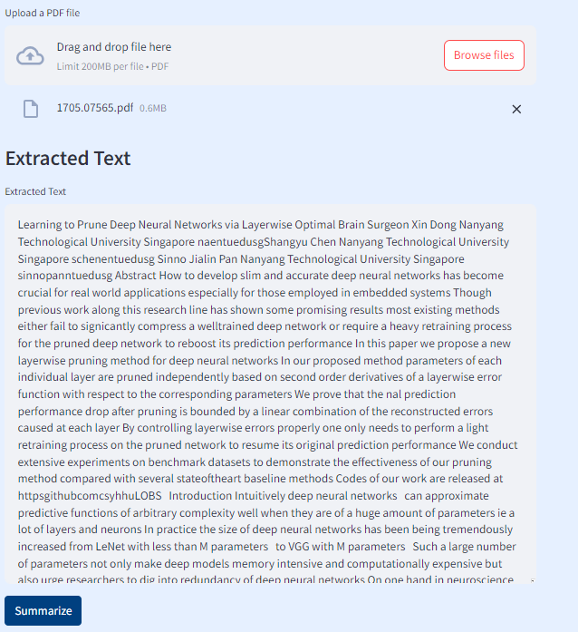

Slide 20
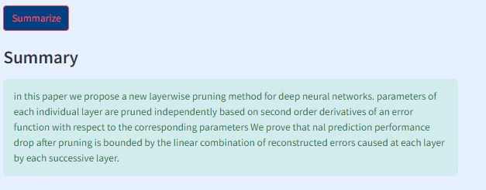
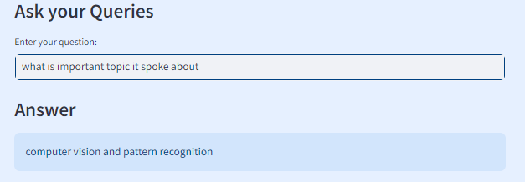

Slide 21

Challenges Faced
Model Accuracy and Hallucination:
Open-source models used for summarization and Q&A might produce incorrect or "hallucinated" information.
Model Deployment and Integration:
Integrating large pre-trained models from Hugging Face into a web application requires careful management of dependencies, versions, and hardware limitations(some require GPU machine)
Scalability:
Scaling the system to handle multiple concurrent users while maintaining quick response times could be challenging
Model Selection:
Choosing the right model for both summarization and question-answering is difficult. There are numerous available models, each varying in accuracy, speed, and resource requirements. The balance between model complexity and available hardware (CPU only) posed a significant challenge.
,

Slide 22

Future Enhancements
Model Optimization for CPU
Multi-document Summarization and Q&A
Multi-language Support:
Collaboration and Sharing
Voice-Enabled Q&A

Slide 23
THANK YOU

