Slide 1
Problem
Development of a Travel Related Software App that can be Installed on mobile phones that could Capture Trip Related Information
81
Statement
25082
Smart India
Hackathon 2025
A Unified Platform that Connects Public Transport, Tourism, and Local Businesses to give Travelers a Smooth and hassle-free experience in Kochi.
Theme
Team
Name
HackHive

Slide 2




TravelOne
“One App, Many Journeys”
Explore Kochi like never before — book, travel, and discover with zero hassle, all in one app.

Slide 3
TravelOne
TravelOne:
Your One-Stop Solution for Travel
Unified Travel & Tourism App
Seamless Planning & Booking
Smart Metro Card / Wallet
Support for Local Businesses
Tourist Engagement

Slide 4
TravelOne
Innovation & Uniqueness
First platform to combine Urban Transport + Tourism + Hospitality in Kerala.
Discounts & rewards integrated with a digital metro card.
Opportunity for local guides and businesses to participate, creating jobs & growth.
Scalable model → can be expanded to other cities in India.

Slide 5
TravelOne
How it Addresses the Problem
Eliminates the need for multiple apps/websites.
Simplifies trip planning for both tourists and daily commuters.
Encourages eco-friendly public transport and promotes Kochi’s cultural heritage.
Boosts local economy by connecting travelers with local guides, restaurants, and businesses.

Slide 6
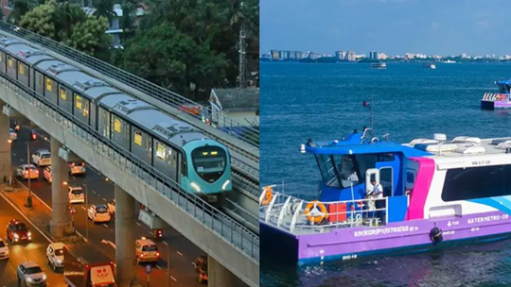

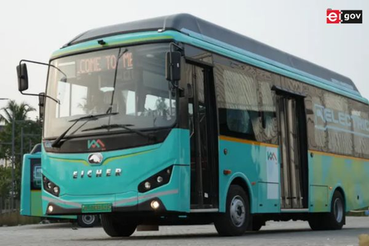



Key Features of TravelOne
Book Metro & Water Metro tickets in seconds
Expense Manager
Expense Tracking Features
Hassle-free travel options
KSRTC & feeder bus schedules & booking.
Hotels & restaurants with metro-card discounts.
Easy Access to Bookings
Savings on local dining
Digital metro card for cashless travel & dining.
Explore tourist spots; book & review guides.
Explore local attractions
Explore local attractions

Slide 7

Technical Tools Overview
Frontend: Figma / React Native (cross-platform).
Backend: Node.js + Firebase/Cloud DB.
APIs: Metro, Water Metro, KSRTC, Tourism, Hotels.
Payments: UPI / QR linked to Metro Card Wallet.

Slide 8
Stakeholders & Benefits
Understanding the impact on users, businesses, and the city.
Travellers | Hassle-free, affordable trips
Kochi Metro & Water Metro | Higher ridership & metro-card use
KSRTC | More Passengers via Feeder Routes
Hotels & Restaurants | New Sales Channels & Discounts
Local Guides / Drivers | Steady Jobs & Ratings
Kerala Tourism Dept. | More visitors & revenue

Slide 9

IMPACT AND BENEFITS
Empowering Kochi’s Tourism
Higher ridership & revenue for Kochi Metro, Water Metro & KSRTC.
Seamless travel — one app for booking, planning & payments.
Better tourist experience with guides, events & discounts.
Boost for hotels, restaurants & local guides through visibility & offers.
Eco-friendly & smart city growth – more jobs, less congestion.
Estimated earning potential: ₹2–3 crore/year (commissions + ads + services).

Slide 10
01
Integration of multiple systems – Metro, Water Metro, KSRTC, hotels, tourism APIs.
Integration of multiple systems – Metro, Water Metro, KSRTC, hotels, tourism APIs.
02
User adoption – encouraging commuters & tourists to shift from existing apps
Challenges in Implementing
03
Secure payments & data privacy compliance.
A falta de informações de viagem unificadas dificulta a navegação pela cidade.
04
Partnerships with govt & private players for data sharing & discounts.
05
Maintenance & scalability as services, routes, and offers grow
Acesso limitado a experiências culturais enriquece a diversidade turística, como Kathakali e festivais.
06
Backend complexity – real-time schedules, payments, and wallet management.

Slide 11
TravelOne
Conclusion
Enables hassle-free travel, bookings, and payments for residents & tourists.
Unifies Transport, Tourism, and Local Businesses into one smart platform.
Boosts ridership, revenue, and job opportunities, supporting Kochi’s smart-city and green-mobility goals.
A scalable solution that can expand across Kerala’s travel & tourism network.

Slide 12
01
Aanavandi.com
02
Busevide.in
Reasearch and References
03
Kochimetro.org
04
Keralartc.in
Development Plan for Kochi City Region 2031
05
06
Indiastat.com

Slide 13
Thank You
Team HackHive
Aakash Raj
Ashwin Nair C M
Anandhakrishnan K S
Sreenivasa Pai
Nandana N
Vikesh K Iyer

