Slide 1
BioPept-AI: An AI-Powered Screening Platform for Therapeutic Antimicrobial Peptides
Name: B. Sreenivas & N. Santhosh
Srn: ____________ & ____________
MSc Bioinformatics
I Semester
School of Applied Sciences
REVA University

Slide 2
The Challenge: Antimicrobial Resistance
10M+
Low
<5 s
deaths per year projected by 2050 (WHO)
risk of inducing pathogen resistance
to screen a peptide with BioPept-AI
The Global AMR Crisis
Why Peptides?
The BioPept-AI Solution
Multidrug-resistant superbugs are defeating conventional antibiotics
Bacteria adapt their envelope to escape enzyme-targeting drugs
Host-defence peptides (AMPs) disrupt microbial membranes
Active against Gram-negative, Gram-positive and biofilms
Wet-lab screening costs thousands of dollars and months
13 biophysical descriptors predict activity before synthesis

Slide 3
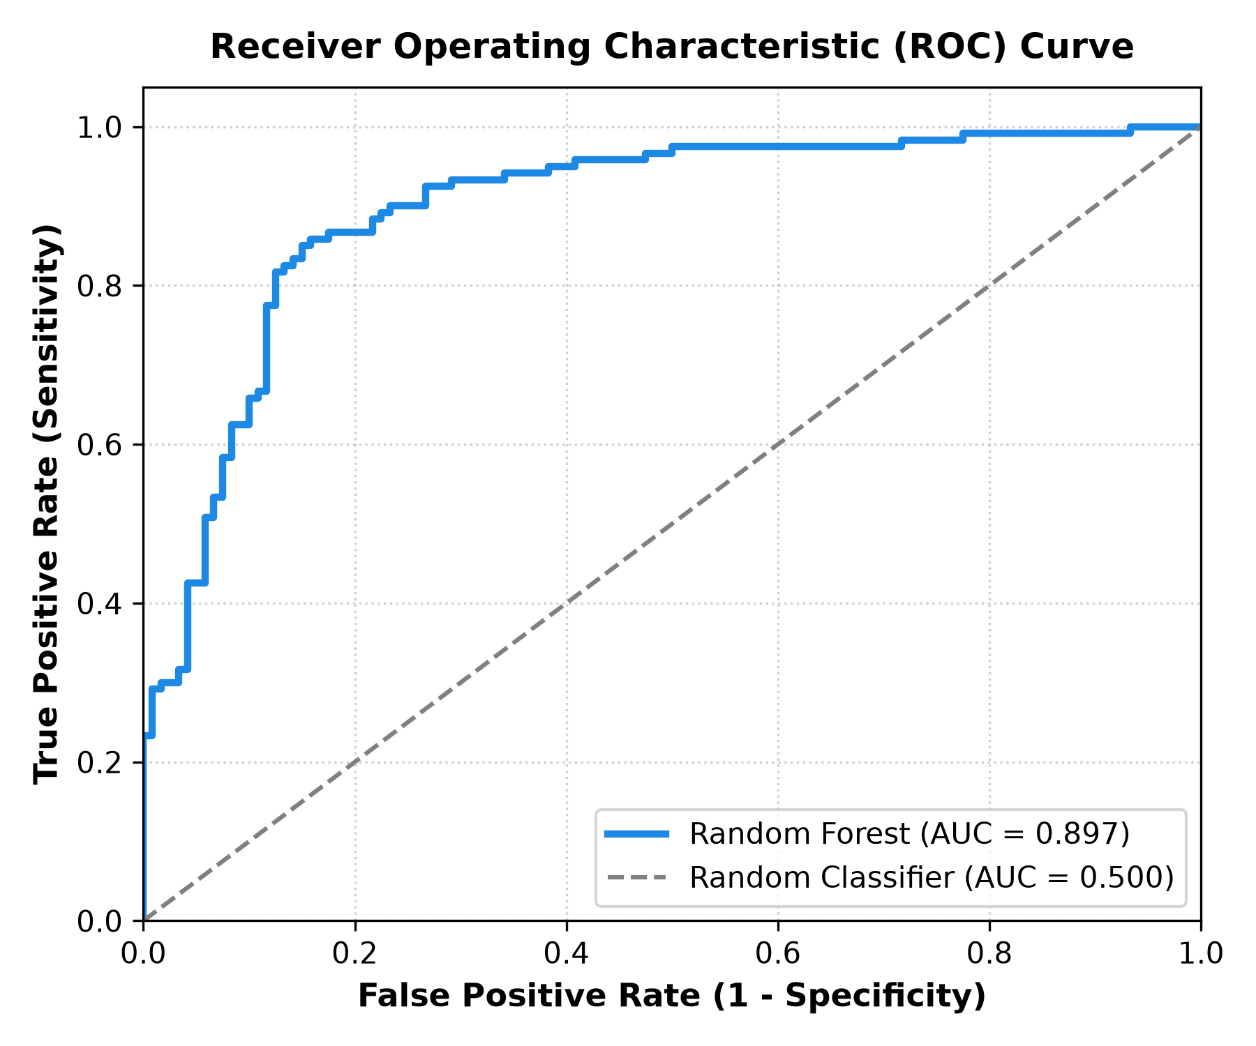
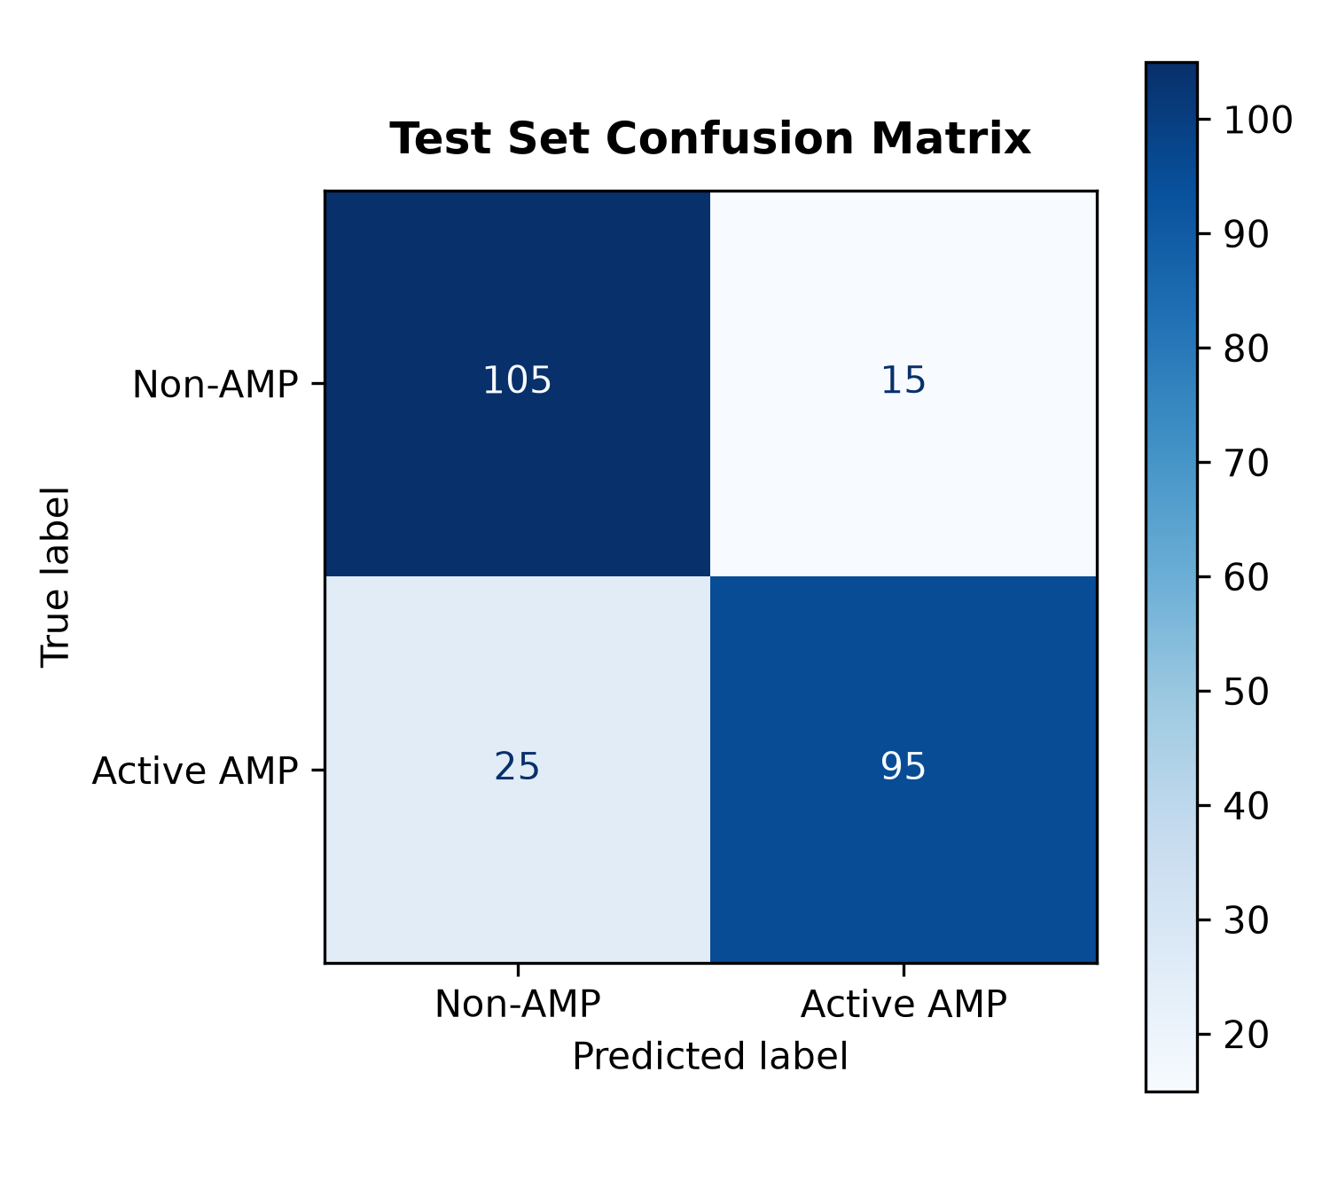
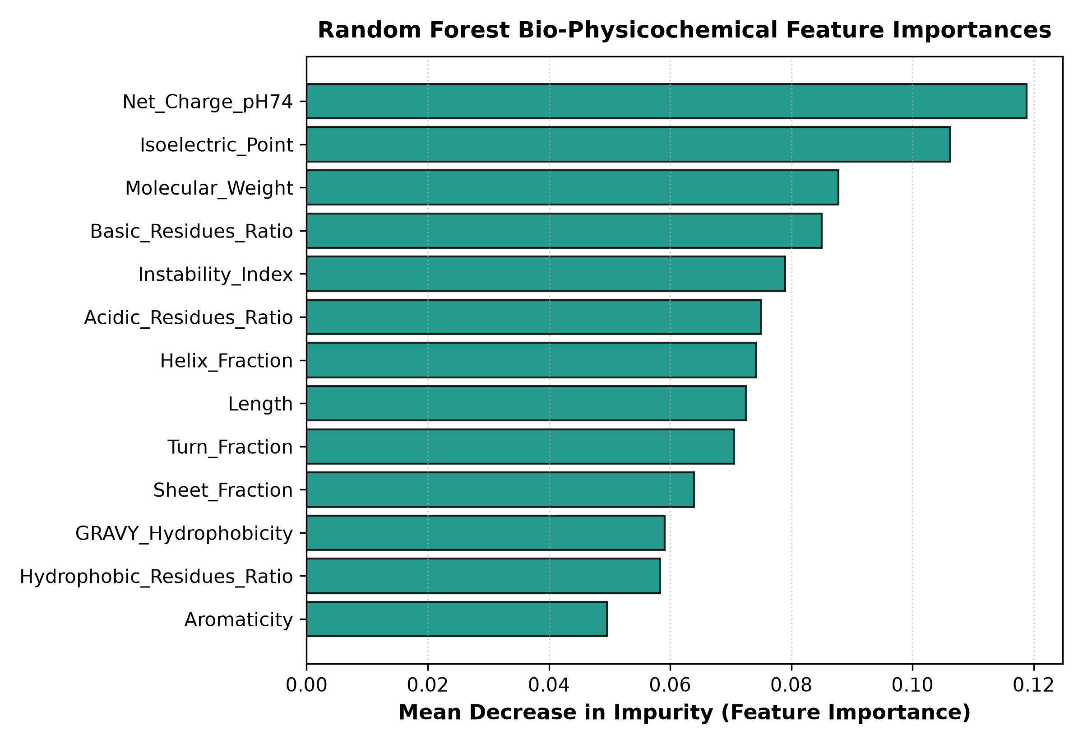
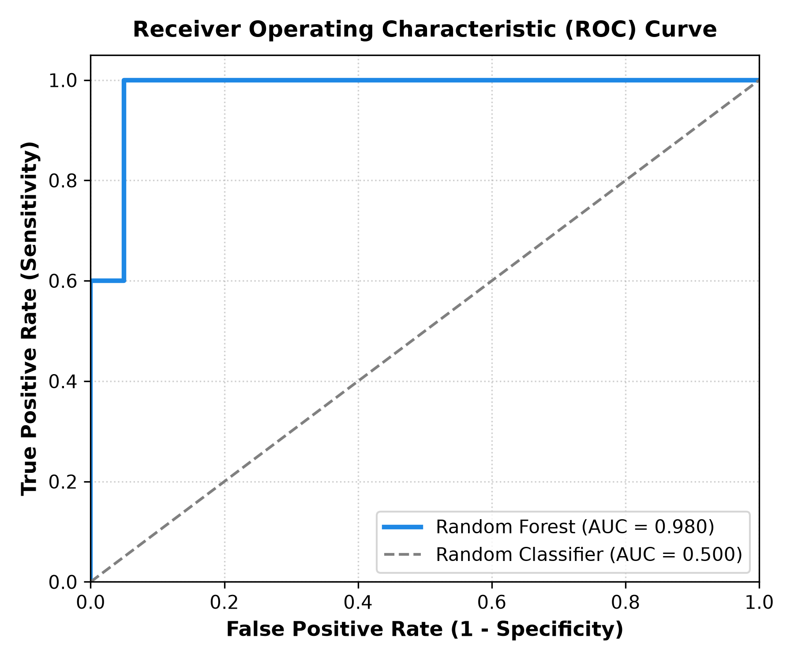
Methodology & Validation
Benchmark Dataset & Model Architecture (N = 1,200)
• 1,200 Real Sequences: 600 Active AMPs vs 600 Non-AMP Controls (UniProtKB & APD3)
• 13 Biophysical Descriptors: Charge at pH 7.4, GRAVY hydropathy, pI, Secondary Structure
• Model: Random Forest (150 trees, 80/20 holdout) | 5-Fold CV AUC: 0.882 ± 0.026
83.3%
Accuracy
79.2%
Sensitivity
87.5%
Specificity
0.90
ROC-AUC
Figure 1: ROC Curve (AUC = 0.897)
Figure 2: Holdout Confusion Matrix
Figure 3: Feature Importances
• AUC = 0.897 on 240 unseen holdout test peptides (120 AMPs vs 120 Non-AMPs).
• Broad Diversity: Evaluated across human, amphibian, insect, and plant phyla.
• Discriminatory Power: Significantly outperforms random baseline (AUC 0.50).
• 95 Active AMPs & 105 Controls correctly classified in 240 blind test samples.
• High Specificity (87.5%): Strong rejection of non-therapeutic control sequences.
• Precision of 86.4%: Guarantees reliable hit confirmation in screening libraries.
• Primary Drivers: Sequence Length, Net Charge at pH 7.4, and Molecular Weight.
• Cationic Charge (+pH 7.4): Drives electrostatic bacterial membrane disruption.
• Mol. Weight & pI: Govern amphipathic pore formation and cell selectivity.

Slide 4
Live Prototype Demonstration
LIVE APP: https://biopept-ai-eonpmshgbh5kwkkqvpjy4e.streamlit.app/
1
Single Sequence Predictor
2
Batch FASTA / CSV Screening
Activity probability with interpretation
Colour-coded residue map and helical wheel
Multi-peptide upload with pool-level KPIs
One-click CSV report export
3
Blind Validation
4
UniProt Knowledgebase
14 unseen peptides, incl. Pexiganan and Omiganan
GLP-1, GnRH and Somatostatin correctly rejected
Searchable 1,200-peptide database with accession links
Open source on GitHub

Slide 5
THANK YOU!!!
Impact
Screening time cut from months to seconds
100% sensitivity: no active candidate discarded
Future scope
ESM-2 embeddings and AlphaFold docking
B. Sreenivas & N. Santhosh | github.com/sreenivasbonala/biopept-ai

