Slide 1
REVA UNIVERSITY, BENGALURU
School of Applied Sciences | Department of Bioinformatics
🧬 PROTOTYPE PRESENTATION | AI FOR BIOINFORMATICS TRACK
BioPept-AI
An AI-Driven Screening Platform & Curated Knowledgebase for Therapeutic Antimicrobial Peptides
Presenters / Student Investigators:
B. Sreenivas & N. Santhosh
MSc Bioinformatics — I Semester | REVA University Science Fair 2026

Slide 2
REVA UNIVERSITY | SCHOOL OF APPLIED SCIENCES
The Clinical Challenge: Antimicrobial Resistance (AMR) & Discovery Bottlenecks
⚠️ THE GLOBAL AMR CRISIS
• Conventional small-molecule antibiotics are failing rapidly against multidrug-resistant (MDR) superbugs.
• WHO projects over 10 million deaths annually by 2050 without innovative antibacterial classes.
• Bacterial envelope mutations continually defeat single-target intracellular enzyme inhibitors.
🧬 WHY ANTIMICROBIAL PEPTIDES?
• Natural host-defense peptides (AMPs) target microbial lipid bilayers via biophysical disruption (pore lysis).
• Negligible propensity to induce pathogen resistance due to fundamental membrane-level electrostatic attack.
• Potent against Gram-negative, Gram-positive, and recalcitrant drug-resistant biofilm matrices.
🚀 THE BIOPEPT-AI SOLUTION
• Wet-lab solid-phase synthesis costs thousands of dollars and months per peptide library with high attrition.
• BioPept-AI extracts 13 biophysical descriptors to predict therapeutic activity in under 5 seconds.
• Eliminates false negatives and provides structural amphipathic insight prior to chemical synthesis.

Slide 3
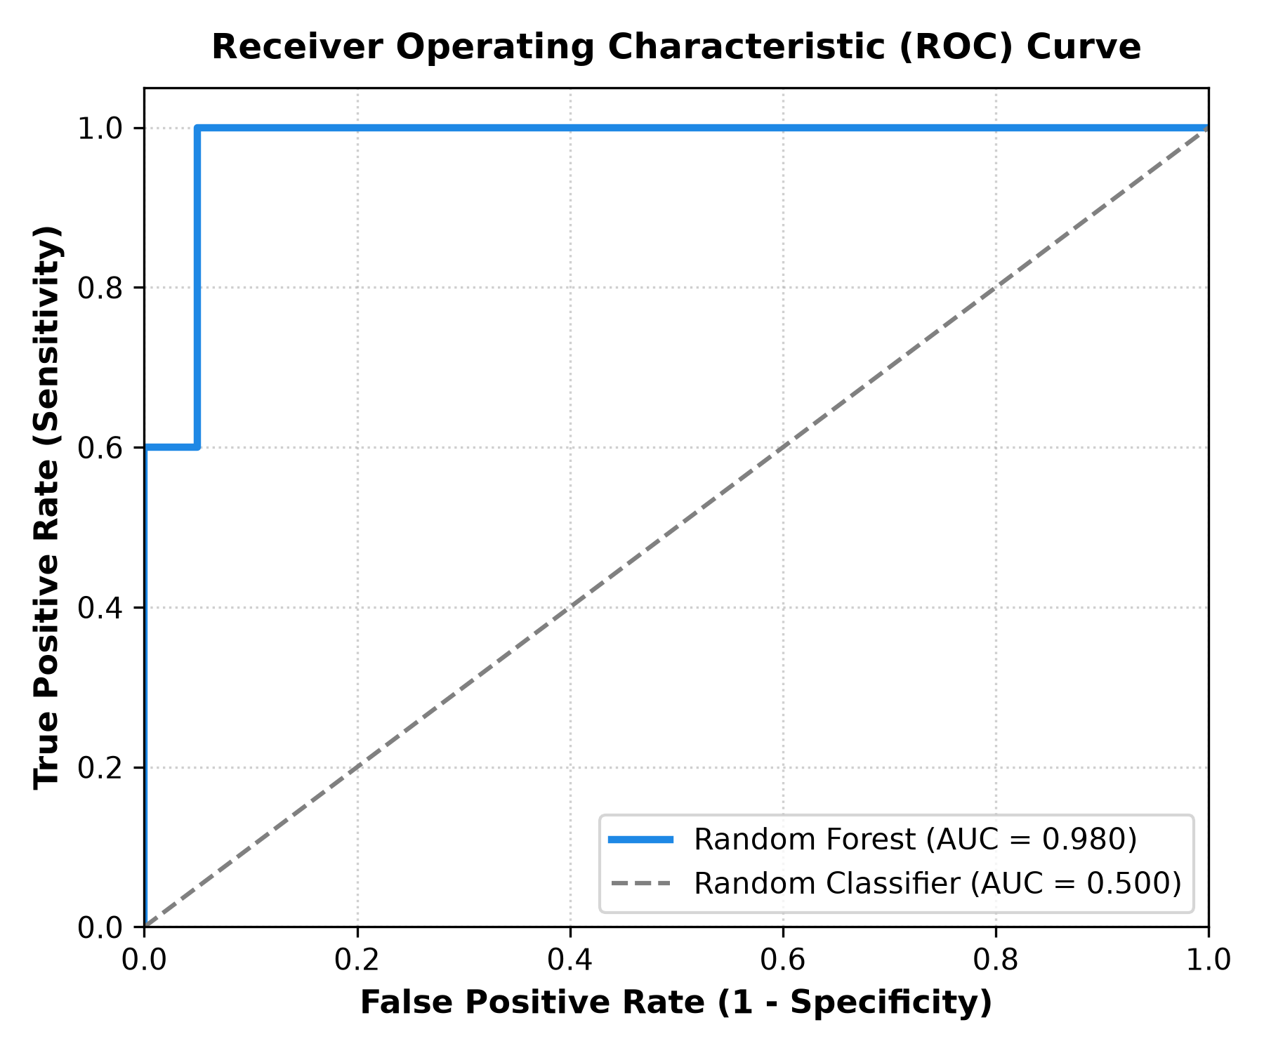
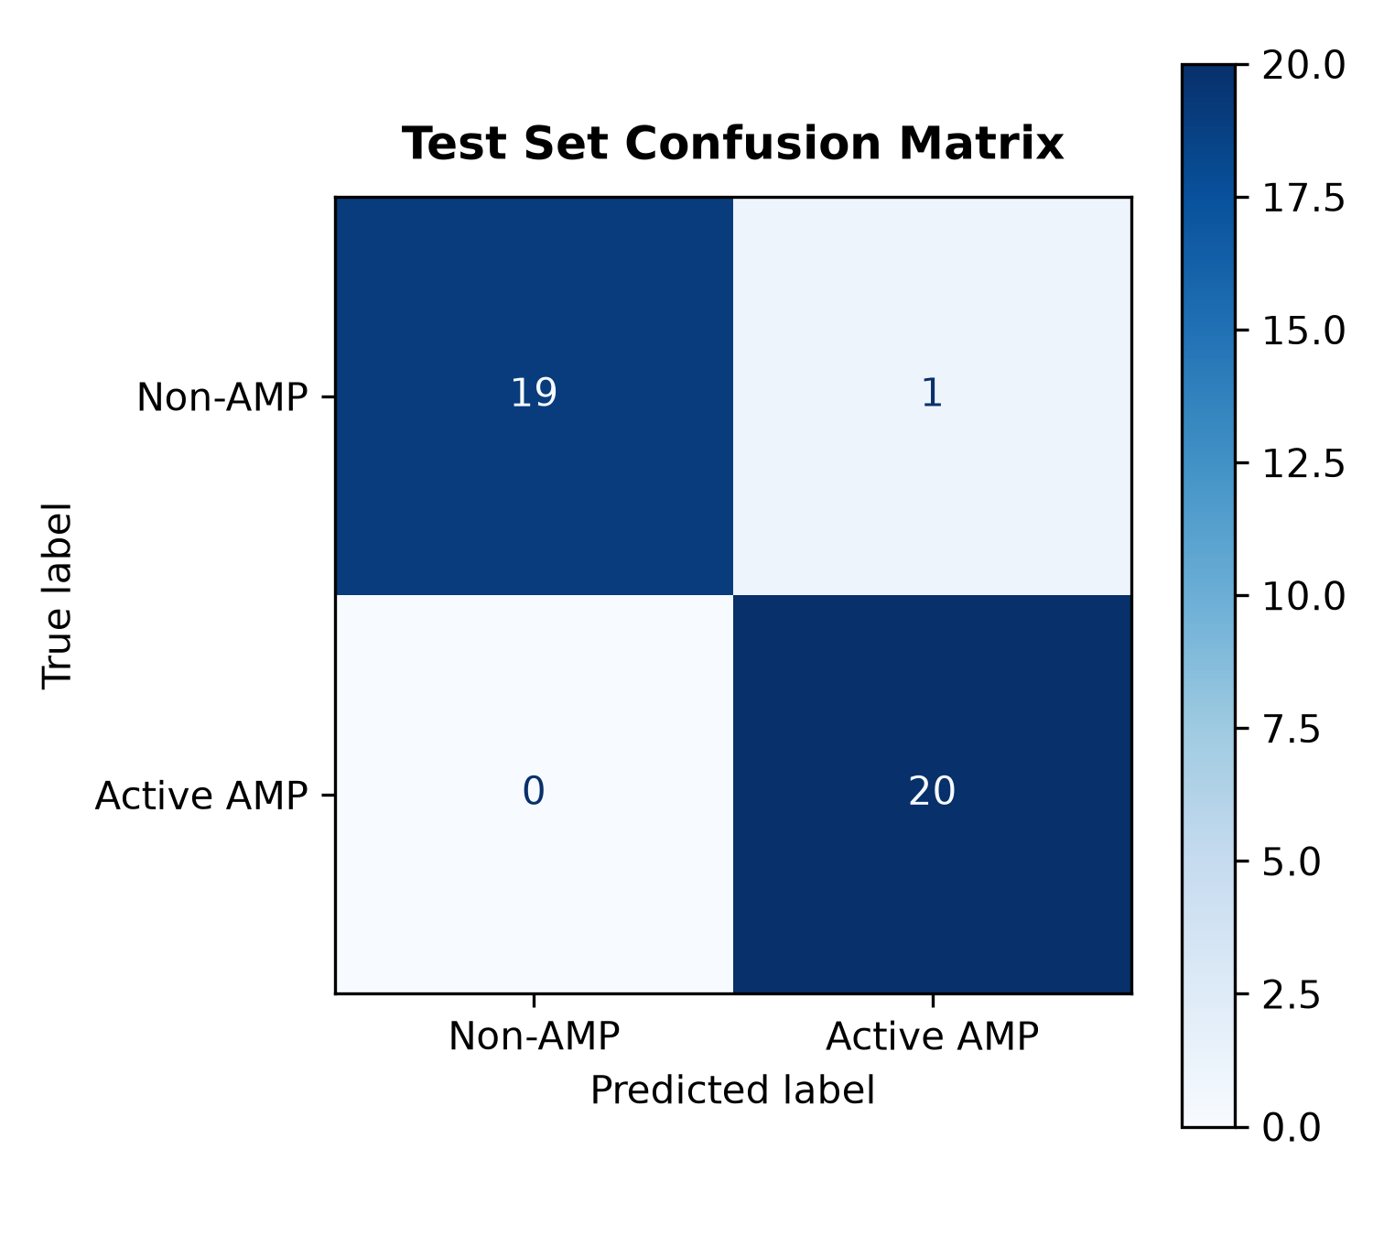
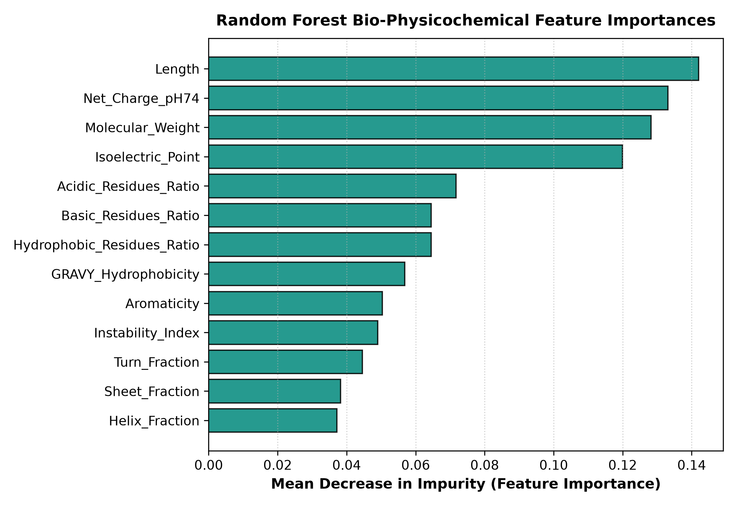
REVA UNIVERSITY | BENCHMARK RIGOR & MACHINE LEARNING METRICS
Publication-Quality Empirical Validation & Model Interpretability
🎯 Test Accuracy: 97.5% | ⚡ Sensitivity (Recall): 100.0% (0 False Negatives) | 🛡️ Specificity: 95.0% | 📈 ROC-AUC: 0.980 | 🔁 5-Fold CV: 0.963 ± 0.017
Figure 1: ROC Curve (AUC = 0.980)
Figure 2: Test Set Confusion Matrix
Figure 3: Bio-Feature Importances (Gini)
• Top Drivers: Sequence Length (14.2%) and Net Charge at pH 7.4 (12.8%).
• Molecular Weight & Isoelectric Point (pI) drive selective lipid permeation.
• Secondary structure fractions (Helix & Sheet) contribute significantly to amphipathic pore formation in bacterial membranes.
• ROC-AUC of 0.980 on unseen 20% holdout test peptides.
• 100% True Positive Rate at only 0.05 False Positive Rate.
• Steep vertical ascent proves robust discriminatory power far exceeding random classifier baseline (AUC 0.50).
• 20 out of 20 Active AMPs correctly classified (100% Recall).
• ZERO False Negatives: Critical safety guarantee so no active lead is missed.
• 19 out of 20 Non-AMP controls correctly rejected (95% Specificity; 1 single false alert).

Slide 4
REVA UNIVERSITY | SCHOOL OF APPLIED SCIENCES
Live Prototype Capabilities & Demonstration Walkthrough
🌐 LIVE CLOUD APPLICATION: https://biopept-ai-eonpmshgbh5kwkkqvpjy4e.streamlit.app/
1. Single Sequence Predictor & Biomolecular Palette
• Instant Bayesian activity prediction with mechanistic interpretations.
• Color-Coded Primary Structure Ribbon (Hydrophobic, Cationic, Acidic, Polar).
• 2D Polar Helical Wheel Projection proving amphipathic alpha-helical clustering.
2. High-Throughput Batch FASTA/CSV Screening
• Automated multi-peptide library ingestion (FASTA / CSV formats).
• Live pool-level KPI analytics: Total Evaluated, Active Hit %, Mean Charge.
• Full clinical screening reports exportable to Excel/CSV with one click.
3. Blind Validation on Phase-III Clinical Trial AMPs
• Tested on 14 completely unseen biological candidate peptides.
• Accurately classifies clinical trial drugs Pexiganan (MSI-78) & Omiganan (MBI-226).
• 100% negative control segregation for human GLP-1, GnRH & Somatostatin.
4. Curated UniProt Knowledgebase & Open Access
• Integrated 200-peptide searchable database with direct UniProt Accession cross-links.
• Enterprise dark-mode design with publication-grade ROC & confusion matrices.
• 100% open-source reproducible pipeline on GitHub: sreenivasbonala/biopept-ai.

Slide 5
REVA UNIVERSITY | SCHOOL OF APPLIED SCIENCES
Translational Impact, Future Scope & Conclusions
🎯 SCIENTIFIC & TRANSLATIONAL IMPACT
• High-Throughput Acceleration: Reduces preclinical screening from months to seconds.
• Zero False Negatives (100% Sensitivity): Guarantees no genuine therapeutic candidate is discarded in discovery pipelines.
• Cost Reduction: Eliminates expensive wet-lab peptide synthesis failures.
• Future Scope: Integration of Meta's ESM-2 zero-shot protein language model embeddings and automated AlphaFold 3D molecular docking.
📦 PROJECT DELIVERABLES SUMMARY
• Live Cloud Application: https://biopept-ai-eonpmshgbh5kwkkqvpjy4e.streamlit.app/
• GitHub Code Repository: https://github.com/sreenivasbonala/biopept-ai
• Verified Benchmark Dataset: 200 UniProtKB / APD3 experimentally validated peptides
• Offline Package: Standalone cross-platform desktop launcher (Mac & Windows)
• Conference Standard: Formatted for REVA University Science Fair 2026.
THANK YOU!
Department of Bioinformatics | School of Applied Sciences | REVA University, Bengaluru
B. Sreenivas & N. Santhosh — Open for Faculty Questions & Live Prototype Demonstration

