Slide 1
SECURITY ARCHITECTURE BRIEFING
Network Intrusion Detection System
How NIDS protects your network — architecture, detection, and value
Client Presentation · Confidential

Slide 2
Agenda
What we will cover today
01
What is NIDS?
02
Why it matters for your business
03
Architecture & data flow
04
Core components
05
Detection methods
06
NIDS vs HIDS & IPS
07
Deployment models
08
Business benefits & next steps
Network Intrusion Detection System | Confidential — Client Briefing
2 / 12

Slide 3
What is a Network IDS?
Passive monitoring that finds threats on the wire
In plain terms
What it is not
A Network Intrusion Detection System (NIDS) watches network traffic in real time.
It sits outside the main path (usually on a tap or SPAN port) so it does not slow production traffic.
When suspicious patterns appear — known attacks, scans, malware callbacks — it raises alerts for your security team.
Not a firewall — it does not block by default.
Not antivirus on endpoints — it watches network flows, not files on laptops.
Not a replacement for patching or access control — it complements them as an early-warning layer.
Network Intrusion Detection System | Confidential — Client Briefing
3 / 12

Slide 4
Why NIDS matters
Visibility into threats that slip past perimeter controls
Early warning
Blind-spot coverage
Detect reconnaissance, lateral movement, and C2 traffic before damage spreads.
Catch threats that bypassed firewalls, VPN, or compromised credentials.
Compliance support
Incident response
Evidence of continuous monitoring for audits (ISO, SOC 2, PCI, etc.).
Rich packet/flow context helps analysts investigate faster.
Network Intrusion Detection System | Confidential — Client Briefing
4 / 12

Slide 5
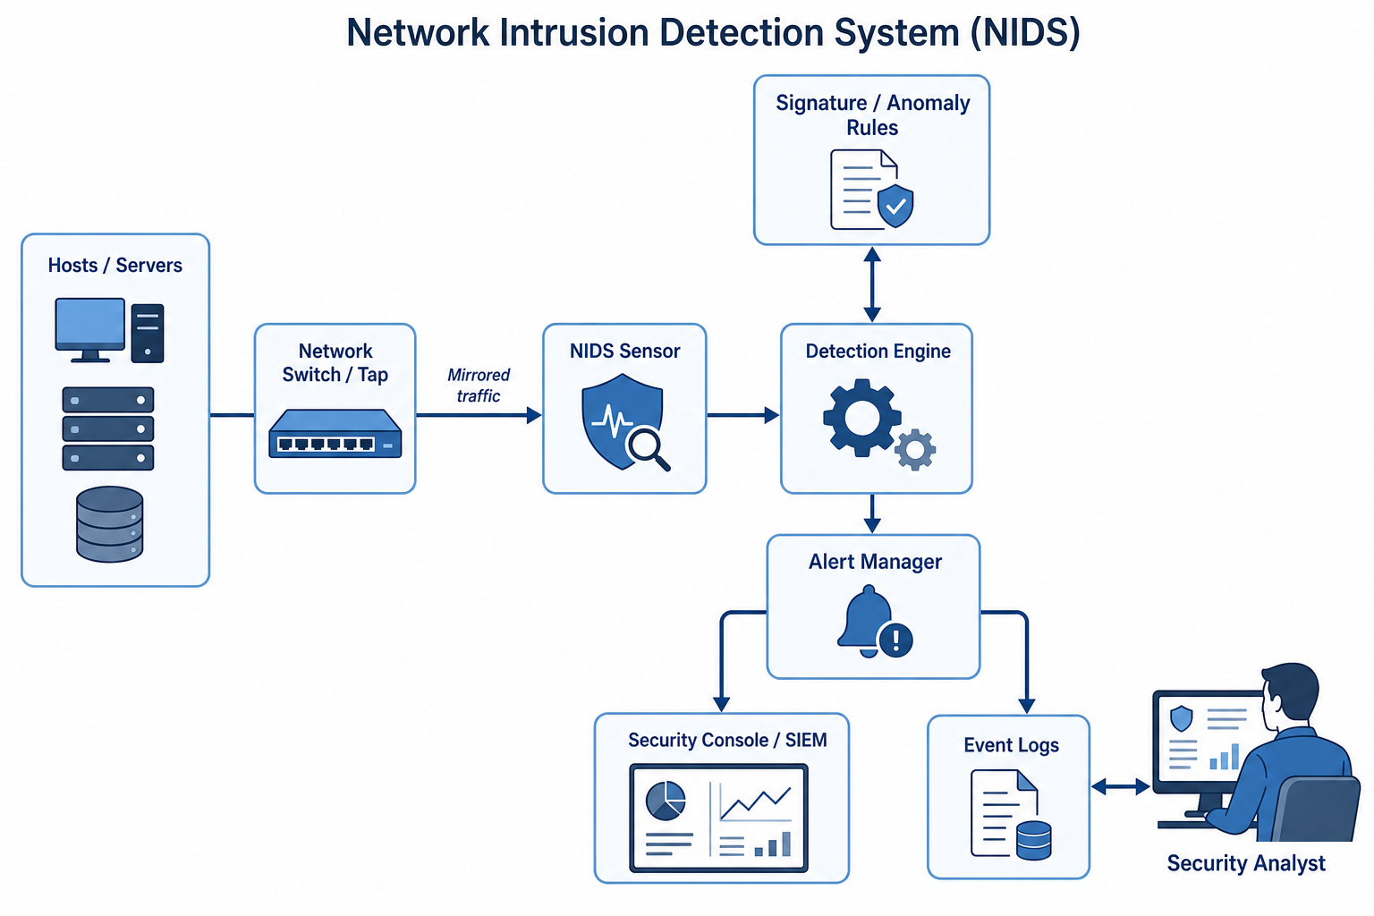
NIDS architecture
End-to-end traffic path from network to analyst
Network Intrusion Detection System | Confidential — Client Briefing
5 / 12

Slide 6
How it works
Five steps from packets to action
1
2
3
4
5
Capture
Decode
Detect
Alert
Respond
Traffic is mirrored via SPAN/tap from critical network segments.
Sensor parses protocols (TCP/UDP, HTTP, DNS, TLS metadata, etc.).
Engine matches signatures and/or scores anomalous behavior.
High-confidence events go to SIEM / SOC console.
Analysts triage, contain, and tune rules for fewer false positives.
Network Intrusion Detection System | Confidential — Client Briefing
6 / 12

Slide 7
Core components
Building blocks of a production NIDS
Network tap / SPAN
NIDS sensor
Detection engine
Copies traffic without interrupting production paths.
Appliance or VM that receives and preprocesses packets.
Signature matching + optional ML/anomaly analytics.
Rule / intel feeds
Alert manager
SIEM / console
Vendor signatures, threat intel IOCs, custom rules.
Deduplicates, prioritizes, and routes events.
Where SOC analysts hunt, triage, and report.
Network Intrusion Detection System | Confidential — Client Briefing
7 / 12

Slide 8
Detection methods
Two complementary approaches
Signature-based
Anomaly / behavior-based
Matches traffic against known attack patterns (CVE exploits, malware beacons, scanners).
Strengths: high precision for known threats; easy to explain.
Limits: weak against brand-new (zero-day) attacks until rules update.
Baselines normal traffic, then flags unusual volumes, destinations, or protocols.
Strengths: can surface unknown or insider threats.
Limits: needs tuning; more false positives without good baselines.
Network Intrusion Detection System | Confidential — Client Briefing
8 / 12

Slide 9
NIDS vs HIDS vs IPS
Choosing the right control for the job
NIDS
HIDS
IPS
Watches
Network traffic
Host/OS activity
Network (inline)
Placement
Tap / SPAN
On each server
In traffic path
Primary action
Detect & alert
Detect on host
Detect & block
Best for
East-west & perimeter visibility
Rootkits, file integrity
Automated prevention
Recommendation: use NIDS for network visibility; pair with HIDS/EDR on critical hosts and IPS where blocking is required.
Network Intrusion Detection System | Confidential — Client Briefing
9 / 12

Slide 10
Deployment models
Where to place sensors for maximum coverage
Perimeter / DMZ
Data center core
Watch internet-facing traffic for scans, exploits, and malware downloads.
Monitor east-west traffic between servers — where attackers often move unseen.
Cloud / hybrid
Branch / OT edges
Virtual taps or cloud-native flow + packet mirrors for VPC/VNet segments.
Lightweight sensors at remote sites or industrial networks when risk warrants.
Network Intrusion Detection System | Confidential — Client Briefing
10 / 12

Slide 11
Business benefits
What your organization gains
Reduced dwell time
Stronger SOC capability
Risk reduction
Spot intrusions earlier and shrink attacker time-to-damage.
Actionable alerts with packet context for faster triage.
Additional control layer when credentials or endpoints fail.
Audit readiness
Scalable visibility
Tunable over time
Demonstrable continuous network monitoring.
One sensor can cover many hosts without agent sprawl.
Rules and baselines improve as your environment is learned.
Network Intrusion Detection System | Confidential — Client Briefing
11 / 12

Slide 12
Recommended next steps
A practical path from briefing to pilot
1. Scope
Identify critical segments: internet edge, DC core, key cloud VPCs.
2. Pilot
Deploy one sensor on SPAN/tap; integrate alerts into your SIEM.
3. Tune
Reduce noise for 2–4 weeks; prioritize high-fidelity use cases.
4. Expand
Roll out to remaining segments; define SLAs for SOC response.
Network Intrusion Detection System | Confidential — Client Briefing
12 / 12

