Slide 1




MAJOR PROJECT
TUMOR TRACKER
BRAIN TUMOR DETECTION: A COMPREHENSIVE OVERVIEW
R180996 – Jhansysreenivas Manchuri

Slide 2

Overview
Introduction
Background and Literature Review
Problem Statement
Project Overview
Research Context
Objectives & Goals
Technologies Used
CNN Algorithm
Results
Challenges and Limitations
Future Enhancements
Conclusion
References

Slide 3

Introduction
Introduction:
Brain tumors are a significant health concern, affecting individuals of all ages, including children. The detection and classification of brain tumors are crucial for timely diagnosis and treatment planning. With advancements in medical imaging and artificial intelligence (AI), there is an opportunity to improve the accuracy and efficiency of brain tumor detection methods.
Importance of Brain Tumour Detection:
Early detection of brain tumors is vital for improved patient outcomes and prognosis. It allows healthcare professionals to intervene promptly, initiate appropriate treatments, and monitor disease progression. Moreover, accurate detection aids in distinguishing between benign and malignant tumors, guiding treatment decisions effectively.
Overview of Project's Objectives and Significance:
Our project aims to develop and deploy an AI-powered Brain Tumor Detection System that leverages medical imaging data, machine learning algorithms, and deep learning techniques. The system will automate the process of analyzing MRI and CT scans to detect and classify brain tumors accurately

Slide 4


Background and Literature Review
In today's medical landscape, brain tumors pose a significant health challenge across all age groups, including children. The need for accurate and timely detection of brain tumors is paramount to ensure effective treatment and improved patient outcomes. However, traditional detection methods may not always keep pace with the evolving complexities of brain tumor diagnosis.
Key Points:
Brain tumors affect people of all ages, necessitating accurate and timely detection for effective treatment.
Innovations in medical imaging and AI present opportunities to revolutionize brain tumor diagnosis.
Our project aims to develop an AI-driven Brain Tumor Detection System for precise analysis and improved diagnostic accuracy.
The system will enable early intervention, personalized treatment plans, and streamlined healthcare workflows.

Slide 5
PROBLEM STATEMENT
Challenges:
Understanding the challenges in brain tumor detection is essential for improving diagnostic outcomes and patient care.
Complexity of Brain Tumors:
Brain tumors present diverse characteristics, making accurate detection and classification challenging.
Variability in Imaging Data:
Interpreting MRI and CT scans can be complex due to variations in imaging features and tumor types.
Impact of Innovative Solutions:
Innovations in imaging technologies and AI offer promising solutions to overcome these challenges.

Slide 6
PROJECT OVERVIEW
Brain Tumor Detection System
Introducing an advanced Brain Tumor Detection System designed to improve diagnostic accuracy and patient outcomes.
Innovative Imaging Analysis:
The system utilizes advanced algorithms for precise analysis of MRI and CT scans, aiding in tumor localization and characterization.
Machine Learning Integration:
By integrating machine learning, the system can differentiate between benign and malignant tumors and classify tumor types based on imaging features.
Early Intervention Capability:
Early detection enables timely interventions, personalized treatment plans, and improved patient survival rates.

Slide 7
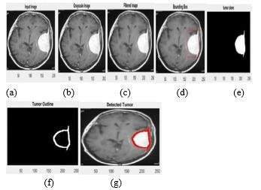
RESEARCH CONTEXT
Brain tumors can significantly impact brain activities, causing cognitive issues such as memory loss and difficulty with attention, motor skill impairments like weakness and coordination problems, sensory changes such as vision or hearing issues, emotional shifts like mood swings, seizures, persistent headaches, fatigue, disrupted sleep, and challenges with executive functions. Effective care involving different medical specialties is crucial for addressing these complex challenges.
Brain Tumor Detection :

Slide 8


Objectives & Goals
Reliable Brain Tumor Detection
Easy Integration Everywhere
Develop a system using technology to alert Patients by showing them if they are by chance affected by the brain tumor through the utilization of the MRI scans.
Create a user-friendly tool that effortlessly fits into Hospitals for easy evaluation of MRI scans for the identification of Brain tumors .

Slide 9




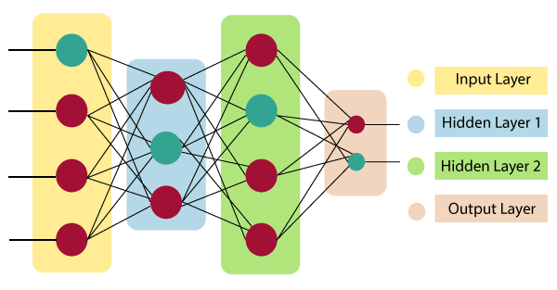
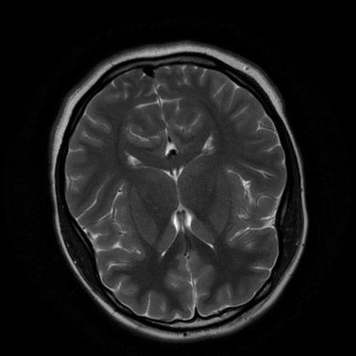
Technologies Used
Machine Learning:
TensorFlow and Keras are employed for developing, training, and evaluating machine learning models.
Tkinter is a Python binding to the Tk GUI toolkit. It is the standard Python interface to the Tk GUI toolkit, and is Python's de facto standard GUI. Tkinter is included with standard Linux, Microsoft Windows and macOS installs of Python.
Neural Network Architecture:
MobileNetV2, a convolutional neural network design optimized for mobile and embedded applications, functions as the underlying architecture in the script train_model.py for extracting features.
MRI is a type of diagnostic test that can create detailed images of nearly every structure and organ inside the body. MRI uses magnets and radio waves to produce images on a computer. MRI does not use ionizing radiation.

Slide 10
CNN Algorithm
Convolutional Neural Networks (CNNs) are a class of deep learning algorithms commonly used for image recognition, classification, and computer vision tasks.
Pattern Recognition: CNN algorithms are designed to recognize patterns in images, starting from simple features like edges and textures.
Feature Combination: These algorithms combine basic patterns to understand larger features, such as shapes or objects.
Learning Process: Through training, CNNs improve their ability to identify specific objects or conditions in images.
Use Cases: They are commonly used in tasks like medical diagnosis from scans or object recognition in photos.
Efficiency: CNNs automate the process of analyzing visual data, making them valuable in various industries.

Slide 11
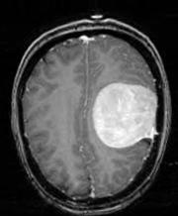
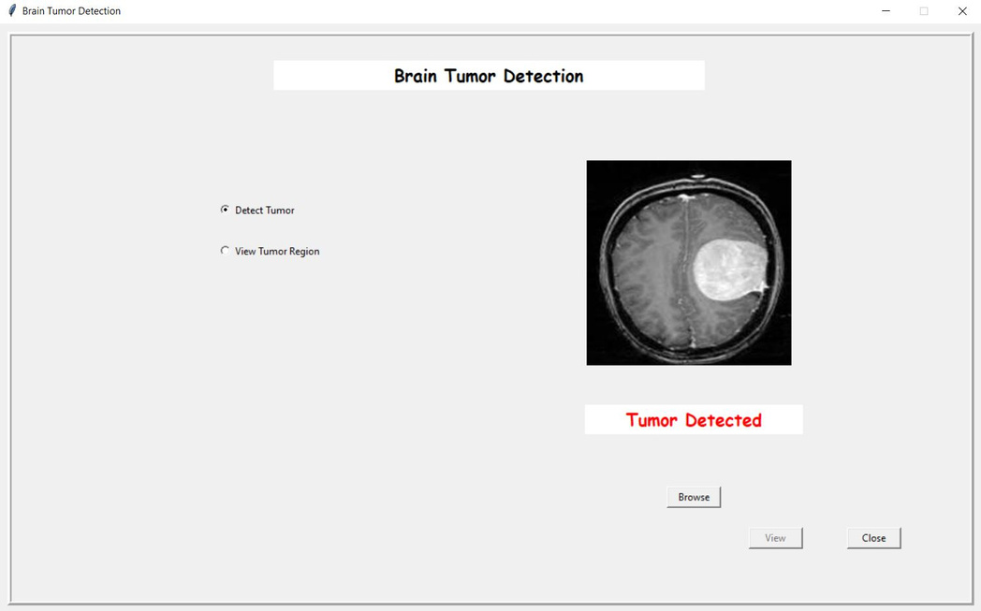
Results
INPUT
OUTPUT

Slide 12
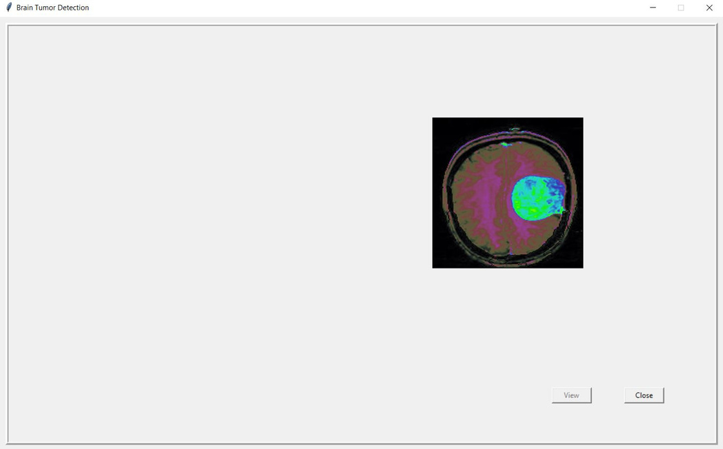
Results
INPUT
OUTPUT

Slide 13


Challenges & Limitations
Implementation Challenges:
Technical Complexity: Implementing advanced algorithms like CNNs for image analysis requires expertise in machine learning and deep learning techniques.
Data Quality and Availability: Access to high-quality and diverse medical imaging datasets is crucial for training accurate models, which may be limited in some cases.
System Limitations:
False Positives/Negatives: CNN algorithms may encounter challenges in distinguishing between benign and malignant tumors, leading to false positives or false negatives.
Environmental Factors: External factors such as imaging artifacts, variations in imaging protocols, and patient movements can affect the accuracy of tumor detection.

Slide 14
Future Enhancements
Our team
Collaborative Research Initiatives
Augmented Reality (AR) Visualization
Exploring AR visualization techniques to overlay tumor information on medical images or surgical navigation systems can aid surgeons in precise tumor localization and surgical planning.
Collaborating with academic institutions, healthcare organizations, and industry partners to access larger datasets, validate models, and conduct clinical trials can accelerate research advancements and validate the system's performance in diverse patient populations.

Slide 15
CONCLUSION
In Conclusion: Advancing Brain Tumor Detection for Improved Patient Care As we conclude our exploration of brain tumor detection, we've embarked on a journey towards enhancing patient outcomes and revolutionizing diagnostic methodologies. Our project signifies not only a technological breakthrough but also a profound impact on healthcare, aiming to transform how we detect and manage brain tumors.
Key Takeaways:
Innovative Technology Deployment: Our project showcases the power of AI and advanced imaging analysis in accurately detecting brain tumors, leading to earlier interventions and personalized treatment strategies.
Real-world Implications: Beyond the algorithms and data, our project holds immense real-world significance. It translates into tangible benefits for patients, healthcare providers, and the medical community, ushering in a new era of precision medicine and improved healthcare delivery.

Slide 16



REFERENCES
Text Books :
Murphy, K. P. (2012). "Machine Learning: A Probabilistic Perspective."
Video lectures and tutorials on platforms like YouTube.

Slide 17

THANK YOU
For watching this presentation
9392763867 Jhansysreenivas Manchuri

