Slide 1
Building AI Application in Agriculture that knows your data: the RAG pipeline
Dr Sreenivasulu M
Data Science Manager
Publicis Sapient

Slide 2
Contents
The Context Challenge: Understanding why AI needs instructions versus context.
RAG vs. Long Context: The debate on whether large context windows replace the need for retrieval.
RAG Architecture & Algorithms:
The Retrieve-Then-Generate Loop.
Sparse (Term-Based) vs. Dense (Embedding-Based) Retrieval.
Hybrid Search and Reciprocal Rank Fusion.
Optimization Strategies:
Chunking Strategies and the Overlap Rule.
Query Rewriting for Disambiguation.
Contextual Retrieval (The Anthropic Approach).
Applications in Agriculture:
Kisan Call Center: Managing government scheme documents.
Soil Health Cards: Handling tabular data with contextual retrieval.
Crop Diagnosis: Using Hybrid Search for symptoms and chemicals.
Market Intelligence: Agentic patterns for real-time data.

Slide 3
The Context Challenge
The Core Problem: AI models need two things to solve a task: instructions (how to do it) and information (context).
Hallucination: Just like humans, models hallucinate when they lack context.
Context Engineering: Constructing context for foundation models is the modern equivalent of "feature engineering" in classical ML.
Two Dominating Patterns:
RAG (Retrieval-Augmented Generation): Retrieving relevant data from external sources.
Agents: Using tools (search, APIs) to actively gather information and interact with the world.

Slide 4
Will Long Context Kill RAG?
The Debate: With 1M+ token windows, do we still need retrieval?
Argument for RAG:
Data Velocity: Data grows faster than context windows expand (Parkinson's Law of Data).
Context Efficiency: Models often focus on the wrong parts of massive contexts ("Lost in the Middle" phenomenon).
Cost & Latency: Every extra token costs money and adds latency. RAG reduces input to only the most relevant tokens.
Anthropic's Rule of Thumb: If knowledge is < 200k tokens (~500 pages), just use the prompt. For anything larger, use RAG. Its for
claude models
Note: Model provider incorporates a retrieval like mechanism to help a model pick out the most salients parts of a context to use.

Slide 5
RAG Architecture Overview
History: Concept introduced in 2017 (Chen et al.)- Reading Wikipedia to Answer open-domain questions.
Term "RAG" coined in 2020 (Lewis et al.)- Knowledge intensive tasks. (they trained both generator and retrieval combinely)
Enhancing generation by retrieving relevant information from external memory (databases, chat history, internet).
The Loop (Retrieve-Then-Generate):
Retriever: Indexes and queries the external memory.
Generator: Uses the retrieved chunks + user prompt to generate the answer.

Slide 6
RAG (cont..)
Example query
Can Acme’s fancy-printer-A300 print 100pps?
Model responds better because of fancy-printer-A300

Slide 7
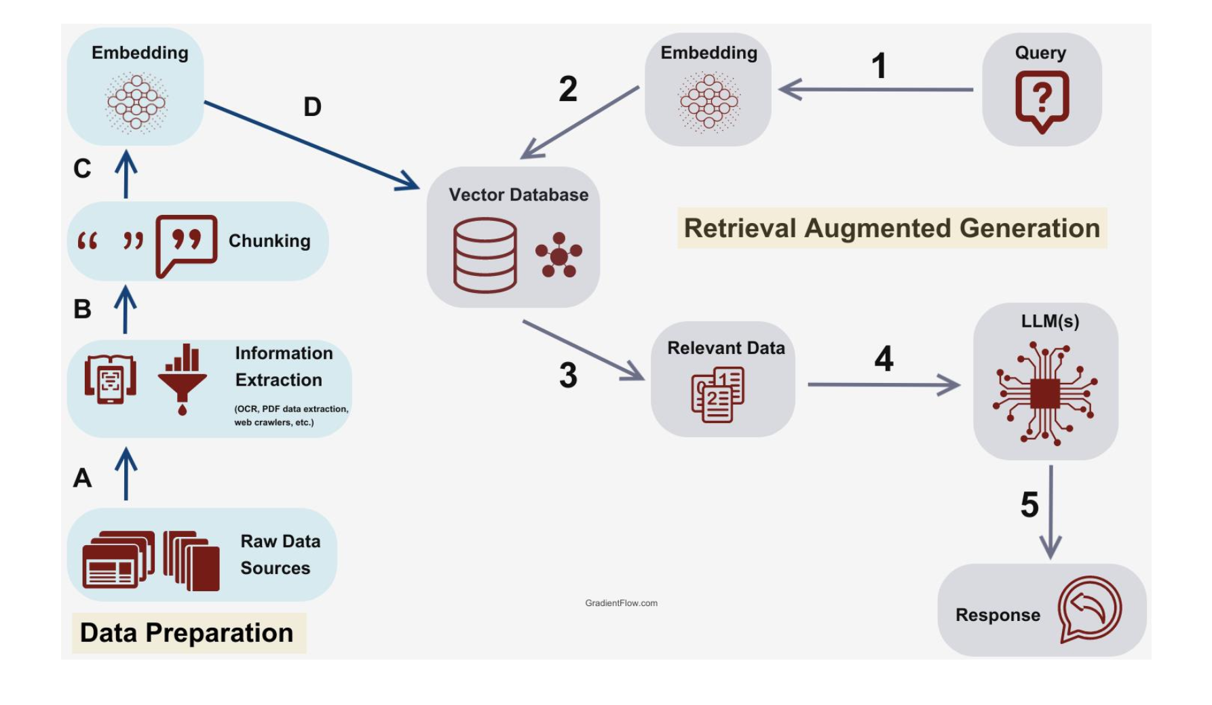
Architecture

Slide 8
Retrieval Algorithms
Information is a century old idea.
1920’s Emanuel Goldberg’s patents for a statistical machine
to search documents stored on films.
Backbone of search engines, recommender system, log analytics, etc.
Two retrieval mechanisms-
Term-based retrieval
Embedding based retrieval.

Slide 9
Retrieval Algorithms I: Term-Based (Sparse)
Mechanism: Matches keywords using sparse vectors (mostly zeros).
Key Metrics:
TF (Term Frequency): How often a term appears in a document.
IDF (Inverse Document Frequency): Penalizes common words (like "the", "for").
Algorithms:
BM25 (Best Matching 25)(1980): The industry standard. Normalizes TF-IDF based on document length.
Elasticsearch (2010): Uses inverted indices for fast lookup.
Pros/Cons: Fast and cheap, but misses semantic meaning (e.g., "Apple" fruit vs. "Apple" company).
Note: Aravind Sreenivas, the ceo of perplexity tweeted “making a genuine improvement over BM25 is hard”

Slide 10
Retrieval Algorithms II: Embedding-Based (Dense)
Mechanism: Uses dense vectors to capture semantic meaning.
Workflow:
Embedding Model: Converts query and documents into vectors.
Vector Database: Stores embeddings (e.g., FAISS, Annoy, HNSW, Milvus).
ANN Search: Finds Approximate Nearest Neighbors.
Pros/Cons: Captures intent/synonyms, but computationally heavy and expensive to index.

Slide 11
Production Strategy: Hybrid Search & Reranking
Hybrid Search: Combining the precision of keyword matching (BM25) with the semantic understanding of embeddings.
Reciprocal Rank Fusion (RRF): An algorithm to combine ranked lists from different retrievers.
Reranking:
Step 1: Fetch 50+ candidates using a cheap retriever (e.g., BM25).
Step 2: Use a high-precision "reranker" model to sort them and select the top 5 for the LLM.
Why? Optimizes for both recall (don't miss data) and precision (don't distract the LLM).

Slide 12
Optimization I: Chunking Strategies
The Problem: Documents vary in length (10 tokens vs 1M tokens).
Strategies:
Fixed Size: e.g., 512 tokens with overlap.
Recursive: Split by section -> paragraph -> sentence.
Semantic/Structural: Split by markdown headers or code functions.
The Overlap Rule: Always overlap chunks (e.g., 20 tokens) to prevent cutting context in the middle of a sentence (e.g., "I left my wife... a note").
Trade-off: Smaller chunks = more diversity but less context. Larger chunks = better context but fewer fit in the window.

Slide 13
Optimization II: Query Rewriting
The Ambiguity Problem:
User: "When did John buy a hat?”
User: "How about Emily?" -> Context missing!.
Solution: Use an LLM to rewrite the last query into a standalone question before retrieval.
Rewritten: "When did Emily buy a hat?”
Impact: Essential for conversational RAG to function correctly

Slide 14
Optimization III: Contextual Retrieval
Technique: Augmenting chunks with metadata or summaries.
Anthropic's Approach:
Use an LLM to generate a 50-100 token summary of the entire document.
Prepend this summary to every chunk of that document.
Benefit: Even small chunks carry the global context of the parent document, improving retrieval accuracy significantly

Slide 15
Evaluation Metrics
Component Evaluation:
Context Precision: % of retrieved documents that are relevant.
Context Recall: % of all relevant documents that were retrieved.
Ranking Metrics: NDCG (Normalized Discounted Cumulative Gain) and MRR (Mean Reciprocal Rank).
End-to-End Evaluation: Judging the final generated answer quality.

Slide 16
Application of RAG in Agriculture
Building Intelligent Text Interfaces for Farmers and Agronomists

Slide 17
The "Context" Problem in Agronomy
The Challenge: To answer a farmer's question, a model needs specific instructions and context.
Missing Information: Without access to specific local data (soil reports, local weather), AI models hallucinate answers.
The Solution:
RAG (Retrieval-Augmented Generation): Retrieves relevant text (manuals, schemes) from an external database.
Agents: Uses tools to search the web for real-time news and prices

Slide 18
The "Kisan Call Center" RAG Bot
Use Case: Answering queries about government schemes and subsidies.
Problem: Government documents are vast. Long context windows are inefficient and models often focus on the wrong part of the text.
Architecture:
Retriever: Fetches specific paragraphs from thousands of PDF scheme documents.
Chunking Strategy: Uses recursive splitting (Section -> Paragraph) to keep related text together.
Result: Precise answers about eligibility criteria without hallucinating non-existent benefits.

Slide 19
Handling Tabular Soil Health Cards
Challenge: Soil reports are often tables (Text + Numbers). Standard chunking breaks tables, losing context (e.g., a row of numbers without headers).
Solution: Contextual Retrieval (The Anthropic Method).
Technique: Use an LLM to generate a summary of the whole soil report (e.g., "Soil test results for Farmer X, Survey No. 123, 2024").
Augmentation: Prepend this summary to every chunk/row of the table.
Outcome: The retriever can successfully find "Nitrogen levels for Survey 123" even if the data was split into small chunks.

Slide 20
Crop Symptom Diagnosis (Hybrid Search)
Use Case: Farmer describes symptoms: "Leaves are turning yellow with brown spots.”
Engineering Challenge:
Semantic Search: Needed for symptoms (e.g., matching "yellowing" to "chlorosis").
Keyword Search: Needed for specific chemical names (e.g., "Imidacloprid") or exact seed varieties.
Solution: Hybrid Search.
Combine Embedding-based retrieval (for symptoms) and Term-based retrieval/BM25 (for chemical names) to find the correct protection manual.

Slide 21
The Market Intelligence Agent
Use Case: "Is now a good time to sell Maize?”
Pattern: Agentic Pattern.
Mechanism:
The model uses Tools (APIs) to fetch external data (live Mandi prices, weather forecasts).
Time-Based Reranking: Retrieves news articles and reranks them to prioritize the most recent market updates.
Impact: Provides advice based on live conditions, not training data from 2 years ago.

Slide 22
Optimization: Query Rewriting for Chatbots
Turn 1 (User): "What is the recommended dosage of Coragen for stem borers?"
System Response: "The recommended dosage is 60ml per acre.”
Turn 2 (User): "Can I mix it with a fungicide?”
The Problem: The user uses the pronoun "it". If the RAG system searches the database for "Can I mix it with a fungicide?", it will likely retrieve generic mixing guides or irrelevant results because "it" is undefined.
The Rewrite: The system uses an LLM to rewrite the query before sending it to the retriever:
Rewritten Query: "Can I mix Coragen with a fungicide?"

Slide 23
Summary
NLP in Agriculture is an Engineering Problem: It requires careful context construction.
Key Takeaways:
Use Contextual Retrieval for Soil/Lab reports.
Use Hybrid Search to handle both symptoms (semantic) and chemical names (keywords).
Use Agents for real-time decision-making (markets/weather).

Slide 24
Thank you

