Slide 1
RNN

Slide 2
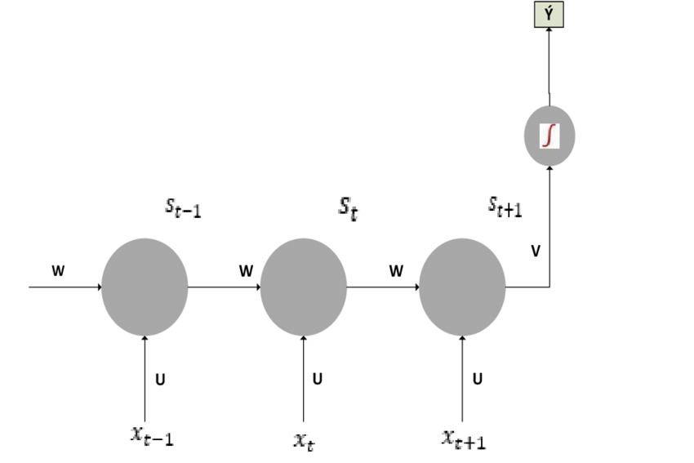
RNN (cont..)

Slide 3
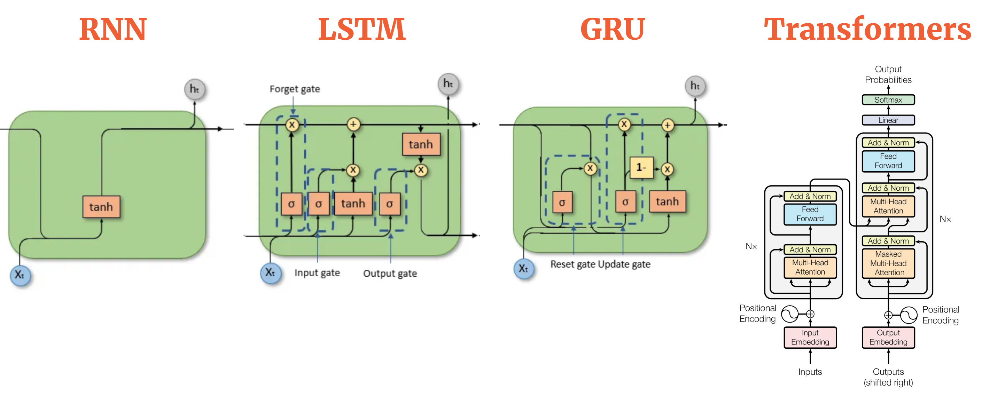
LSTM

