Slide 1
Transformers and its applications

Slide 2
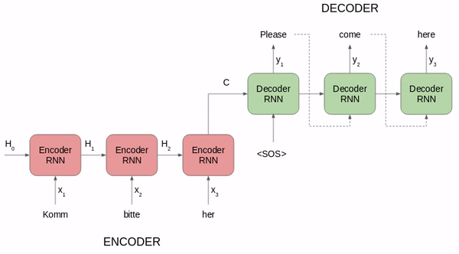
RNN

Slide 3
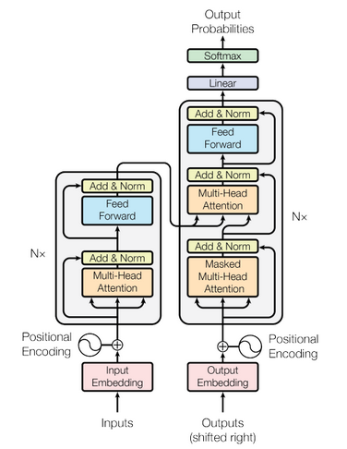

Slide 4
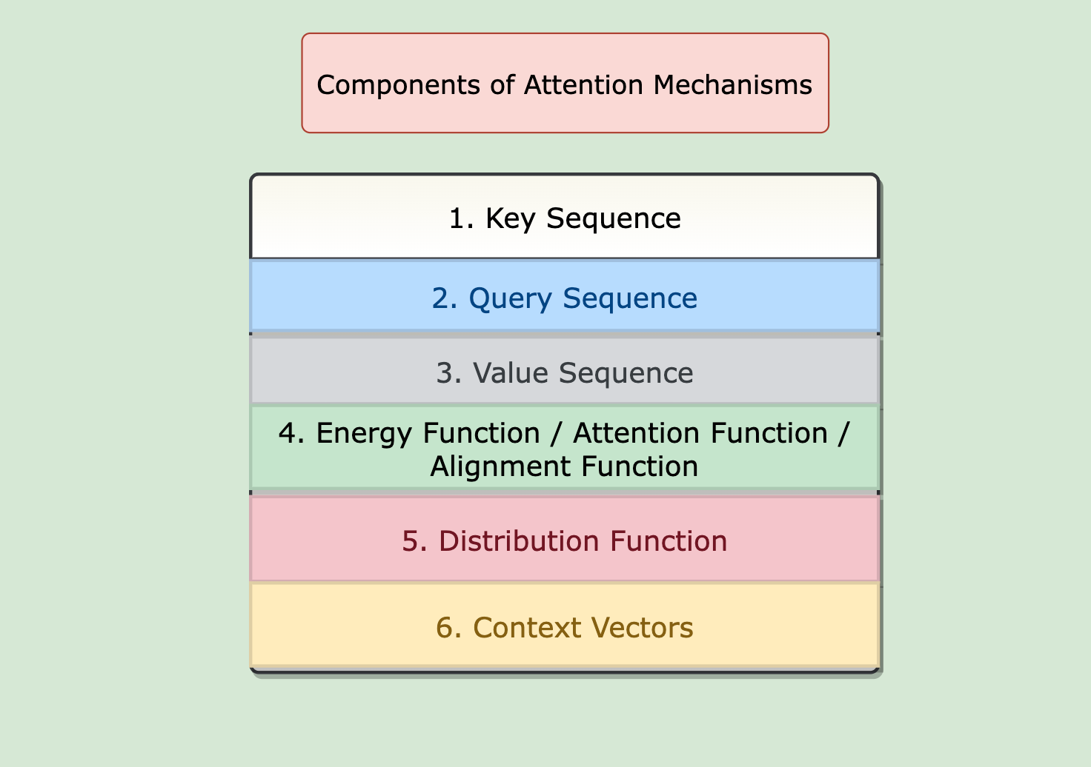

Slide 5
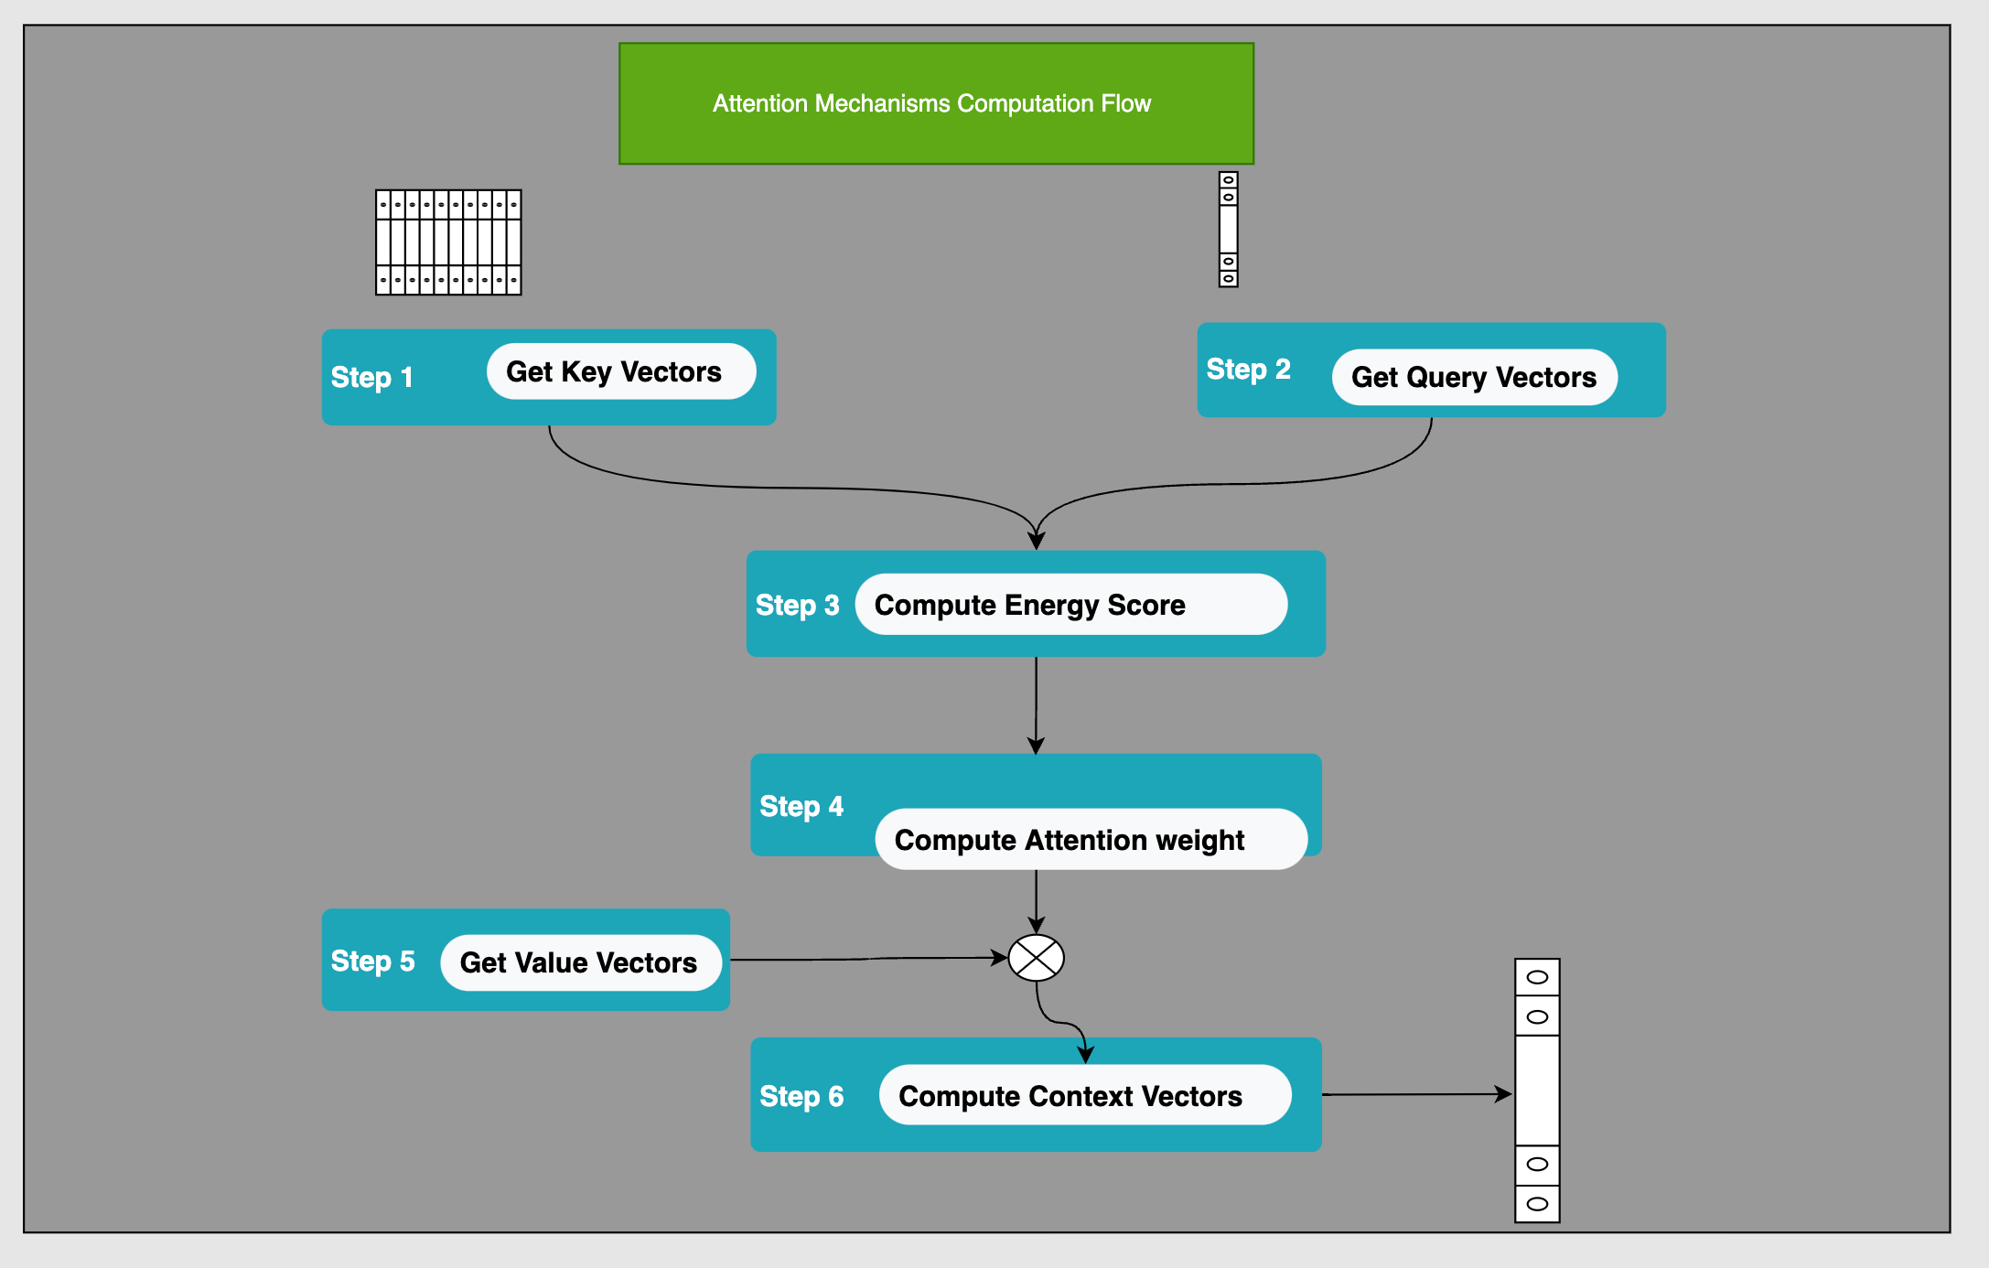

Slide 6
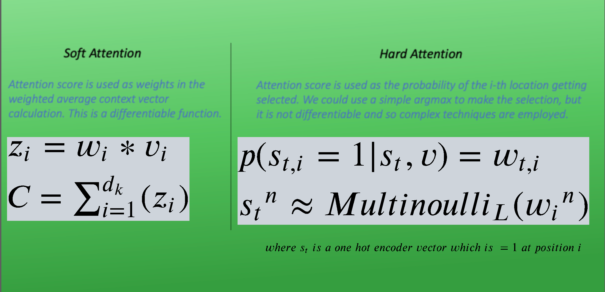
Transformers and its applications (cont..)

Slide 7
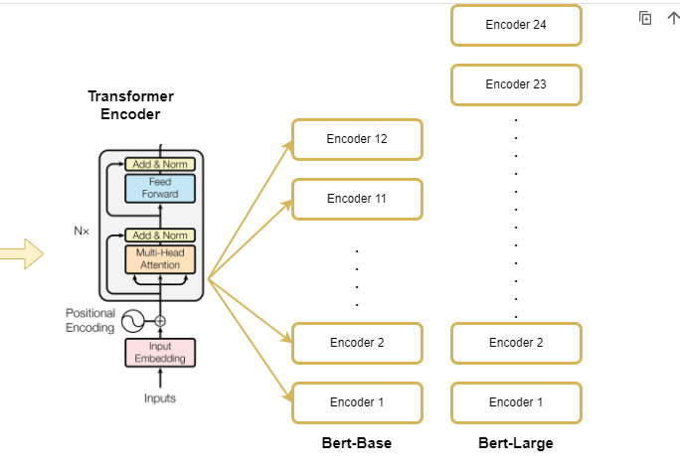

Slide 8
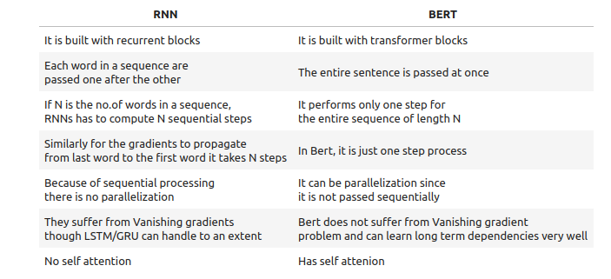
How BERT is different from RNN/LSTM?

Slide 9
BERT (cont..)
Is BERT a word embedding model or pre-trained model?
How was it pre-trained?
Data- Wikipedia (2500 million words) and bookcorpus(800 million words)

Slide 10
BERT
BERT was pre-trained on two tasks:
1. Predicting the masked works
2. Next Sentence prediction

Slide 11

Examples of predicting the masked works

Slide 12
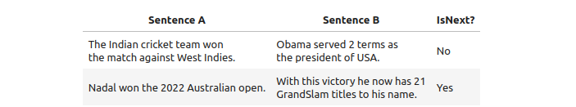
Examples of NSP

Slide 13
Which one is easier to predict?
Today morning, I went for a___________?
Today morning, I went for a___________ removal to my dentist?

Slide 14
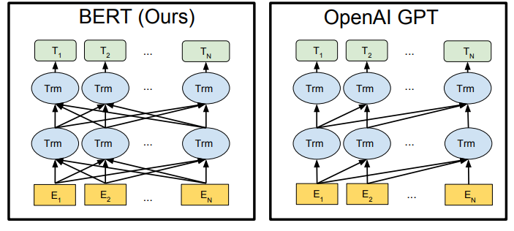
BERT is bi-directional

Slide 15
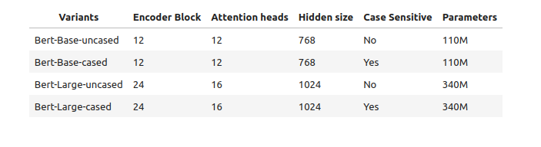
Types of BERT

Slide 16
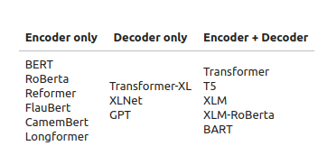
More Architectures on Transformer

Slide 17
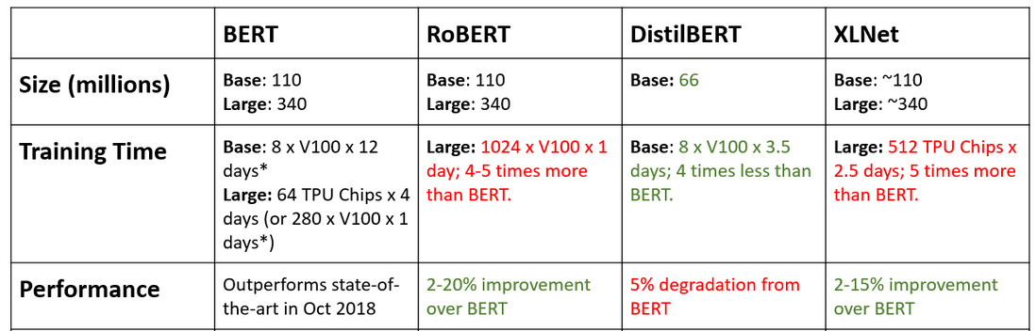
Comparison of different architectures

Slide 18
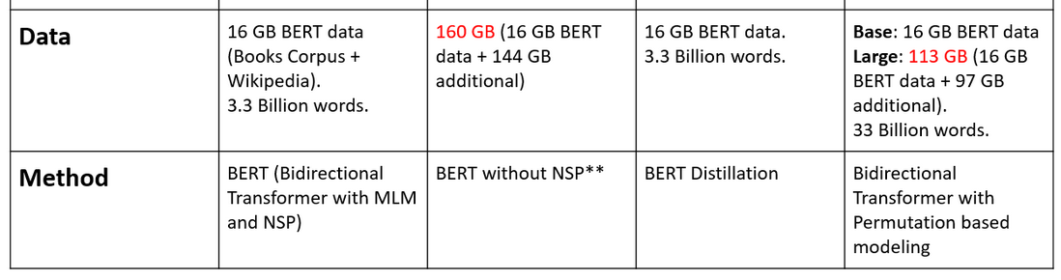
Comparison of different architectures(cont..)

