Slide 1
GROUP-03
S20210020292-ADI NARAYANA REDDYMALLALA
S20210020263 - JAYARAJ CHIPPADA
S20210020251 - AKULA KIRANMAI
S20210020327 - VADITHYA SREENIVAS
BLOCK DIAGRAM

Slide 2
SD CARD
APP INTERFACE
TEMPERATURE
SENSOR
LCD DISPLAY
FIREBASE
ARDUINO
MEGA
VIBRATION
SENSOR
NODEMCU
GYROSCOPE
SENSOR
GPS MODULE

Slide 3
.
GET LOCATION FROM GPS
CONTROL FLOW BLOCK DIAGRAM:
TEMPERATURE
>THERSHOLD
LOCATION WILL BE DISPLAYEDON APP
SEND IT TO FIRE BASE
VIBRATION >
THERSHOLD
BUZZER
ALERT
AND ALERT IN APP
ALERT THE USER OF APP WITH ALERT NOTIFICATION
GYRO VALUE
>
THRESHOLD
DISPLAY ALL VALUES IN APP

Slide 4
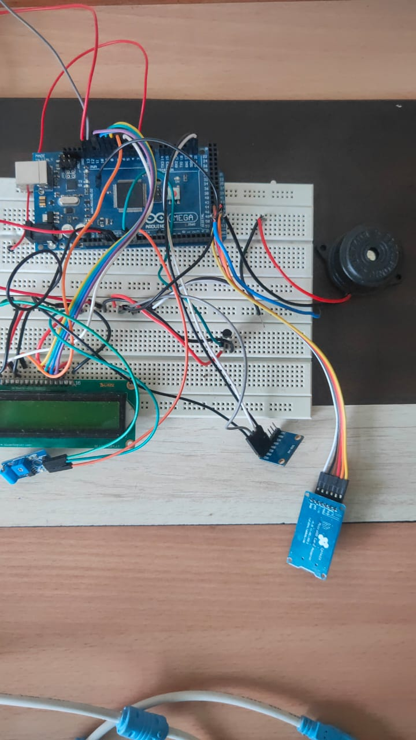
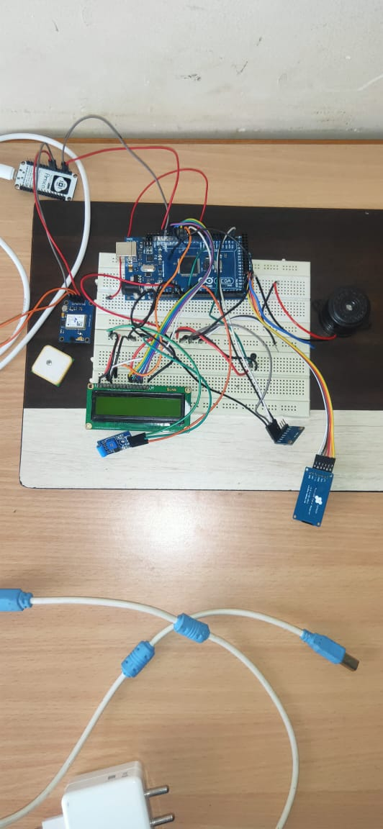
HARDWARE CIRCUIT

Slide 5
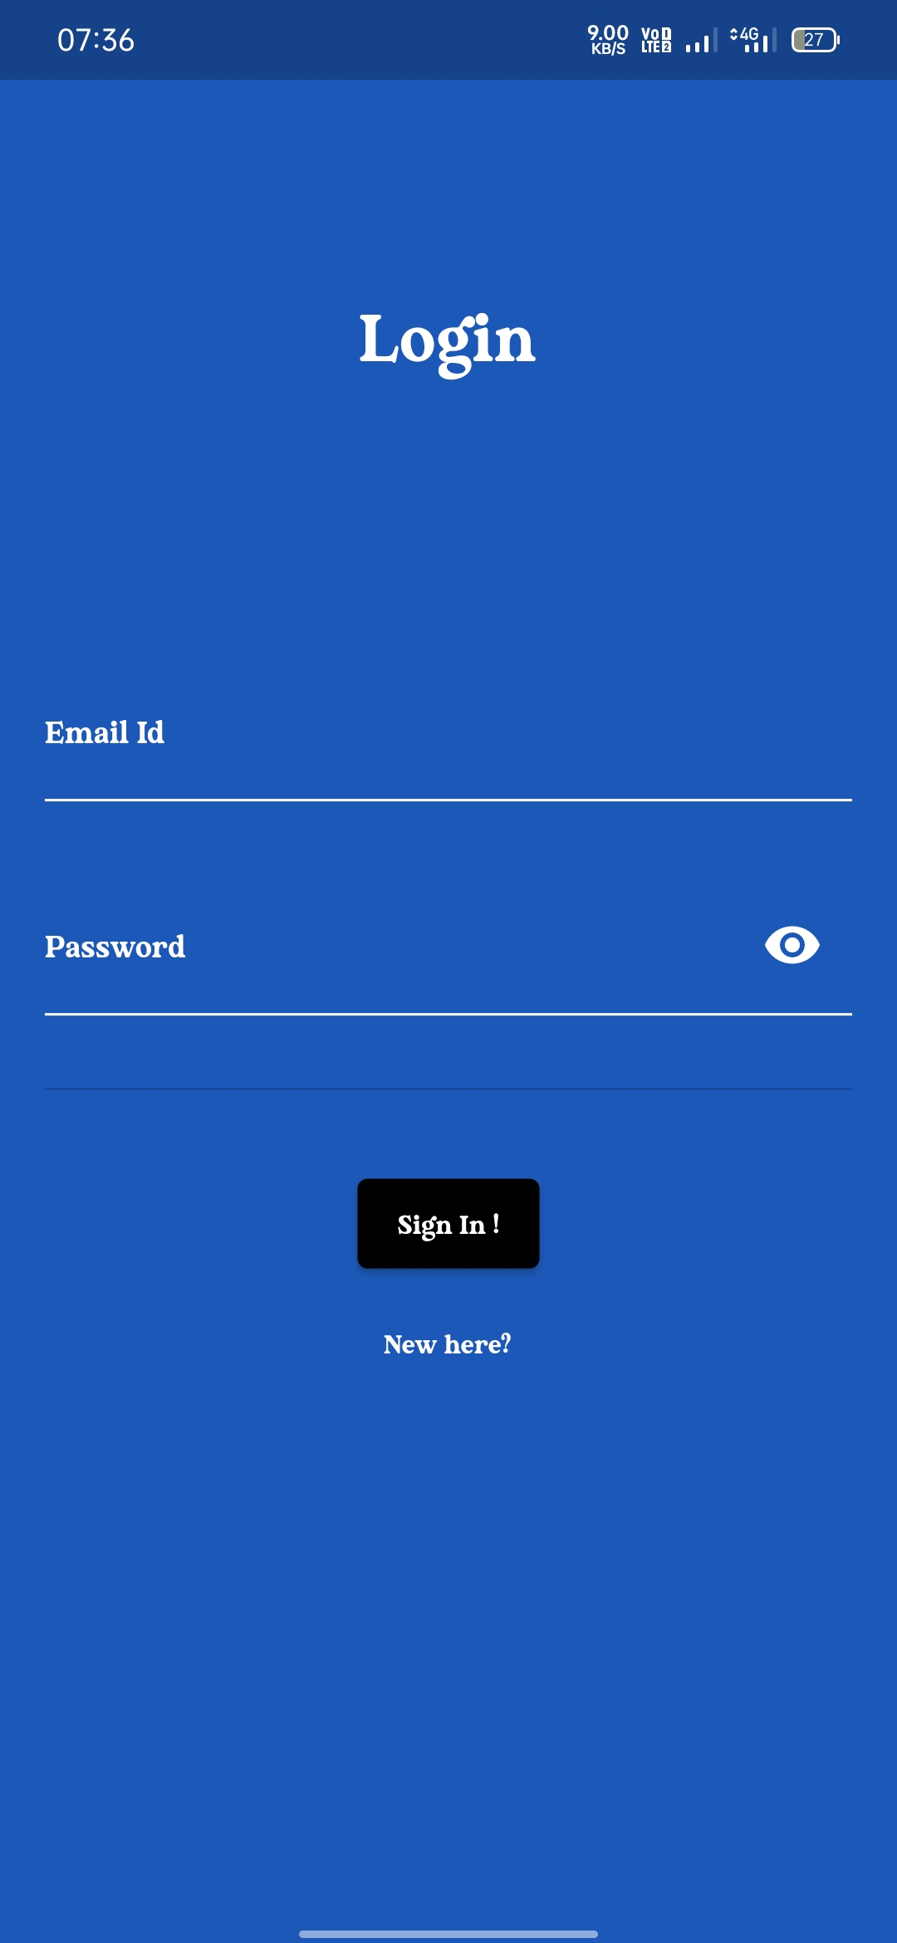
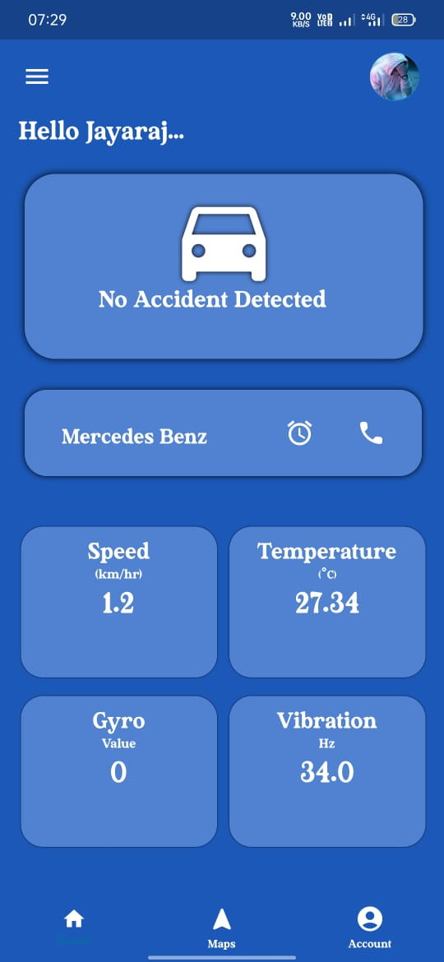
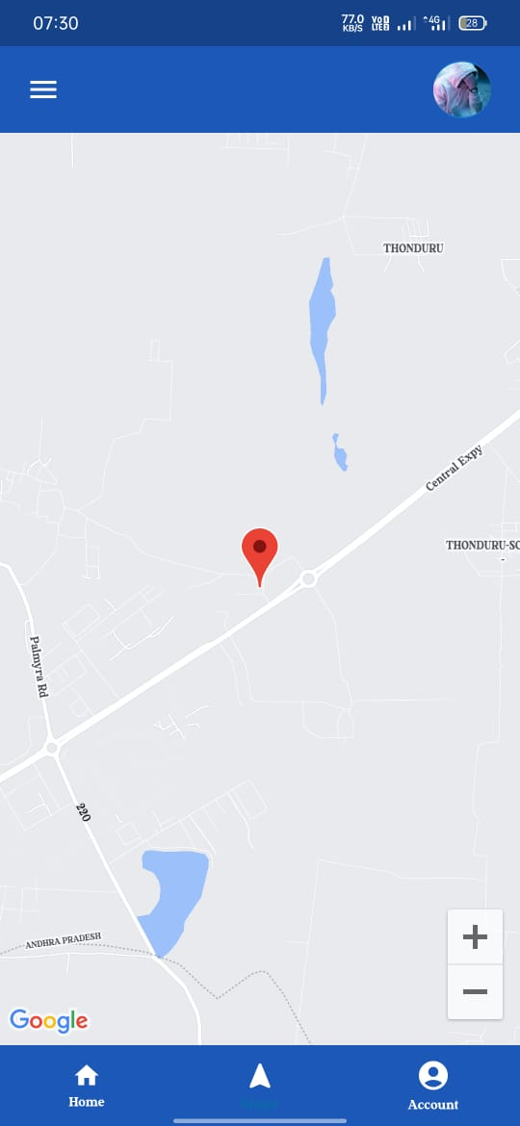
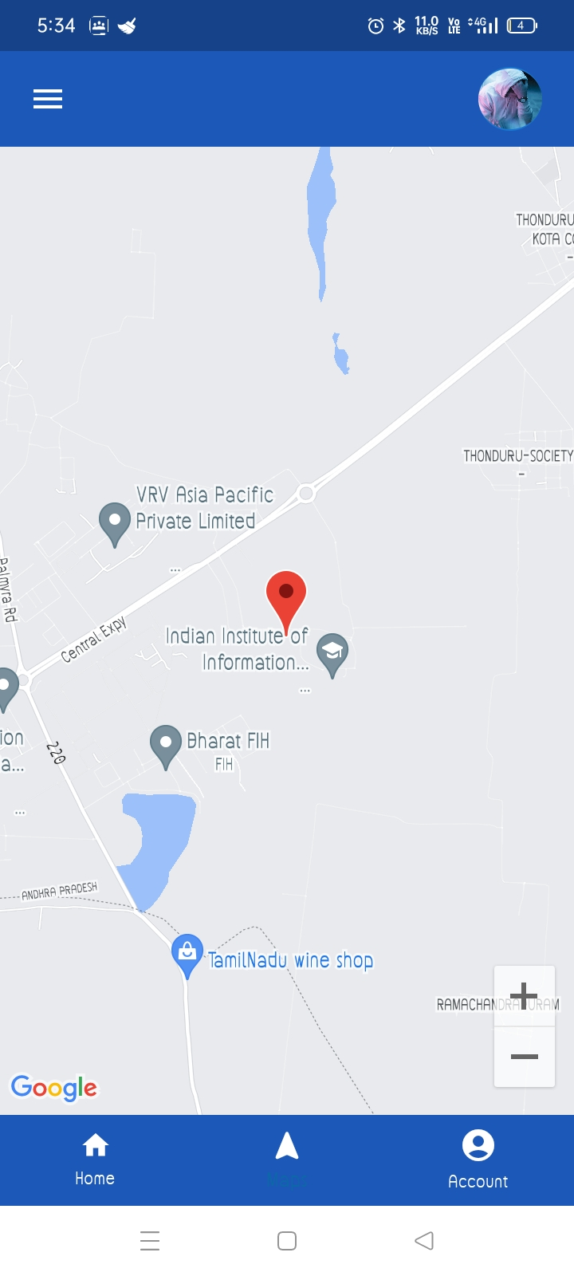
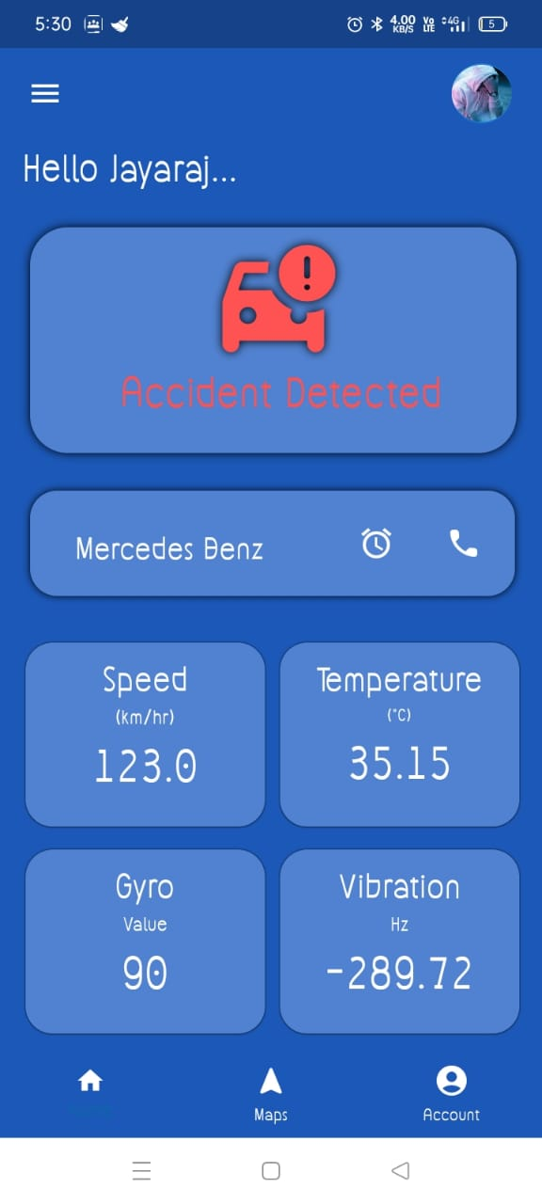
APP USER INTERFACE SCREENSHOTS
USER INTERFACE:
THIS SECTION GIVES LAST LOCATION OF VEHICLE:
WHEN ACCIDENT DETECTED:

Slide 6
ACHIEVED OUTCOMES:
Able to print all the sensor data
Stores all the data in sd card
Sends data from Arduino to nodemcu using i2c protocol
Able to update all the values to the database and then to the app
Able to show the last location of the vehicle in the app and update the live location
Finally,sends accident alert notification to all users of the app

Slide 7
Pending tasks
Unable to show the shortest route to accident location

