Slide 1


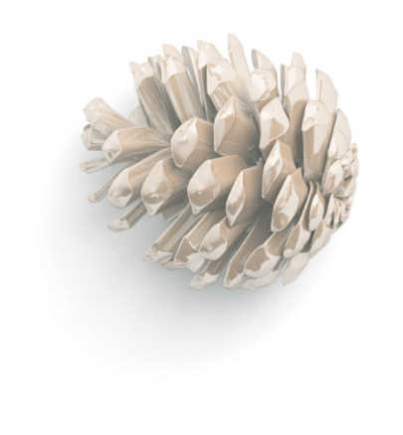
To develop a simplified prototype for non-invasive blood glucose estimation using IR and RED LEDs along with photodiodes and signal amplification circuits.
Non-Invasive Glucose Estimation
Using Multi-Wavelength Optical Sensors

Slide 2
INTRODUCTION:
Objective:
Develop a low-cost, non-invasive glucose monitoring prototype using NIR spectroscopy principles with IR LEDs and photodiodes.
Scientific Basis:
Glucose absorbs specific NIR wavelengths (940nm)
Reflected light intensity correlates with blood glucose concentration.
Key Features:
- Wavelength optical sensing (IR)
- Signal amplification and filtering
- ESP32-based data acquisition
- Cloud connectivity (Firebase)
- Visual alerts (LED indicators)

Slide 3

Hardware Setup:
METHODOLOGY:
I initially designed a simplified system using:
IR LED (940nm) and Red LED
BPW34 photodiode
LM358P Op-Amps
ESP32 Dev Board
Basic analog signal processing circuit
Photodiode was connected to LM358P op-amp configured as a voltage amplifier.
Output of the op-amp was filtered using parallel capacitors (100nF + 10µF to GND).
IR and RED LEDs connected to separate GPIOs on ESP32 and driven alternately.
ESP32 ADC pins (GPIO34 and GPIO35) used to read voltage values from op-amp outputs.
This setup aimed to estimate blood glucose levels non-invasively by analyzing reflected light intensity through a fingertip. The goal was to monitor light absorption changes due to glucose levels using basic ADC voltage readings.

Slide 4
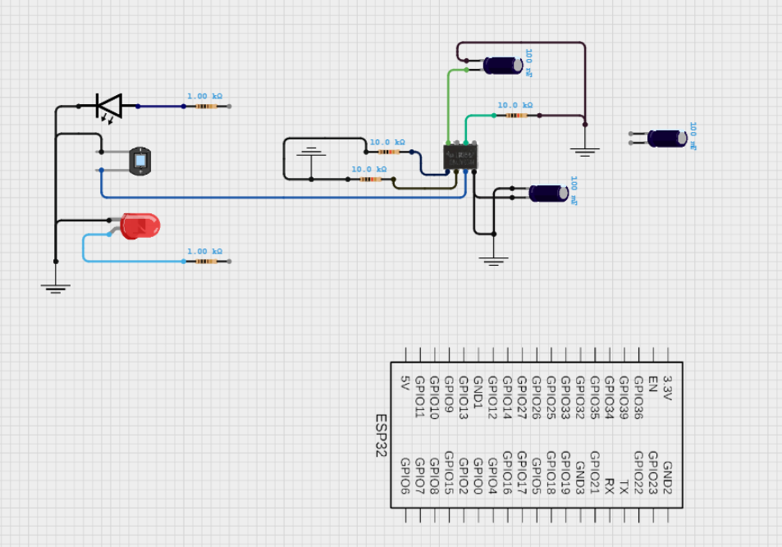

First Circuit:
Major Issues:
1. Incorrect resistor values (1kΩ for LEDs → Underpowered)
2. Missing feedback resistor on LM358P
3. No bypass capacitors
IR LED
(940nm)
BPW 34
LM358P
RED LED
LED Circuit Fix: Current Limiting
Before: GPIO12 → 1kΩ → LED → GPIO12
After: GPIO12 → 220Ω → LED → GND
□
1 KOhm
Op-Amp Fix:
Before: LM358 Pin 2 → 10kΩ→ GND
After: LM358 Pin 2 → 1MΩ → Pin 1 (feedback resistor) Missing decoupling capacitors (caused unstable signals)

Slide 5
Challenges & Observations:
Signal Stability Issues: Output from the photodiode-opamp circuit remained constant even when changing conditions (finger, paper, no object).
Low Sensitivity: The BPW34 photodiode + LM358 circuit did not show significant variation between IR and Red LED readings.
Inconsistent Readings: Ambient light and circuit noise introduced instability.
The LEDs and photodiode were in an open setup on a breadboard, making it hard to maintain the optimal sensing distance was
5mm to 15 mm. Any small movement caused unstable readings, and ambient light interference further reduced accuracy.
Despite optimizations (pull-down resistors, shielding from ambient light, adjusting resistor values), the accuracy and reliability were not suitable for a real-world or research-grade prototype.

Slide 6
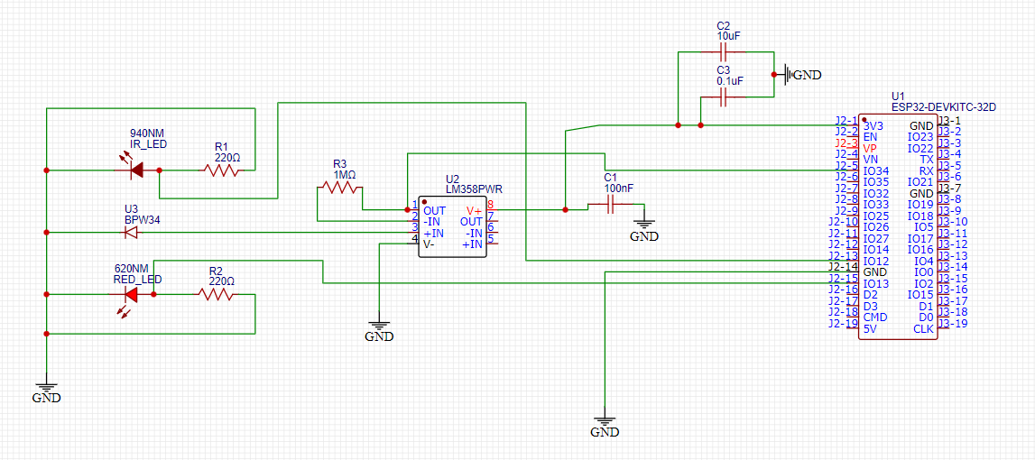
Second Circuit:

Slide 7
Aspect | First Circuit (Not Working Well) | Second Circuit (Working Well)
Photodiode Biasing | Not clearly reverse-biased or biased at all. This reduces sensitivity and response speed. | Properly reverse-biased via resistors. Improves sensitivity and faster response of BPW34.
Op-Amp Configuration | LM358 not clearly isolated between inputs, and power rails unclear. Capacitor use is minimal or unfiltered. | Clean LM358 differential setup with proper gain, bypass capacitors (C1, C2, C3) stabilizing power and reducing noise.
LED Resistor Values | IR and Red LED share similar resistor and are mixed with logic control lines (orange and black). May not provide constant, correct current. | IR LED (220Ω) and Red LED (220Ω) have proper current-limiting resistors, and are clearly isolated from each other.
Signal Routing | Mixed power and signal lines may lead to noisy analog readings. Improper ground references. | Clean analog signal path from op-amp output to ADC (ESP32 pin). GND references are clean and separated.
Stability Components | No decoupling capacitors near op-amp. | Capacitors (100nF, 10μF, etc.) provide power stability and signal smoothing. Crucial for analog accuracy.
Analog Input to ESP32 | May be affected by floating or unbuffered values. | Signal is properly conditioned and filtered before going into ESP32 analog pin.

Slide 8
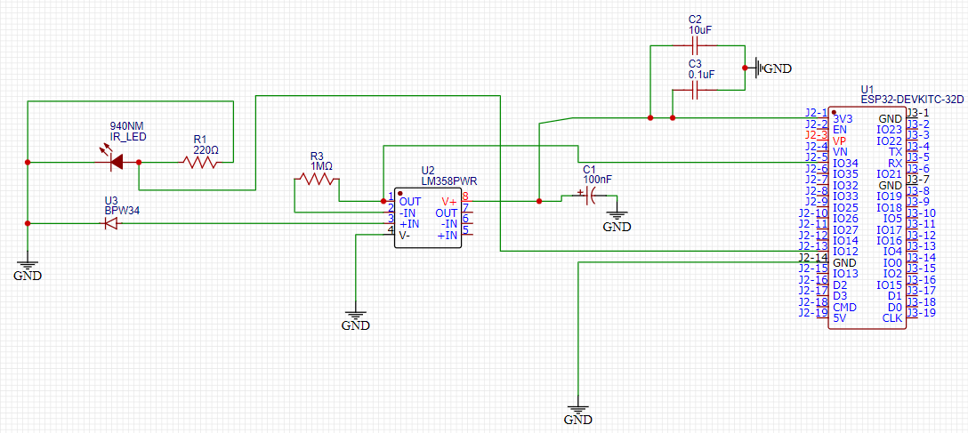
Third Circuit:
removed RED LED

Slide 9
Hardware Setup:
Designed a simplified system using:
IR LED (940nm) : Emites IR light through skin tissue
BPW34 photodiode : Detects how much IR light is reflected back
LM358P Op-Amps : signal amplification
ESP32 Dev Board : Reads the analog voltage using ADC and sends to Firebase
Photodiode was connected to LM358P op-amp configured as a voltage amplifier.
Output of the op-amp was filtered using parallel capacitors (100nF + 10µF to GND).
ESP32 ADC pin (GPIO34) used to read voltage value from op-amp output.
Dual LED Visual Alerts:
Green LED blinks for normal glucose levels (0.25V-1.80V)
Red LED blinks for high glucose levels (>1.80V)
This setup aimed to estimate blood glucose levels non-invasively by analyzing reflected light intensity through a fingertip. The goal was to monitor light absorption changes due to glucose levels using basic ADC voltage readings.

Slide 10
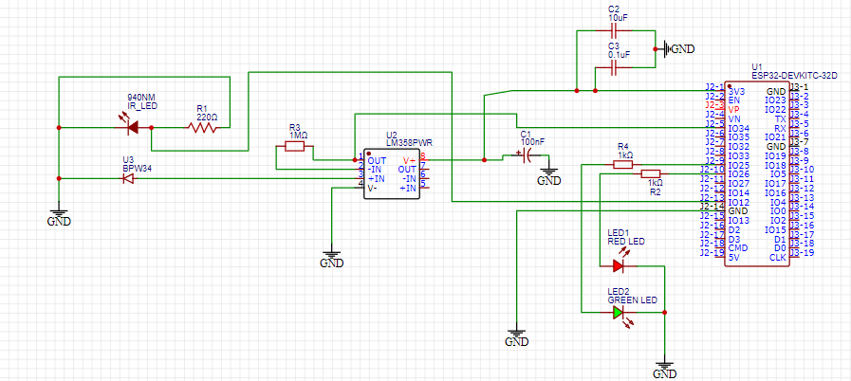
Final Circuit:
Added green led and red led
used 220Ω resistors:
I=3.3V/220Ω≈15mA

Slide 11
BLOCK DIAGRAM:
ESP32
(Micro Controller)
IR Led / BPW34
Arduino ide (Sreial Monitor)
Firebase (Stores IR Voltage)
WiFi
Google Colab
(Signal processing and glucose prediction)

Slide 12
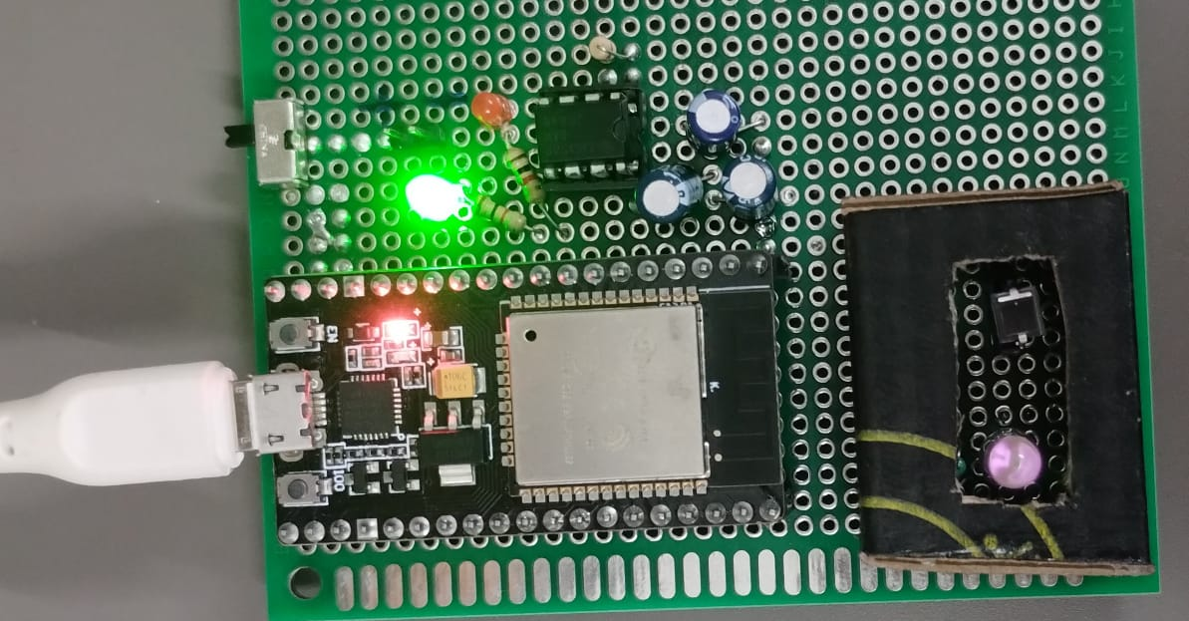
The Hardware setup:

Slide 13
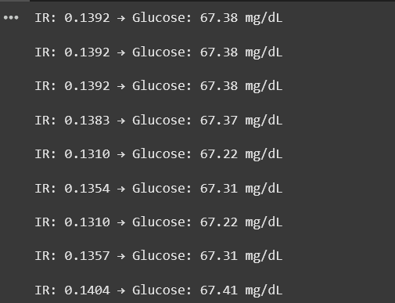

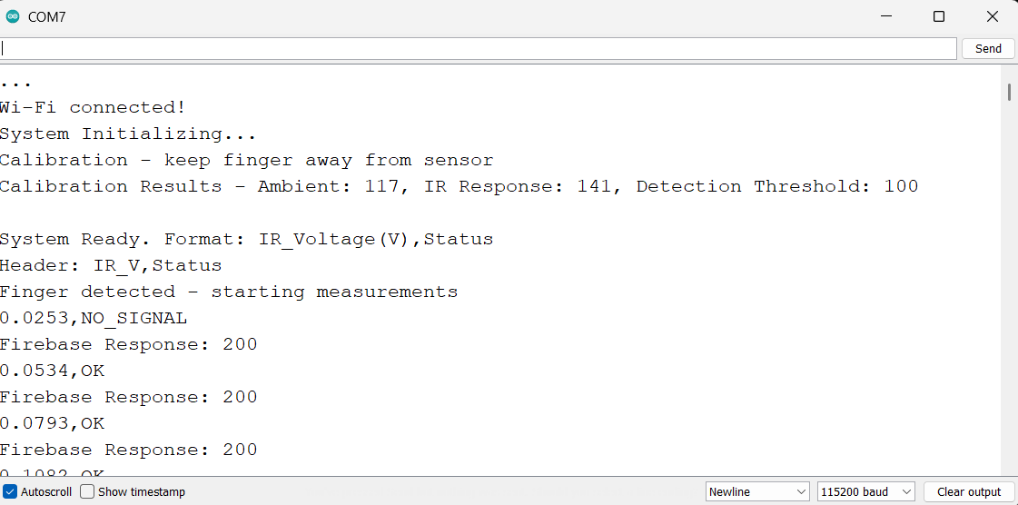
Google Colab :
Firebase:
Arduino ide:

Slide 14
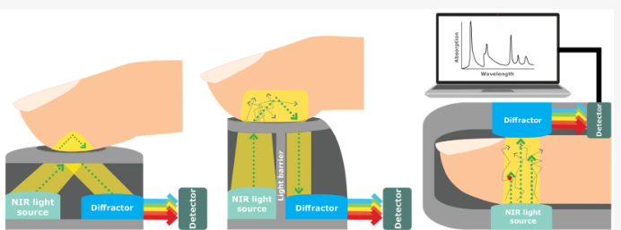

Slide 15
Reference Papers:
NIR-Based Electronic Platform for Glucose Monitoring for the Prevention and Control of Diabetes Mellitus by William Oñate 1ORCID,Edwin Ramos-Zurita 2,ORCID,Juan-Pablo Pallo 2ORCID,Santiago Manzano 2ORCID,Paulina Ayala 2ORCID andMarcelo V. Garcia 2,3,*
[1].
Non-Invasive IR-Based Measurement of Human Blood Glucose by Mhd Ayham Darwich 1,2ORCID,Anas Shahen 1,Abbas Daoud 1,Abdullah Lahia 1,Jomana Diab 1,3 andEbrahim Ismaiel 1,*ORCID
[2].
[3].
Noninvasive Blood Glucose Monitoring Systems Using Near-Infrared Technology—A Review, Authors: Aminah Hina, Wala Saadeh

Slide 16
Thank you

