Slide 1

GIT&GERRIT
Version Control System
Basics and Architecture

Slide 2
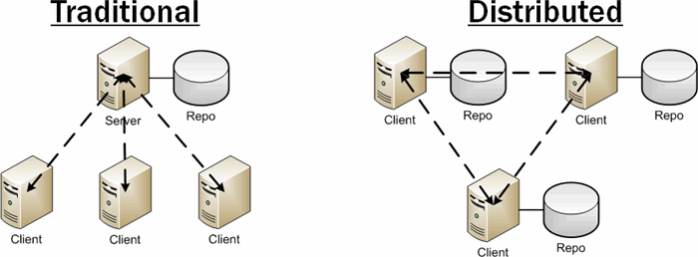
VCS and DVCS
In computer programming, distributed version control, also known as distributed revision control or decentralized version control, allows many software developers to work on a given project without requiring them to share a common network.

Slide 3
Benefits of Distributed Version Control system
Work Fully offline
Encourages frequent commits
Easy to switch work
Powerful tools for viewing and rewriting history - Gerrit
Increasingly popular – Widely used in market

Slide 4
VCS Architecture
Two Tree Architecture
Repository
Checkout
Commit
Working

Slide 5
GIT Architecture
Repository
Three Tree Architecture
Advantage :
We can commit files at any
Point of time once our
changes are done until
files will be in staging area
Commit Files
Staging Index
Add files
Working

Slide 6
Git workflow
Working directory
Staging Area
Repository
Modify files in your local system/server
When you stage the files, snapshot of them is added to the staging area
After the commit, snapshots are stored as it is in the git directory

Slide 7
HEAD POINTER
Points to “tip” of current branch in repository
Last state of repository , what was checkout
Point to parent of next commit
Head always point out to the tip of the current checkout branch/master

Slide 8
HEAD workflow
Repository
File.txt
Commit A
HEAD
Commit A
Commit B
HEAD
Commit A
Commit B
Commi C
HEAD

Slide 9
Merge Conflict:
S
C
M
Conflict
Master
a1
a2
a3
a4
a5
a1
a1
Merge
Featurebranch1
a1
a2
a3
a4
a5
a1
Merge
a1
a2
a3
a4
a5
a1
Featurebranch 2

Slide 10

Questions

