Slide 1
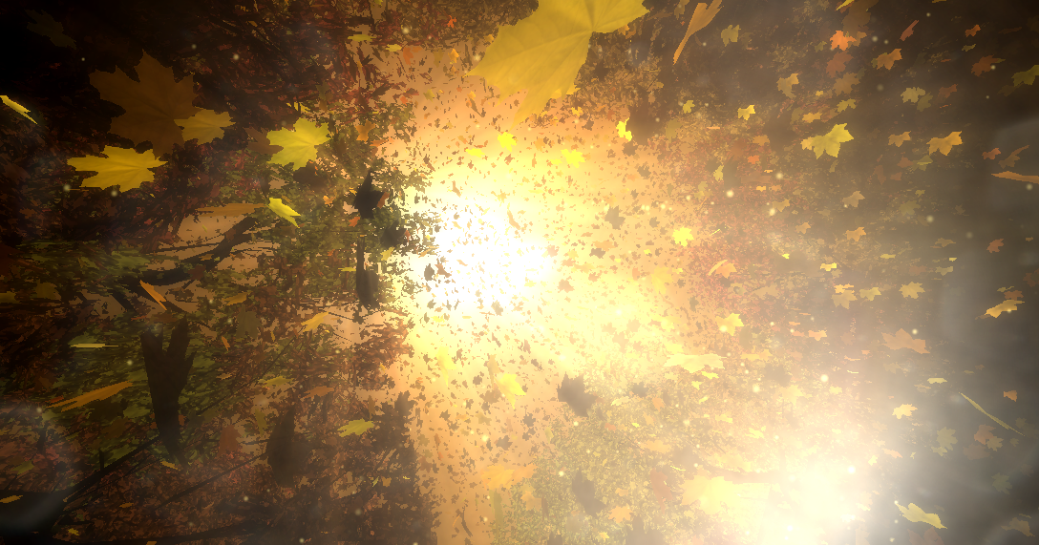
Team : Uncanny Valley
CSCI 580
CREPESCULAR RAYS

Slide 2
About
Crepuscular rays are sun rays radiating from a point in the sky where the sun is located.
Crepuscular as they occur during the crepuscular hours i.e. dawn and dusk.
Inspite of its converging appearance they are merely parallel and apparently appear to converge owing to perspective effect.
Ray Tracing for leaves, shadow rays for volumetric shadow calculation, procedural texture (Julia Set) for sun, LEE’s scan line algorithm for tree.

Slide 3
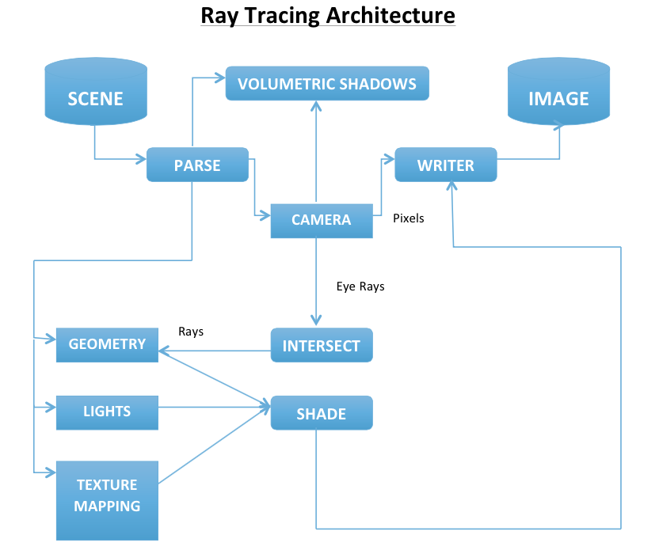
Ray Tracing System Architecture

Slide 4
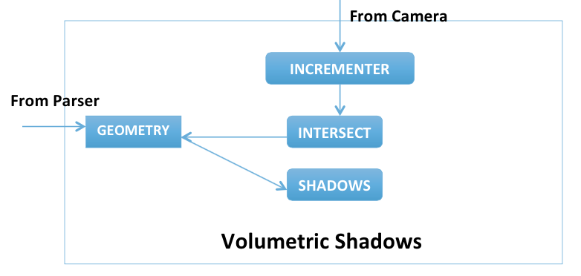
Volumetric Shadow block

Slide 5
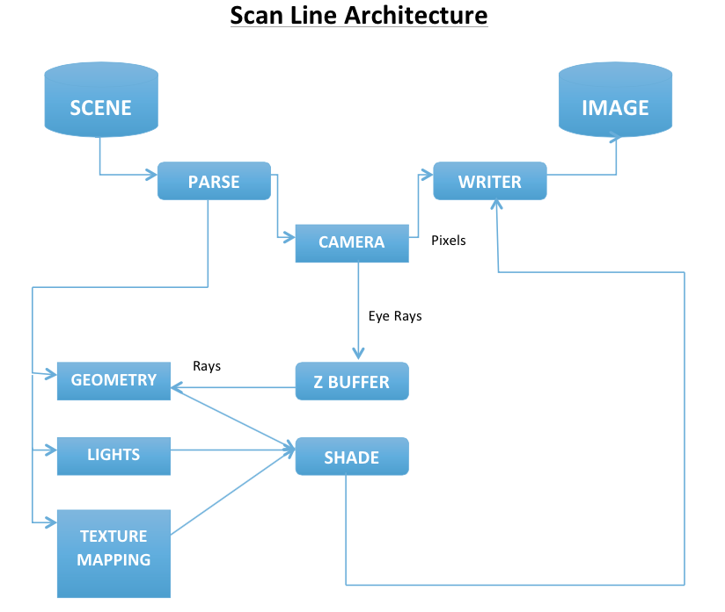
Scan Line System Architecture

Slide 6
Ray Tracing

Slide 7
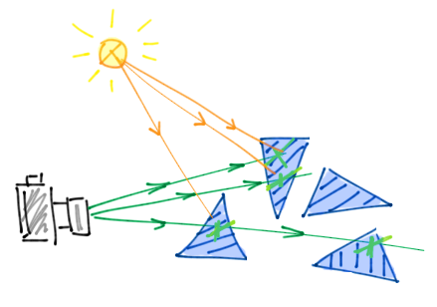
Ray Tracing Implementation – Eye to Object
For every pixel value
Map the pixel value to the vector space
Calculate the ray’s position and direction
Calculate the point on the ray using the rays parametric equation
u
v
Eye Coordinate System
Notes:
ray position will be the mapped value of camera on to the image plane and direction will be the camera position – the rays position .

Slide 8
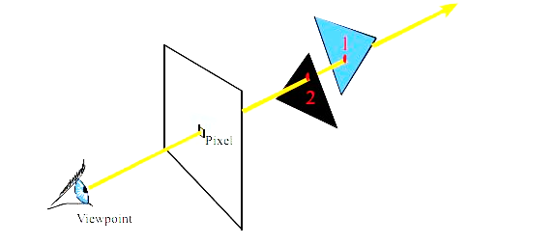
Ray Tracing cont’d
- For every triangle in the geometry
Calculate the normal and check if the dot product of the normal and the ray direction is not equal to 0
Calculate the intersection of the ray with the triangle plane and check whether it is the minimum positive intersection and whether the point lies inside the triangle or not.
For the minimum intersection value that lies within the triangle we compute the color of that pixel.

Slide 9
Volumetric Shadow Rendering

Slide 10
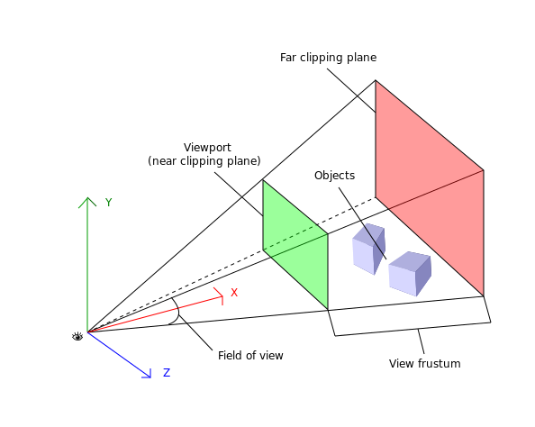
Shadow Volume
Extension of shadow ray using ray tracing.
Calculated aggregate shadow of each subsequent image plane between the original image plane and the closest object to light.

Slide 11
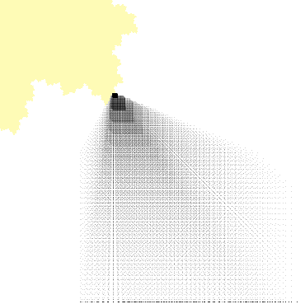
Shadow volume steps
For each pixel:
For each image plane
Calculate ray equation from pixel to light
Find any intersections between the pixel and light
If any intersections: color the pixel as shadow
End for
End for

Slide 12
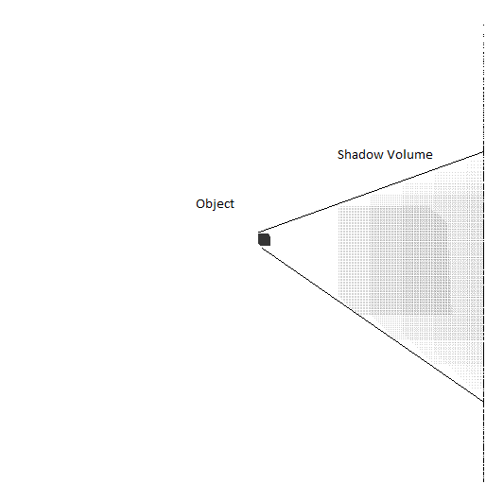
How the Shadow Volume Grows ?
Previous slide showed a compactly spaced
Shadow Volume.
The figure along side gives a better
understanding of the consideration of
multiple plane usage for shadow
Rendering.
As the distance from the object increases the
Shadow becomes larger and fades out. The
shadow plan here is sparsely spaced. Hence
the glitchy spaced shadow volume render.

Slide 13
Challenges
Ray Tracing calculations. More the number of lights more the computational complexity.
Each pixel is accounted for all the geometry present in the object space.
Visualization of every object in the object space in contrast to the image space
Light positions to get shadow volume rendering.
Separate ray equations per intermediate shadow plane led to increased computational complexity and time complexity.

Slide 14
Possible solutions
Multi threaded application to reduce computation time.
Application dependent selection of ray equation per ‘n x n’ pixel where n can be any positive number.
Again the project was done without using any external libraries which accounts for a slow renderer. Use of external libraries can considerably reduce the time complexity.

Slide 15
Future Work
Extending the phenomena of crepuscular rays to medical applications.
Pre operative planning for tumors; where crepuscular rays is used as a phenomena for deciding safety operative measures and for real time volume rendering for ease and assistance of the physician.

Slide 16


