Slide 1
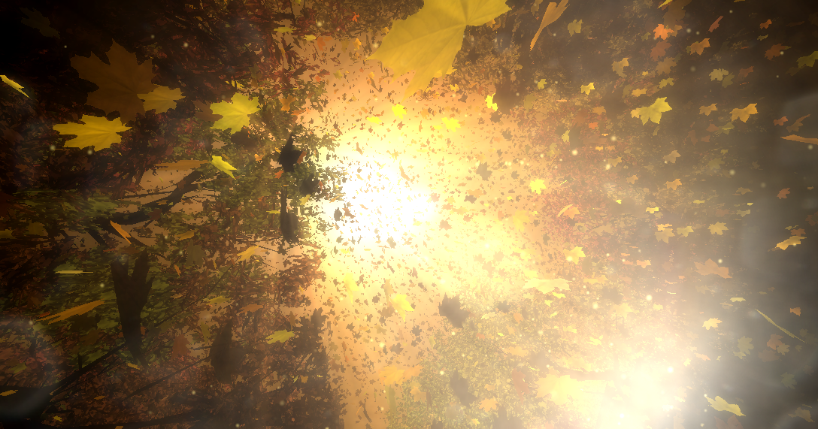
Team : Uncanny Valley
CSCI 580
CREPESCULAR RAYS

Slide 2
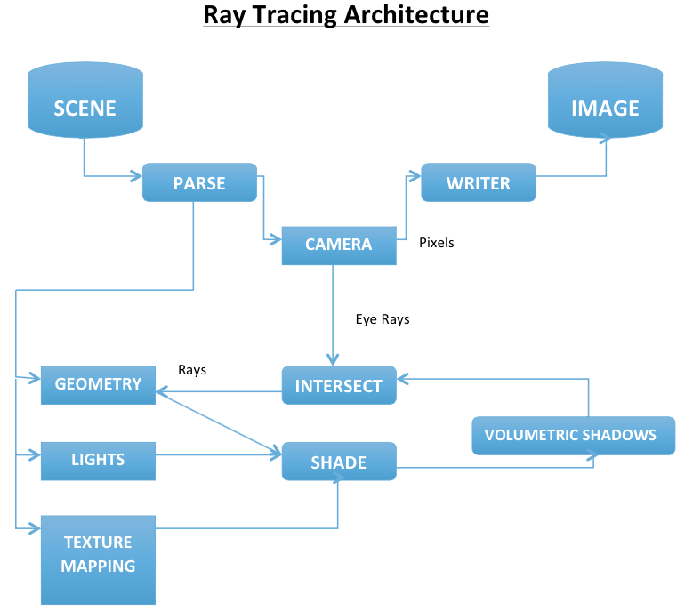
Ray Tracing System Architecture

Slide 3
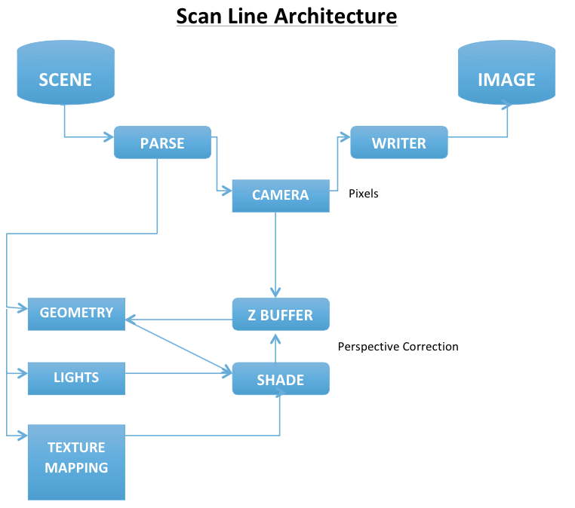
Scan Line System Architecture

Slide 4
Ray Tracing

Slide 5
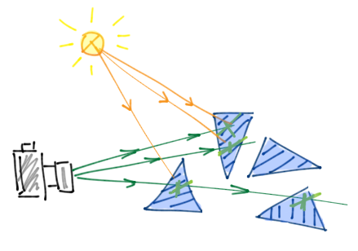
Ray Tracing Implementation – Eye to Object
For every pixel value
- Map the pixel value to the vector space
- Calculate the ray’s position and direction
- Calculate the point on the ray using the rays parametric equation
- For every triangle in the geometry
u
v
Notes:
ray position will be the mapped value of camera on to the image plane and direction will be the camera position – the rays position .

Slide 6
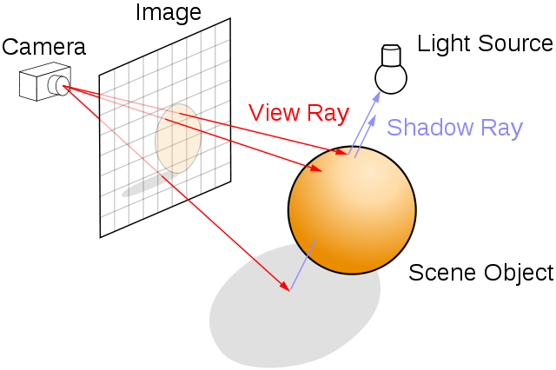
Ray Tracing cont’d
Calculate the normal and check if the
dot product of the normal and the
direction is not equal to 0
Calculate the intersection of the ray with
the triangle plane and check whether it is
the minimum positive intersection and
whether the point lies inside the triangle
or not.
For the minimum intersection value that
lies within the triangle we compute the
color of that pixel.

Slide 7
Volumetric Shadow Rendering

Slide 8
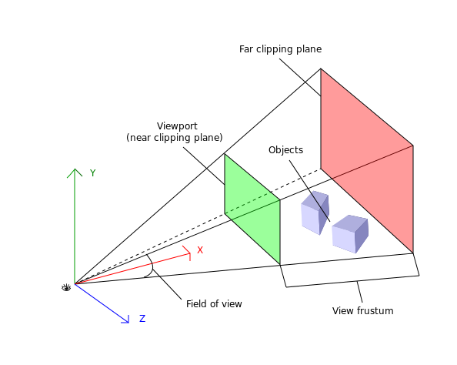
Shadow Volume
Extension of shadow ray using ray tracing.
Calculated aggregate shadow of each subsequent image plane between the original image plane and the closest object to light.

Slide 9
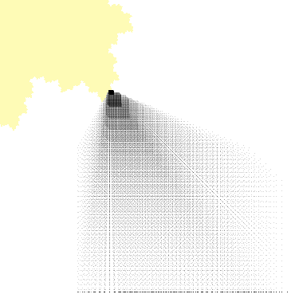
Shadow volume steps
For each pixel:
For each image plane
Calculate ray equation from pixel to light
Find any intersections between the pixel and light
If any intersections: color the pixel as shadow
End for
End for

Slide 10
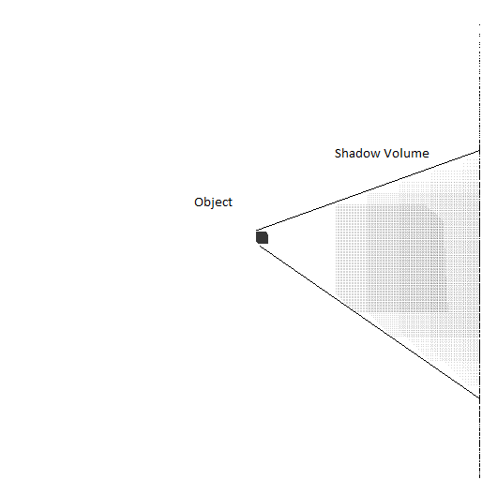
How the Shadow Volume Grows ?
Previous slide showed a compactly spaced
Shadow Volume.
The figure along side gives a better
understanding of the consideration of
multiple plane usage for shadow
Rendering.
As the distance from the object increases the
Shadow becomes larger and fades out. The
shadow plan here is sparsely spaced. Hence
the glitchy spaced shadow volume render.

Slide 11
Challenges

