Slide 1
DIGITAL ELECTRONICS PROJECT
Simulation of Half Adders
and Full Adders in Logisim
Design, implementation and verification of combinational adder circuits.
BY: Sreepada Ch
Cherish Keshto
Alyaan Khan
Nagilla Anish
Digital Electronics Project • 1

Slide 2
What Is an Adder?
02
Adder
Two Important Adders
An adder is a combinational logic circuit used to perform binary addition. It produces a SUM output and, when required, a CARRY output.
• Half Adder — adds two 1-bit inputs.
• Full Adder — adds two 1-bit inputs plus an incoming carry.
Binary addition
A | B | Sum | Carry
0 | 0 | 0 | 0
0 | 1 | 1 | 0
1 | 0 | 1 | 0
1 | 1 | 0 | 1
The carry output represents the extra 1 produced when the binary sum is 2.

Slide 3
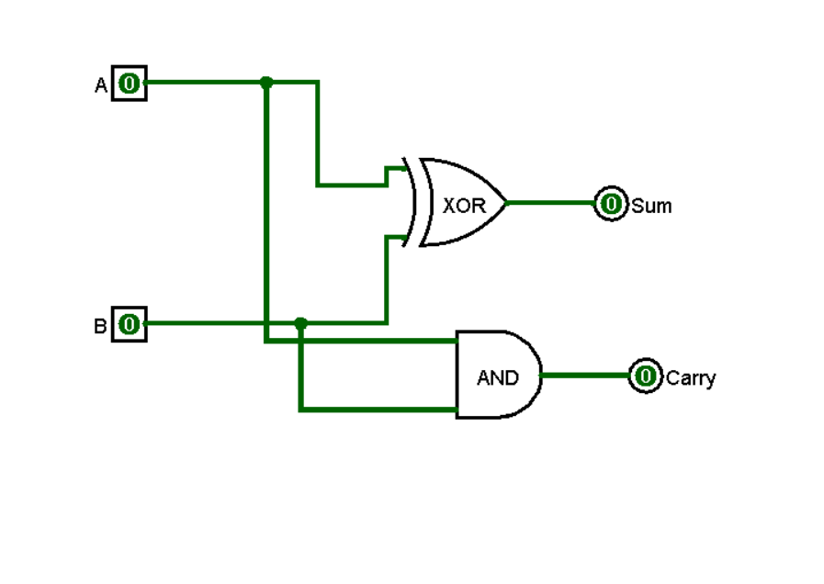
Half Adder
03
A Half Adder adds two single-bit inputs A and B.
SUM
CARRY
Key Limitation
S = A ⊕ B
XOR gate
C = A · B
AND gate
No carry-in input is available, so it cannot directly add a previous stage's carry.
Half Adder — Logic Diagram
A ───────► XOR ─────► S
B ───────►
A ───────► AND ─────► C
B ───────►
In Logisim, connect two input pins to an XOR gate for SUM and an AND gate for CARRY.

Slide 4
Half Adder Truth Table
04
A | B | A + B | SUM | CARRY
0 | 0 | 0 | 0 | 0
0 | 1 | 1 | 1 | 0
1 | 0 | 1 | 1 | 0
1 | 1 | 10 | 0 | 1
Observation
• SUM is 1 when the inputs are different.
• CARRY is 1 only when both inputs are 1.
• This directly matches XOR and AND behavior.

Slide 5
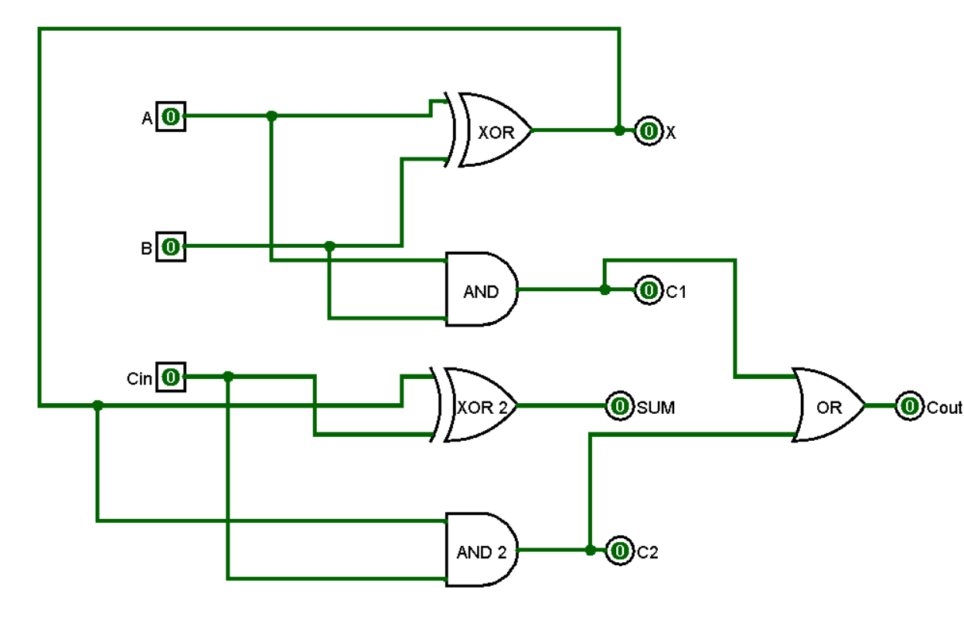
Full Adder
05
A Full Adder adds three 1-bit values: A, B and an input carry Cin.
SUM
CARRY
Why It Matters
S = A ⊕ B ⊕ Cin
Cout = AB + Cin(A ⊕ B)
Full adders can be cascaded to build multi-bit binary adders.
Full Adder using two Half Adders
A,B ─► [Half Adder 1] ─► S1, C1
S1,Cin ─► [Half Adder 2] ─► SUM, C2
C1,C2 ─► [OR] ─► Cout
This structure is especially useful to reproduce and test in Logisim.

Slide 6
Full Adder Truth Table
06
A | B | Cin | SUM | Cout
0 | 0 | 0 | 0 | 0
0 | 0 | 1 | 1 | 0
0 | 1 | 0 | 1 | 0
0 | 1 | 1 | 0 | 1
1 | 0 | 0 | 1 | 0
1 | 0 | 1 | 0 | 1
1 | 1 | 0 | 0 | 1
1 | 1 | 1 | 1 | 1
Example
A=1, B=1, Cin=1
1 + 1 + 1 = 11₂
SUM = 1, Cout = 1
Pattern
SUM is 1 for an odd number of 1s. Cout is 1 whenever the total is 2 or 3.

Slide 7
Half Adder — Logisim Simulation
07
Suggested Logisim circuit layout
XOR
SUM
Test Cases
A
00 → SUM 0, CARRY 0
01 → SUM 1, CARRY 0
10 → SUM 1, CARRY 0
11 → SUM 0, CARRY 1
AND
CARRY
B
Use the Logisim switches to toggle A and B and observe the output indicators.

Slide 8
Full Adder — Logisim Simulation
08
Suggested construction: two Half Adders + one OR gate
A, B
S1, Cin
Verification
HA 1
HA 2
OR
SUM
Try all 8 combinations of A, B and Cin.
Example:
1, 1, 1 → SUM 1, Cout 1
Compare each result with the truth table.
C1, C2
Cout

Slide 9
Conclusion
9
What We Designed
Half Adder: XOR for SUM and AND for CARRY.
Full Adder: combines A, B and Cin and produces SUM and Cout.
What We Verified
All possible input combinations can be tested in Logisim and matched against the corresponding truth tables.
Final Outcome
The simulation demonstrates how basic logic gates form the foundation of binary arithmetic.
THANK YOU

