Slide 1

PROJECT
Climate-Aware Disease
Outbreak Prediction
Dengue Case Forecasting using Random Forest & Climate Data
BY SREERAG S

Slide 2

PROJECT OVERVIEW
Problem
Dengue fever is a climate-sensitive disease affecting millions. Traditional prediction methods are manual, slow, and inaccurate.
Objective
Build a machine learning model to predict dengue cases using climate factors: rainfall, temperature, humidity, year, and state.
Approach
Random Forest Regressor with GridSearchCV hyperparameter tuning, preprocessing pipeline, and outlier removal.
Outcome
An automated, data-driven system for early outbreak detection supporting public health planning and resource allocation.

Slide 3
DATASET & FEATURES
Dataset Info
Input Features
File
Mergeddataset.xlsx
Year
Temporal trend indicator
Target Variable
Cases (Dengue Count)
Actual Rainfall
Monthly/annual rainfall (mm)
States Covered
Multiple Indian States
Temperature
Features
5 (Year, Rainfall, Temp, Humidity, State)
Avg ambient temperature (°C)
Split
80% Train / 20% Test
Humidity
Relative humidity (%)
Outliers Removed
Top 5% from training set
State
Geographical region (encoded)
Missing Values
Imputed with train mean

Slide 4
SYSTEM ARCHITECTURE / PIPELINE
01
02
03
04
Load Dataset
Train/Test Split
Outlier Removal
Impute Missing
Read Mergeddataset.xlsx
Filter 'Total' rows
80% Train
20% Test
Remove top 5%
from training only
Fill NaN with
train column mean
05
06
07
08
Preprocessing
Model Training
Evaluation
Prediction
OneHotEncode State
Pass-through numerics
Random Forest +
GridSearchCV (cv=5)
R² Score
MAE Metrics
Manual input for
new predictions

Slide 5
MACHINE LEARNING MODEL
Random Forest Regressor
GridSearchCV Parameters
An ensemble method that builds multiple decision trees and averages their predictions to reduce overfitting.
n_estimators
[200, 500]
max_depth
[None, 10, 20]
Handles both numerical and categorical (encoded) features seamlessly.
min_samples_split
[2, 5]
Robust to outliers and non-linear relationships in the data.
cv (folds)
5
Feature importance scores help identify key predictors of dengue outbreaks.
scoring
R² Score
n_jobs
-1 (all cores)
Pipeline: Preprocessor → Random Forest Model

Slide 6
CODE WALKTHROUGH
Data Loading & Cleaning
Outlier Removal (Train Only)
df = pd.read_excel("Mergeddataset.xlsx")
df = df[df["State"] != "Total"]
upper = y_train.quantile(0.95)
mask = y_train <= upper
X_train = X_train[mask]
→ Removes summary rows that would corrupt model training.
→ Prevents extreme cases from skewing the regression model.
Preprocessing Pipeline
Grid Search & Training
preprocessor = ColumnTransformer([
("cat", OneHotEncoder(), ["State"])
], remainder="passthrough")
grid_search = GridSearchCV(
pipeline, param_grid, cv=5, scoring="r2"
)
grid_search.fit(X_train, y_train)
→ Encodes state names; passes numeric features unchanged.
→ Finds optimal hyperparameters using 5-fold cross-validation.

Slide 7
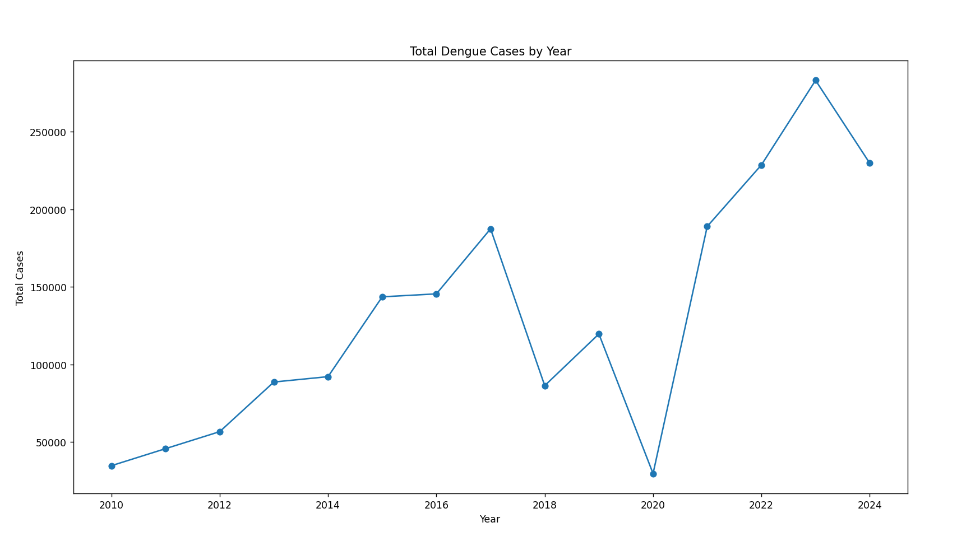
DENGUE CASES TREND OVER YEARS
Yearly Trend Graph
Line plot showing total dengue cases per year to visualize epidemic cycles and climate correlation.

Slide 8
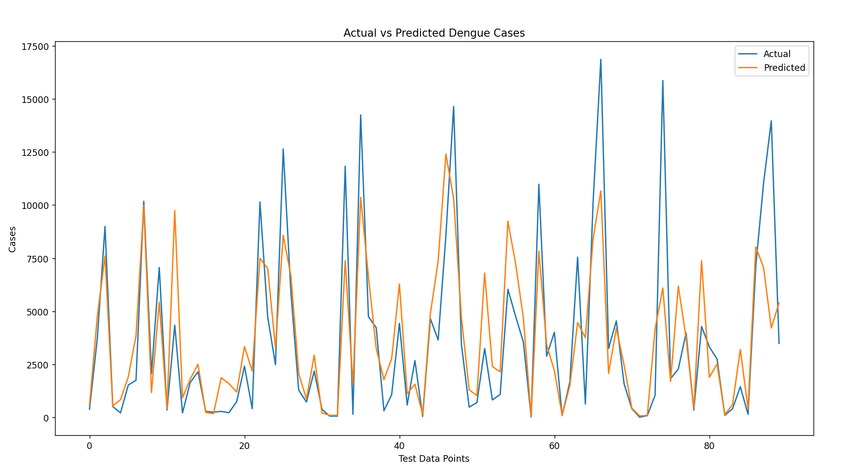
MODEL PERFORMANCE: ACTUAL VS PREDICTED
Actual vs Predicted
Overlay line chart comparing ground truth vs model predictions on the test set.

Slide 9
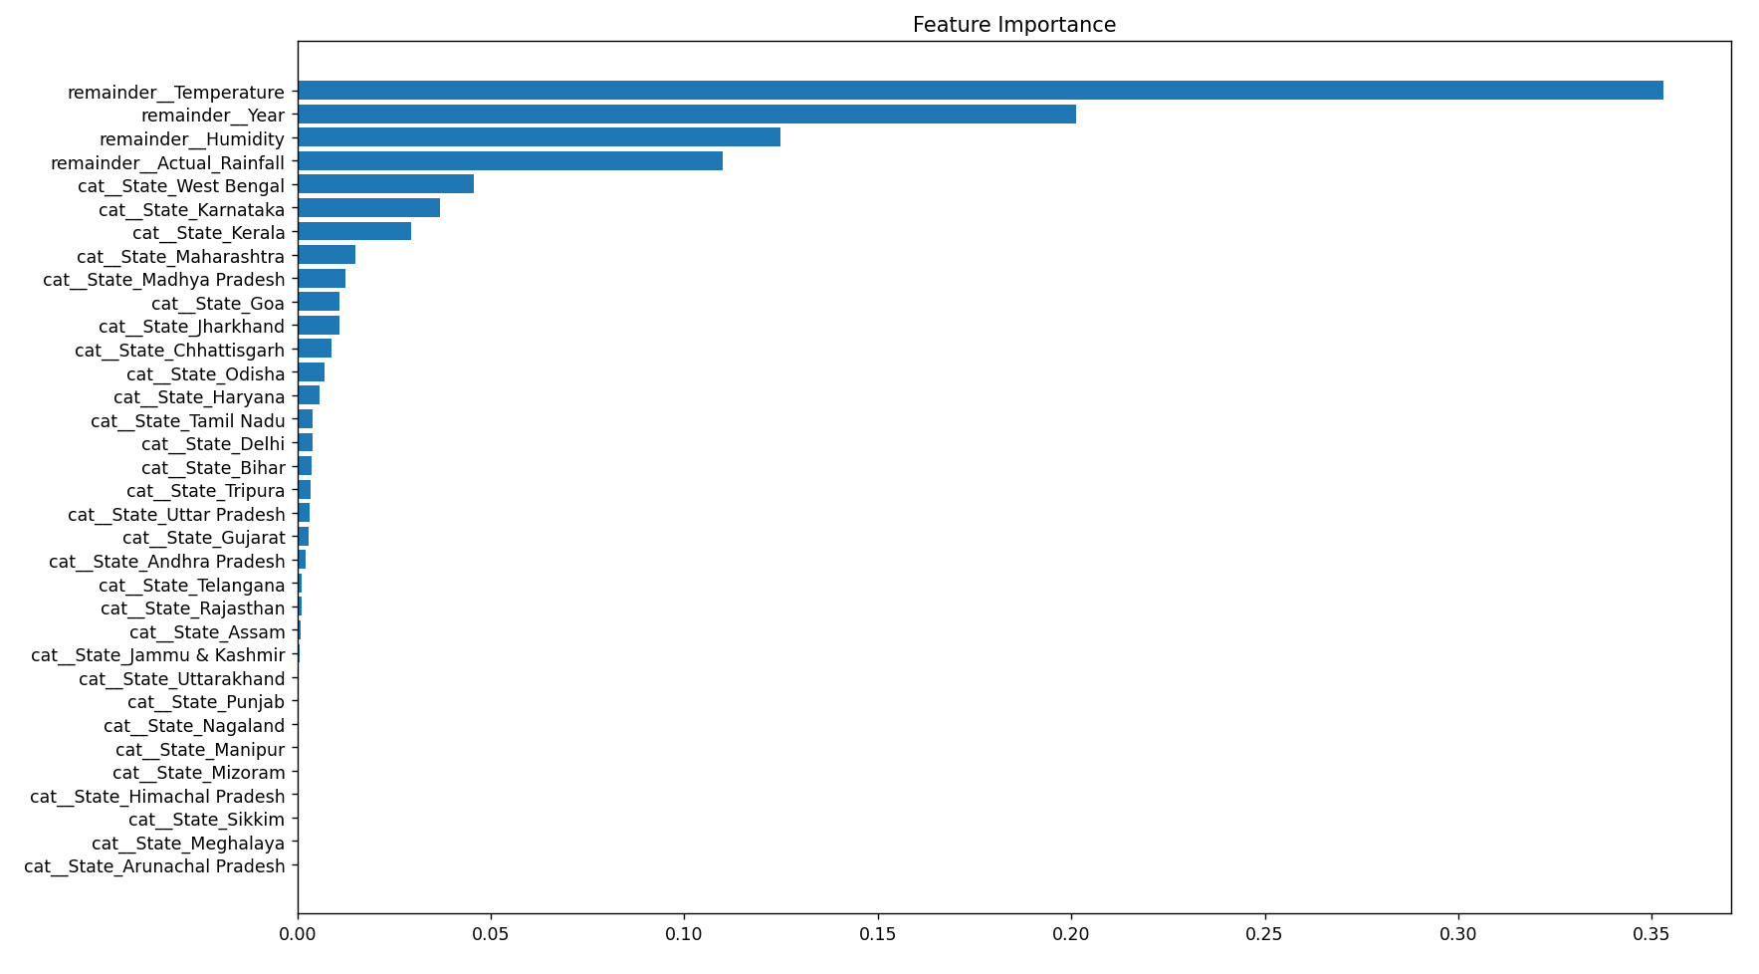
KEY FACTORS AFFECTING DENGUE CASES
Feature Importance
Horizontal bar chart revealing which features most influence the Random Forest model.

Slide 10
SYSTEM ANALYSIS: EXISTING vs PROPOSED
⚠ Existing System
✓ Proposed System
Manual statistical analysis
Automated ML-based prediction
Relies on retrospective data only
Uses historical + real-time climate data
VS
Cannot detect complex patterns
Random Forest captures non-linear patterns
Time-consuming and error-prone
Fast, consistent, and repeatable
No multi-factor integration
Integrates rainfall, temperature, humidity & state
Delayed outbreak response
Early outbreak detection & forecasting

Slide 11
CONCLUSION & LEARNINGS
Key Takeaways
Skills Gained
Successfully built a Random Forest model that predicts dengue outbreaks using climate and location data.
Python & Scikit-learn
Pandas / NumPy
Achieved strong R² and low MAE through proper data preprocessing, outlier removal, and hyperparameter tuning.
Machine Learning
Demonstrated the full data science lifecycle: data loading, cleaning, feature engineering, modeling, and evaluation.
Data Preprocessing
GridSearchCV Tuning
State and year were found to be the most influential predictors — geography and temporal trends matter most.
Matplotlib Visualization
The system supports manual prediction for any Indian state, providing a practical public health decision tool.
Feature Engineering

