Slide 1


SMART INDIA HACKATHON 2025
TITLE PAGE
Problem Statement ID –
Problem Statement Title-
Theme-
PS Category- Software/Hardware
Team ID-
Team Name (Registered on portal)

Slide 2
AI-powered Digital Mental Health Platform
Your Team Name
Idea / Prototype :
An AI-powered Digital Mental Health Platform for higher education, college-mapped with options for anonymous ↔ public support at every step.
Features:
AI Chatbot – first-level psychological aid, coping strategies, resource suggestions (books, videos, music).
Screening Tests – PHQ-9, GAD-7, stress assessments for early detection.
Anonymous / Public Toggle – switch anytime; “public” notifies grievance cell instantly.
Peer-to-Peer Forum – moderated, stigma-free student support.
Confidential Consultations – psychologists/counsellors available online/offline.
College Analytics Dashboard – anonymized trends, risk alerts, preventive insights.
How It Solves the Problem:
Reduces stigma through anonymity
Detects issues early via AI + screening and 24/7 support
Empowers and Alerts colleges with data-driven insights
Builds a holistic support ecosystem (AI + Peer + Doctor + Admin)
Innovation & Uniqueness:
Dynamic anonymity toggle at every step
College-mapped accountability
Multi-layered support system (AI + Peer + Professional + Analytics)
Real-time insights for institutions for swift in-campus action
Impact: Scalable, stigma-free, inclusive, data-driven mental health ecosystem for Indian students.

Slide 3

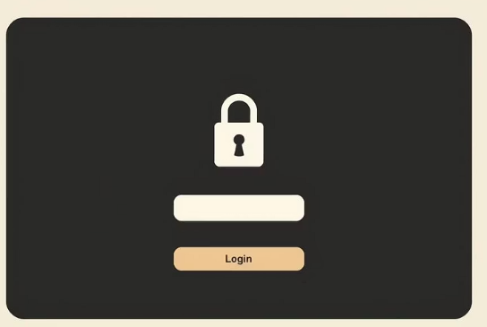



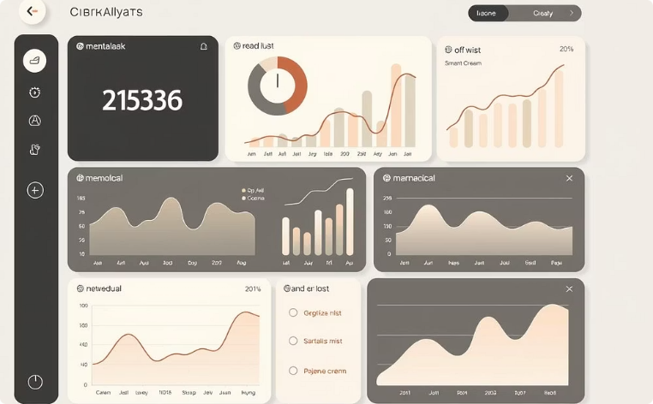
TECHNICAL APPROACH
Your Team Name
Technologies to be Used:
Programming Languages:
Python (AI/ML), JavaScript, HTML, CSS (frontend/backend), Frameworks: Django (backend), React / Flutter (cross-platform app).
AI/ML Models:
NLP (Dialogflow / Rasa / LLM fine-tuning), Sentiment Analysis, Early Detection (PHQ-9, GAD-7 tests scoring models).
Databases:
MongoDB (secure student data), Cloud & Deployment:
AWS / GCP / Azure (scalability, hosting, analytics), Docker Security: OAuth2, End-to-End Encryption, Role-Based Access Control (college grievance cell, counsellors, Peers, Doctors).
Student Login
(College Mapped)
AI Chatbot, First Level Aid
PHQ-9, GAD-7 Screening Tests
Anonymous / Public Toggle
OR
College Grievance cell
(With Details if Public
With ID if Anonymous)
Resources like Books, Videos, etc…
Moderated Peer Forum
College Dashboard
Consultation
Doctor/ Counsellor

Slide 4
FEASIBILITY AND VIABILITY
Your Team Name
Feasibility of the Idea:
Technically Feasible: Uses existing AI/NLP models (Dialogflow, Rasa, LLM APIs), mobile/web frameworks (Flutter/React).
Cost-Effective: Can run on cloud/free-tier initially; open-source tools for AI/chatbot & screening.
Scalable: College-mapped structure allows rollout across institutions.
Socially Relevant: Directly addresses a rising mental health crisis in student communities.
Potential Challenges & Risks
Data Privacy & Confidentiality – sensitive mental health data handling.
Stigma & Adoption – students hesitant to use even anonymous systems.
AI Accuracy & Bias – risk of misinterpretation of student sentiment.
Strategies to Overcome Challenges
Privacy First → End-to-End Encryption, role-based access, anonymized dashboards. Awareness Campaigns → orientation sessions, gamified wellness challenges. Human-in-the-Loop → AI gives first aid; escalation always possible to human experts. Offline + Online Hybrid → app links directly to local counsellors/helplines. Phased Rollout → pilot in few colleges, feedback → nationwide scaling. Open-Source Base → reduces cost, allows community-driven improvement.

Slide 5
IMPACT AND BENEFITS
Your Team Name
Potential impact on the target audience
Benefits of the solution (social, economic, environmental, etc.)

Slide 6
RESEARCH AND REFERENCES
Your Team Name
Details / Links of the reference and research work

Slide 7
IMPORTANT INSTRUCTIONS
Please ensure below pointers are met while submitting the Idea PPT:
Kindly keep the maximum slides limit up to six (6). ( Including the title slide)
Try to avoid paragraphs and post your idea in points /diagrams / Infographics /pictures
Keep your explanation precise and easy to understand
Idea should be unique and novel.
You can only use provided template for making the PPT without changing the idea details pointers (mentioned in previous slides).
You need to save the file in PDF and upload the same on portal. No PPT, Word Doc or any other format will be supported.
Note - You can delete this slide (Important Pointers) when you upload the details of your idea on SIH portal.

