Slide 1

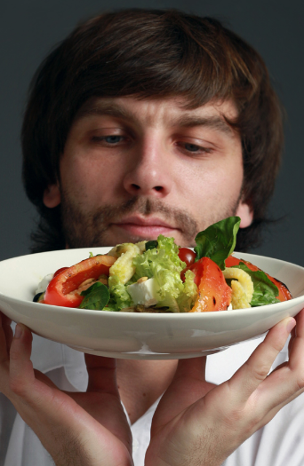

Finding harmony through food -Team Braniacs

Slide 2

Task 1.
Restaurant revenue didn’t grow as fast as number of visitors after the re-launch, because…
Drivers/ KPIs indicating this reason
Reason
Short argumentation
Decrease in number of items/visitor
Avg. number of items sold per day
Avg. number of visitors per day.
The number of families visiting increased , we can verify this by number of visitors/number of receipts.
As the number of families increased ,sharing of items was promoted.
Avg. revenue per day, EUR.
Avg. number of items sold per day.
Average price of top 5 items decreased after re-launch.
Lunch combo was discontinued so people switched to cheaper alternatives.
New salads and desserts don’t sell as expected and cheap cocktails became instant hit.
Revenue per item is decreased
Weekdays slump
Avg. revenue per day during weekdays.
Lunch combo was discontinued so working professionals stopped visiting.
Families don’t visit a restaurant as often on weekdays.

Slide 3
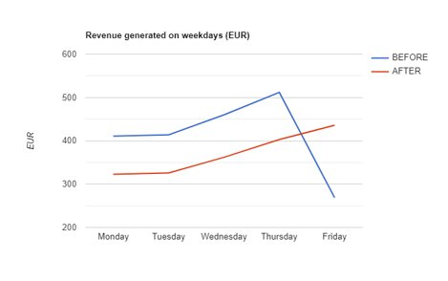
Supporting materials for Task 1
1
As it is quite evident by the trend line, that no. of items have been increasing drastically after the relaunch from a weekly average of 1.27 to 0.88 . ​
Post relaunch ,the target audience has been families which is evident from the fact that Average person per table has increased .(visitors/receipts)​.
When families visit , the average no. of items per person is likely to decrease because sharing is prevalent as the quantity is sufficient for more than 1 person .​
Note: The sudden dip in the blue trend line takes place because prior to the relaunch the restaurant was closed on Sunday, hence the value swoops down to 0.​
After relaunch the target audience shifted from working professionals to families which is evident from the shift in peak days of the restaurant.​
The company lost a major chunk of their target most probably due to removal of lunch combo which was the most appealing dish for working professionals.​

Slide 4
Supporting materials for Task 1
2
Looking at average revenue obtained each day before and after the re-launch it can be observed that , before it was quite uniform whereas after re-launch it has decreased on weekdays and has high increase on weekends .But this shouldn’t be confused with high average revenue.
It can be evidently seen from other two indicators that the average of all days before is 4.35 whereas after it is 3.64.
The average of top 5 items before is 4.7 and after is 4.2 .The main reason seems to be removal of Lunch Deal as it was the most popular dish before relaunch but after the relaunch, due to lack of substitute to that, instead of ordering salad and soup separately visitors choose one of two , being more pocket friendly.
The reason for cocktails for being a big hit is that they act as a good evening substitute while costing less. So two cocktails made their way to top five list and the busiest hours also shifted to evening from afternoon.

Slide 5
Task 2. Solution
Lunch combos must be Re-Launched but this time with some exciting fusions!
Price of top 5 purchased items must be increased to meet up the standards of the expected revenue(except the salads.)
Quantity served per item must be decreased for all salads to prevent sharing which leads to decline in revenue.
Make sure that all new dishes are introduced to the customers by offering them as complimentary dishes.
Work on increasing the no. of families visiting on weekdays and increase single person visits on weekends.
Recommendation
Argumentation
Re-launch of lunch combos will appeal the working professionals to switch back to them, which will re-flourish the business during weekdays
The popularity of top 5 items hints that people would stick to it even if the prices were to increase slightly ,especially cocktails which seemed to be an instant hit.
One of the major reasons for below par growth in revenue as compared to visitors was increase in the number of families visiting and the prevalence of sharing , so we could decrease the quantity of soups and salads so it would be sufficient for one person .This would also increase the sales among individuals who don’t buy salads /soups as it could be too much for them.
The top 5 dishes didn’t change much except introduction of cocktails , which might be due to lack of exposure .The restaurant could serve a small complimentary servings of different dishes/desserts every day and take customer review to see which one to advertise/remove from the menu.
Apart from these we need to encourage families to visit on weekdays and individuals to visit on weekends . For this we could have targeted offers for targeted cost.

