Slide 1
A simplified case study of startup Ninjacart By : HumanSparks (Roshan Dev Prajapati, Sree Rakhi Kudipudi)

Slide 2
Initials you must know!
Since
2015
Ninjacart is India’s Leading Agri-Tech platform with Integrated supply chain of perishables that connects farmers with Businesses.

Slide 3

Statistics
Ninjacart works with 37000 farmers across 20 states.
~4000 farmers contribute to daily pool of 1400 tonnes of produce.
Serving 17000+ Retailers across 7 major cities.
1700+ Employees, 300+ Helpers, 200+ Drivers.

Slide 4
Looking at the market!
Fun Fact :
This sector is completely Recession proof.
😉😋
Ninjacart lies compositely in Agri-Tech Industry with B2B transactions.
Size: 190 Bn Market growing 9% annually and will touch 250Bn by 2023.
Bengaluru itself is 30Bn perishable market.

Slide 5

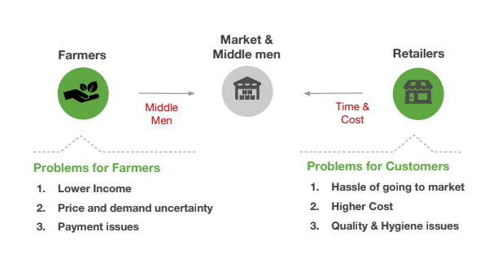
Need of Ninjacart!

Slide 6

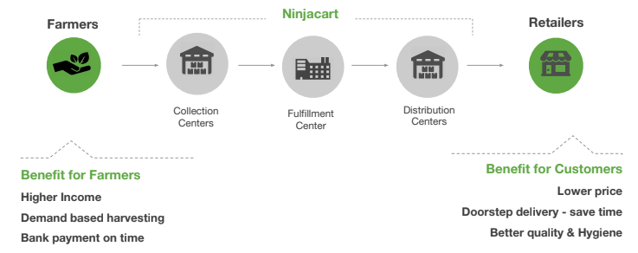
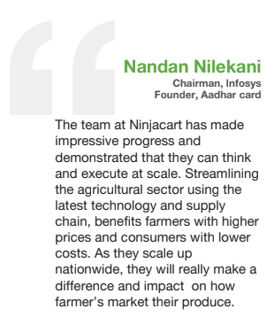
Solutions!

Slide 7
How they do it?
Forecasting
Analytics combine weekly growth plan with historic demand data and market conditions to prepare the weekly sales and procurement forecast at SKU level.
Pricing
Pricing is based on price data collected from various markets a day before delivery.
Farmer Harvesting
Based on Pricing and indents, farmers harvests the produce. Harvested crops are sent to collection centers.
It helps in purchase planning and planning supply chain more efficiently.

Slide 8
Collection centers
Items are checked for QUALITY. Weighed and farmers immediately gets the receipt.
Fulfillment Centers
Items from multiple fulfillment centers are brought to fulfillment centers, and batched according to distribution center wise as per customer demand
Distribution Centers
Crates are loaded into vehicles and distributed.
In the way back, driver collects empty crate and cash both and deposit it at D centers.
Retailers
FACT :
From forecasting to retailers, the whole process takes only 12 hours

Slide 9
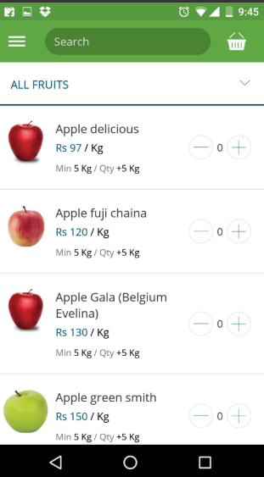
Mobile
Place your screenshot here
Most of the communications are based on application based software created and maintained by the company.

Slide 10
Here comes the Competitors!
In terms of revenue, Ninjacart stands 2nd , But it is growing very fast.
Jumbotail
Farmioc
Chilibeli
ArgoStar
byFarmerz

Slide 11
Audience Analysis
Present:
Ninjacart as of now works with 37000 farmers across 20 states.
~4000 farmers contribute to daily pool of 1400 tones of produce.
Serving 17000+ Retailers across 7 major cities.

Slide 12
Targeted Audience:
Total number of customers that can use Ninjacart = (Total number of farmers) + (Total number of retailers)
Total number of farmers = total population(1350m) * percentage of farmers(21%) * literacy rate in rural India(64.5%) * percentage of internet users in rural India(25.5%) = 46.5m
Total number of retail users = total population(1350m) % average family size(4) % average number of families that attend a retail store in a day(50) % average literacy rate of India(75%)= 5.06m
Total targeted audience =46.5+5.06 = 51.6m

Slide 13
User Personas

Slide 14
Case 1
Murali is a small farmer in rural Andhra Pradesh.
His family has 5 members.
He studied till 9th standard and knows how to use a smartphone.
He cultivates bananas in 3 acres of land.
He spends his wholen year to cultivate the crop but is worried about the market price and fears selling his crop at an unreasonable price.
He is even scared that the payment would be delayed.

Slide 15
Case 2
Ankita is a small farmer in rural Maharashtra.
She is a single mother of 2 children.
She studied till 10th standard and knows how to use a smartphone.
She cultivates potatoes in 3 acres of land.
She spends 4 months a year to cultivate the crop but is worried about the storage costs .
She is often tricked and weight was even miscalculated leading to huge loses.
She is even scared that the cost for transportation might be a burden for after all spending all her money on the produce.

Slide 16
Case 3
Ramesh is a small retailer in Delhi.
His family consists of 4 people.
He studied till 12th standard and knows how to browse internet.
He has a small shop and sells vegetables.
He has to travel for 4 hours 5 times a week for acquiring the produce.
The truck owner sometimes even demands him to pay more or sometimes even denies him if he has a better offer.
He even has no choice but have to select the available the that are available.
He even gets complaints about the hygiene issues which he has no control over.

Slide 17
The solution is Ninjacart

Slide 18
Plans to attract target audience
Implementing feedback after every transaction and even getting to know how they found out about the service so that it can be further improved.
Advertising blogs released by the company itself over popular social media handles such as Facebook.
Conducting offline workshops for rural farmers around 3-5 villages and explaining how services of Ninjacart benefit them and having one to one conversations with them which even helps Ninjacart re innovate itself. This can be then even increased to a larger scale.
Offline advertising can also be done in places such as rural cinema theatres.
Analysing current data and drawing some insights from it.
Partnering with local stores where farmers acquire seeds , fertilizers and tools can also be done.

