Slide 1

Design and Comparative Performance Analysis of Dynamic Comparator Circuit Using Various CMOS Technologies
Team members:
BHUPATHI AKHIL 2105A41L03
NERELLA SAI HUTHRIK 2005A41046
ELABOINA ROHINI 2105A41L06
KOMMU SREERAM 2005A41038
Under the Guidance of :
Dr . Sandip Bhattacharya
Head of the department
Electronics and Communication Engineering Department

Slide 2
Contents
Introduction
Problem Identification
Literature Review
Proposed Methodology
Circuit design
Results
Conclusion
Future Work
References

Slide 3
Introduction
A dynamic comparator circuit using various CMOS technologies. Analyzing the performance in terms of delay, power consumption and power delay product is the purpose of this circuit design. For applications like Sigma-Delta, Pipelining ADCs, Relaxation oscillators, PWM generation, Flash, Sigma-Delta, Successive Approximation, Zero Crossing Detector, Overvoltage and Undervoltage Detectors in electronics systems. Here, we have proposed a dynamic comparator with low power consumption and high-speed. We also compared the dynamic comparator to the conventional comparator and furthermore, we examined the performance characteristics of the dynamic comparator using different CMOS technologies, each corresponding to distinct gate lengths.

Slide 4
Problem Identification
Problem : The power consumption and delay of the dynamic comparator are high with existing technology.
Need for innovation :We're aiming to propose a dynamic comparator circuit, which establishes a Low power-High speed using various technologies.

Slide 5
Literature Review
Author | Journal | Findings
Yuchuan Liu, 2023 | An Review of Dynamic CMOS Comparators | CMOS Dynamic comparators can achieve a very low power dissipation and goes to inactive state when closed. Dynamic comparators contributes a major role on the implementation of mixed signal successive approximation register (SAR) type of analog to digital converters (ADC).
Jerome K. Folla, Maria L. Crespo 27 August 2020 | A low‐offset low‐power and high‐speed dynamic latch comparator with a preamplifier‐enhanced stage | The dynamic latch comparator reduces the power dissipation and increases the comparison speed. This architecture was therefore obtained and Thus, offset and kickback noise were reduced and the time delay was improved.
Vasu Deva Gowdagere Girish J R January 2021 | Design of High Performance CMOS Comparator using 90nm Technology | This High performance CMOS comparator has low offset voltage with high gain. The CMOs comparator will work in 90nm technology and The proposed design of CMOS comparator as produced a low offset voltage and low power dissipation.

Slide 6
Author | Journal | Findings
Kulothungan Brindha, Jothilingam Manjula Jun 25, 2023 | A low power and high speed 45 nm CMOS dynamic comparator with low offset. | Designing dynamic comparators with low power consumption and high-speed capabilities greatly enhances the sampling rate and accuracy of data converters. This design is better suited for developing data converters for applications that require high-speed performance and low power consumption.
Mir Muntasir Hossain , Satyendra N. Biswas | Analysis and Design of a 32nm Dynamic Latch Comparator | The proposed comparator has shown impressive performance in case of power consumption, time delay, power delay product and offset voltage while compared with the other recent comparators

Slide 7
Proposed Methodology
The methodology involves designing the dynamic comparator circuit in different CMOS technologies and evaluating its performance, conducting a comparative analysis with a conventional comparator and different technologies.
Problem Identification
Dynamic Circuit Design
Performance Evaluation
Comparative
Assessment
Technology
Variation

Slide 8
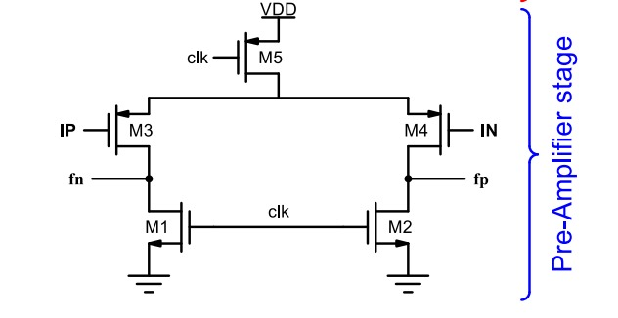
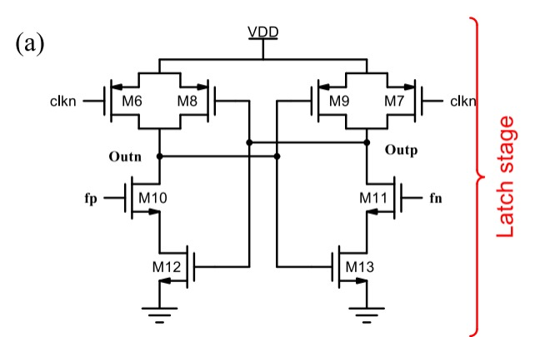
Circuit Design
Conventional comparator

Slide 9
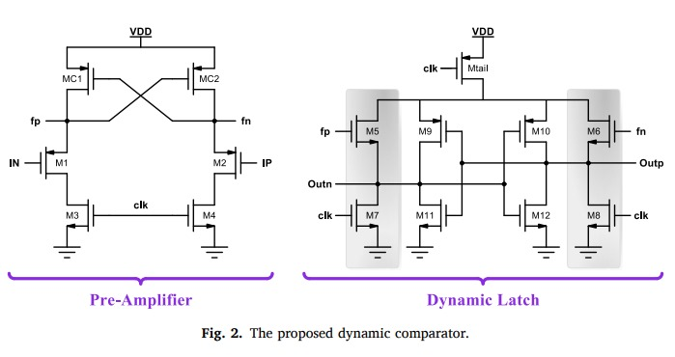
Circuit Design
Dynamic comparator

Slide 10
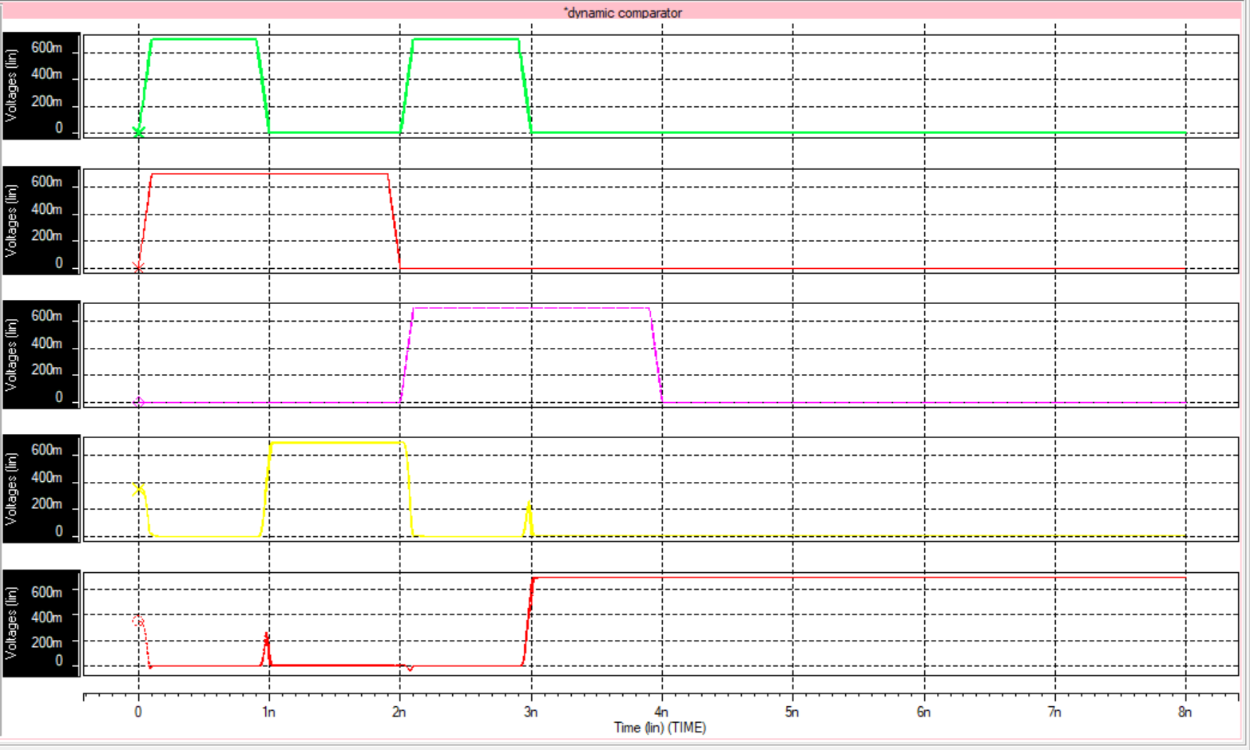
Results

Slide 11
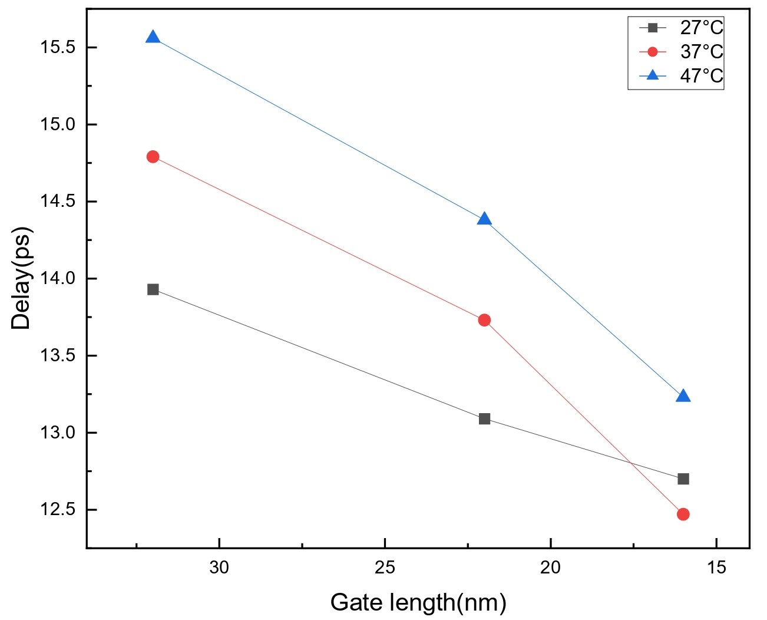
Results
Gate length vs Delay

Slide 12
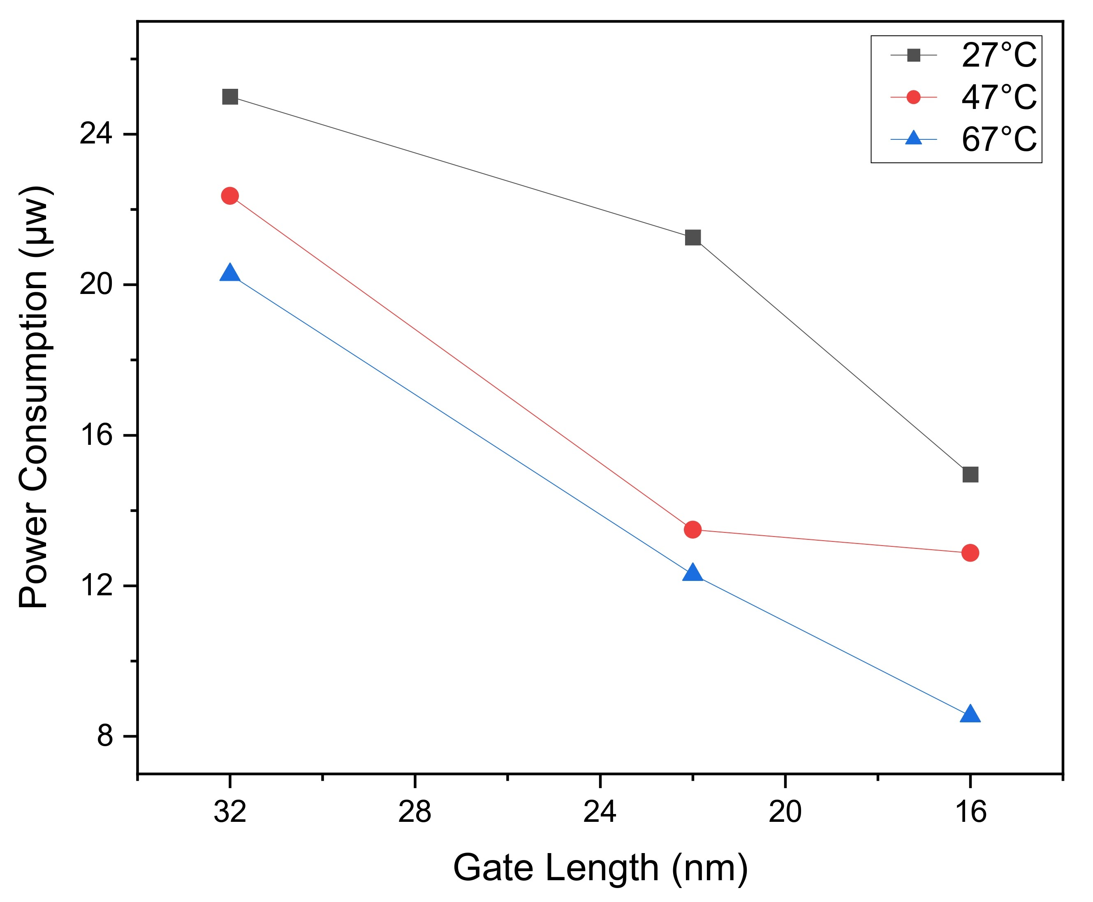
Results
Gate length vs Power Consumption

Slide 13
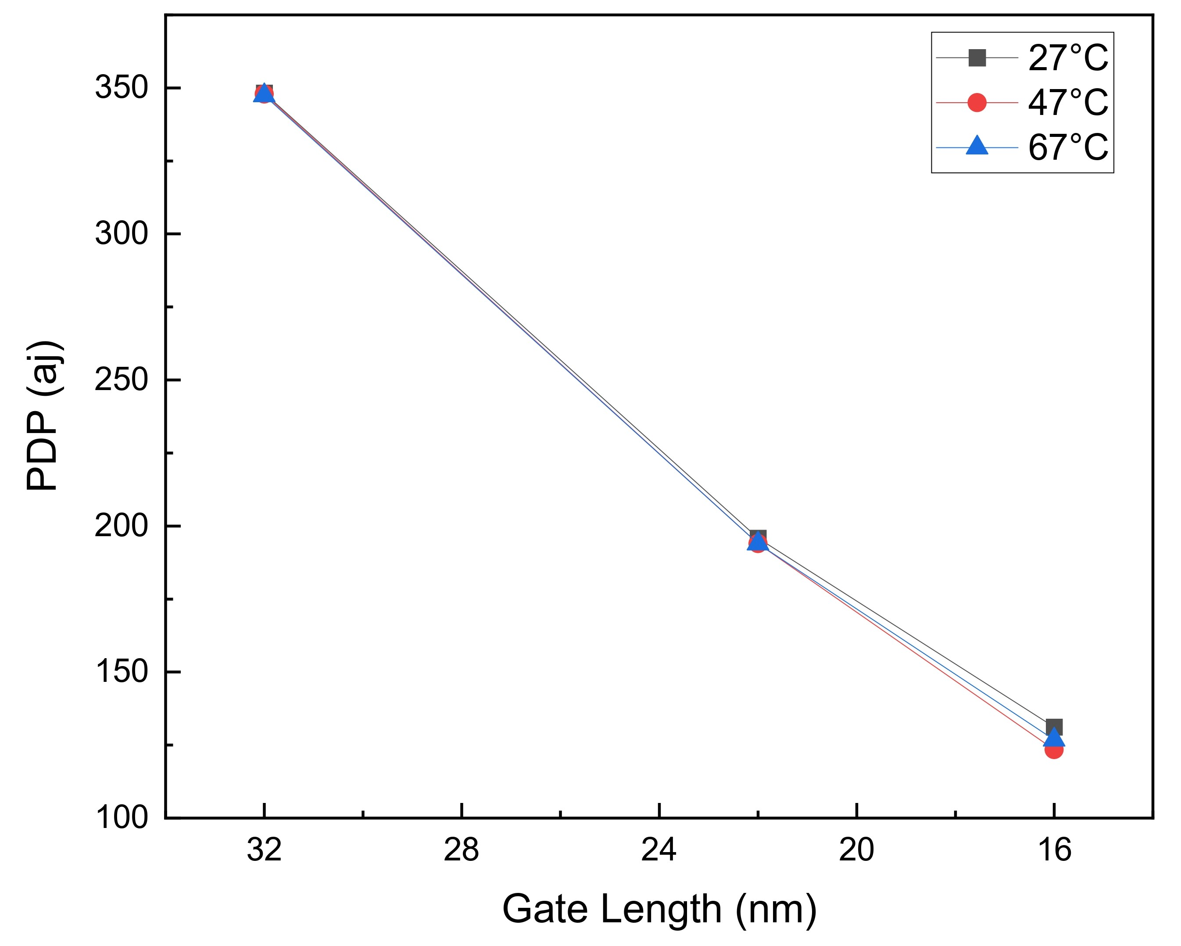
Results
Gate length vs Power Delay Product

Slide 14
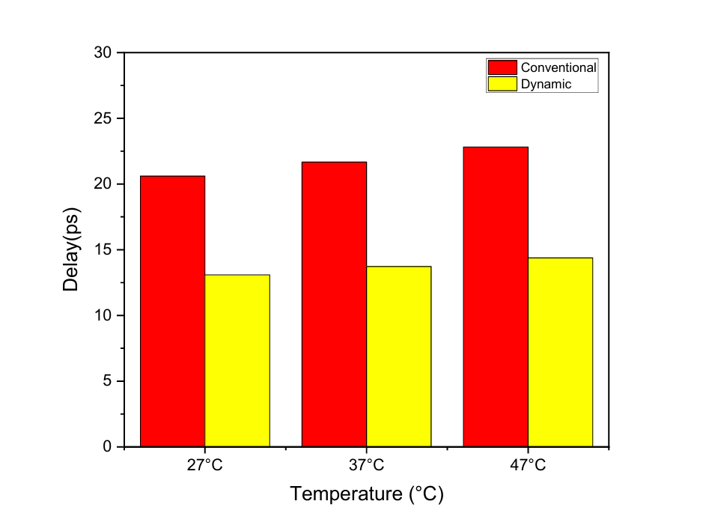
Results
Conventional comparator(22nm) vs Dynamic comparator (22nm) in terms of Delay

Slide 15
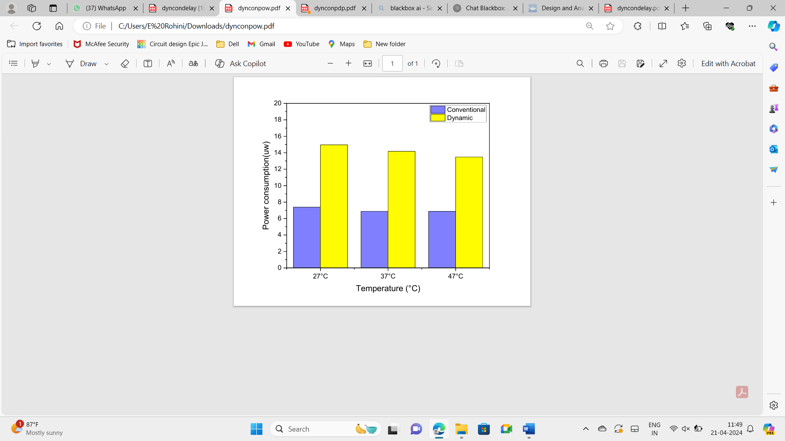
Results
Conventional comparator(22nm) vs Dynamic comparator (22nm) in terms of power consumption

Slide 16
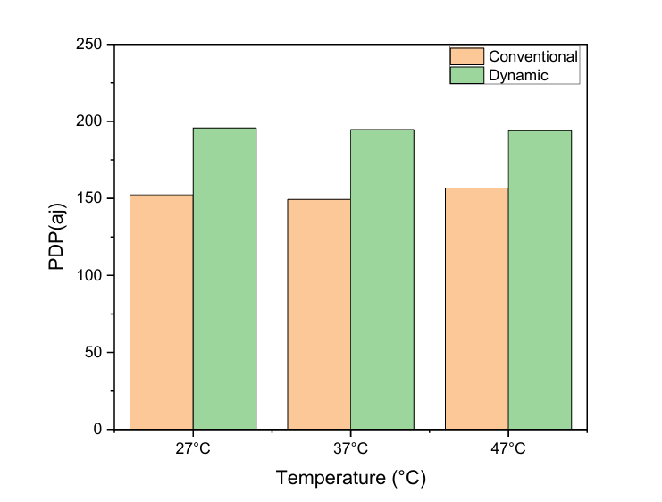
Results
Conventional comparator(22nm) vs Dynamic comparator (22nm) in terms of PDP

Slide 17
Conclusion
In this work, a dynamic comparator circuit is designed using three different CMOS technologies and analyzed the performance in terms of propagation delay, power consumption and power delay product (PDP). It is observed that the 16nm CMOS technology is performing better as compared with 22nm and 32nm CMOS technologies with wide temperature variations. As a result, the 16nm based CMOS dynamic comparator circuit is outperforming w.r.t other two technologies. This analysis result is useful for next generation advanced mixed signal circuit design for IoT application and AI enabled decision making circuit design where speed should be more and power consumption should be less.

Slide 18
Future Work
Future Steps: “ We intend to continue refining the dynamic comparator design as Gate length goes on scaling down to further improve its performance characteristics.”

Slide 19
References
[1] Amirkhan M, Dousti M. A dynamic power-efficient 4 GS/s CMOS comparator
[2] Ragab K, Chen L, Sanyal A, Sun N. Digital background calibration for pipelined ADCs based on comparator decision time quantization. IEEE Trans Circuits Syst Part II: EXpress Briefs 2015;62:456–60.
[3] Dubey AK, Nagaria R. Optimization for offset and kickback-noise in novel CMOS
[4] Savani V, Devashrayee N. Design and analysis of low-power high-speed shared charge reset technique based dynamic latch comparator. Microelectron J 2018;74: 116–26
[5] Razavi B, Wooley BA. Design techniques for high-speed, high-resolution comparators. IEEE J Solid State Circuits 1992;27:1916–26.
[6] Khorami A, Sharifkhani M. High-speed low-power comparator for analog to digital converters. AEU Int J Electron Commun 2016; 70:886–94.
[7] Abbas M, Furukawa Y, Komatsu S, Takahiro JY, Asada K. Clocked comparator for high-speed applications in 65nm technology. In: 2010 IEEE Asian Solid-State Circuits Conference, IEEE, 1–4, (2010).
[8] Gao J, Li G, Li Q. High-speed low-power common-mode insensitive dynamic comparator. Electron Lett 2015; 51:134–6.
[9] Huang S, Diao S, Lin F. An energy-efficient high-speed CMOS hybrid comparator

Slide 20
References
[10] Khorami A, Sharifkhani M. A low-power technique for high-resolution dynamic
[11] Fazle Rabbi, Sajan Das. Design of a Low-Power Ultra High Speed Dynamic Latched Comparator in 90-nm CMOS Technology.
[12] Zhang X. High-sensitivity high-speed dynamic comparator with parallel input clocked switches.
[13] Razieh G, Azim Karami M. A low-power high-speed two-stage dynamic comparator with a new offset cancellation technique in 90 nm CMOS technology.
[14] Pierre B, Wembe E. A 10GH Z Low-Offset Dynamic Comparator for High-Speed and Lower-Power ADC S.
[15] Huang S. An energy-efficient high-speed CMOS hybrid comparator with reduced delay in 40-nm CMOS process.
[16] Ashima Gupta, Anil Singh. A low-power high-resolution dynamic voltage comparator with input signal dependent power down technique.
[17] Ata Khorami, Roghayeh Saeidi. A low-power dynamic comparator for low-offset applications[18] Bernhard G, Zimmermann H. A Comparator With Reduced Delay Time in 65-nm CMOS for Supply Voltages Down to 0.65 V.

Slide 21


