Slide 1
DATA ANALYTICS PORTFOLIO
119K+
E-Commerce
Olist Store Analysis
Total Orders
20.6M
Total Sales
12.49
Insights across Excel · Tableau · SQL · Power BI
Avg Delivery Days
66,343
5-Star Orders
Tools: Microsoft Excel | Tableau | SQL | Power BI

Slide 2
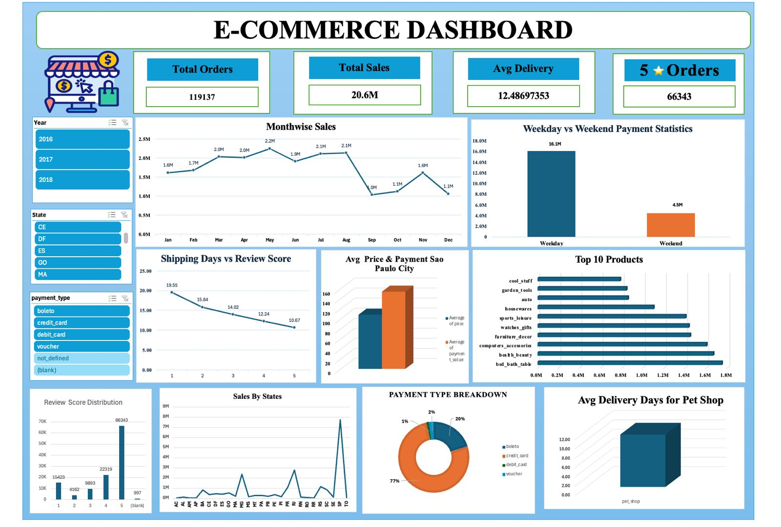
01 Microsoft Excel Dashboard
EXCEL
Key Insights
› Monthly sales peak in May at 2.2M › Weekday sales (16.1M) dominate weekends (4.5M) › Top category: bed_bath_table at 1.8M › 77% payments via credit card › Avg delivery: 12.49 days across all states › SP state drives majority of total revenue
E-Commerce Olist Store Analysis · Excel

Slide 3
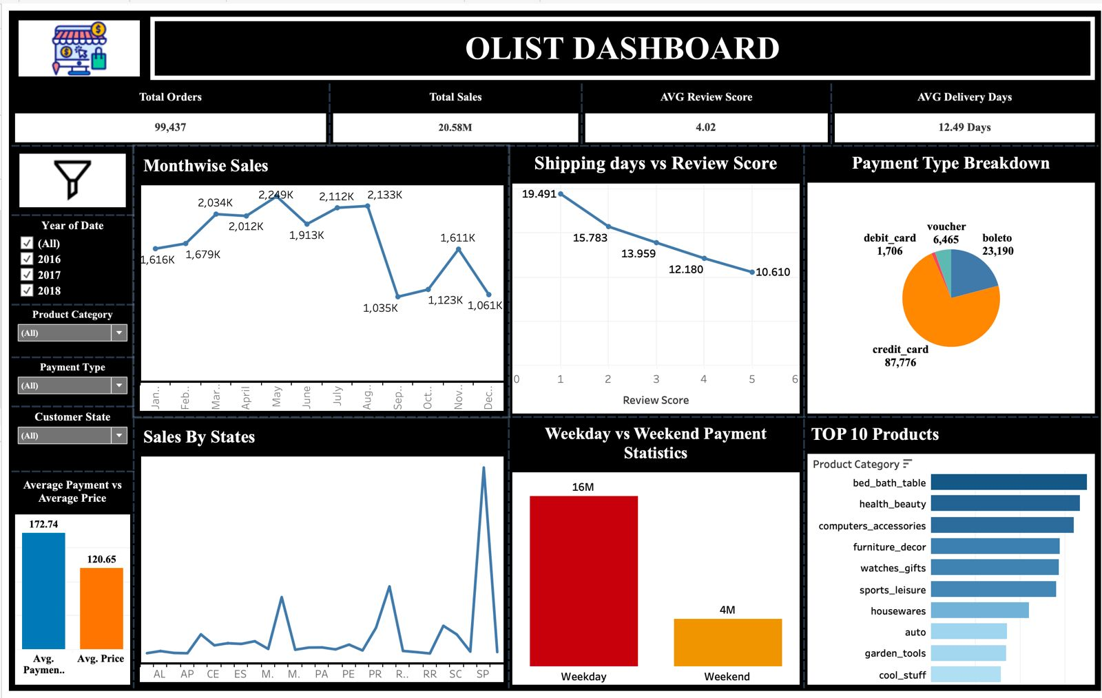
02 Tableau Dashboard
TABLEAU
Key Insights
› 99,437 total orders; 20.58M total sales › Avg review score: 4.02 / 5.0 › Higher review scores = fewer shipping days › SP state far exceeds all others in sales › Avg payment (172.74) > Avg price (120.65) › Credit card dominates (87,776 transactions)
E-Commerce Olist Store Analysis · Tableau

Slide 4
03 SQL Data Analysis
SQL
📄 ecommerce.sql
📄 Adventure_Works.sql
Olist e-commerce database schema, order pipeline, customer & seller tables, payment and review data.
AdventureWorks sales database with products, employees, territories, and financial transactions.
Sales Analysis
Customer Insights
Delivery & Reviews
› Monthly & yearly revenue trends › Payment method breakdown › Top revenue categories
› Unique customer segmentation › Geographic distribution › Repeat purchase rates
› Avg shipping days by product › Review score correlations › Seller performance metrics
E-Commerce Olist Store Analysis · SQL

Slide 5
04 Power BI Dashboard
POWER BI
Page 1: Store Analysis
Page 2: Customer & Product
KPIs
KPIs
● 96.1K unique customers ● 3,089 sellers ● 15.82M total sales ● 3.34M total profit ● 12.48M total price
● Top city: Sao Paulo (2.2M) ● Top product: beleza_saude (1.43M) ● Credit card: 76K customers ● 5-star orders: 22%+ of total
Charts
Charts
→ WeekDay/WeekEnd payment donut → Day-wise total sales line → Month-wise price & sales bar → Avg payment – Sao Paulo city
→ Sales by top 10 product category → Sales by customer state → Orders by payment type → Review score segmentation
E-Commerce Olist Store Analysis · Power BI

Slide 6
KEY TAKEAWAYS
What the Data Tells Us
📈 Sales Momentum
🏆 Top Performers
Consistent growth from 2016–2018 with peak months in May & August. Weekday transactions drive 77% of all revenue.
Bed & bath, health & beauty, and computers lead product revenue. São Paulo state alone contributes ~35% of national sales.
💳 Payment Behavior
⭐ Customer Satisfaction
Credit card is dominant (77%+ of transactions). Average payment value exceeds average product price, indicating installment purchases.
66K+ five-star reviews. Higher satisfaction correlates directly with faster delivery — avg 10.6 days for 5-star vs 19.5 for 1-star.
Thank you

