Slide 1
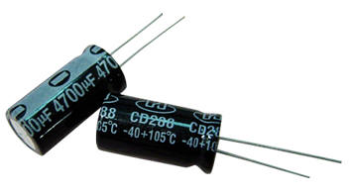
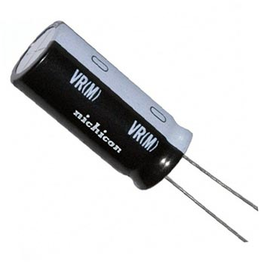
CAPACITOR PINs
(-Ve)
Negative symbol
Positive Side
(+Ve)
Negative Terminal
Positive Terminal

Slide 2
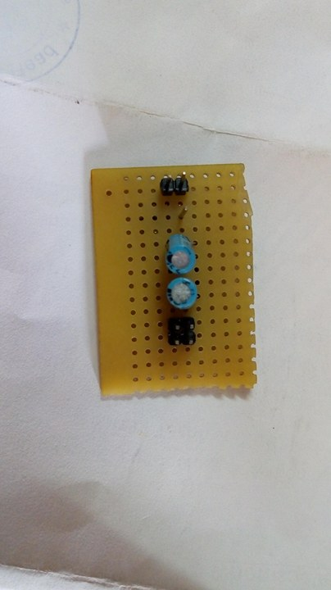
3.3v POWER SUPPLY
+3.3v output
POSSITIVE SIDE
NEGATIVE SIDE
5v Input from TTL
GND

Slide 3
3.3v POWER SUPPLY
+3.3v output
Parallel connection
POSSITIVE SIDE
NEGATIVE SIDE
5v Input from TTL
GND

Slide 4
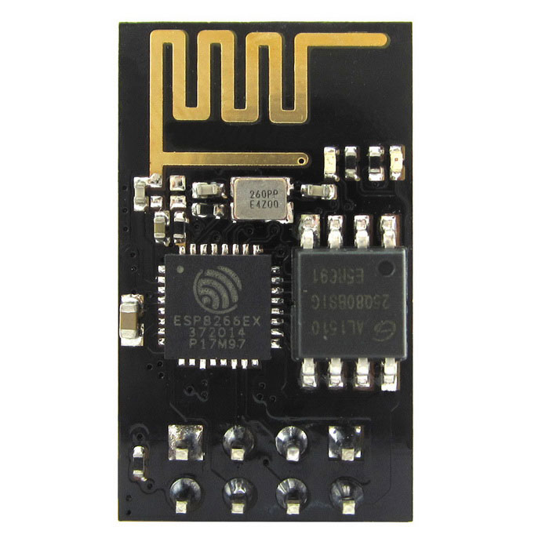
Check Power LED is ON or Not In wifi module
+3.3v
Gnd
Rx
Now connect TTL to Laptop
+5v
Gnd
TTL
Gnd
Gnd
Tx
+5v
TXD
RXD
ESP MODULE
3.3v
GND

Slide 5
TO WORK WITH MICROCONTROLLER

Slide 6
AVR BOARD
Tx
Rx
RX
TTL
Tx
3.3v
GND

Slide 7
THANK YOU

