Slide 1
Windows 10: Disable Signed Driver Enforcement
Click the Start menu and select Settings.
Click Update and Security.
Click on Recovery.
Click Restart now under Advanced Startup.
Click Troubleshoot.
Click Advanced options.
Click Startup Settings.
Click on Restart.
On the Startup Settings screen press 7 or F7 to disable driver signature enforcement.

Slide 2
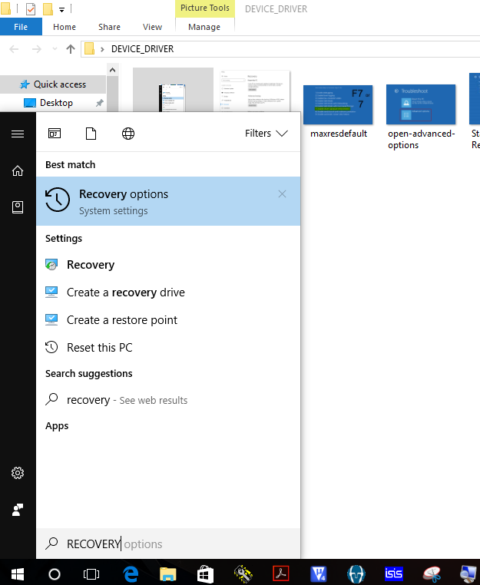
DISABLE DRIVER SIGNATURE ENFORCEMENT

Slide 3
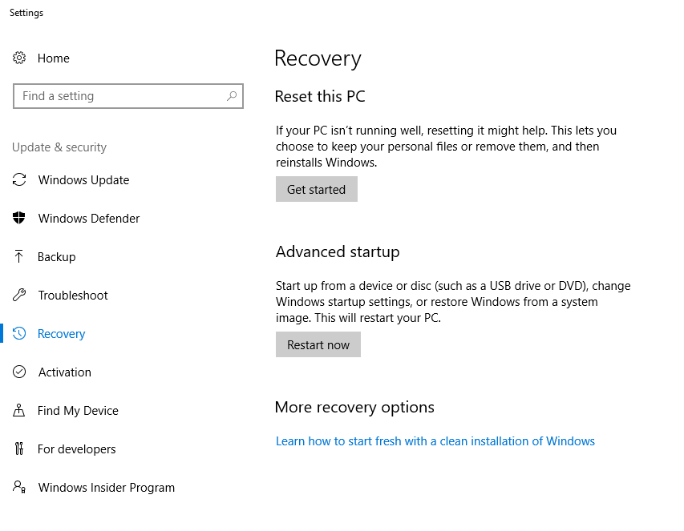
DISABLE DRIVER SIGNATURE ENFORCEMENT

Slide 4
WARNING……!!!!!!!
Don’t use double click

Slide 5
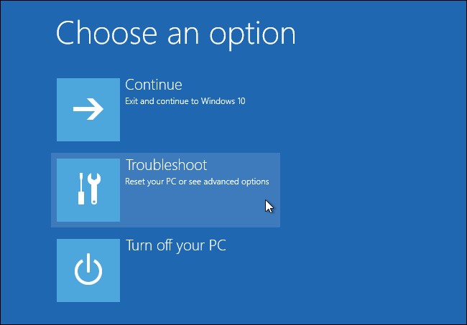
DISABLE DRIVER SIGNATURE ENFORCEMENT

Slide 6
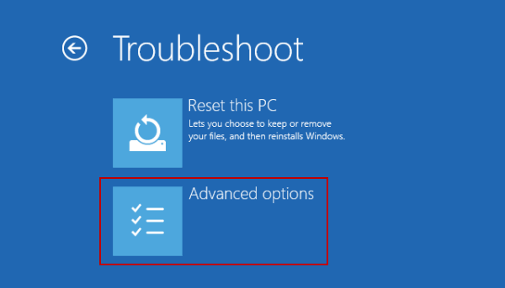
DISABLE DRIVER SIGNATURE ENFORCEMENT

Slide 7
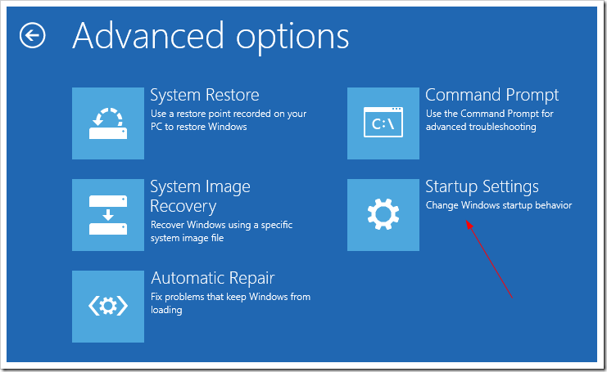
DISABLE DRIVER SIGNATURE ENFORCEMENT

Slide 8

DISABLE DRIVER SIGNATURE ENFORCEMENT

Slide 9
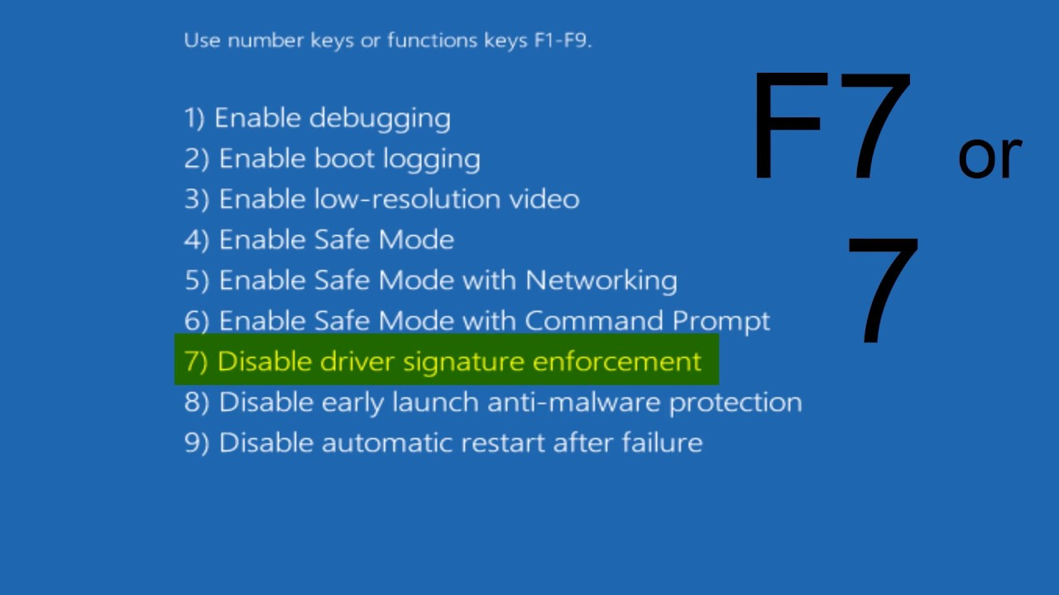
DISABLE DRIVER SIGNATURE ENFORCEMENT

Slide 10
How to create a Project

Slide 11


Slide 12
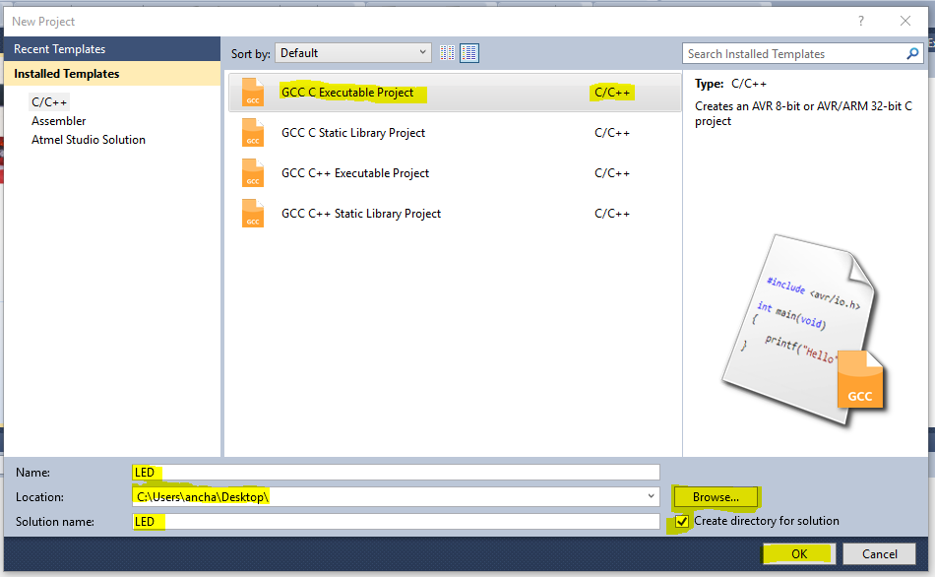

Slide 13
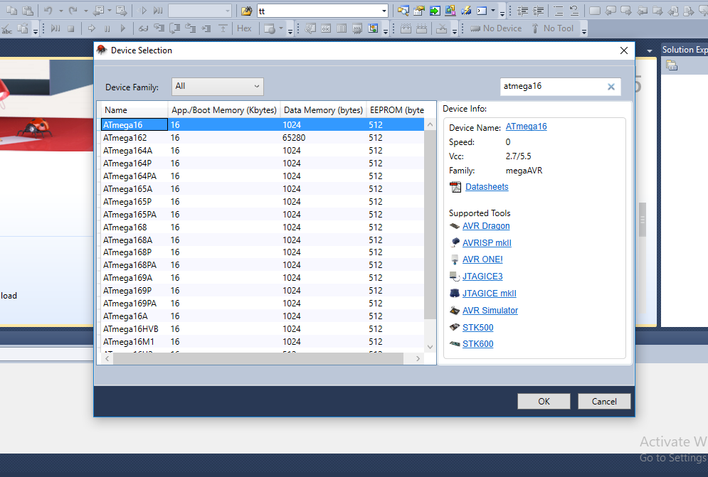

Slide 14
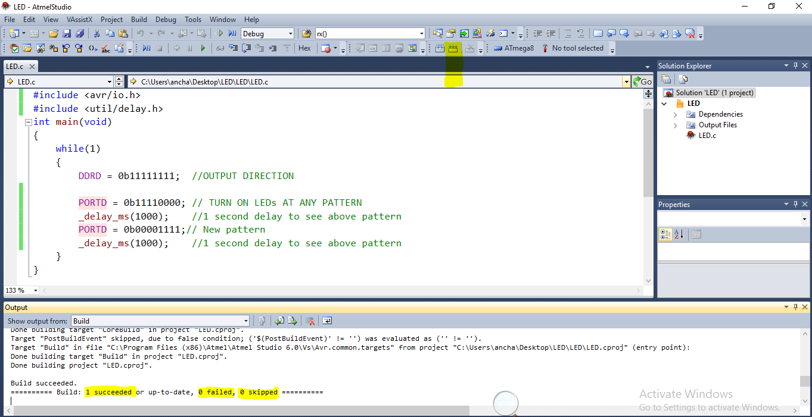
To build the solution
Press this button or F7

Slide 15
Interfacing LED with At mega8
#include<avr/io.h>
void main()
{
DDRB=0B11111111;
PORTB=0B11111111;
}
#define F_CPU 16000000UL
#include<avr/io.h>`
#include<util/delay.h>
void main()
{
DDRB=0B11111111;
PORTB=0B11111111;
_delay_ms(1000);
PORTB=0B11111111;
}

Slide 16
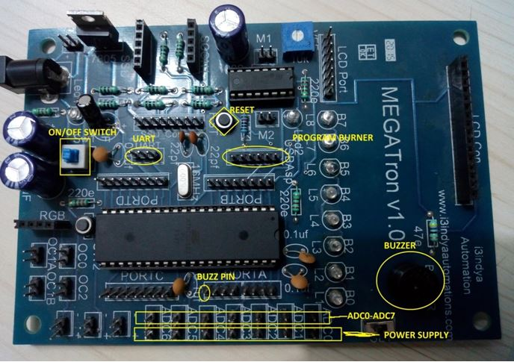
Write a code on the board
gnd

Slide 17
How to install the driver
usbASP Programmer

Slide 18
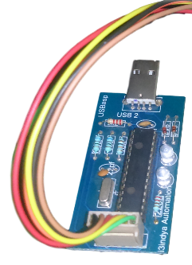
CONNECT
USBasp Programmer with LAPTOP

Slide 19
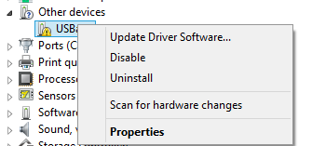
Update the Driver
Go to Device manager

Slide 20
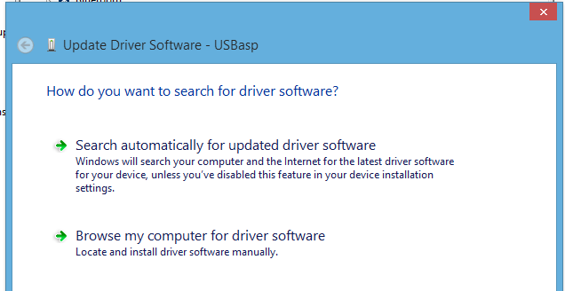
Update the Driver

Slide 21
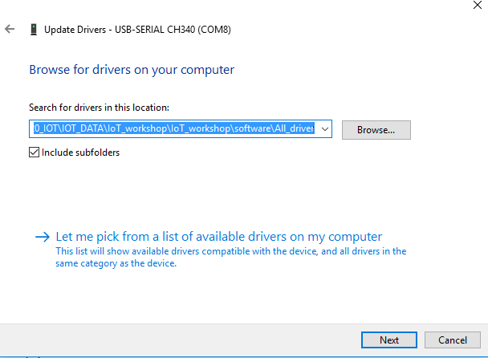
Update the Driver

Slide 22
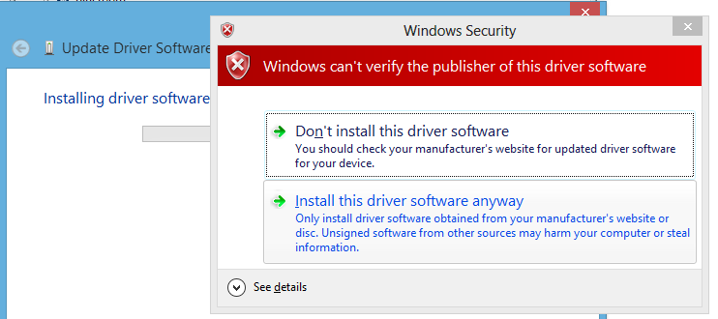
Update the Driver

Slide 23
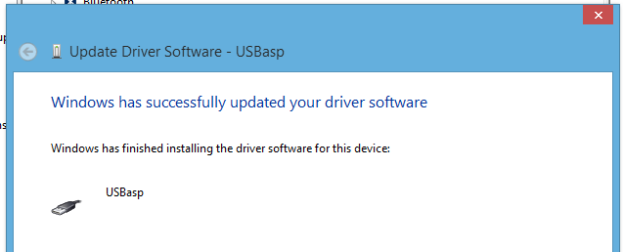
Update the Driver
If you are getting encountered a problem the again go for recovery setting

Slide 24

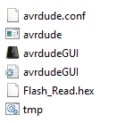
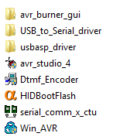
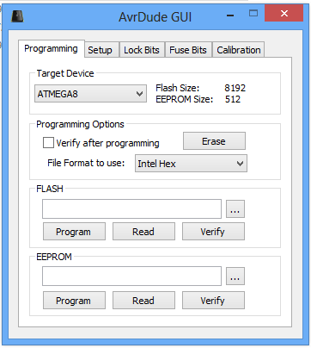
Steps to Burn the program.
1
3
2
4
5

