Slide 1
BIT MANIPULATION IN AVR
BASICS OF CONTROLLER

Slide 2
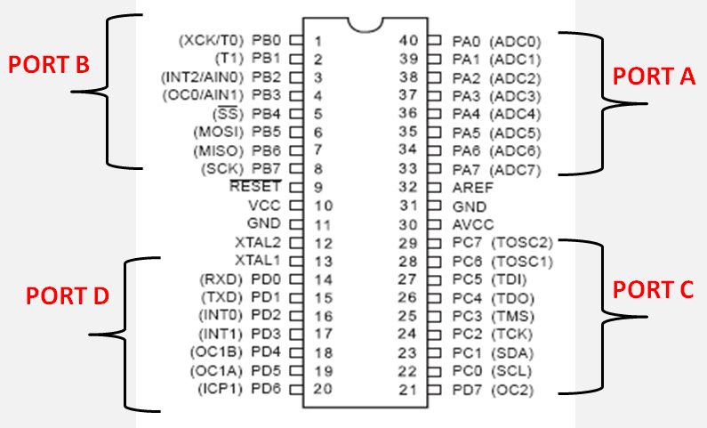
ATmega16

Slide 3
LED blinking

Slide 4
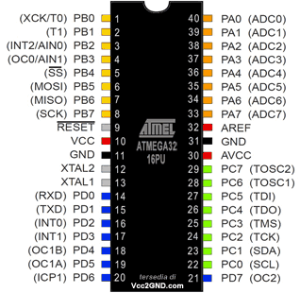
LED blinking
PORTB
PORTA
We will use

Slide 5


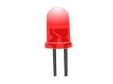

LED blinking
DDRB - Give Direction
PORTB - To flow the current
DDRB
PORTB
Turn ON all led

Slide 6

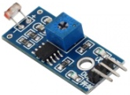
LED blinking
1→ Output for output device
DIRECTION ONLY
0→ Input for input device
DDRB
1
Allow current
to flow out
side from
the
controller
1
1
1
1
1
1
1
0
Now current direction is inside at PB7 for sensor

Slide 7

LED blinking
1→ Output for output device
Voltage
To on LEDs
0→ Input for input device
PORTB
ON
1
(+5v)
ON
1
(+5v)
OFF
0
(GND)
OFF
0
(GND)
ON
1
(+5v)
ON
1
(+5v)
OFF
0
(GND)
OFF
0
(GND)
PORTB = 0b
0
0
1
1
0
0
1
1
;

Slide 8

Buzzer (PA7)
1→ voltage
DIRECTION ONLY
0→ Ground
DDRA
1
Allow
current
to flow out
side from
the
controller
1
1
1
1
1
1
1

Slide 9
Buzzer ON (PA7)
1→ voltage
Voltage
0→ Ground
PORTA
0
0
0
0
0
0
0
1

Slide 10
THANK YOU

