Slide 1
Impact of Ad Libraries on Ratings of Android Mobile Apps
By:
Israel J. Mojica Ruiz, McAfee
Meiyappan Nagappan, Rochester Institute of Technology
Bram Adams, École Polytechnique de Montréal
Thorsten Berger, University of Waterloo
Steffen Dienst, University of Leipzig
Ahmed E. Hassan , Queen’s University
Presenters:
Tejaswi Ganne
Sree Rama Raju Pericharla
Shanmukha Reddy Aalla
Rahul Ramini

Slide 2
Introduction:
App developers use several third-party ad libraries to monetize their apps. This article examines the relationship between the number of ad libraries in Android apps and the user ratings of these apps.

Slide 3
What are Mobile Apps?
Mobile apps are software programs that you can download and access directly using your mobile device such as smartphones, tablets and other personal digital assistants.
Downloads increased from 7 billion apps in 2009 to 102 billion apps in 2013.
What are Ad Libraries?
Ad Libraries are libraries that are integrated in mobile app, that are used to display ads.
These are provided by the third party ad companies such as Google Mobile Ads and Flurry’s AppSpot, where developers get profited by displaying advertisements to the end users.
What is fill rate?
Fill rate is the success rate in receiving an add from an ad company when an ad is requested.
Average fill rate in first half of 2011 for the top 40 ad networks was less than 18%.
To achieve the fill rate developers need to integrate multiple ad libraries from different ad companies.

Slide 4
Relationship between ad libraries and the user app ratings
This article deals with two issues, number of ad libraries commonly integrated in an app or if integrating several different ad libraries impacts an app’s rating.
The user app ratings isn’t related to number of ad libraries integrated in an app, however certain specific ad libraries does have negative impact on app’s rating.
Developers does integrate as many as 28 ad libraries in their app to maximize revenue.
Adding an extra ad library doesn’t necessarily imply lower app rating

Slide 5
Study data collection
Analyzation was done on 519,739 app version distributed in 236,245 different android apps.
There are over 27 google paly categories in google app store.
Entertainment category having more than 20000 apps (highest).
Weather category having more than 1000 apps (lowest).

Slide 6
Crawling Google play
In 2011 study was done on google play app store once a day during first half of the year and twice a day during second half of the year.
A set of 625,067 app version distributed across 281,079 mobile apps were obtained.
Google play classifies apps into 27 different categories.
For each app version that was free to download , datasets contained two elements.
The binary in the Android specific packaging format (APK).
App-store-specific metadata information for each app version.

Slide 7
Extracting App Bytecode
App developers integrate ad libraries into the APK in order to use the ad libraries’ APIs.
Apps are packaged in the APK format and authors only had access to the app’s Dalvik bytecode, which contains both application and library classes.
To extract the Java byte- code from the APKs they used an open source tool dex2jar (http://code.google.com/p/dex2jar).
To extract the fully qualified class names and their corresponding set of method names (APIs) for each class in each app, they used Apache BCEL library (http:// commons.apache.org/bcel/).
After this process, they ended up with 519,739 app versions of 236,245 different apps and stored in a database and then used this data to identify the ad libraries in each app.

Slide 8
Identifying Ad Libraries
Steps followed to identify the ad libraries:
For each fully qualified class name, perform a Web search for the package name to find the website of the ad library provider (the ad company) and verify that the name of the library found is a real ad company.
If an ad library website is found, add the package name to the set of ad libraries. Other- wise, discard it.
Filter out from the database all the class names that belong to the package name identified in step 1.
Repeat this process for each remaining class name.

Slide 9
Identifying Ad Libraries Contd.
They repeated this process until a class name was repeated no more than 200 times in the database.
The most frequent, fully qualified class was com.google.ads.AdActivity, with 149,321 repetitions.
More than half (51.21 percent) of the studied Android apps (236,245) had at least one ad library.
They had identified 72 different ad libraries that were used by apps in our study and obtained the unique package name that identifies each of these ad libraries.

Slide 10
Integrating Multiple Ad Libraries
Due to low fill rate for ads in mobile apps, developers may choose to integrate more than one ad library in an app.
Hence the authors had decided to determine the number of ad libraries that are integrated in each app in their dataset.
They found
Most apps only integrate one ad library.
At least 42,206 (34.88 percent) of the apps with ad libraries in them have two or more ad libraries.
Eight apps that integrate as many as 28 ad libraries.

Slide 11
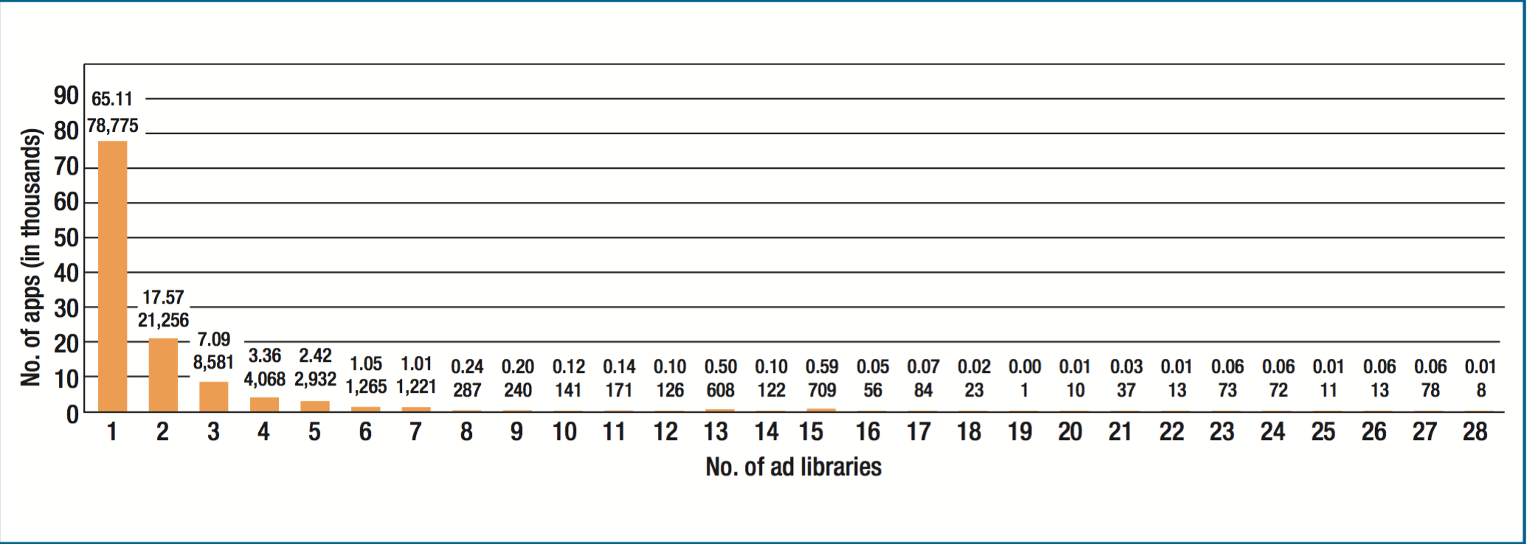
App vs Ad libraries

Slide 12
Effect of increase in number of ad Libraries
Thousands of apps we use today are integrating more than one ad Library. This increment in the number of ad libraries increases the maintenance effort for the developers as they need to write extra piece of code.
Thus , increase in number of ad libraries consequently has an impact on app’s quality.
The main difference between ad libraries and other libraries is that the ad libraries are not responsible for the functionality of the app instead they are required for monitoring the app.
Research was conducted to determine the relation between the ad libraries in an app and its rating.

Slide 13
App Rating
Google play provides a facility for the app users to rate their apps from one to five star. The apps overall rating is rater bias i.e number of users rating the app is a major factor for app overall rating.
So to minimize the rating bias the author had limited the analysis to ad-supported app versions with at least 10 raters. The author also did analysis on two versions of the apps in 2011 as they represent the most actively maintained apps.
This resulted in 13,983 versions distributed across 5,937 different apps.

Slide 14
App Rating (Cont..)
Only the latest versions of the apps taken for consideration
The results are provided based on number of ad-libraries within each app.
The Spearman rank has got the correlation between the app rating and number of ad libraries in an app as 0.016. This result clearly indicates that there is no relation between number of ad libraries in an app and its rating.

Slide 15
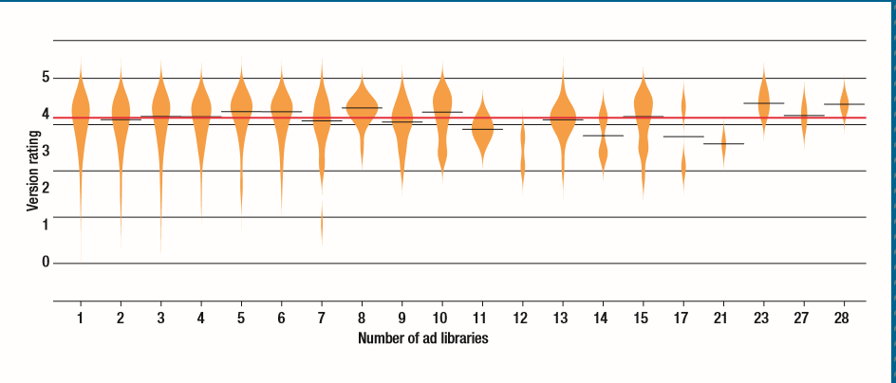
Number of Ad libraries Vs User rating

Slide 16
Relation Between ad libraries and App Rating
The ad libraries have no impact on the app rating. The sensible reason for this is that high number of ad libraries does not mean that the app displays more number of adds at the same time.
Large number of ad libraries means that the app is being monetarized to achieve high fill rate.

Slide 17
Specific Ad libraries
The main reason for the ads is to attract users attention. Ads are in fact part of GUI.
So the app developers must consider how the users react to the ads displayed. This affects the user ratings.

Slide 18
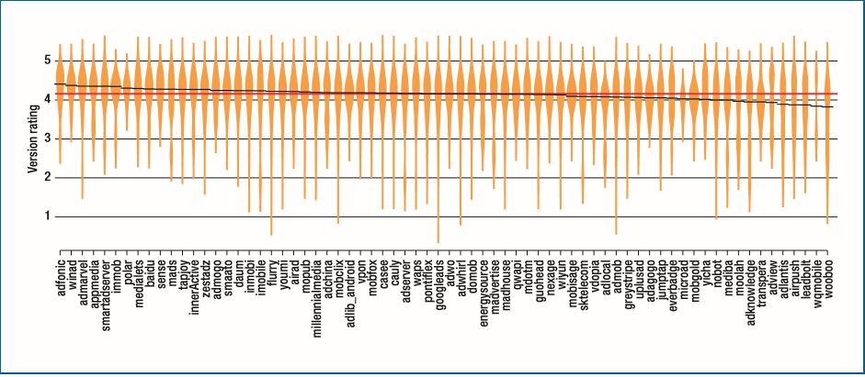
Graph
Notes:
Distribution of the ratings of the apps that contain each of the ad libraries. The beanplots are sorted descending by the median app rating. The red and black lines across each beanplot represent the median rating of all the apps and the median rating of the apps that integrate a particular ad library, respectively
Figure presents beanplots for 70 out of the 72 ad libraries in our studied dataset.
The beanplots present the ratings for all the apps that integrate each specifi c ad library, sorted in descending order by the median rating. The dotted and solid lines across each beanplot represent the median rating of all the apps and the median rating of the apps that integrate a particular ad library, respectively
The beanplots show a slight decrease, depending on the type of ad libraries. Most of the apps in the dataset with a specifi c ad library are higher or slightly lower than the overall median rating (4.15).

Slide 19
Analysis on Three ad Libraries
From the figure three ad libraries that have apps with low app rating to determine the possible reasons for low app ratings.
Wooboo (www.wooboo. com.cn)
This is an ad network based in china. Researches had confirmed that wooboo is a spyware.
Users have complained that “This ad Library is direct copy from another app, It displays ads and now your password belongs to someone in china.”
This ad library implied for low app rating.

Slide 20
Analysis on Three ad Libraries (Cont..)
Lead-bolt (www.leadbolt.com)
It is based in Australia.
This ad library uses a technique called push notification which pushes the ads into the notification bar.
So, the ads being displayed even when the application is not in use.
In 2012 , Lead Bolt introduced a new type of ad called app icon that installs new icons on the device without users authorization.
One more problem with this ad library is that it sends device id in plain text.

Slide 21
Analysis on Three ad Libraries (Cont..)
3. Air Push(www.airpush.com) :
It is based in US
Similar to Lead Bolt, Air Push also uses push notifications and app icon ads to serve advertisements.
In fact, this ad library has become controversial among app users for its intrusive behavior.

Slide 22
Conclusions
Addition of extra libraries to the app does not necessarily imply low app rating
Ad libraries in an app has no relation with its rating.
Specific ad libraries have a severe impact on app rating. Many apps are unsuccessful because of Specific ad libraries.
Apps with high invasive ad network behavior resulted in more number of complaints from the app users.
Ad libraries which involve security issues also resulted in low app rating
Notes:
We found comments such as “Good game, bad ads. I was loving the game until I noticed it put a new shortcut called ‘Apps’ on my launcher. Sorry, but if your idea of advertising is putting sh*t in launcher pages or notifi cations then I’m not interested. Keep ads INSIDE the app.” Another user complained, “Good game, bad ads. This game is awesome but the ads ... embarrising.These apps totally ruin it and there isn’t a way to take them off

Slide 23
References
Impact of Ad Libraries on Ratings of Android Mobile Apps paper by
Israel J
Meiyappan Nagappan
Bram Adams
Thorsten Berger
Steffen Dienst
Ahmed E. Hassan

