Slide 1

Review Point
By Team RooCoders
Sree Rama Raju Pericharla
Akhilesh Gattu
Nagi Reddy Sollapuram
Santosh Kumar

Slide 2

Introduction
Review point is an user friendly web application which provides the unified analyzed review for all the electronic products.
Review Point Rating
Review Point Suggestion

Slide 3



Architecture Diagram
server
Elastic Search
Request to db
Storing data in db
Response from db
Query
Result
Product Review Data
Tools & Technologies used:
Python
ElasticSearch
Angular JS,Jqeury
HTML, CSS
Bootstrap
Web Application

Slide 4
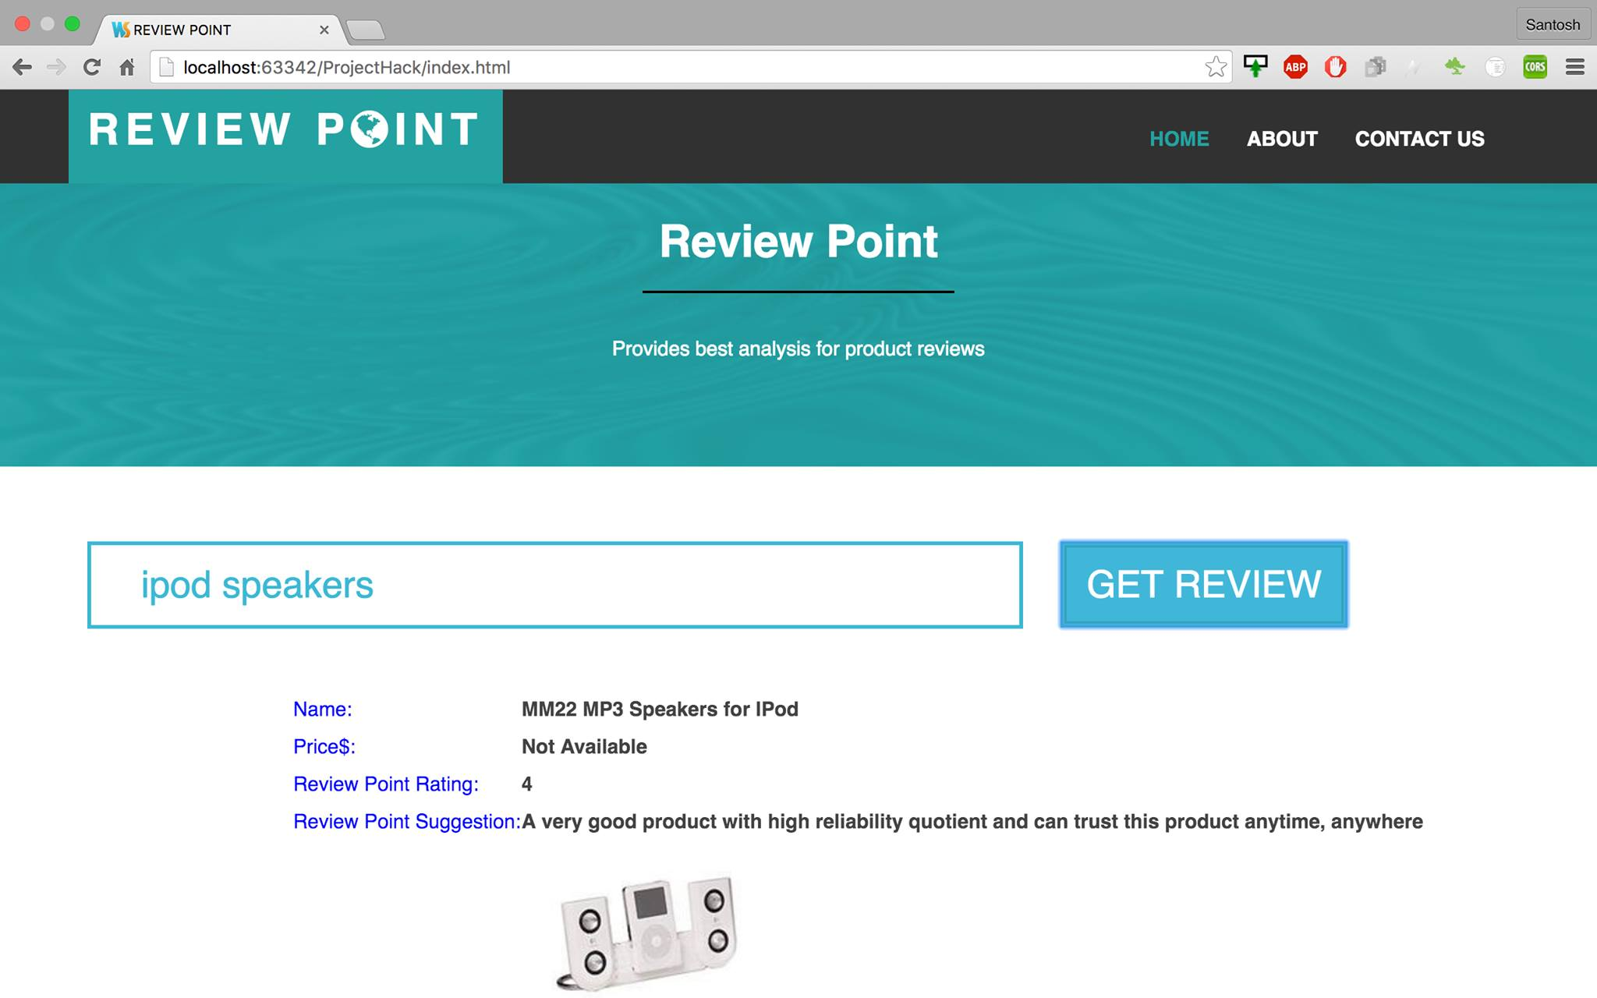
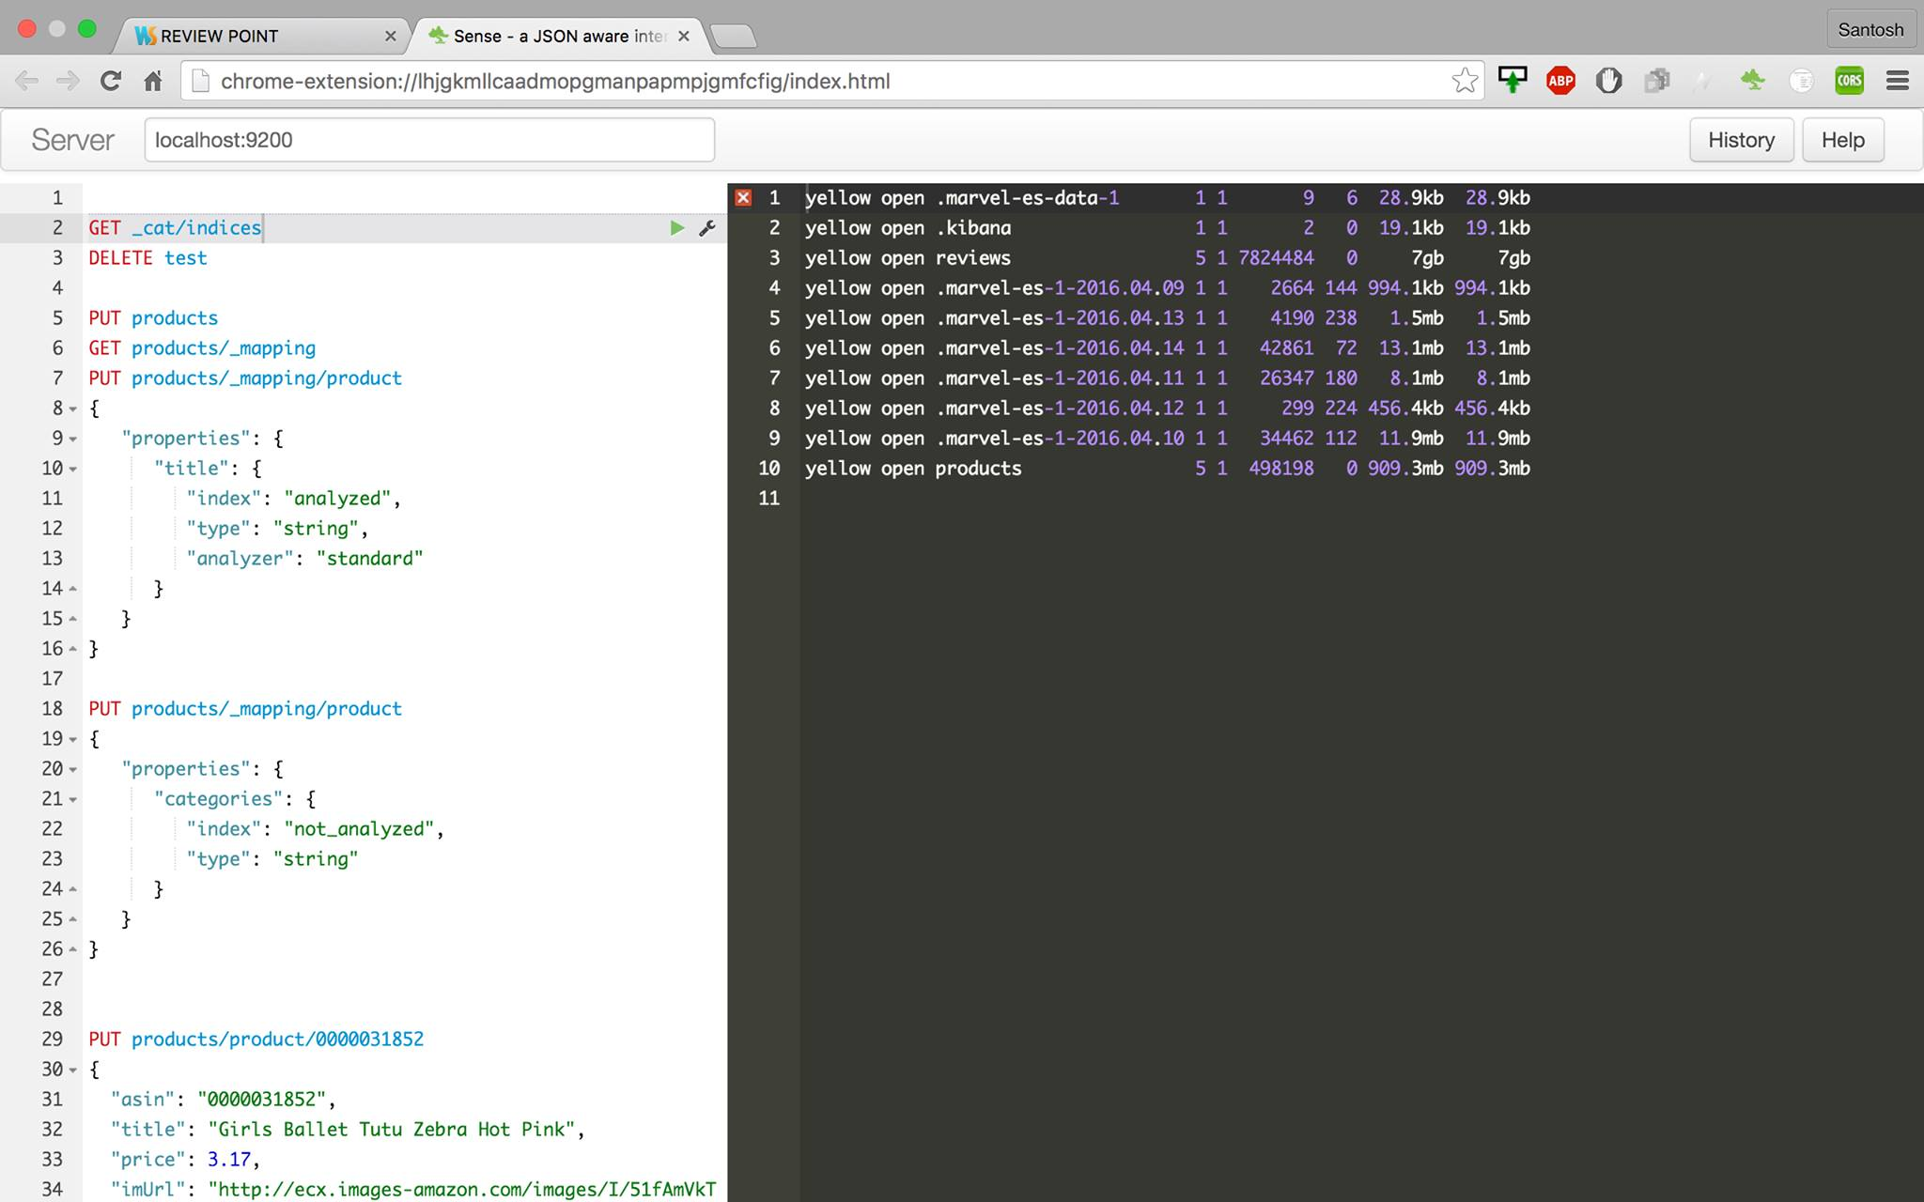
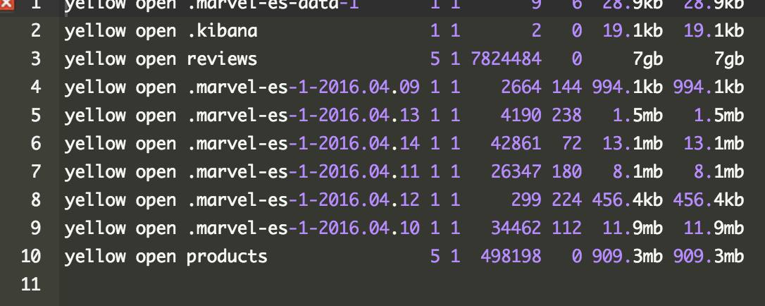
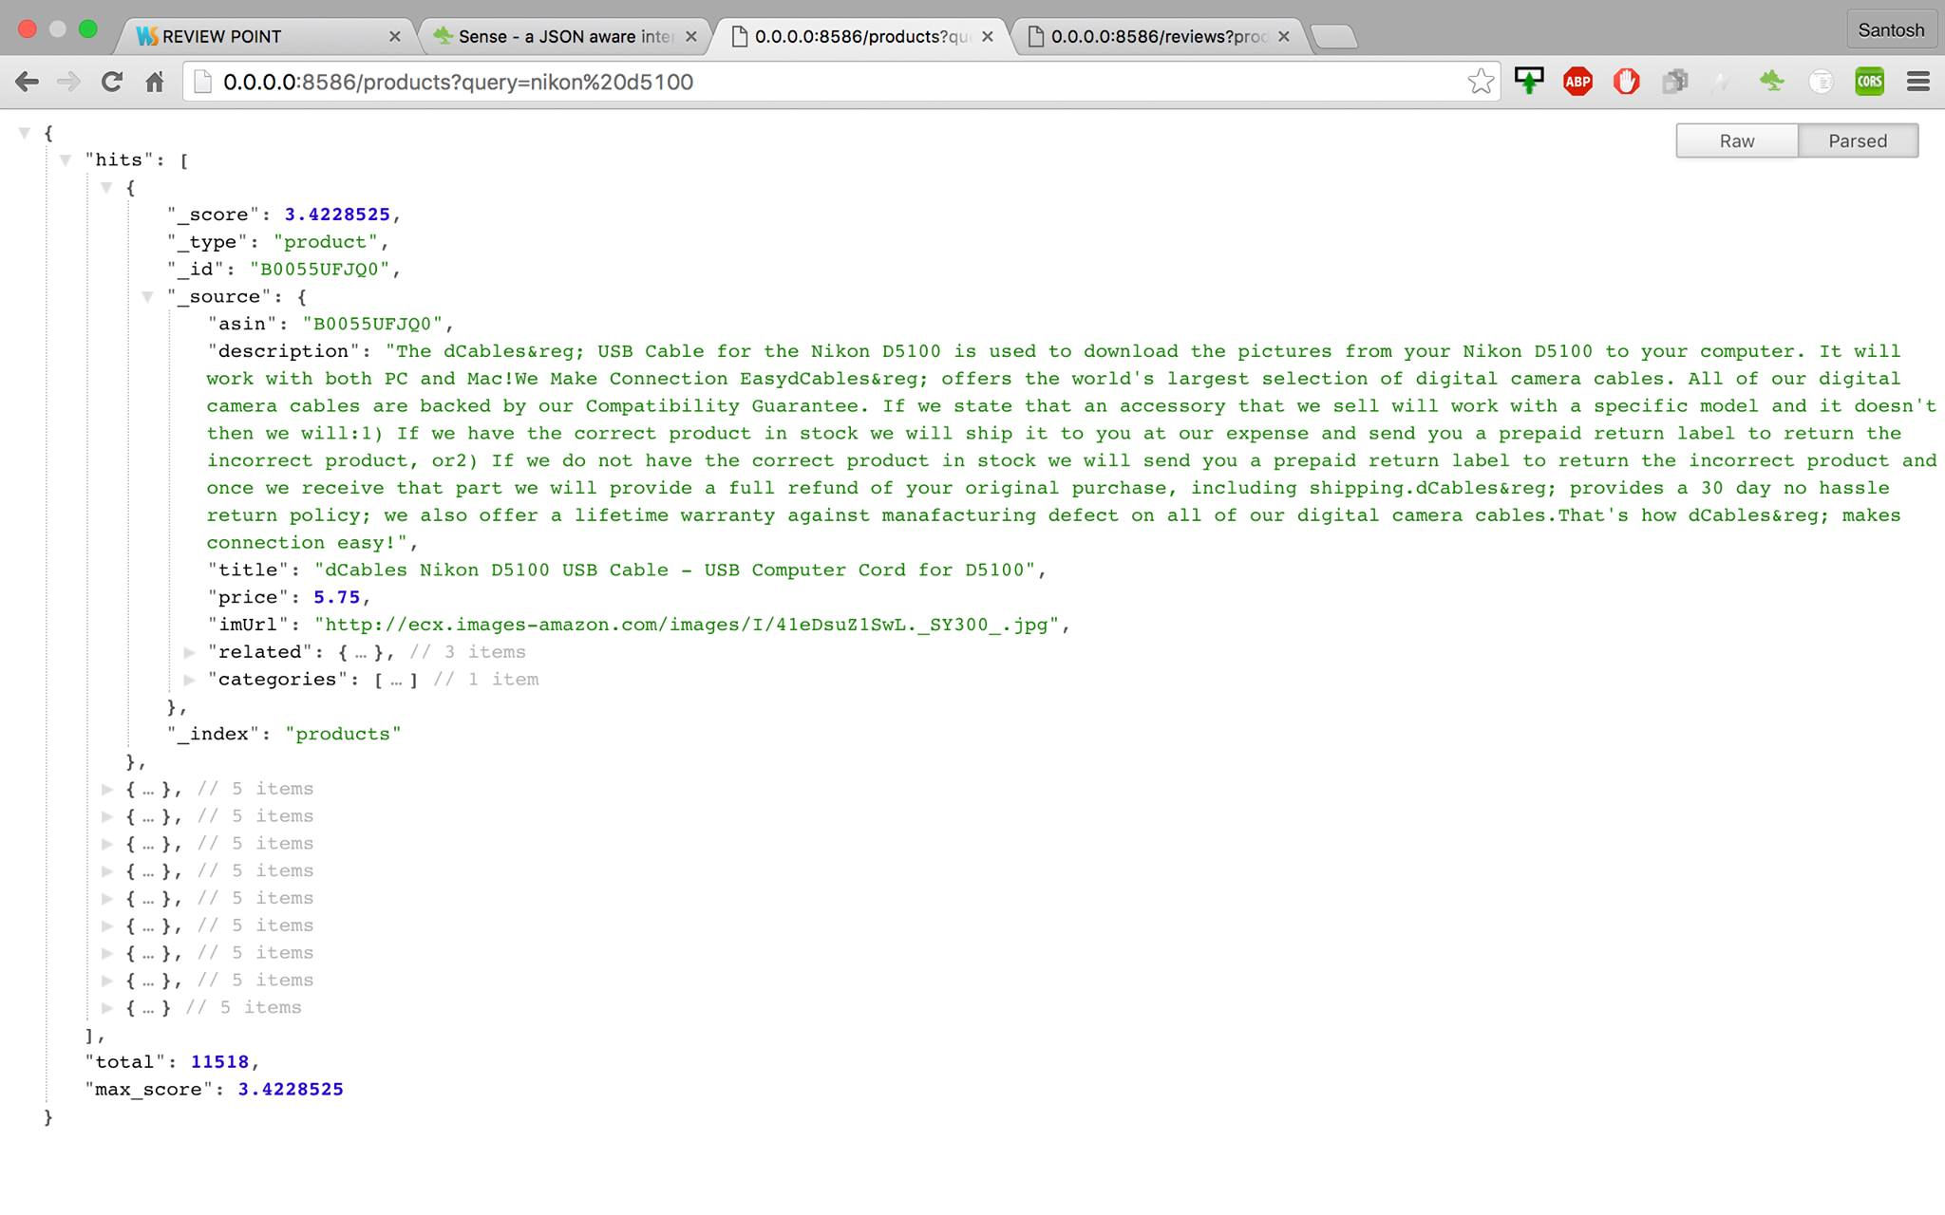
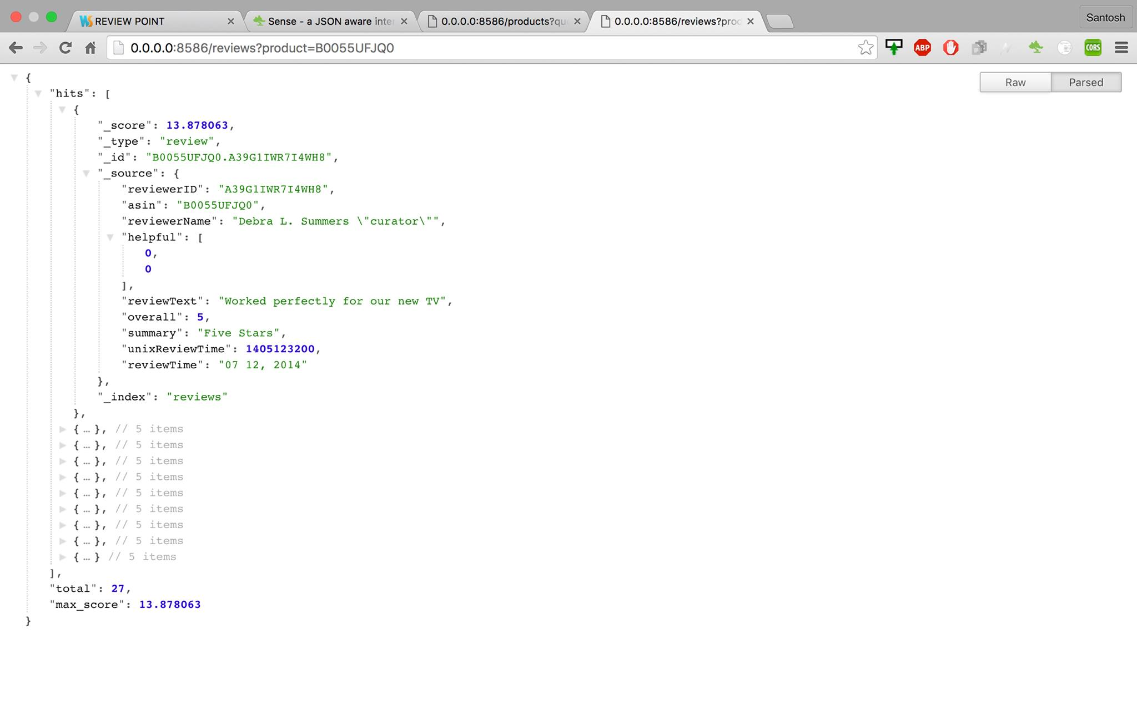
How it Works

Slide 5


