Slide 1
Use Case (Senior) Machine Learning Engineer Position (Prediction of Heart Disease)
Sreeram Jagannathan

Slide 2
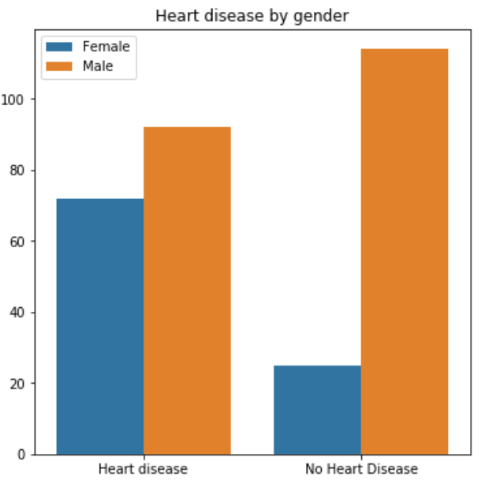
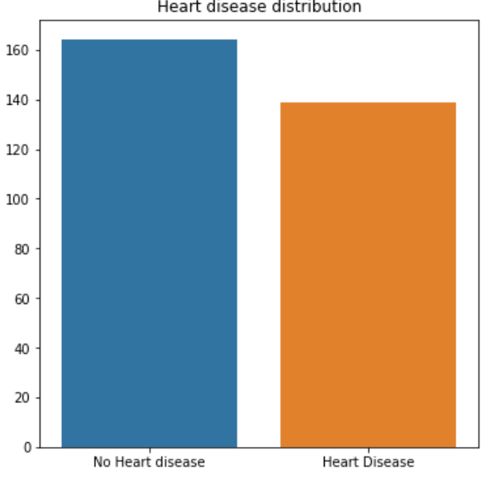
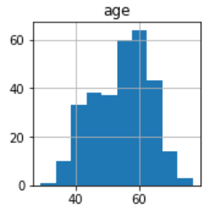
Steps
Dataset download (https://archive.ics.uci.edu/ml/machine-learning-databases/heart-disease/processed-Cleveland.data)
Data Preprocessing
Handle NA’s, missing values and correct datatypes
Understanding the dataset
Histograms and plots of different attributes
Model Selection (Binary Classification Disease/noDisease)
Compare LogisticRegression, RandomForest(Tree-based),
XgBoost(GradientDescent) and Neural Network.
Steps
Hyperparameter tuning(GridSearchCV, RandomSearchCV)
Model Fit
Model Prediction
Evaluation (Confusion matrix)
Feature Importance (Permutation Importance)

Slide 3
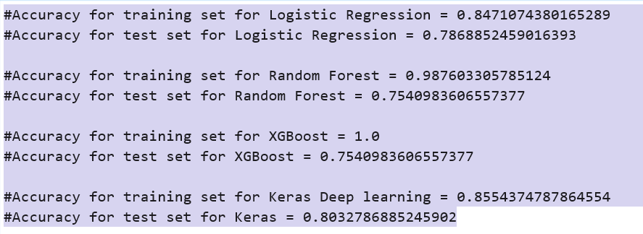
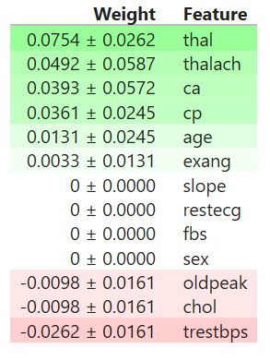
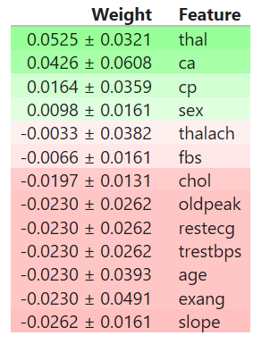
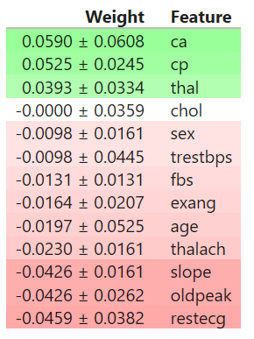
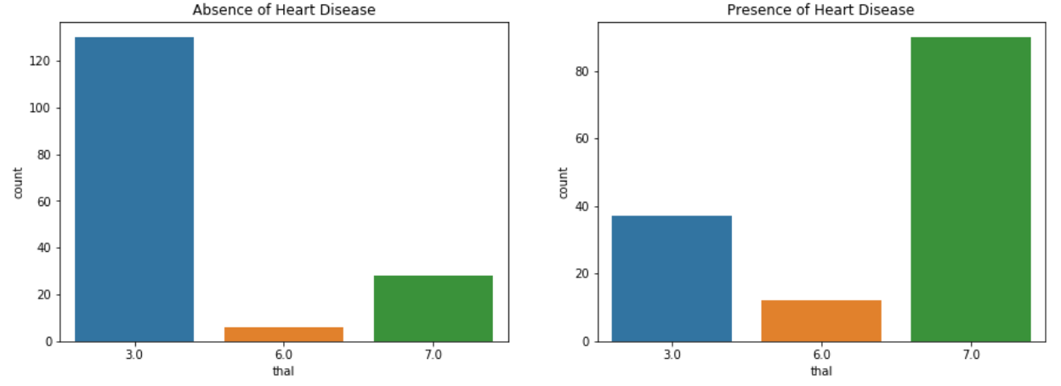
Results
Accuracy of prediction is highest with Keras Neural Network model
Feature Importances (Feature Importance with keras is not possible)
Further enhancements
* Handle categorical data with dummy variables
* Removing observations with high deviation from mean standard deviation using Z-score
* Analyse features with high importance for specific category (eg. thal)
LogisticRegression
RandomForest
XgBoost

