Slide 1
Capital Gains Distributions
Group 2
Aakanksha Rao
Mattock Callahan
Martin Mathew
Sreerekha Rajendran
Notes:
Presenter: ALL
Notes:
Everyone please take 30 seconds to introduce yourself, mention what you are studying

Slide 2
Project Scope
What are we trying to do?
Obtain capital gains distribution estimates directly from mutual companies via their websites
How are we doing it?
Web-scraping techniques
Why is it valuable?
By centralizing this information, we can help financial advisors and independent investors mitigate unnecessary tax burdens
Notes:
Presenter: Sreerekha
Notes:
We have 10 target firms whose data we would like to collect
Each firm has a different website, and the formatting can be very different
We want to help centralize this information, standardize the formatting, and make it easier to access
More to come on this in 2 slides

Slide 3



What are capital gains distributions?
A disbursement of the proceeds from the sale of a security by a mutual fund to its shareholders
Required by law
Shareholders pay taxes on the distributions
Mutual
Fund
Notes:
Presenter: Mattock
Notes:
Official definition: “A disbursement of the proceeds from the sale of a security by a mutual fund to its shareholders”
Required by law
Shareholders pay taxes on the distributions
Not “free money”
The fund’s net asset value is reduced by the amount of the distribution on the “ex-dividend” date
You get money, but the fund you own is worth less as a result of the distribution
You can keep the distribution, or reinvest it
We have this problem at my job. People spend hours and hours collecting this information manually, or they outsource it to another service.

Slide 4
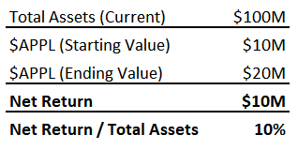
Example: Capital Gains Distributions
Mutual Fund: $XYZ
Share Price: $10/share
Total Fund Assets: $100M
$XYZ bought Apple stock in early 2020. Since then, the value of the stock has increased significantly
The total net return (capital gain) when $XYZ sells Apple in June, 2021 is $10M
Resulting capital gain distribution:
10% of total fund assets
Notes:
Presenter: Mattock
Notes:
A bit tricky to wrap your head around
A theoretical mutual fund buys Apple stock at a great time in early 2020
Real world: the stock has grown by 17,000% since 2000
In this example, the price doubles since just early 2020
The gain alone is now worth 10% of the total fund ($10M)
Capital gains tax must be paid when the fund sells Apple in June 2021

Slide 5
Example: Capital Gains Distributions
Your Account
10/31/2021: You buy 1,000 shares of $XYZ
Price per Share of XYZ: $10
Total Investment in XYZ: $10,000
12/15/2021: $XYZ decides to distribute the gains from the sale of their Apple stock
Since you hold $10,000 worth of mutual fund XYZ, you receive $1,000 in tax liability from the fund on 12/15, regardless of how long you have owned shares of XYZ
You now owe taxes on that $1,000
Jun. 30 2021
XYZ sells $APPL Holdings
Oct. 31 2021
You buy 1,000 shares of XYZ
Dec. 15, 2021
XYZ distributes capital gains, you inherit tax liability
Notes:
Presenter: Mattock
Notes:
Timeline is very important here
Investor is potentially getting a bad deal
They will have to pay extra taxes on something they did not benefit from
Fundamental drawback with the mutual fund structure
Why they are much more popular in retirement accounts
Less tax burden from this kind of activity

Slide 6
How Can These Distributions be Avoided?
Simple: Sell your position in the fund before the distribution occurs, and buy back in at a later date
Investors will have to decide if this is the right decision for them based on their individual situation
For example, if they have accumulated significant gains while holding the fund, they could potentially incur a similar (or larger) tax bill by selling the fund in an attempt to avoid the distribution
Notes:
Presenter: Mattock
Notes:
One of the data points we are collecting is the “distribution date”
This is really the key data point
Avoid → Sell
Really a circumstantial decision for the investor
Depends on how long they’ve been in the fund and what other capital gains they might have to deal with
May be cases where selling would lead to a larger immediate tax burden
Decision is easy in our example: Sell!

Slide 7
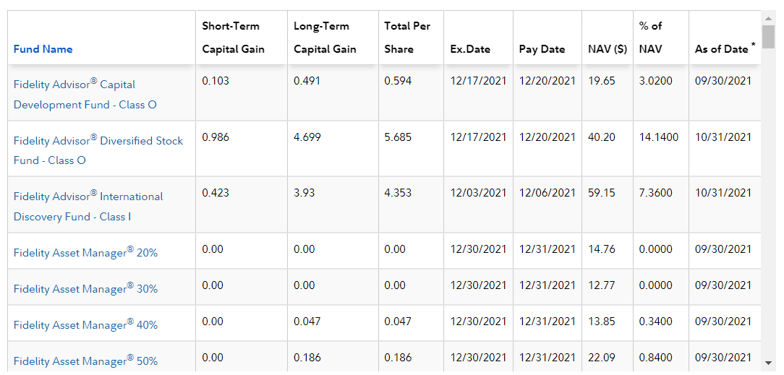
Example Data
Notes:
Presenter: Sreerekha
Notes:
In this example, we would be interested in:
Fund Name
Short Term Capital Gain & Long Term Capital Gain
Formatting is “Per Share”
Pay Date
When the distributions will be made

Slide 8
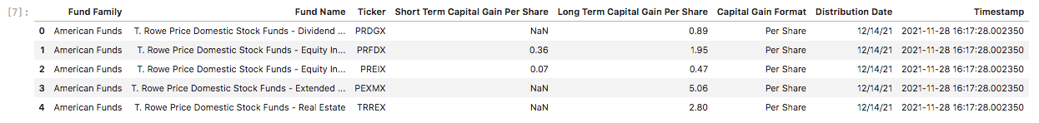
Final Dataset Design
Critical Data Points:
The total per-share capital gains that will be distributed for each mutual fund (unless noted)
The date upon which the capital gains will be distributed
Column | Notes
Fund Family | Example: "Fidelity"
Fund Name
Ticker | *If Available
Short Term Capital Gain Per Share | Format: Decimal (If Min/Max range is given, provide average of Min/Max)
Long Term Capital Gain Per Share | Format: Decimal (If Min/Max range is given, provide average of Min/Max)
Capital Gain Format | Should be either "Per Share" or "Per Share Percent"
Distribution Date | Format: MM/DD/YY
Notes:
Presenter: Mattock
Notes:
Explain each column of the final dataset

Slide 9
Who might be interested in this data?
Independent Investors
Give them more information to help with decision-making
Financial Advisors
Help them put their clients in the best possible position
Companies + Technologies Serving Audiences 1 & 2
Allow them to notify clients about upcoming distributions in products they hold
Examples: Fidelity, Charles Schwab, eTrade, etc.
Notes:
Presenter: Sreerekha
Notes:
Independent Investors
Very few firms are looking out for independent investors
It can be hard to find this information, and it can be confusing to interpret
Financial Advisors
Great for client relations - “Hey, I saved you some money!”
Every financial advisor whose clients hold mutual funds should be helping their clients with this kind of stuff
Companies
Idea: Provide tailored recommendations to clients to let them know when a distribution is coming up
Helps them save money, makes them a more loyal customer

Slide 10
Limitations + Challenges
Inconsistent Data Formats
Source Variety
Different Source Types
Timing
Notes:
Presenter: Mattock
Notes:
Source Variety
10 different sources = 10 different code bases
We are working to mitigate this by using global functions that can be used across the different source types
However, the actual parsing is almost always unique to the source
Timing
All this information is released at different times
Different Source Types
Traditional Websites
Websites w/ JS Elements
PDF
Inconsistent Data Formats
Some sites (American Funds) only release cap gains estimates as a percentage of total share price
Dates can be very inconsistent in terms of formatting
Sometimes ticker is provided, sometimes it is not

Slide 11
Target Firms
Firm | Retail Net Assets | Assignee
Fidelity | $984B | Mattock
American Funds | $956B | Sreerekha
JP Morgan | $43B | Sreerekha
T. Rowe Price | $345B | Aakanksha
Columbia Management | $167B | Mattock
Dodge & Cox | $126B | Mattock
Franklin Templeton | $377B | Mattock
American Century | $71B | Martin
PIMCO | $118B | Aakanksha
BlackRock | $90B | Martin
$3 Trillion: The total retail net assets of the firms we targeted
52%: The percentage of total retail net assets across the top 100 mutual fund families that our 10 target firms hold
Notes:
Presenter: Sreerekha
Notes:
Top 100 mutual fund companies hold $6.3T in assets
Just by targeting 10 of the biggest, we’ve covered 52% (~$3T) of those assets
We broken it up into individual scraping assignments
Bottom Line: We’ve built a broadly useful dataset by focusing on the top priorities first

Slide 12
Access Rights & Distribution
Presenter: Sreerekha
Notes:
Access Rights
The disclosure of this information is legally required
Not prohibited in the various robots.txt files
Distribution
We would like to provide this data to our various potential audiences as an alternative to existing paid services like CapGainsValet
Firm | Rate Limits? | Page Disallowed?
Fidelity | None | No
American Funds | None | No
Franklin Templeton | None | No
T. Rowe Price | None | No
Columbia Management | None | No
Dodge & Cox | None | No
JP Morgan | None | No
American Century | None | No
PIMCO | None | No
BlackRock | None | No
Notes:
Presenter: Sreerekha
Notes:
Disclosure of data is legally required
Not prohibited by anything in the robots.txt files
One other service (CapGainsValet) is selling this type of data, so there is precedence for its use and distribution

Slide 13
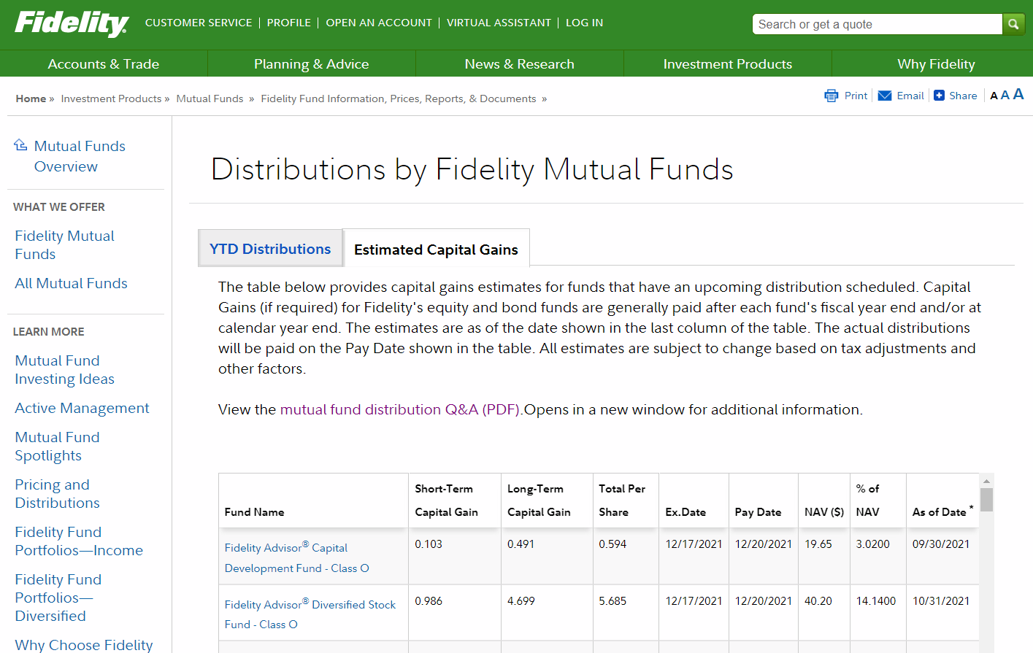
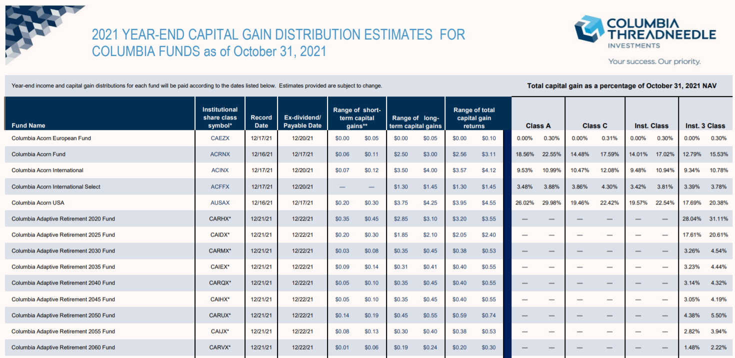
Process Discussion: Mattock
Key Libraries Used
Selenium
PDFPlumber
Challenges Encountered
Incomplete HTML pulls with BS4
Need for automated site scrolling
Data wrangling free text in PDF’s

Slide 14
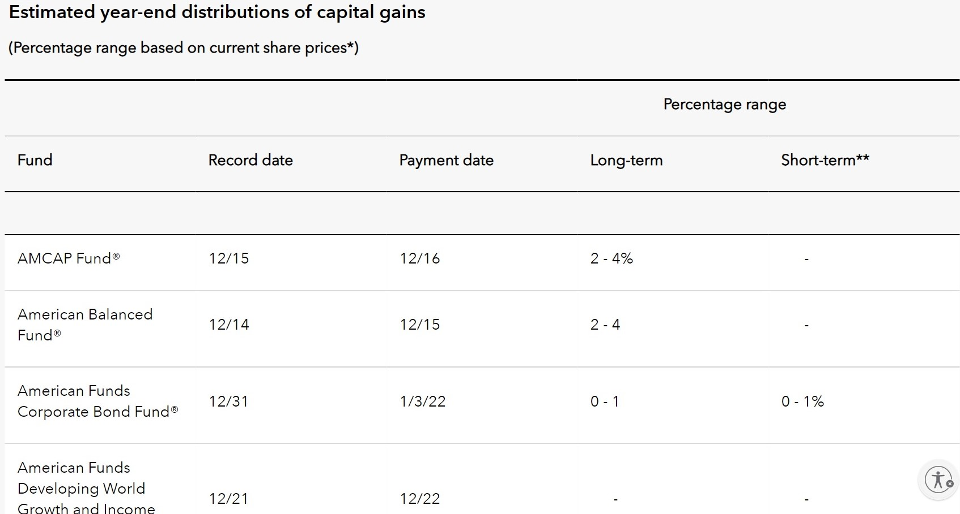
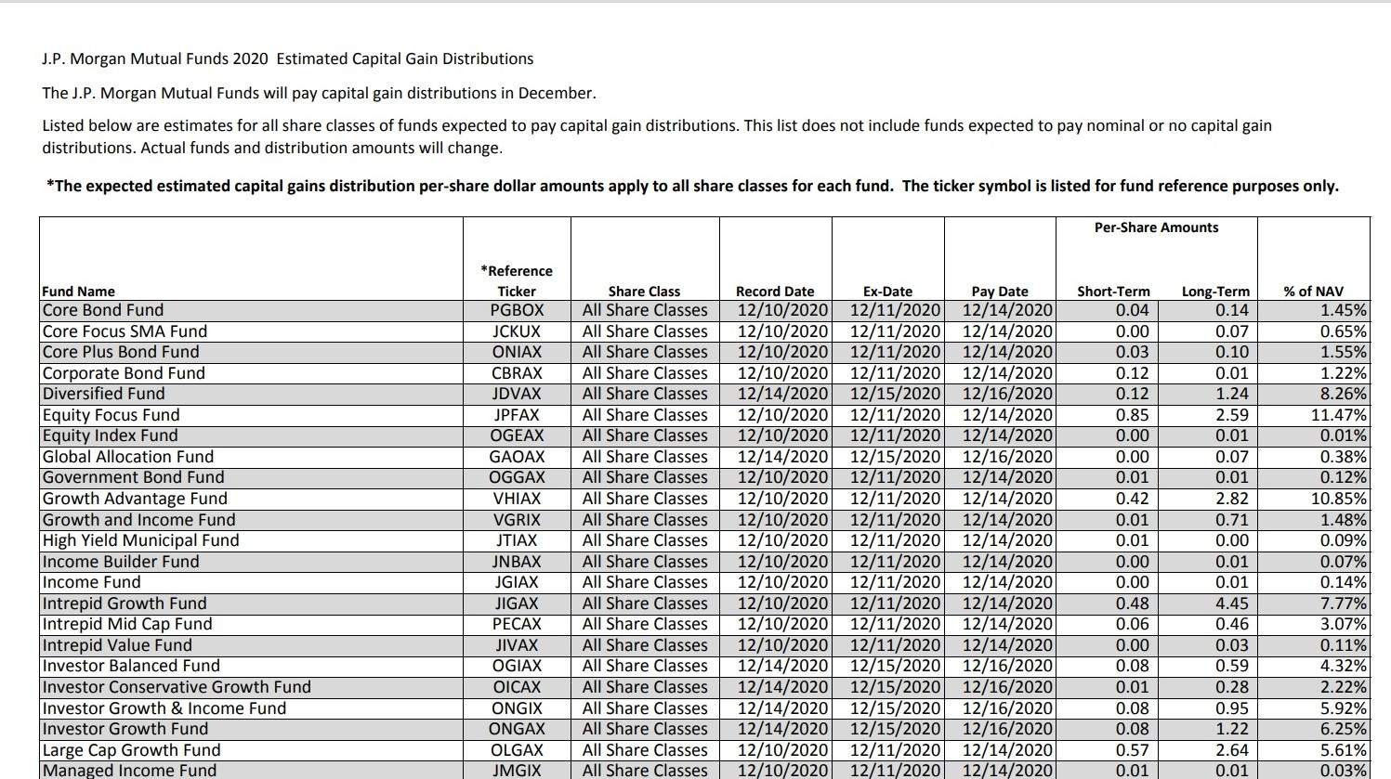
Process Discussion: Sreerekha
Key Libraries Used
Pandas, BeautifulSoup
PDFPlumber
Challenges Encountered
Formatting for PDF scraping
Does not work with PDFMiner and Slate

Slide 15
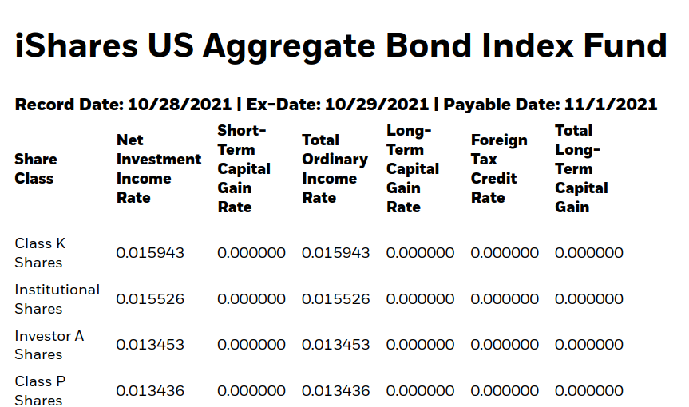
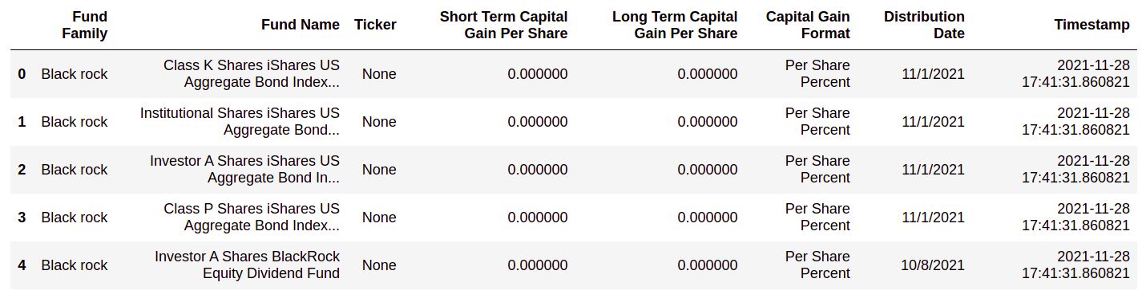
Process Discussion: Martin
Challenges Encountered
Integrate data into table from outside the table.(eg: date and fund name)
Tried using ‘tabula’ to scrape from pdf, formatting to csv was a challenge
Used pandas alone to scrape tables, even though coding was easy, difficult to handle output.
Key Libraries Used
Pandas
Selenium, Beautifulsoup, requests

Slide 16
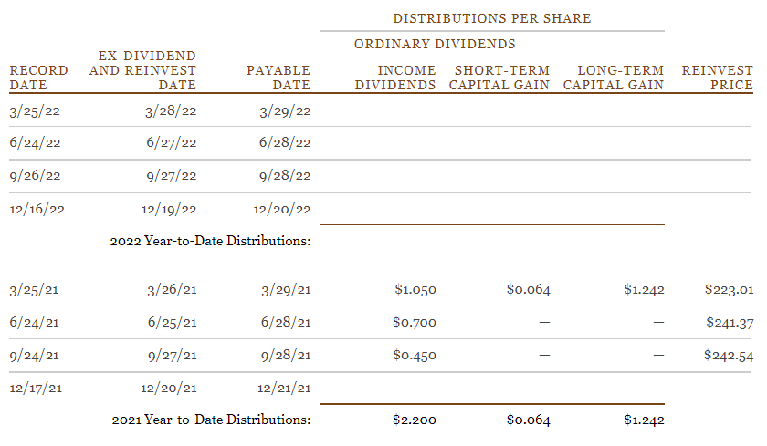
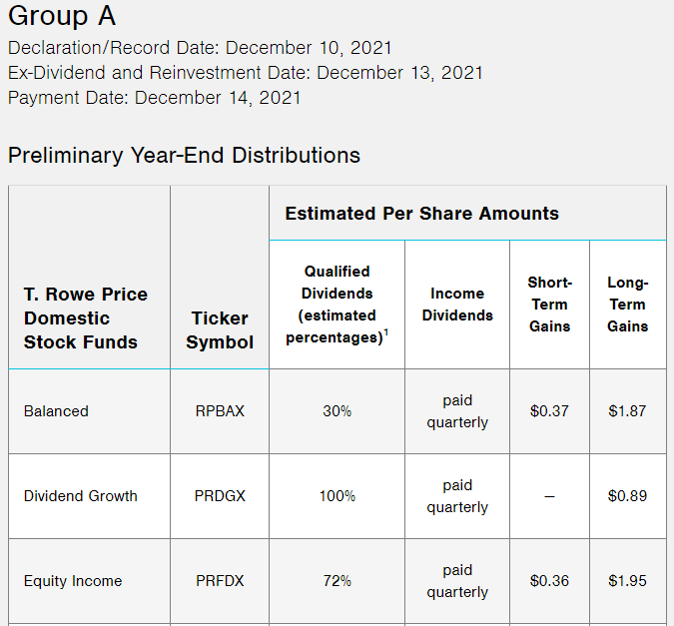
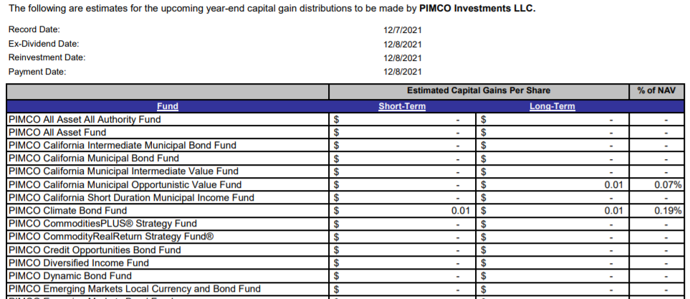
Process Discussion: Aakanksha
Key Libraries Used
pdfplumber
BeautifulSoup
Challenges Encountered
Inconsistent data pulls with BS4
Final data representation

Slide 17
Collective Challenges: Bringing It All Together
Portability
Ensuring our scraping processes can easily and reliably be run on other machines
“Run” Mechanism
One ipynb file that contains scripts for all sites?
A master script that runs all the subscripts in sequence?
Notes:
Presenter: Mattock
Notes:
Big challenge is portability, especially as it relates to Selenium
There’s a bit of an involved setup process
We’re going to spend a lot of time ensuring that there are clear instructions with regard to how to configure the proper environment
How to run all the sub-scripts:
First Try: Master notebook that ran all sub-notebooks
Current Strategy: Single master notebook that contains clear sections + instructions
Better for documentation and clarity

Slide 18
Conclusion
Challenging test of our acquisition skills
Forced us to use new tools reach our various goals
Created a dataset that will:
1) Save users valuable time
2) Save people money
Notes:
Presenter: Sreerekha
Notes:
Feel free to add anything useful here -Mattock

Slide 19
Sources
Bruno, Mark. “The 100 Largest Mutual Fund Families.” InvestmentNews, 23 June 2021,
https://www.investmentnews.com/the-100-largest-mutual-fund-families-38196.
Chen, James. “Understanding Capital Gains Distribution.” Investopedia, Investopedia, 8 Sept. 2021,
https://www.investopedia.com/terms/c/capitalgainsdistribution.asp.
McGowan, Lee. “What Are Mutual Fund Capital Gains Distributions?” The Balance, The Balance, 1 Nov. 2020,
https://www.thebalance.com/mutual-fund-capital-gains-distributions-2466692.

