Slide 1
IBM University Engagement Project Submission
“Exploring the Power of Agentic AI with IBM Granite and LangFlow”

Slide 2

Project Tile – Smart Recipe Preparation Agent using IBM Granite and Watsonx Orchestrate
Domain of Project – Food & Nutrition
Student Name | Recent Passport Photo | Email ID | Mobile number [WhatsApp]
Sreeshaa Shanmugavel |  | sreeshaashanmugavel07@gmail.com | 7448310640

Slide 3
Problem Statement -
Problem Statement : Nutrition Agent
The Challenge
Many people struggle to decide what meals they can prepare using the ingredients available at home. Recipe information is scattered across multiple sources, making meal preparation time-consuming. Users also need ingredient substitutions, dietary adjustments, and cooking guidance.
The Objective
Build an AI-powered Recipe Preparation Agent that:
Accepts available ingredients from users.
Retrieves relevant recipes using RAG.
Generates step-by-step cooking instructions.
Suggests ingredient substitutions.
Provides cooking tips.
Supports dietary preferences and food restrictions.
Helps reduce food waste and save time.

Slide 4
Technology Used
Tech Stack IBM Watsonx Orchestrate IBM Granite Model Retrieval-Augmented Generation (RAG) IBM Cloud Lite Recipe Knowledge Base Development Approach IBM Watsonx Orchestrate + IBM Granite Models + RAG

Slide 5
Proposed Solution – Smart Recipe Preparation Agent
Proposed Solution: Smart Recipe Preparation Agent
The proposed solution is an AI-powered Recipe Preparation Agent built using IBM Watsonx Orchestrate and IBM Granite Models.
The system allows users to enter available ingredients, dietary preferences, and food restrictions. Using Retrieval-Augmented Generation (RAG), the agent retrieves relevant recipes from a recipe knowledge base and generates personalized cooking guidance.
The solution provides:
• Recipe Suggestions • Step-by-Step Cooking Instructions • Ingredient Substitutions • Cooking Tips • Dietary Adjustments
The system helps users prepare meals efficiently while reducing food waste and improving the cooking experience.

Slide 6
Components Used
1) Chat Input Allows users to enter available ingredients, dietary preferences, and food restrictions. 2) IBM Watsonx AI Agent Processes user requests using IBM Granite Models. 3) IBM Granite Model Granite 4.0 Instruct Model used for recipe generation and reasoning. 4) Knowledge Base Stores recipe documents used for retrieval.
5) RAG Retrieval
Retrieves relevant recipes from uploaded recipe documents.
6) Chat Output
Displays recipe suggestions, cooking instructions, substitutions, and dietary adjustments.

Slide 7

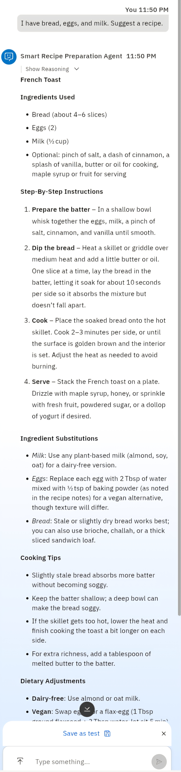
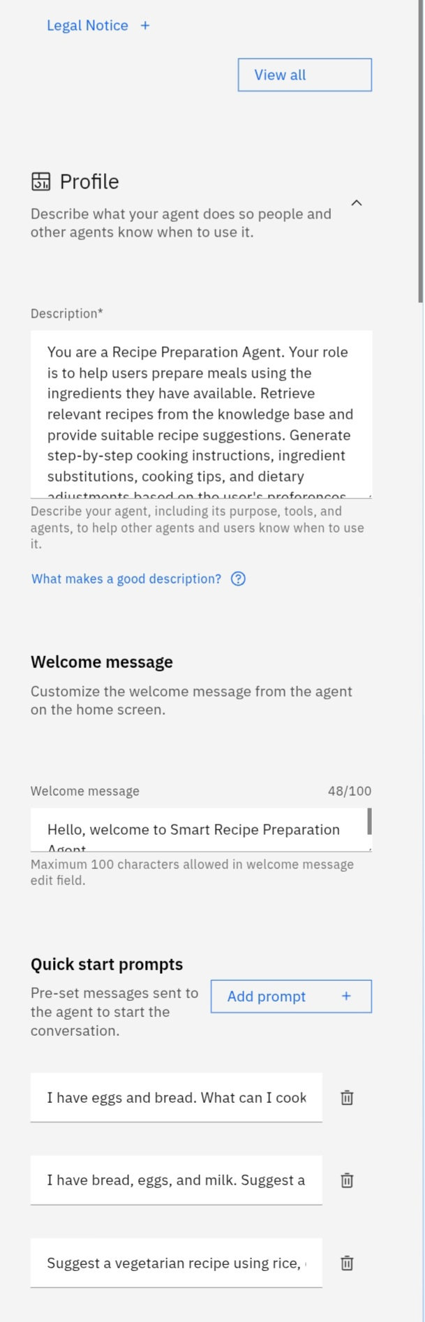
SCREENSHOT

Slide 8
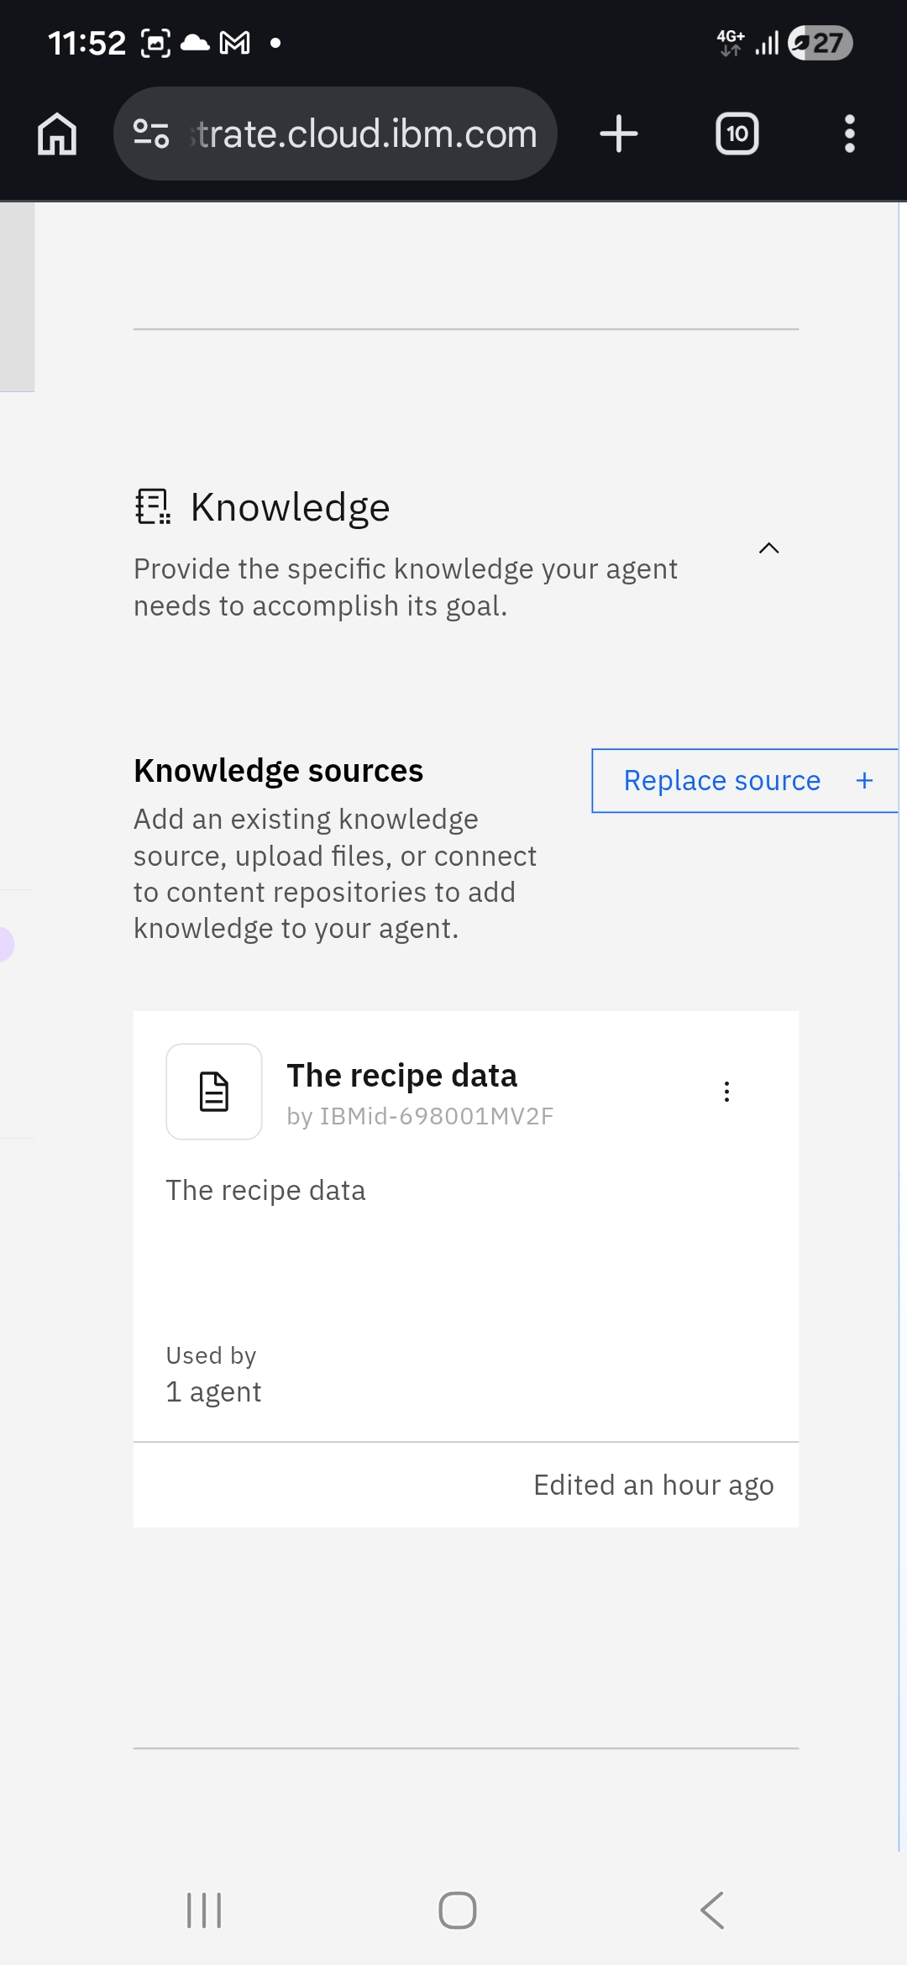
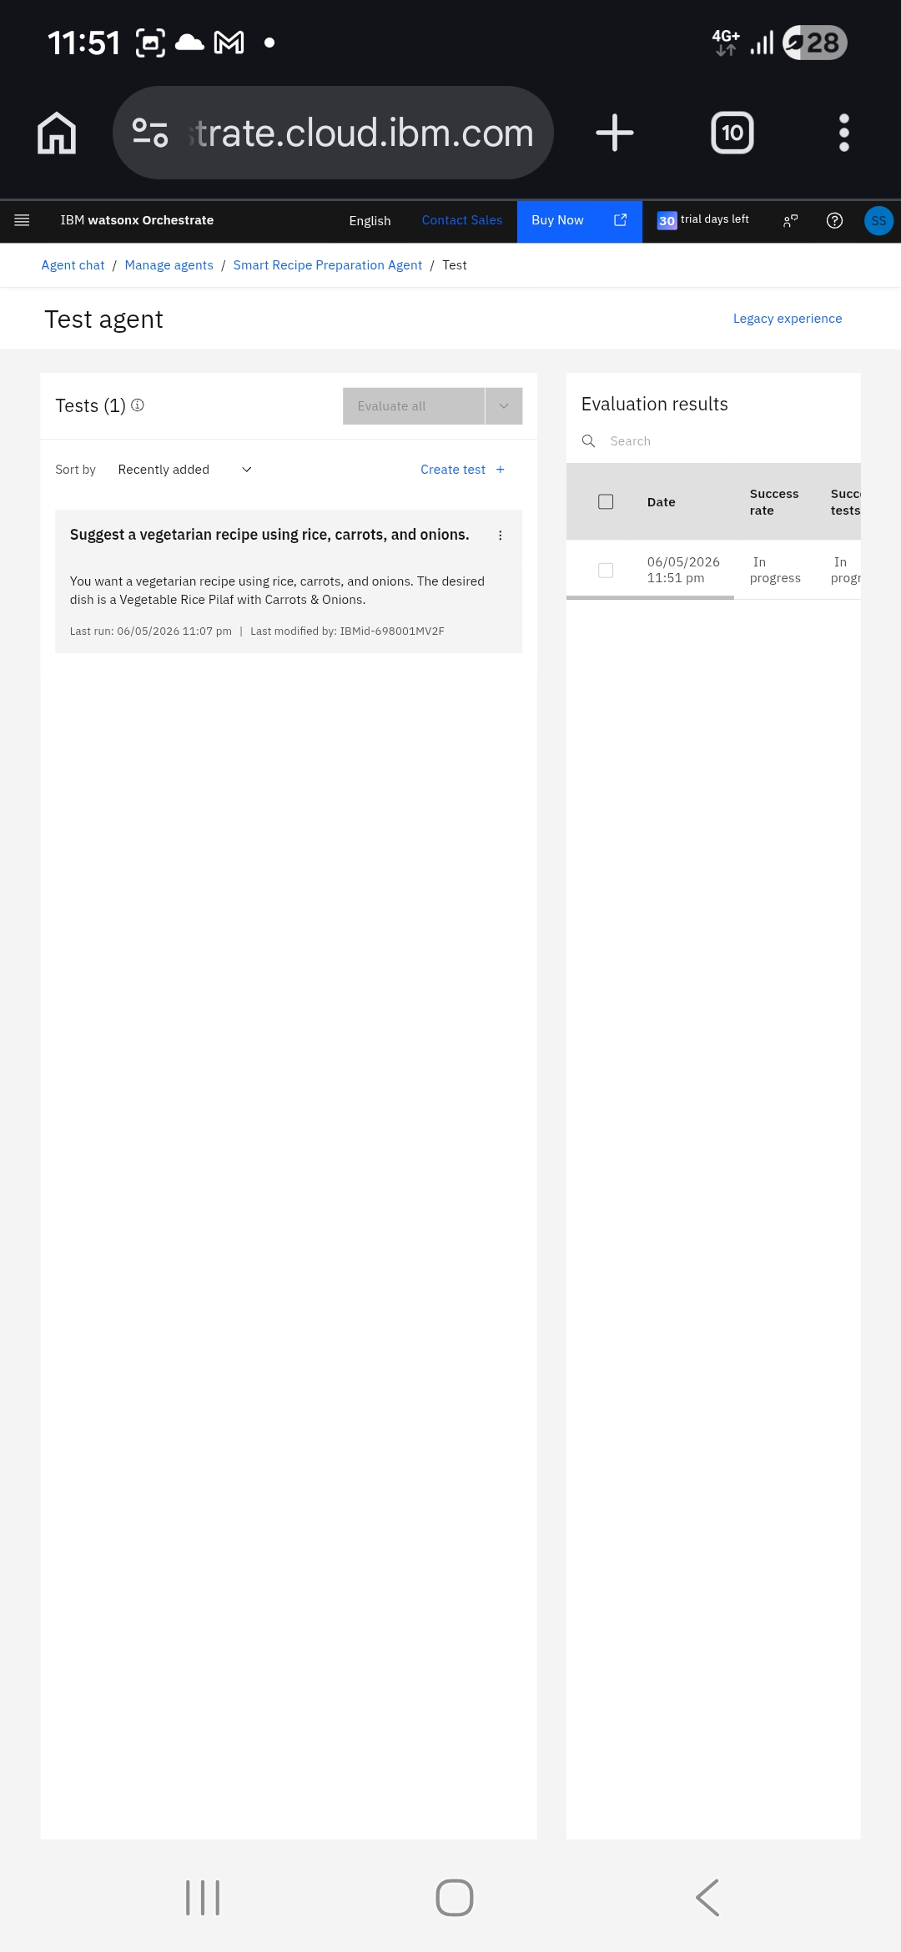
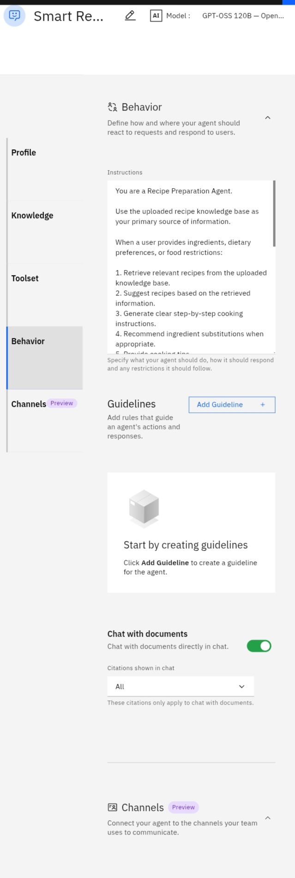

Slide 9

Role of Agentic AI in the solution
Role of Agentic AI in Nutrition Agent
Agentic AI enables the Recipe Preparation Agent to function as an intelligent cooking assistant rather than a traditional chatbot. The agent retrieves recipe information from the knowledge base, understands user ingredients and dietary requirements, and generates personalized cooking recommendations. Using IBM Granite and Watsonx Orchestrate, the system autonomously performs retrieval, reasoning, and response generation to deliver practical meal suggestions. This makes the solution intelligent, context-aware, and user-centric.

Slide 10
Technology Used
IBM Watsonx Orchestrate
Used to build and manage the AI agent workflow.
IBM Granite Model
Used for recipe generation, reasoning, and personalized recommendations.
IBM Cloud Lite
Provides cloud infrastructure and AI services.
Retrieval-Augmented Generation (RAG)
Retrieves recipes from the knowledge base before generating responses.
Recipe Knowledge Base
Stores recipes, substitutions, and cooking instructions.

Slide 11
Novelty and Uniqueness
Novelty and Uniqueness
AI-Powered Recipe Generation Generates personalized recipes based on available ingredients. RAG-Based Retrieval Retrieves accurate recipe information from a knowledge base. Personalized Dietary Adjustments Supports dietary preferences and food restrictions. Ingredient Substitution Support Suggests alternatives when ingredients are unavailable.
Food Waste Reductio
Encourages the use of existing ingredients.
Intelligent Cooking Assistance
Provides step-by-step instructions and cooking tips.
The solution acts as a smart AI cooking assistant rather than a simple recipe search tool.

Slide 12
Git Hub Link
https://github.com/sreeshaashanmugavel07-blip/Smart-Recipe-Preparation-Agent
·

Slide 13
Future Scope
1. Nutrition Analysis Provide calorie, protein, carbohydrate, and vitamin information for generated recipes. 2. Voice-Based Assistant Allow users to interact using voice commands. 3. Multi-Cuisine Support Support Indian, Chinese, Italian, and other cuisines. 4. Smart Grocery Suggestions Recommend missing ingredients and shopping lists. 5. Mobile Application Develop Android and iOS versions for wider accessibility.
·
·
·

Slide 14


