Slide 1
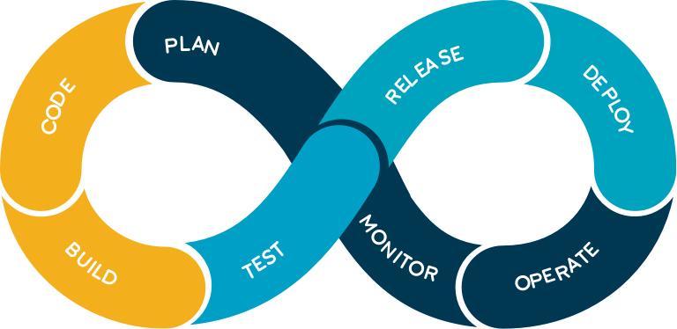
Welcome to DevOps Deep Dive
Dev
Ops

Slide 2
Agenda:
Introduction
What is DevOps?
DevOps Lifecycle
Roles and responsibilities of a DevOps Engineer
CI CD pipeline
Scope of this course

Slide 3
Introduction

Slide 4
What is DevOps?
Set of practices that combines software development and IT operations
It is a combination of cultural philosophies, practices, and tools that increase an organization’s ability to deliver applications and services at high velocity
A compound of development (Dev) and operations (Ops), DevOps is the union of people, process and technology to continually provide value to customers.

Slide 5
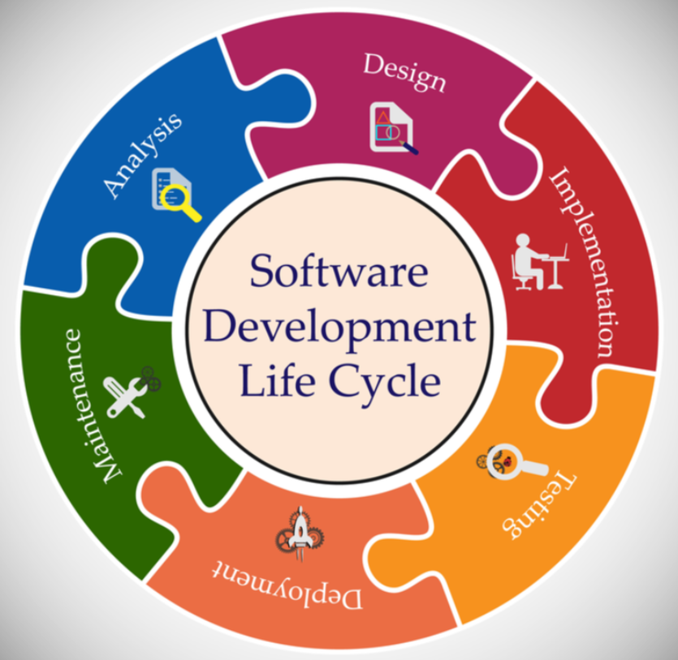
SDLC:
Methodologies:
Waterfall
Agile
DevOps

Slide 6
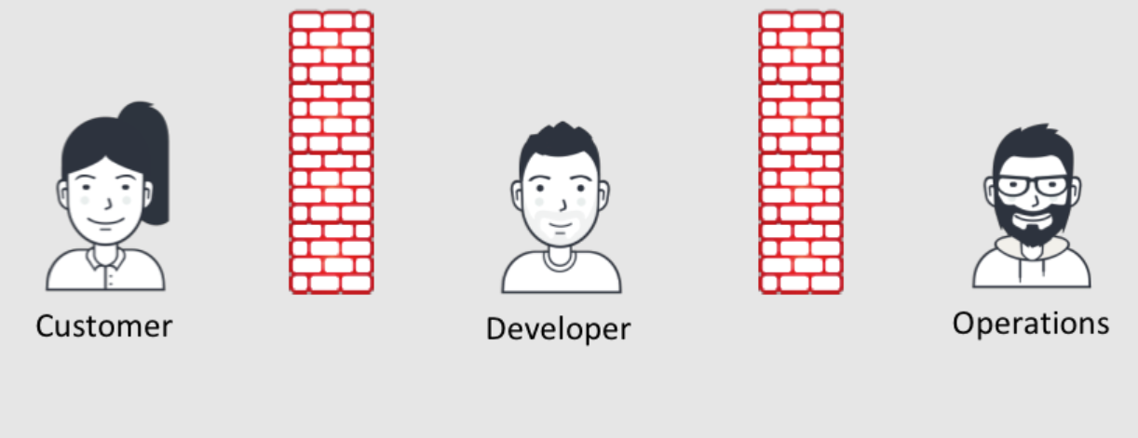
Agile
DevOps
Agile:
Iterative approach to project management and software development that helps teams deliver value to their customers faster and with fewer headaches
Scrum, Kanban, etc.,

Slide 7
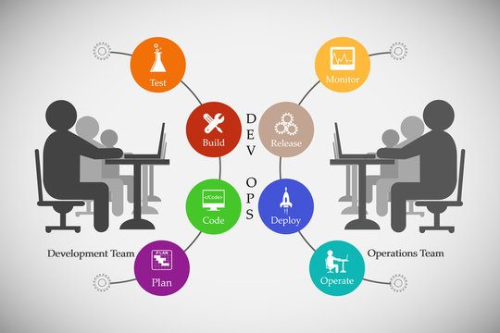
Development Team: develops the code and create applications
Testing Team: Tests the application and ensures quality intact
Operations Team: Configures and maintains the infrastructure, monitors and supports the application and ensures 100% availability
DevOps Team: Builds and supports CI CD pipelines, takes care of end to end automation and ensures continuous integration, continuous delivery/deployment, continuous testing and continuous monitoring.

Slide 8
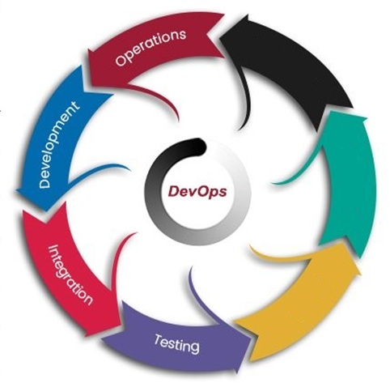
DevOps Lifecycle
Docker, Docker Swarm, K8s, etc.,
Alerts from Monitoring Tools, Surveys from customers, etc.,
SCM: Git, GitHub, GitLab, BitBucket, etc.,
IDE: Eclipse, VSCode, Sublime, etc.,
Project Management: Jira, ServiceNow, Confluence
Feedback
Monitoring
Nagios, Splunk, ELK stack, Prometheus, etc.,
Deployment
Build: Maven, Gradle, etc.,
Orchestrator: Jenkins, ADO, TeamCity, Bamboo, etc.,
Artifact Management: Nexus,
Artifactory, etc.,
Ansible, Chef,
Puppet, Terraform, etc.,
Selenium, Tosca,
Worksoft, etc.,

Slide 9
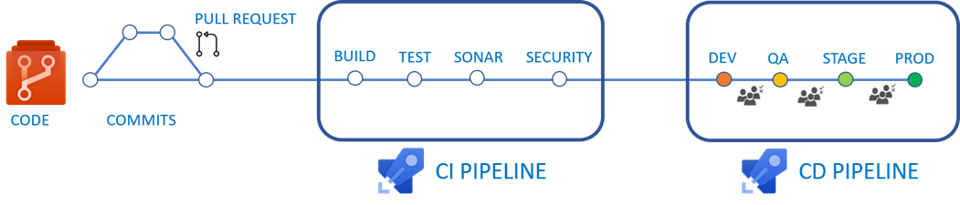
CI CD Pipeline
SCA
SCM
Continuous Integration
Continuous Delivery - keeping the code in a deployable state at any given time.
Continuous Testing
Continuous Deployment - every change that is made will be automatically deployed to production

Slide 10
Scope of this course (CI CD Tools)
Source Code Management
Git, GitHub
CI Orchestrator
Jenkins
Unit Test
Static Code Analysis
SonarQube
Build
Maven & npm
Artifact Management
Nexus
Configuration Management
Ansible
Terraform
Microservices architecture & Containerization
Docker
Kubernetes
Cloud Environment
AWS
Linux
Shell scripting
Web Server
Apache Tomcat
Real-Time project scenarios
Real-Time day to day activities

Slide 11
Thank You!

