Slide 1

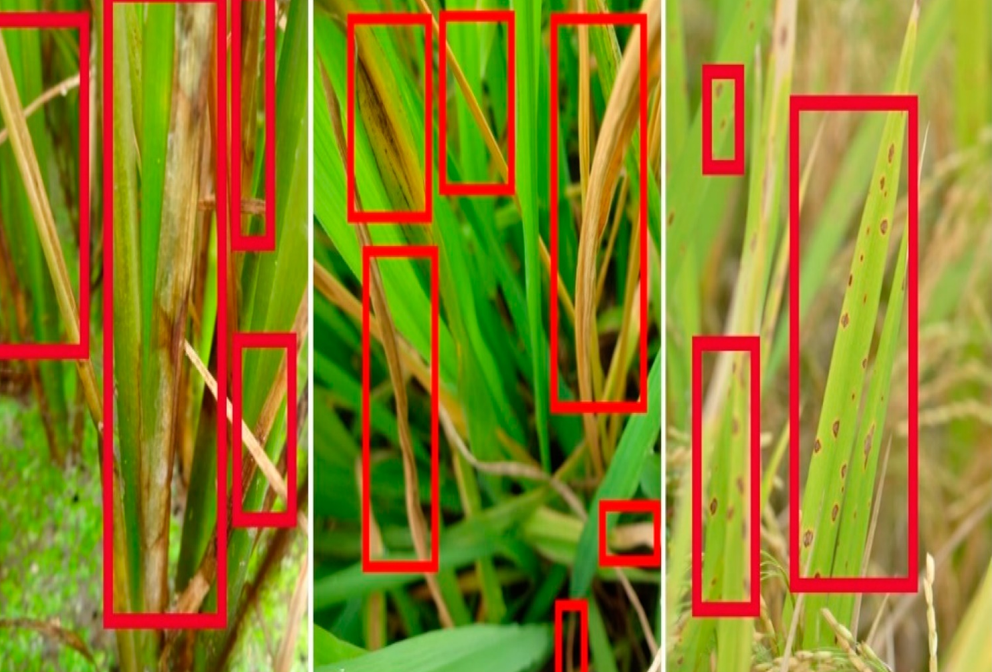
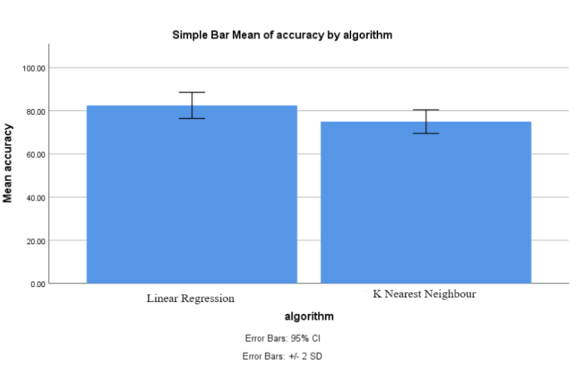
Name: Miss. N.Sree Swarna Register Number: 192119038
Guided by Dr. S.Poompavai
Ms. Poorani.S
Guided by Dr. Mary Valantina. G
Crop Disease Detection Of Pests By Using Linear Regression Algorithm With Fine K-Nearest Neighbor Classifier Algorithm
INTRODUCTION
This research paper explores the application of machine learning algorithms for the detection of crop diseases caused by pests.
The primary aim of this project is to develop a robust and reliable system for the early detection of crop diseases caused by pests.
The project involves a comparative analysis of two machine learning algorithms: Linear Regression Algorithm and Fine K-Nearest Neighbor (KNN) Classifier Algorithm.
The main algorithm, Fine K-Nearest Neighbor (KNN) Classifier Algorithm, offers several advantages within the scope of the project Robustness to noise, Non-parametric nature.
In conclusion, this research demonstrates the potential of machine learning algorithms in the field of crop disease detection caused by pests.
K-Nearest Neighbor Classifier Algorithm emerges as a preferable choice for crop disease detection
Crop Disease Detection Of Pests
MATERIALS AND METHODS
MODEL EVALUTION &TUNING
DEPLOYMENT &MONITORING
DATASETS
DATA RETRIEVAL
MODELING
DATA PROCESSING
FEATURE EXTRACTION
FEATURE SELECTION
Linear Regression Algorithm
K-Nearest Neighbor Algorithm
DATA PREPPARATION
Crop Disease Detection Of Pests
RESULTS
Table 1: Accuracy values
S.NO | Linear Regression Algorithm (LRA) | K-Nearest Neighbor Algorithm (KNN)
1 2 3 4 5 6 7 8 9 10 | 78.5 79.3 80.4 81.6 82.7 83.6 84.3 85.1 86.9 87.4 | 71.3 72.5 73.2 74.1 75.9 76.5 77.1 78.8 79.6 80.4
Table 2:Group Statistics analysis of Linear Regression Algorithm
of 82.50%%) and Statistics analysis of K-Nearest Neighbor Algorithm (mean accuracy of 75.00%) with Sample size, Mean, Standard deviation, Standard Error Mean.
 | Algorithm | N | Mean | Standard Deviation | Std.error Mean
Accuracy | LRA | 10 | 82.50 | 2.02765 | 0.95743
Accuracy | KNN | 10 | 75.00 | 2.73861 | 0.91287
Fig 1:Statistical Analysis Performed using SPSS tool-graph obtained by comparing the Linear Regression Algorithm and K-Nearest Neighbor Algorithm
DISCUSSION AND CONCLUSION
These two Algorithms were assessed across two distinct groups , and a total of 100 samples considered in the analysis
Based on T-test Statistical analysis, the significance value of p=0.001 (independent sample T - test p<0.05) is obtained and shows that there is a statistical significant difference between the group 1 and group 2.
Overall , the accuracy of the Linear Regression Algorithm is 82.50 % and K-Nearest Neighbor Algorithm is 62.50%.
Linear Regression Algorithm(LRA) - 92.50%
K-Nearest Neighbor Algorithm(KNN)- 62.50%
From the work , it is concluded that the Linear Regression Algorithm attains the high accuracy when comparing with other K-Nearest Neighbor Algorithm
Conversation to Crop Disease Detection Of Pests
Imbalanced Dataset can lead to biased model, and rapid evolution of SQL Injection Detection challenges model adaptability
BIBLIOGRAPHY
Smith, J., & Johnson, A. (Year). "Advancements in Crop Disease Detection Techniques." Journal of Agricultural Engineering, Volume (Issue), Pages.
Wang, Y., & Liu, Q. (Year). "Comparative Study of Machine Learning Algorithms for Crop Disease Detection." International Conference on Agricultural Technology, Pages.
Jones, R., & Patel, S. (Year). "Linear Regression Approach for Crop Disease Severity Prediction." Journal of Agricultural Science, Volume (Issue), Pages.
Patel, M., & Gupta, S. (Year). "Fine K-Nearest Neighbor Classifier for Crop Disease Classification." Conference on Computer Vision and Pattern Recognition, Pages.
Li, X., & Zhang, W. (Year). "Integration of Linear Regression and KNN for Crop Disease Detection." International Journal of Agricultural Sciences, Volume (Issue), Pages.
Tan, J., & Lim, K. (Year). "Machine Learning Applications in Agriculture: A Review." Journal of Agricultural Informatics, Volume (Issue), Pages.
Kumar, A., & Singh, R. (Year). "Enhancing Crop Disease Detection Using Machine Learning Techniques." International Conference on Intelligent Systems for Agriculture, Pages.
Chen, L., & Wang, Z. (Year). "Predictive Modeling for Crop Disease Detection: A Comparative Study."

