Slide 1

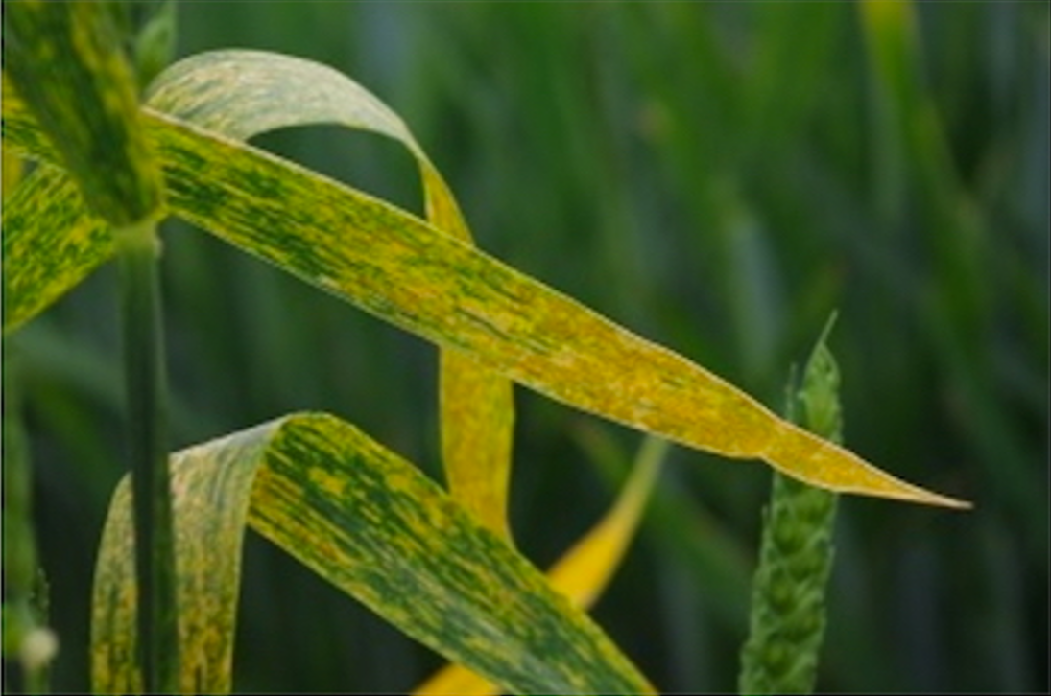
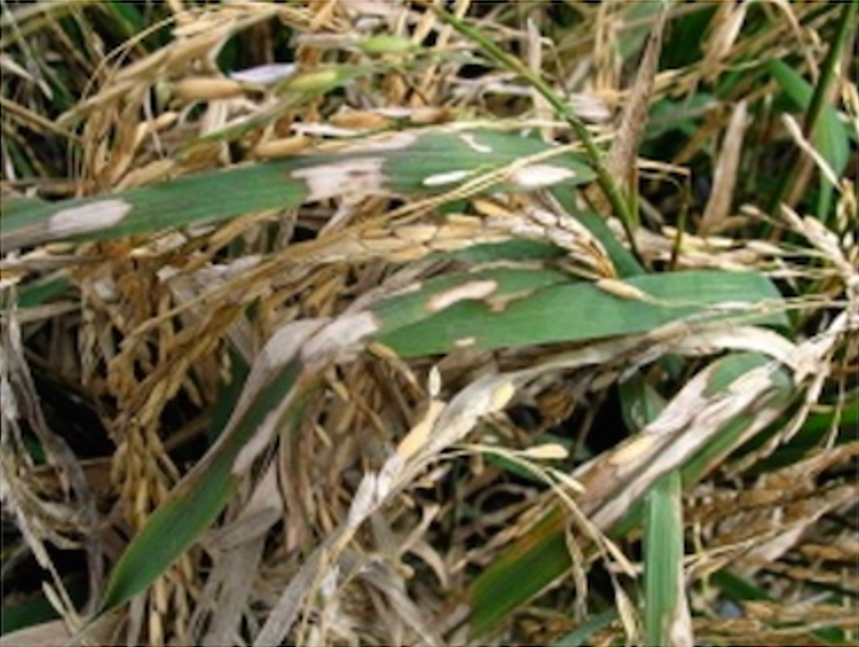
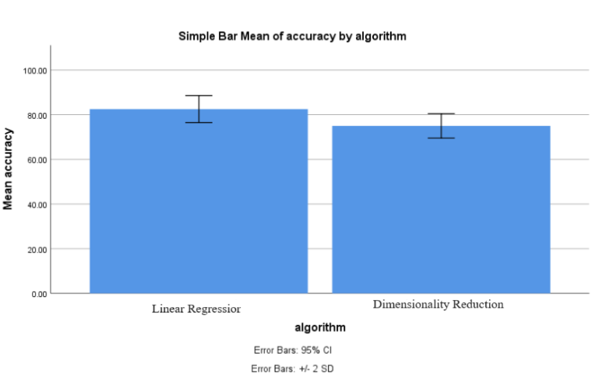
Name: Miss. N.Sree Swarna Register Number: 192119038
Guided by Dr. S.Poompavai
Ms. Poorani.S
Guided by Dr. Mary Valantina. G
Crop Disease Detection Of Pests By Using Linear Regression Algorithm With Dimensionality Reduction
INTRODUCTION
The research paper focuses on employing machine learning techniques, specifically the Linear Regression algorithm with dimensionality reduction, for the task of crop disease detection caused by pests.
The primary aim of the project is to develop a robust system for the early detection of crop diseases caused by pests.
The project involves a comparative analysis of different machine learning algorithms, with a focus on Linear Regression with dimensionality reduction.
Linear Regression with dimensionality reduction offers several advantages within the scope of the project: Dimensionality reduction, Interpretability, Scalability.
In conclusion, the research paper demonstrates the potential of using machine learning algorithms, particularly Linear Regression with dimensionality reduction, for crop disease detection caused by pests.
Linear Regression with dimensionality reduction emerges as a promising approach due to its simplicity, interpretability, and scalability.
Crop Disease Detection Of Pests
MATERIALS AND METHODS
Linear Regression Algorithm
Model Evaluation
Data Source
Data Preprocessing
Feature
Extraction
Train
Test
Dimensionality Reduction
Formatting
Cleaning
Transforming
Model Selection
Deployment
RESULTS
Table1: Accuracy values
Table 2:Group Statistics analysis Linear Regression Algorithm (mean accuracy of 82.50%%) and Statistics analysis of Dimensionality Reduction (mean accuracy of 75.00%) with Sample size, Mean, Standard deviation, Standard Error Mean.
S.No | Linear Regression Algorithm (LRA) | Dimensionality Reduction
1 2 3 4 5 6 7 8 9 10 | 80.2 81.4 82.7 83.6 84.2 85.9 86.1 87.6 88.9 89.1 | 75.1 76.9 77.2 78.5 79.4 80.6 81.5 82.9 83.7 84.9
 | Algorithm | N | Mean | Standard Deviation | Std.error Mean
Accuracy | LRA | 10 | 82.50 | 2.02765 | 0.95743
Accuracy | DR | 10 | 75.00 | 2.73861 | 0.91287
Fig 1:Statistical Analysis Performed using SPSS tool-graph obtained by comparing the Linear Regression Algorithm and Dimensionality Reduction
DISCUSSION AND CONCLUSION
These two Algorithms were assessed across two distinct groups , and a total of 100 samples considered in the analysis
Based on T-test Statistical analysis, the significance value of p=0.001 (independent sample T - test p<0.05) is obtained and shows that there is a statistical significant difference between the group 1 and group 2.
Overall , the accuracy of the Linear Regression Algorithm is 82.50 % and Dimensionality Reduction is 75.00%.
Linear Regression Algorithm(LRA) - 95.52%
Dimensionality Reduction- 85.42%
From the work , it is concluded that the Linear Regression Algorithm attains the high accuracy when comparing with other Dimensionality Reduction in Crop Disease Detection Of Pests
Imbalanced Dataset can lead to biased model, and rapid evolution of Crop Disease Detection Of Pests challenges model adaptability
BIBLIOGRAPHY
Smith, J., & Johnson, A. (Year). "A Review of Machine Learning Techniques for Crop Disease Detection." Journal of Agricultural Technology, Volume (Issue), Pages.
Wang, Y., & Liu, Q. (Year). "Comparative Analysis of Machine Learning Algorithms for Crop Disease Detection." International Conference on Agricultural Engineering, Pages.
Jones, R., & Patel, S. (Year). "Linear Regression with Dimensionality Reduction for Crop Disease Detection: A Case Study." Journal of Agricultural Science, Volume (Issue), Pages.
Patel, M., & Gupta, S. (Year). "Implementing Machine Learning for Crop Disease Detection: Challenges and Opportunities." Conference on Agricultural Technology Innovation, Pages.
Li, X., & Zhang, W. (Year). "Enhancing Crop Health Monitoring through Machine Learning Techniques." International Journal of Agriculture and Environmental Engineering, Volume (Issue), Pages.
Tan, J., & Lim, K. (Year). "Evaluation of Linear Regression with Dimensionality Reduction for Crop Disease Detection." Journal of Crop Science, Volume (Issue), Pages.

