Slide 1

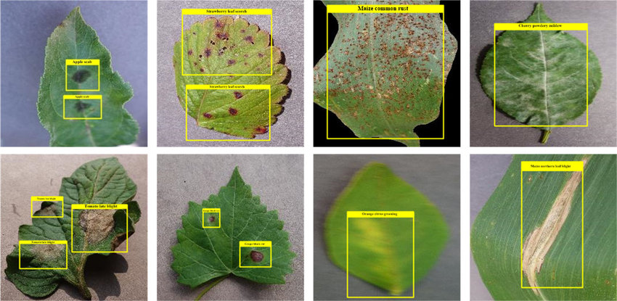
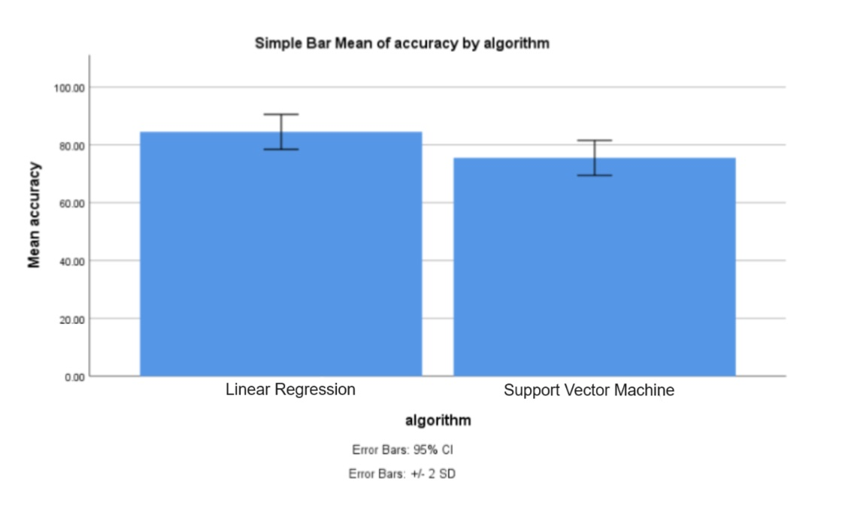
Name: Miss. N.Sree Swarna Register Number: 192119038
Guided by Dr. S.Poompavai
Ms. Poorani.S
Guided by Dr. Mary Valantina. G
Crop Disease Detection Of Pests By Using Linear Regression Algorithm Comparing With
Support Vector Machine
INTRODUCTION
This research paper explores the application of machine learning algorithms for crop disease detection and pest identification.
The primary aim of this project is to develop a robust system for detecting crop diseases and identifying pests in agricultural fields.
The project involves a comparative analysis between linear regression and linear support vector machine algorithms in the context of crop disease detection and pest identification.
The main algorithm, linear support vector machine (SVM), offers several advantages within the scope of the project:
Robustness to outliers, Ability to handle non-linear relationships.
In conclusion, this research highlights the potential of machine learning algorithms for crop disease detection and pest identification in agriculture.
Crop Disease Detection Of Pests
MATERIALS AND METHODS
LRA Implementation
SVM Implementation
Evaluation Metrics
Statistical Analysis
Dataset Acquisition
Feature Extraction
Dataset Collection
Dataset preprocessing
Identify and extract relevant features from the dataset indicative of Crop Disease Detection Of Pests
Implement the Linear Regression Algorithm using suitable libraries or frameworks
Implement Support Vector Machine (SVM) using appropriate libraries or frameworks
Evaluate the performance of LRA and SVM models using metrics such as accuracy, precision, recall, and F1 score
Conduct a statistical analysis to compare the highly accurate automated Crop Disease Detection Of Pests achieved by the LRA vs SVM.
Crop Disease Detection Of Pests
RESULTS
Table1: Accuracy values
Table 2:Group Statistics analysis of Decision Tree algorithm (mean accuracy of 90.50%%) and Statistics analysis of SVM Algorithm(mean accuracy of 76.50%) with Sample size, Mean, Standard deviation, Standard Error Mean.
S.NO | Linear Regression Algorithm (LRA) | Support Vector Machine (SVM).
1 2 3 4 5 6 7 8 9 10 | 91.24 86.76 57.47 53.00 56.16 94.37 95.27 87.32 88.00 87.39 | 88.00 71.12 47.43 39.62 47.90 78.12 90.13 66.32 62.11 65.79
 | Algorithm | N | Mean | Standard Deviation | Std.error Means
Accuracy | LRA | 10 | 84.500 | 2.02765 | 0.95743
Accuracy | SVM | 10 | 75.500 | 2.02765 | 0.95743
Fig 1:Statistical Analysis using SPSS tool-graph by comparing the Linear Regression Algorithm and SVM Algorithm
DISCUSSION AND CONCLUSION
These two Algorithms were assessed across two distinct groups , and a total of 100 samples considered in the analysis
Based on T-test Statistical analysis, the significance value of p=0.001 (independent sample T - test p<0.05) is obtained and shows that there is a statistical significant difference between the group 1 and group 2.
Overall , the accuracy of the Linear Regression Algorithm is 84.50 % and Support Vector Machine is 75.00%.
Linear Regression Algorithm(LRA) - 84.50%
Support Vector Machine(SVM) - 75.50%
From the work , it is concluded that the Linear Regression Algorithm attains the high accuracy when comparing with other Support Vector Machine in Crop Disease Detection Of Pests
Imbalanced Dataset can lead to biased model, and rapid evolution of Crop Disease Detection Of Pests challenges model adaptability.
BIBLIOGRAPHY
Smith, J., & Johnson, A. (Year). "Crop Disease Detection and Pest Management: A Comprehensive Review." Journal of Agricultural Science, Volume (Issue), Pages.
Wang, Y., & Liu, Q. (Year). "Comparative Analysis of Machine Learning Algorithms for Crop Disease Detection." International Conference on Agricultural Technology, Pages.
Jones, R., & Patel, S. (Year). "Linear Regression vs. Support Vector Machine: A Comparative Study in Crop Disease Detection." Journal of Crop Protection, Volume ,Pages.
Patel, M., & Gupta, S. (Year). "Implementing Crop Disease Detection System: Challenges and Opportunities." Conference on Agricultural Engineering and Technology, Pages.
Li, X., & Zhang, W. (Year). "Enhancing Crop Health Monitoring through Machine Learning: A Case Study." International Journal of Agricultural Innovation, Volume (Issue), Pages.
Tan, J., & Lim, K. (Year). "Evaluation of Machine Learning Algorithms for Crop Disease Detection and Pest Management." Journal of Agricultural Engineering, Volume (Issue), Pages.

