Slide 1



₹ CLEARSPEND
ClearSpend
AI-Powered Expense Tracker
& Money Coach
Log spending in one line, trust the numbers, and get warned before your month goes wrong — not after.
BUILT FOR INDIA
UPI • CASH • CARDS
Live: clearspend-ai-expense-tracker.vercel.app
GitHub: sreetejlakkam / ClearSpend-Expense-Tracker-Outskill

Slide 2
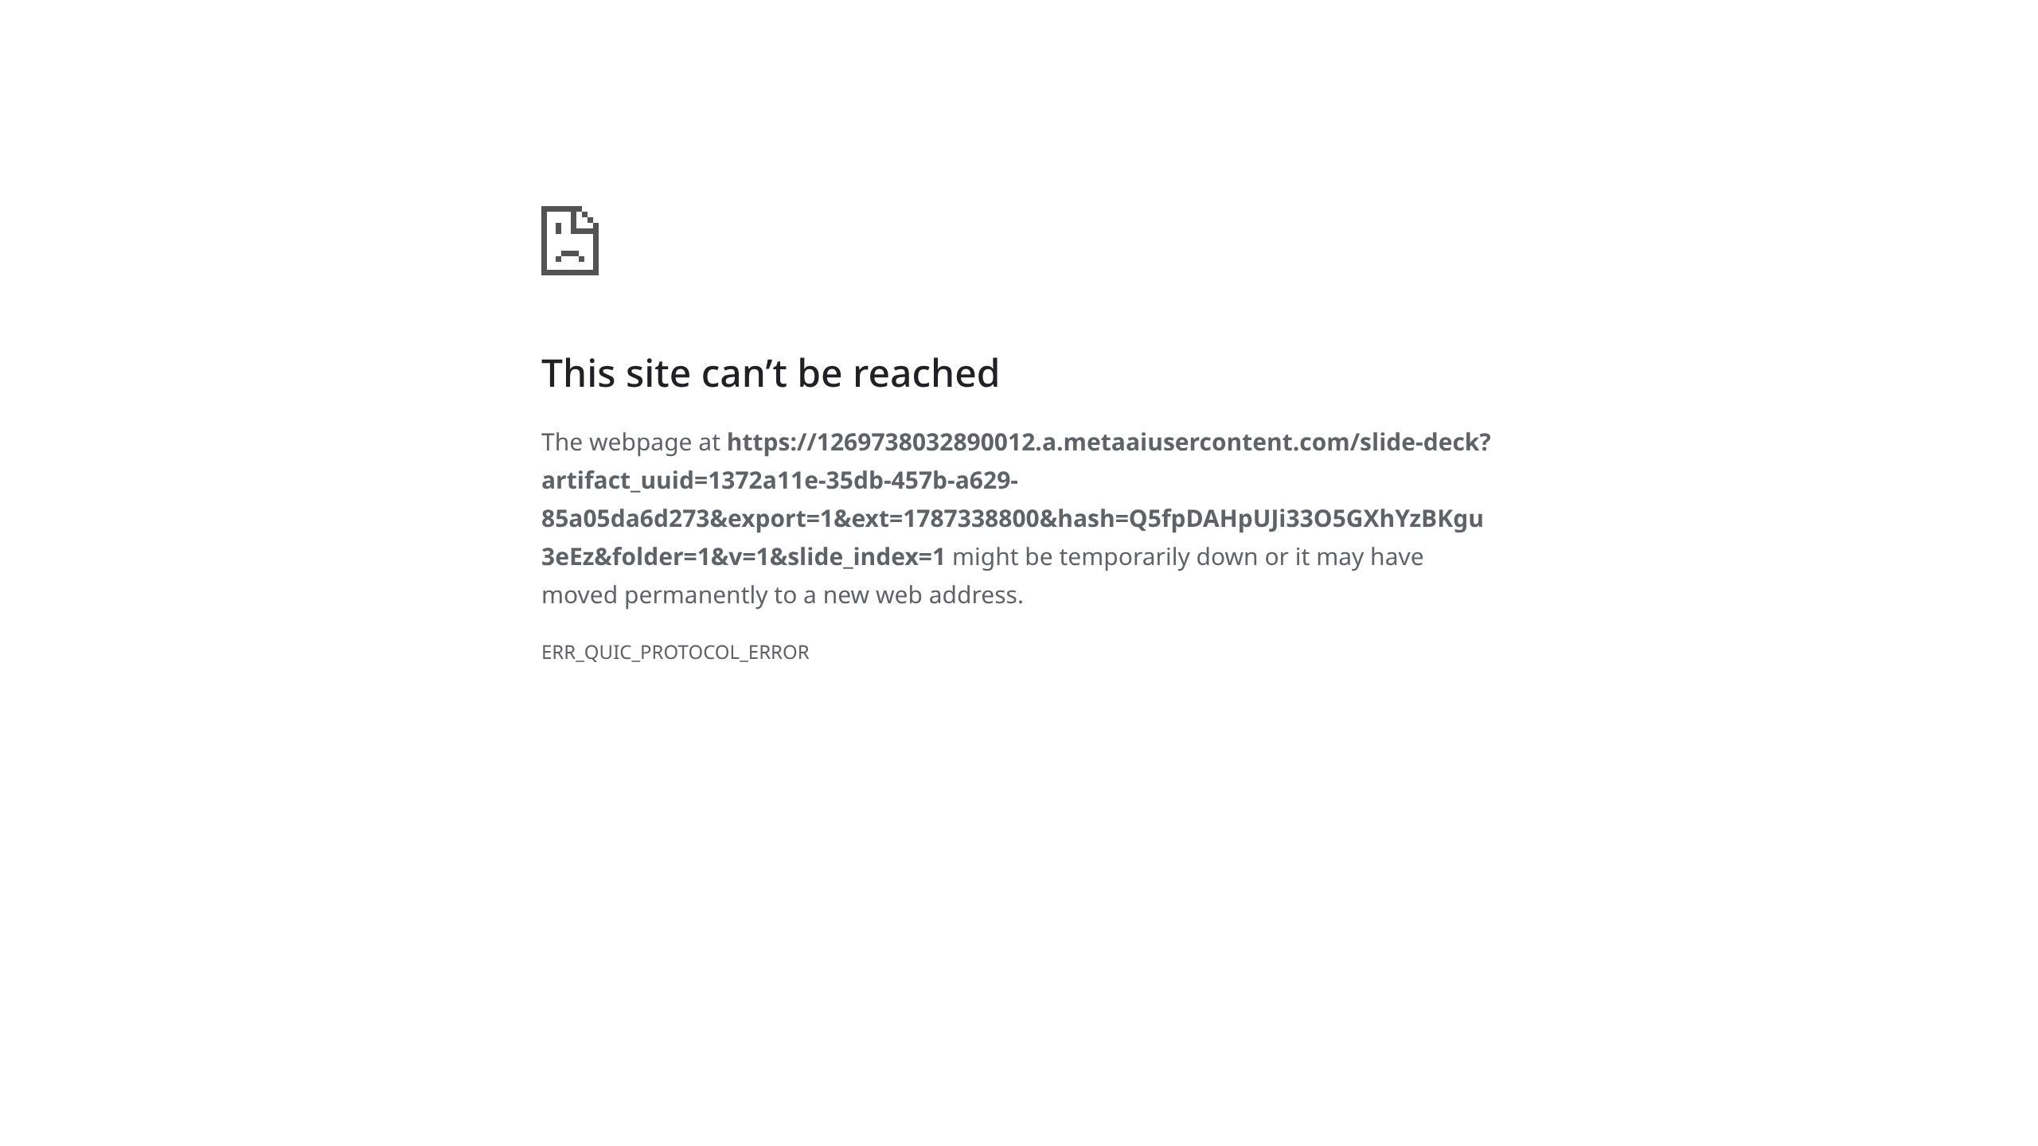

Slide 3


Slide 4


Slide 5


Slide 6


Slide 7


Slide 8


Slide 9


Slide 10


Slide 11


Slide 12


Slide 13


Slide 14


Slide 15


Slide 16


Slide 17


Slide 18


Slide 19


Slide 20


