Slide 1
Cover / Title
• Title: ClearSpend
• Subtitle: AI-Powered Expense Tracker & Money Coach
• Tagline: "Log spending in one line, trust the numbers, and get warned before your month goes wrong — not after."
• Badge: Built for India | UPI • Cash • Cards
• Footer: Live: clearspend-ai-expense-tracker.vercel.app | GitHub: sreetejlakkam/ClearSpend-Expense-Tracker-Outskill
• Visual: Hero image of Indian professional
• Layout: cover

Slide 2
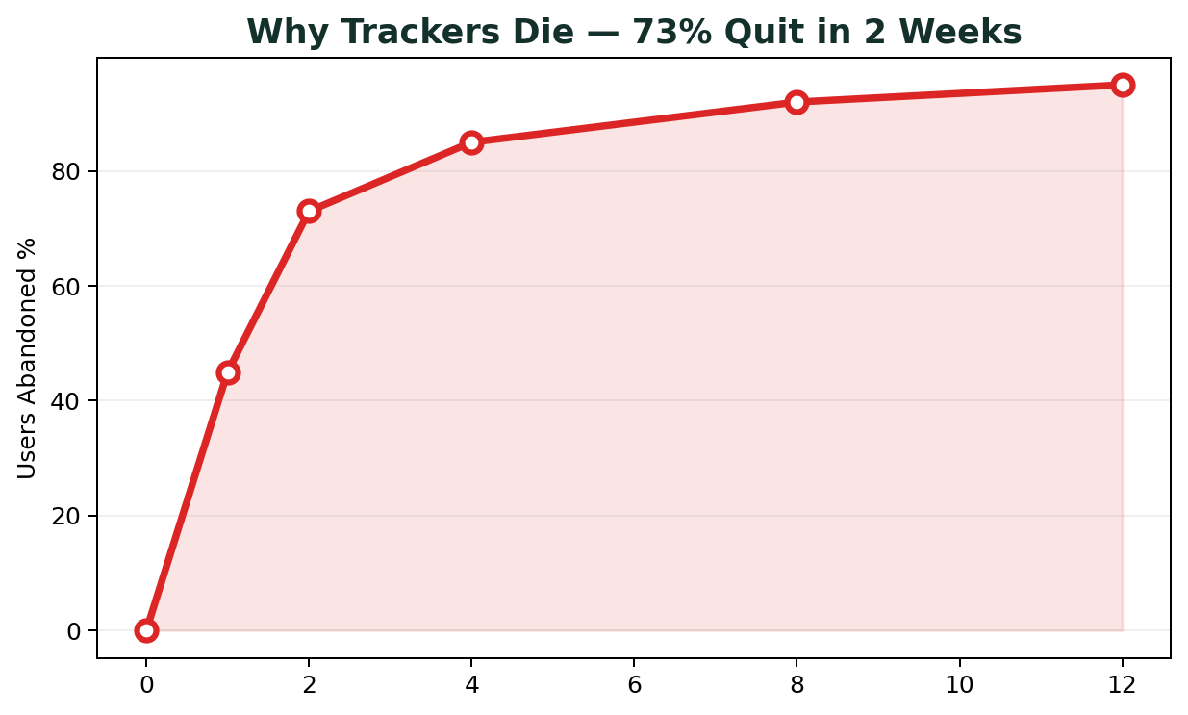
The Problem — Why Expense Trackers Die in 2 Weeks
• Headline: Everyone Downloads. Almost No One Stays.
• Stats: 73% abandon in 30 days (industry avg)
• 3 Pains:
• Logging friction: 5+ fields per expense → 20 sec becomes 2 min chore
• Untrustworthy data: Bank sync duplicates, credit card bill booked as income, wrong categories
• Passive insights: Rearview pie chart after month is already blown
• India context: UPI + Cash + Cards split, SMS alerts noisy, no single app handles ₹2k, ₹, rs shorthand
• Quote: Spendee Play Store reviews: "duplicate transactions, credit-card balances booked as income with no way to fix"
• Visual: abandonment curve chart

Slide 3
Who We Serve — Indian Context
• Headline: Built for Salaried Professionals & Students Managing Money Across Cash, UPI & Cards
• Persona: 22-40yo, Bengaluru/Hyderabad/Mumbai, ₹35k-₹1.2L salary, 10-20 sec bursts right after paying
• Behaviors: Zomato ₹380, Uber ₹450 yesterday, 2k rent, got 50k salary
• Needs: One-handed mobile at 390px, thumb-reach actions, trust over automation
• India-specific: Understands 2k=2000, 1.5k, last Friday, day before yesterday, ₹/Rs symbols
• Visual: persona collage India

Slide 4
Market Gap — What Incumbents Get Wrong
• Headline: Everyone Has Tracking + Categories + Charts. Nobody Owns Trust.
• Table:
• Spendee: Beautiful design, 2500+ banks | Bank sync breaks weeks, duplicates, income misbooking, subscription push
• YNAB: Rigorous zero-based | Steep learning curve, expensive, US-centric
• Walnut / Money Manager India: SMS auto-capture | Noisy parsing, category chaos, dated UI, weak insights
• Insight: The wedge = "The ledger repairs itself and warns you early"
• Visual: competitor pain points

Slide 5
Introducing ClearSpend — The Solution
• Headline: One-Line Capture. Self-Healing Ledger. Proactive AI Coach.
• Three pillars:
• ⚡ Instant: Type "380 zomato lunch" → parsed, categorized, saved <1s
• 🛡️ Trustworthy: Duplicate guard, anomaly >3x median, Review Inbox with Merge/Keep/Delete
• 🔮 Proactive: "At this pace you'll spend ₹18,400 on Food — cap at ₹320/day to stay on track"
• Promise: From tedious chore to effortless peace of mind
• Visual: 3 pillars icon

Slide 6
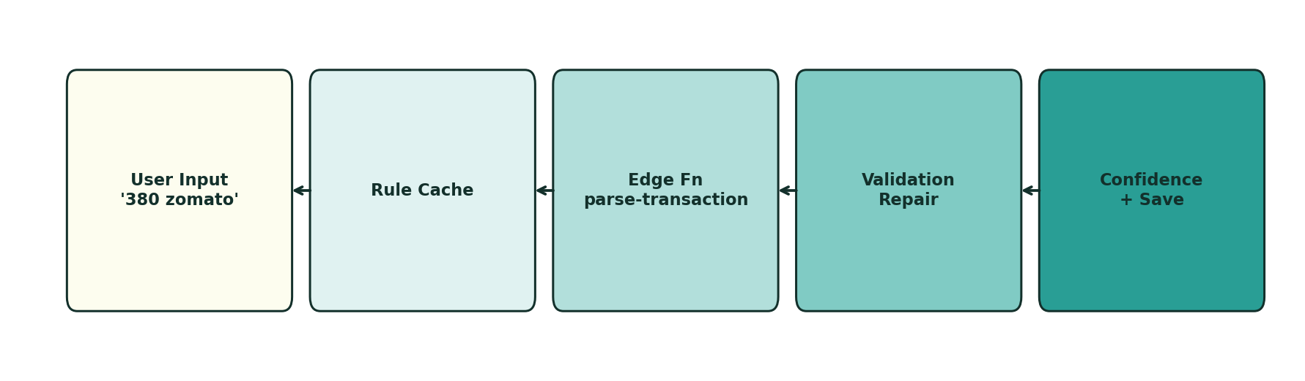
Wow Moment #1 — One-Line Natural Language Quick Add
• Headline: Log 5 Transactions in 60 Seconds. No Forms.
• Demo inputs:
• "380 zomato lunch" → Food ₹380 Today, High confidence
• "2k rent yesterday" → Housing ₹2000 Yesterday, Indian shorthand resolved
• "got 50000 salary" → Income ₹50,000, kind detection
• "paid 450 to uber last friday" → Transport ₹450 Date resolved
• "1.5k bday gift for mom" → Gifts ₹1500
• Tech: LLM Edge Function parse-transaction + offline fallback, validation layer, degraded flag
• Visual: parsing pipeline diagram

Slide 7
AI Feature — Confidence & Transparency
• Headline: We Show Our Work. You Stay in Control.
• Badges:
• High >0.8 → green, auto-trusted
• Check this 0.5-0.8 → amber, please verify
• Guess <0.5 → red, manual review
• UX: Confidence chip on every transaction, tap to edit
• Why it matters: Most AI hides uncertainty. We surface it → builds trust
• Visual: confidence badges UI mock

Slide 8
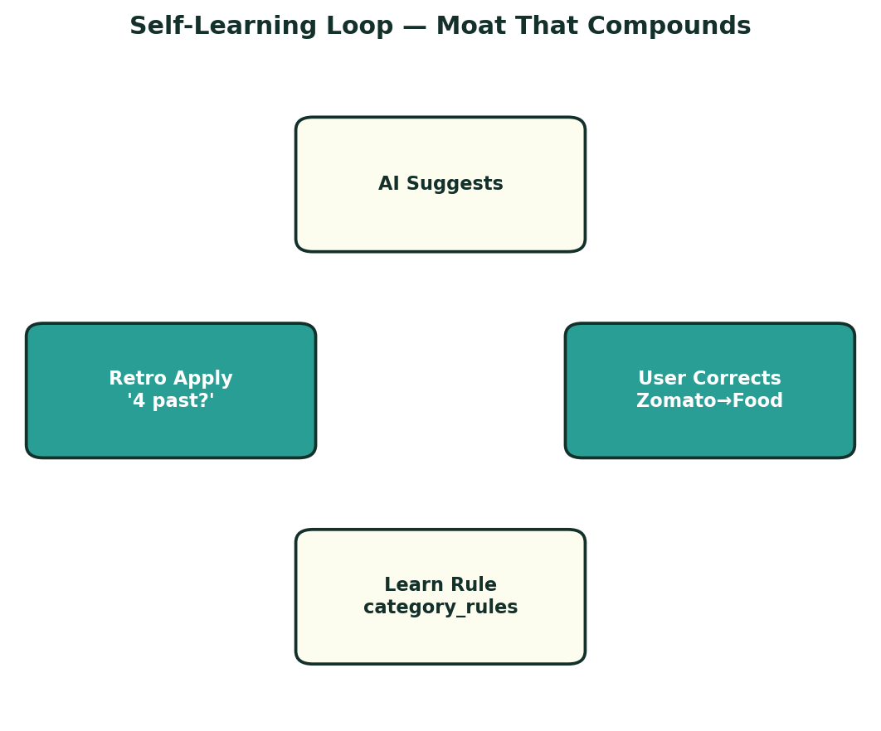
Wow Moment #2 — Self-Learning Category Rules
• Headline: Correct Once. It Learns Forever.
• Flow:
• User corrects Zomato from Shopping → Food
• Toast: "Learned — I'll file Zomato under Food from now on. Apply to 4 past transactions?"
• One-click retroactive update → compounding switching cost
• Storage: category_rules table: match_text(lower), category_id, hit_count
• Moat: Every correction = personalized model. Accuracy rises, cost drops with use
• Visual: learning loop diagram

Slide 9
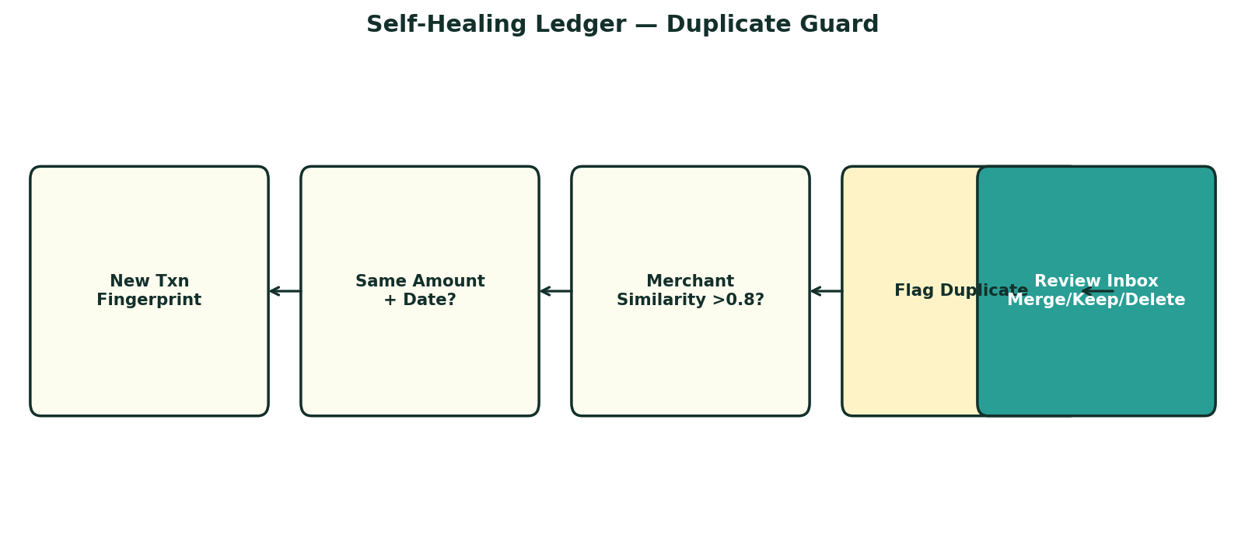
Wow Moment #3 — Self-Healing Ledger & Review Inbox
• Headline: The Failure Mode That Kills Competitors — We Catch It.
• Duplicate Detection:
• Fingerprint matching + same amount/date + merchant similarity (Levenshtein)
• Actions: Merge (keep older, mark newer merged), Keep Both, Delete
• Anomaly Detection: >3x category median flagged as unusual spike
• Review Inbox: Central trust guard, not buried in settings
• Result: Ledger you believe in
• Visual: Review Inbox flow diagram

Slide 10
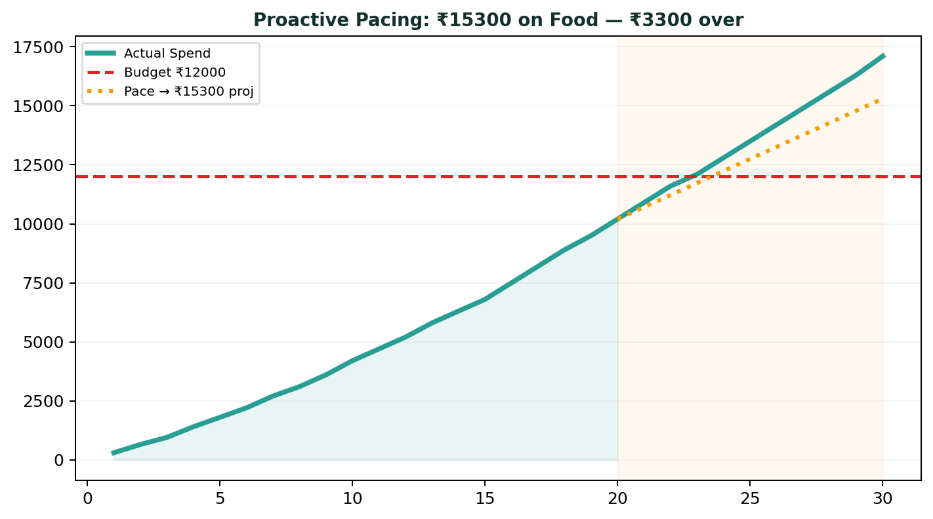
Wow Moment #4 — Proactive Budget Pacing & Forecast
• Headline: Warned Before You Overspend. Not After.
• Calculation: projected = (spent so far / days elapsed) * days in month
• UI:
• Amber at 80% threshold, Red >100%
• Banner: "At this pace you'll spend ₹X on <Category> — ₹Y over budget. Cap at ₹Z/day"
• Daily target: ₹X/day left
• Suggested limits based on 3-month average
• Difference vs others: Client-side compute, no extra API call, appears above the fold
• Visual: pacing chart / forecast

Slide 11
Wow Moment #5 — AI Coach Insight Cards
• Headline: Not a Rearview Pie Chart. A Forward-Looking Coach.
• Types:
• Monthly Forecast & Pace Digest
• Top Movers: Largest MoM increases
• Subscription Creep Detector: Recurring charges across consecutive months
• Streaks & Anomalies
• Generated by: generate-insights Edge Function + payload JSON
• Example: "Swiggy spend up 62% MoM — 12 orders vs 7 last month"
• Visual: insight cards mock

Slide 12
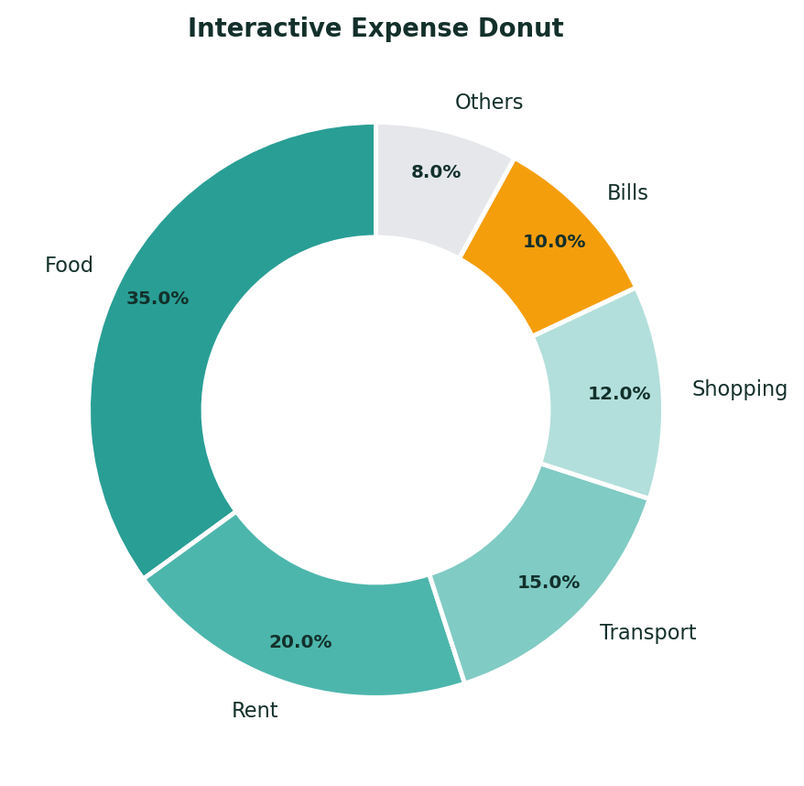
Product Experience — Dashboard That Feels Like Money
• Headline: Numbers Are The Loudest Thing on Screen.
• Components:
• Month totals: Income vs Expense vs Balance
• Interactive Recharts donut — tap slice filters ledger history instantly
• Recent transactions with merchant, category icon, confidence
• Wallets: Cash, Bank, UPI Wallet, Credit Card with opening balances
• Multi-select bulk recategorize/delete, CSV export
• Design System: #FAFAF8 paper, #18181B ink, #0F766E teal accent, #DC2626 expense, #059669 income, Inter font, rounded-xl soft shadow, tabular-nums
• Mobile-first 390px, thumb-reach, 44px tap targets, skeleton loaders, empty states
• Visual: dashboard screenshot / mockup

Slide 13
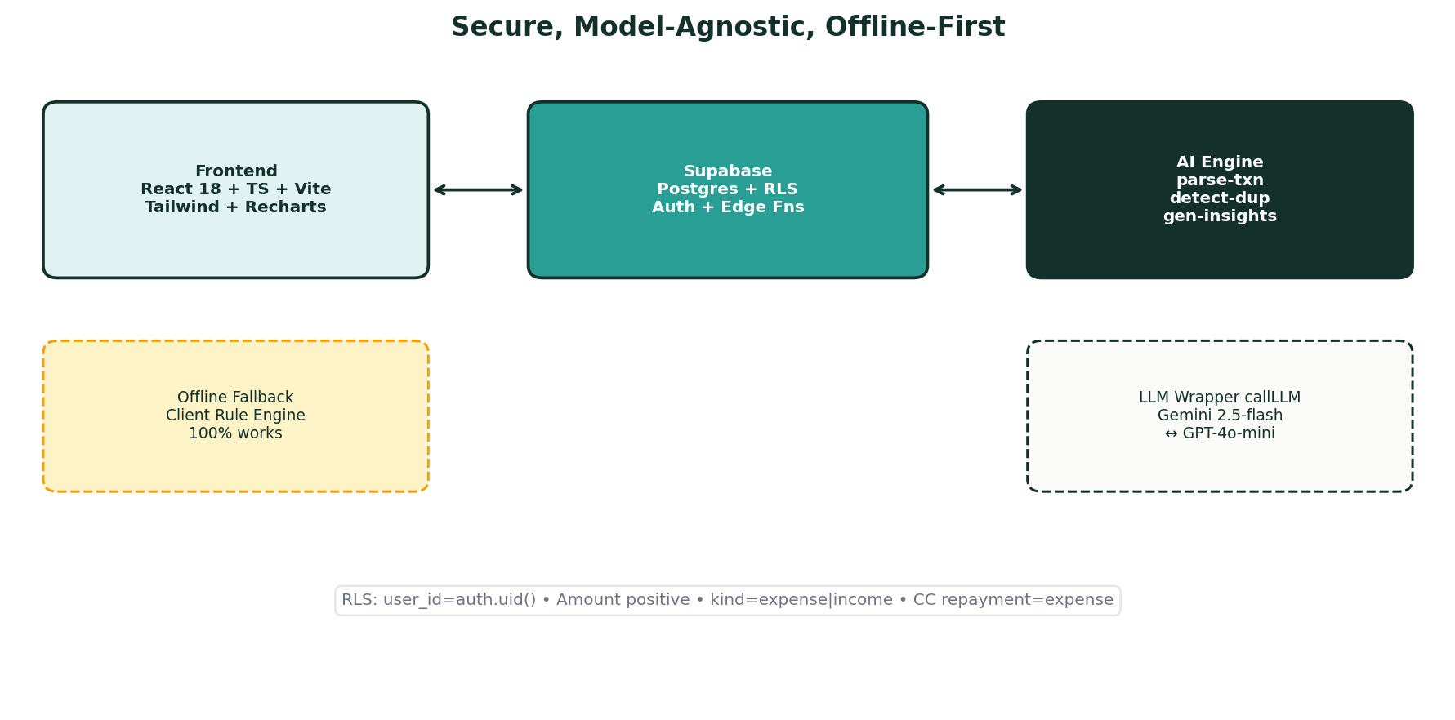
Tech Architecture — Secure, Model-Agnostic, Offline-First
• Headline: LLM Key Never Touches Frontend. 100% Functional Anywhere.
• Stack:
• Frontend: React 18, TypeScript, Vite, Tailwind, Lucide, Recharts, date-fns, Confetti
• Backend: Supabase Postgres + RLS (user_id = auth.uid()) on all tables, Auth, Edge Functions
• AI: Edge Functions: parse-transaction, detect-duplicates, generate-insights; callLLM wrapper Gemini 2.5-flash / gpt-4o-mini switch via env
• Fallback: High-fidelity offline client rule engine → works out-of-box, no keys
• Schema highlights: transactions amount always positive, kind carries direction, fingerprint, status active/merged/dismissed
• Visual: architecture diagram

Slide 14
Why Trustworthy — Data Integrity by Design
• Headline: We Chose Trustworthy Ledger Over Unreliable Feed.
• Rules:
• Amounts always positive, direction via kind (expense/income)
• Credit card repayment = expense, never income (fixes competitor bug)
• RLS on all tables, validation layer repairs single field not whole result
• Offline-first, degrades gracefully: if Edge Function fails → manual save still works
• Q&A Ready:
• Why no bank sync? Top cause of failure, can't be reliable in 3 days. CSV covers bulk.
• What stops LLM getting categories wrong? Deterministic rule cache → LLM → confidence → permanent rule learning
• What's defensible? category_rules table = compounding switching cost
• Visual: trust shield diagram

Slide 15
Differentiation — ClearSpend vs Others
• Headline: Not Just Another Tracker. A Ledger That Learns and Warns.
• Matrix (5 columns):
• Feature: One-line NL add, Indian shorthand 2k, Self-learning rules, Duplicate guard, Proactive pace forecast, Confidence badges, Offline-first, Retroactive apply, Subscription creep, CSV + Bulk
• ClearSpend: Yes all
• Spendee: No / Partial
• YNAB: No
• Walnut: Partial / No
• Moat Summary: Learning loop + Trust guard + Proactive coaching
• Visual: comparison table graphic

Slide 16
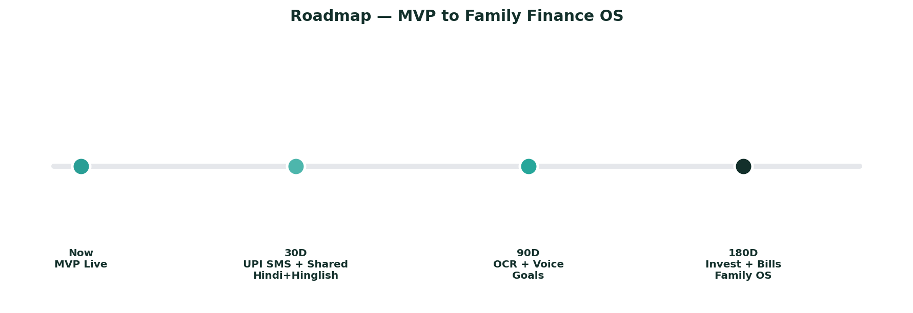
Business Model & Roadmap — India First
• Headline: From Hackathon MVP to Family Finance OS
• Monetization:
• Freemium: Free 200 transactions/month, Pro ₹199/month or ₹999/year
• Pro: UPI SMS auto-capture, shared wallets (family/couple), advanced insights, export
• B2B: Expense management for startups SMEs
• Roadmap:
• Next 30 days: UPI SMS parser (on-device), shared wallets for families, Hindi + Hinglish NL
• Next 90 days: Receipt OCR, voice add, goal-based budgeting
• Next 180 days: Investment tracking, bill reminders
• Market: 900M UPI users, 65M salaried filing ITR, ₹5T personal finance app TAM
• Visual: roadmap timeline

Slide 17
Traction — Built, Shipped, Demo-Ready
• Headline: Not a Mockup. Live on Vercel With One-Click Demo.
• Metrics:
• 40+ seeded realistic transactions across 2 months (Food, Rent, Transport, UPI)
• 1 deliberate duplicate planted for Review Inbox demo
• Insights pre-generated (no live API lag risk)
• 5 phrasings tested: 2k rent, got 50000 salary, 380 zomato etc.
• Fresh incognito signup works end-to-end
• Links:
• Live: clearspend-ai-expense-tracker.vercel.app
• GitHub: github.com/sreetejlakkam/ClearSpend-Expense-Tracker-Outskill
• Visual: traction / demo screen

Slide 18
Build Story — 3-Day Sprint
• Headline: 3 Days. One Product. Zero Excuses.
• Order:
• Principles: Small commits, working main, handle every failure state, mobile-first
• Visual: build timeline

Slide 19
Demo Script — 3 Minutes to Wow
• Headline: How We Win Demo Day in 180 Seconds
• Script:
• Problem 20s: "Everyone downloads, almost everyone quits... bank feeds produce duplicates, card payments as income. Once you stop trusting number, you stop opening app."
• Solution 15s: "ClearSpend. One-line logging, ledger repairs itself, warns before month goes wrong."
• Live 90s: Type 380 zomato lunch → parsed; 2k rent yesterday → shorthand+date; correct category → Learned toast + retro apply; Review Inbox → Merge duplicate; Dashboard → amber forecast card "At this pace you'll be ₹4,200 over"
• Close 15s: "Next: UPI SMS auto-capture + shared wallets for families. We skipped bank aggregation deliberately — trustworthy ledger > unreliable feed."
• Visual: stopwatch / flow

Slide 20
Closing — Try It Now
• Headline: Log Spending in One Line. Trust The Numbers.
• CTA:
• Scan QR → Live App
• GitHub Repo + README + Build Playbook
• One-Click Demo Mode button
• Tagline: Built with ❤️ for financial wellness. Made for India.
• Team: Sreetej Lakkam + Outskill Hackathon
• Footer: ClearSpend — AI Expense Tracker & Money Coach | MIT License
• Visual: closing hero with confetti / celebration

