Slide 1
Agentic RAG Chatbot using MCP
End-to-End Chatbot with Multi-Agent Collaboration, RAG & LLaMA2

Slide 2
Agent-Based Architecture with MCP
• Modular agents: Ingestion, Retrieval, LLM
• MCP (Message Control Protocol) for communication
• Messages carry sender, receiver, type, trace_id, and payload
• Each agent focuses on a specific task
• Router handles message passing and memory

Slide 3
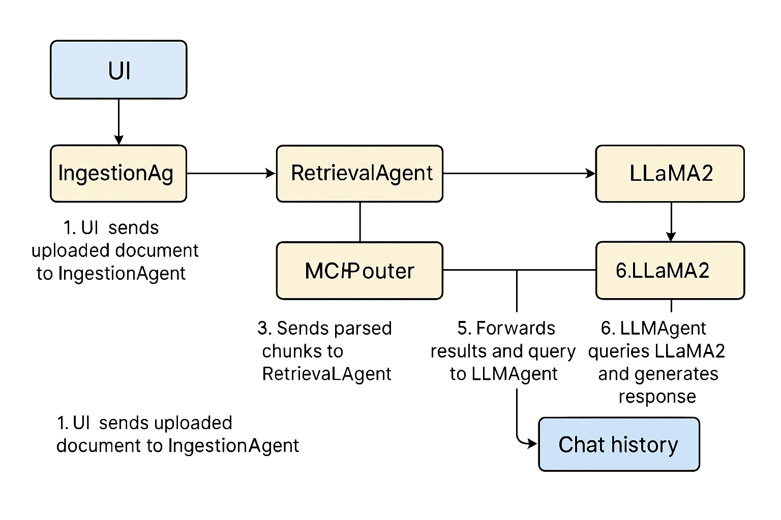
System Flow Diagram
1. UI sends uploaded document to IngestionAgent
2. IngestionAgent parses and vectorizes content
3. Sends parsed chunks to RetrievalAgent
4. RetrievalAgent performs semantic search
5. Forwards results and query to LLMAgent
6. LLMAgent queries LLaMA2 and generates response
7. Response shown in UI & stored in chat history

Slide 4
Tech Stack Used
Frontend: Streamlit
Backend: Python (agents, router, message protocols)
Embeddings: SentenceTransformers (MiniLM)
Vector DB: ChromaDB
LLM: LLaMA2 via Ollama
File parsing: PyMuPDF, pandas, python-docx, python-pptx

Slide 5
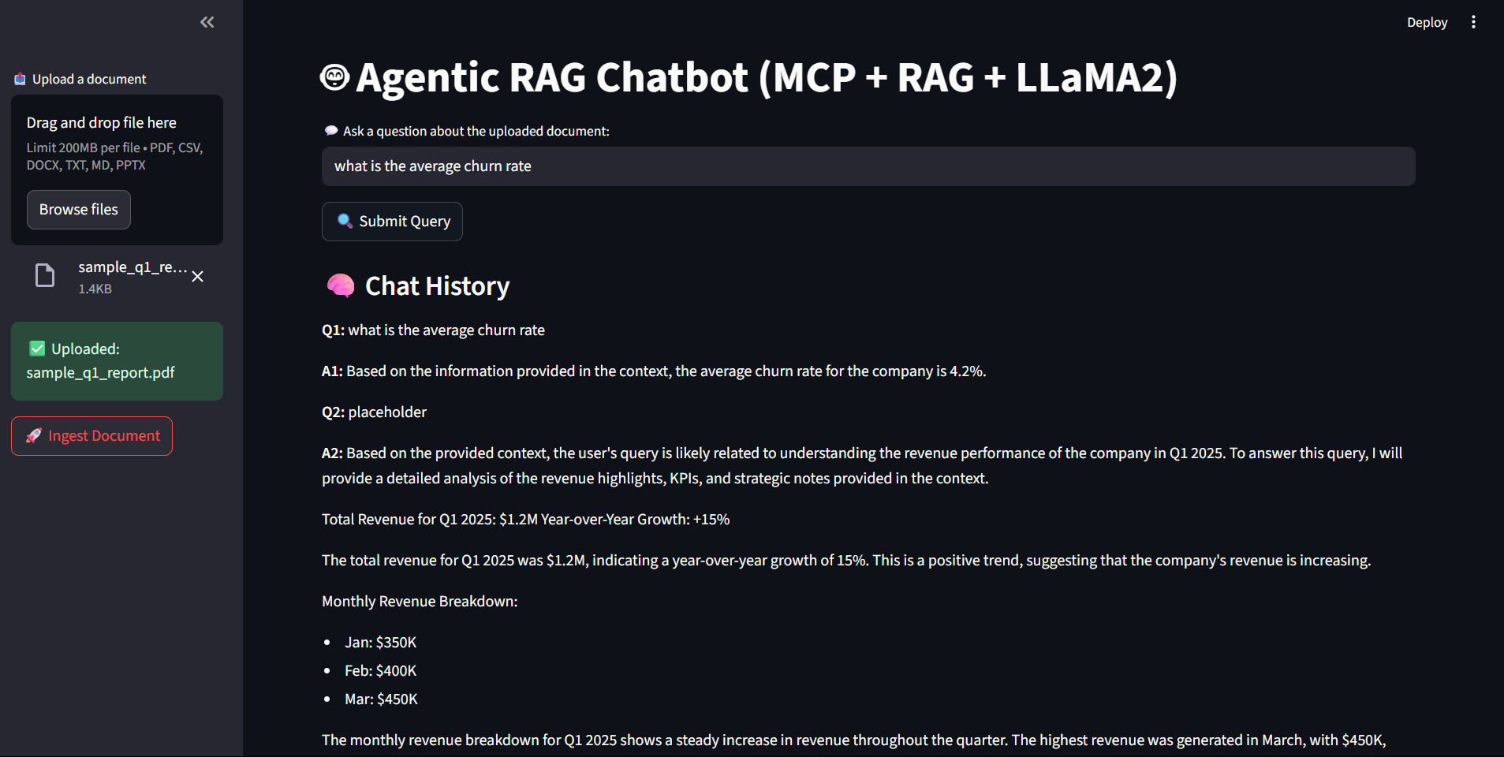
UI Screenshots of Working App

Slide 6
Challenges & Future Scope
Challenges Faced:
• faiss-cpu install errors (resolved by switching to ChromaDB)
• Ollama configuration and LLaMA model runtime
• Integrating multiple file formats cleanly
• Maintaining state with agentic messaging
Future Improvements:
• Add authentication layer
• Expand to multilingual support
• Fine-tune LLaMA2 on domain-specific data
• UI enhancements and persistent DB for chat logs

