Slide 1
Enhancing college management using cognos

Slide 2
Team members: r. v. manvithA – 221191101117 u. sreevanI -- 221191101143 s . thishitha -- 221191101121

Slide 3
ABSTRACT:
College Insights is a transformative project designed to enhance college management systems by
leveraging cognos BI. This project integrates diverse data sources, including student records,
course enrollment, faculty information, and administrative data, to provide real-time insights and
actionable recommendations. By analyzing this comprehensive dataset, College Insights enables
colleges to make informed decisions in critical areas such as student performance tracking,
resource allocation, scheduling, and institutional planning. This project aims to optimize operational
efficiency, improve student success rates, and enhance overall organizational effectiveness. College
Insights revolutionizes college management by harnessing the power of data analysis for smarter desicion-making and continuous improvement.

Slide 4
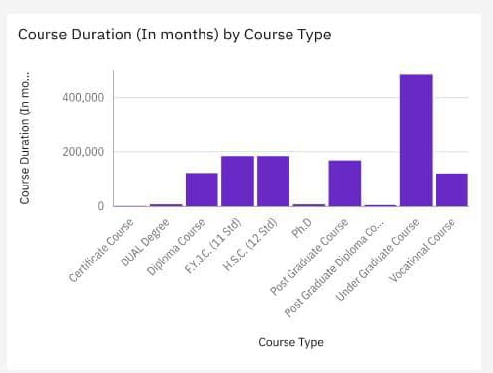
The bar chart shows the course duration in months for different types of courses. The courses are listed along the vertical axis, and the duration in months is on the horizontal axis . Here's the course duration for each type : Vocational Course: Approximately 600,000 months NCE (ED) SE: Approximately 200,000 months NCE (ED) SCE: Approximately 150,000 months Diploma Course: Approximately 100,000 months Dual Course: Approximately 100,000 months Certificate Course: Approximately 50,000 months The Vocational Course has the longest duration, followed by NCE (ED) SE. The Certificate Course has the shortest duration.

Slide 5
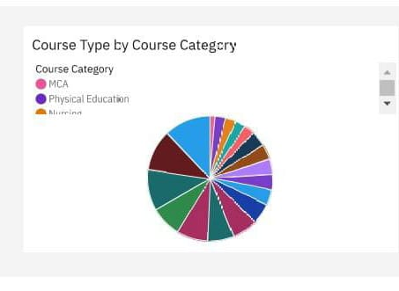
The pie chart displays the distribution of course types by course category. Each segment of the pie chart represents a different course category, and the legend indicates the specific categories .From the visible part of the legend, we can see:
MCA (Magenta)
Physical Education (Purple)
Nursing (Orange)
The colour in the pie chart correspond to these and other course categories. Without more detailed labelling on the segments, it's difficult to provide exact proportions for each category. However, the chart clearly shows a variety of course types, each represented by a different colour in the pie chart.

Slide 6
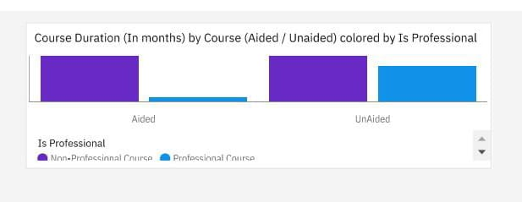
The chart displayed appears to be a bar graph illustrating the course duration in months, categorized by whether the course is aided or unaided and further coloured by whether the course is professional or non-professional . Here’s a detailed interpretation of the chart:
Course Types:
Aided Courses: These are represented by the top pair of bars.
Unaided Courses: These are represented by the bottom pair of bars.
Colour Coding:
Professional Courses: Depicted in purple.
Non-Professional Courses: Depicted in blue.

Slide 7
DURATION:
The aided professional courses have a duration indicated by the length of the purple bar in the top section .
The unaided professional courses have a duration indicated by the length of the purple bar in the bottom section .
The aided non-professional courses have a duration indicated by the length of the blue bar in the top section .
The unaided non-professional courses have a duration indicated by the length of the blue bar in the bottom section
From the chart, it seems that : The aided professional courses have a significantly longer duration compared to the unaided professional courses .
The unaided non-professional courses have a shorter duration compared to the aided non-professional courses .
The exact durations would need to be read from the chart, but this provides an overview of the visual representation.

Slide 8
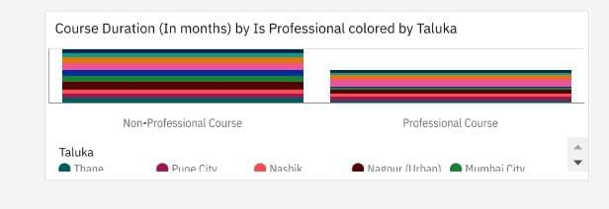
The image shows a bar chart comparing the course duration (in months) for professional and non-professional courses, with the data categorized by different Talukas (administrative subdivisions) in India .
Key details : The left side of the chart represents non-professional courses .
The right side of the chart represents professional courses .
Each bar within these sections is coloured according to a specific Taluka Talukas mentioned include Thane, Pune City, Nashik, Nagpur (Urban), Mumbai City, among others . The visualization aims to illustrate the distribution and length of course durations across various Talukas for both types of courses.

Slide 9
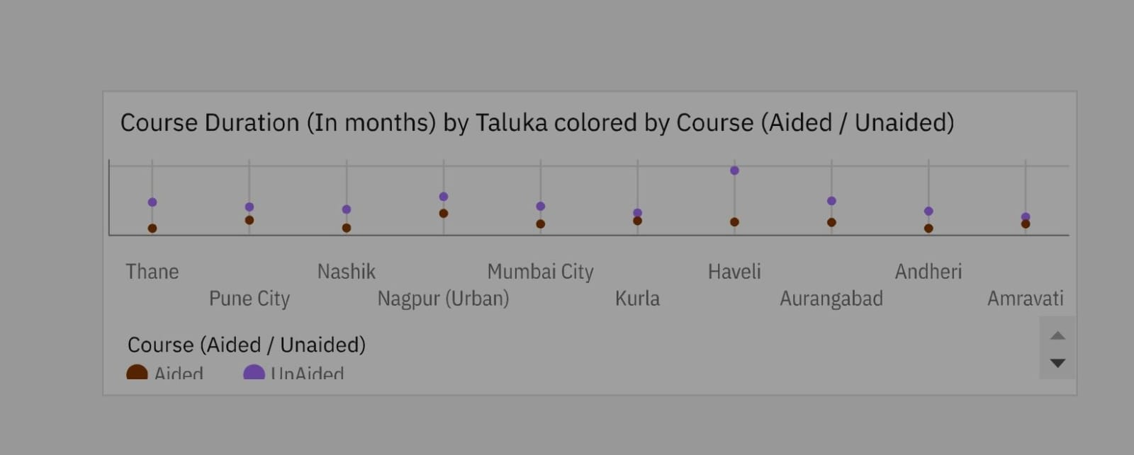
The image shows a dot plot chart depicting the course duration (in months) for different Talukas, with the courses coloured by whether they are aided or unaided .
Key details : Each column represents a specific Taluka
(e.g., Thane, Pune City, Nashik, Mumbai City, Nagpur (Urban), Kurla, Haveli, Aurangabad, Andheri, Amravati).
Each dot within the columns indicates the duration of a course in months .
The colour of the dots differentiates between aided (brown) and unaided (purple) courses.
This visualization helps compare the duration of aided versus unaided courses across various Talukas.

Slide 10
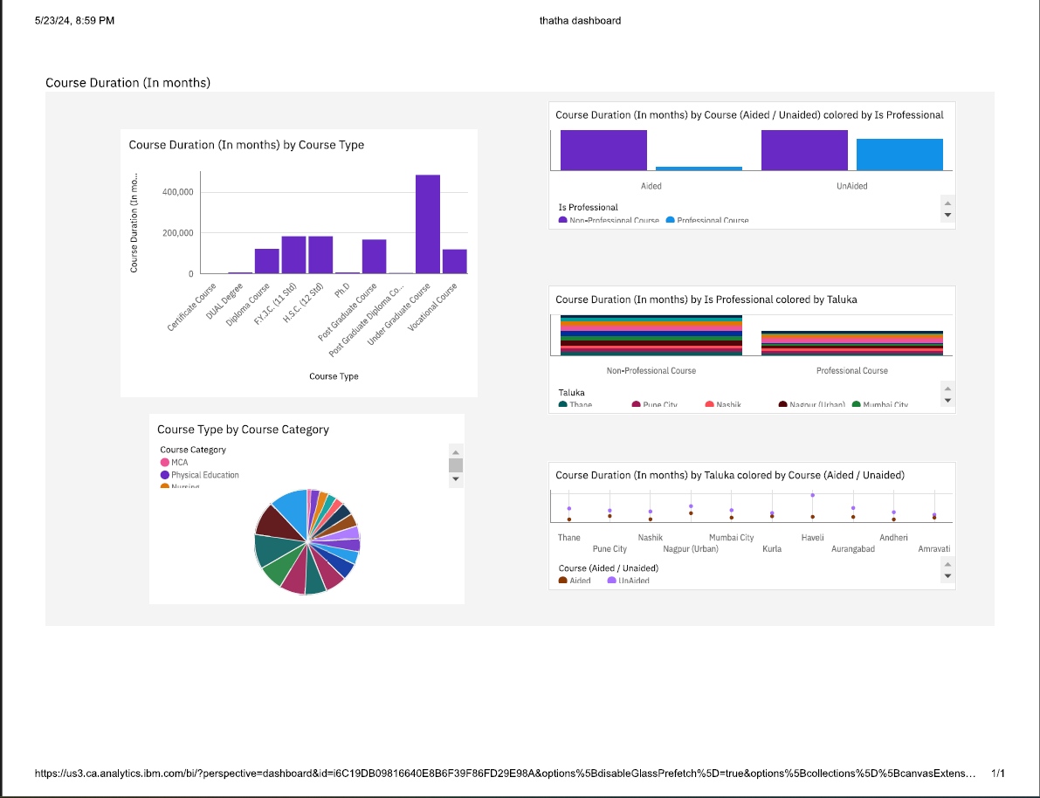

Slide 11
INSIGHTS:
Enhancing college management using IBM Cognos provides several key insights into how educational institutions can leverage data-driven strategies for improved performance and decision-making. Here are some of the main insights :
Data Integration and Accessibility : Cognos consolidates data from various sources, such as student records, financial systems, and academic databases, into a single platform. This integration facilitates seamless access to comprehensive information, breaking down silos and enabling a holistic view of the institution's operations .
Improved Decision-Making : With advanced analytics and reporting tools, Cognos enables college administrators to make informed decisions. Predictive analytics can forecast enrollment trends, financial health, and student performance, allowing for proactive measures and strategic planning .
Enhanced Reporting and Compliance : The platform offers customizable dashboards and automated reporting capabilities, ensuring that compliance with accreditation standards and regulatory requirements is met efficiently. Accurate and timely reports also support transparency and accountability within the institution.

Slide 12
CONCLUSION:
In conclusion, leveraging IBM Cognos for enhancing college management presents a transformative opportunity to optimize administrative functions and improve decision-making processes. Cognos, as a robust business intelligence and performance management tool, facilitates the integration of data across various departments, offering a unified platform for comprehensive data analysis and reporting. By implementing Cognos, colleges can achieve greater efficiency in managing student information, financial records, and academic performance metrics.
The tool's advanced analytics capabilities enable predictive modeling and trend analysis, helping institutions to anticipate challenges and opportunities, thereby fostering a proactive approach to management. Additionally, the user-friendly interface and customizable dashboards ensure that stakeholders at all levels can access relevant information promptly, enhancing transparency and accountability.

Slide 13
Overall, the deployment of Cognos in college management systems supports data-driven strategies that lead to improved operational effectiveness, enhanced educational outcomes, and an enriched campus experience for students and staff alike. This strategic adoption positions institutions to navigate the complexities of modern education with agility and informed precision.

Slide 14
THANK YOU

