Slide 1
Mathematical Foundations of Data Science: mini-project
A
U
·
Σ
·
V^{T}
Clustering ideas, not words
=
Finding topics in documents with Latent Semantic Analysis and the singular value decomposition
Team:
Sreevatshan S – PES2UG25CS541
Tanisha Sinha - PES2UG25CS574
Tanu Bansal - PES2UG25CS576
Sonali Kumar - PES2UG25CS538
1,404 words × 400 articles, kept as 5 concepts
Notes:
Our project asks a simple question: can a computer group documents by what they are about, rather than by the exact words they use?
The answer is Latent Semantic Analysis. It is one idea from linear algebra: write the documents as a matrix A and take its singular value decomposition, A = U Σ Vᵀ.
The coloured blocks on the right are that factorisation for our real data set: 1,404 words by 400 news articles, compressed to 5 concepts.

Slide 2
Two articles about web search share no words, so word vectors call them unrelated
Autonomy, Mamma.com Join Desktop Search Ranks
Not to be left out of desktop search, two search vendors on Monday leaped into the growing space for managing e-mail, documents and other hard-drive data.
kept words: com, data, desktop, drive, growing, hard, join, left, mail, monday, ranks, search, space
New Version Of Google Groups Launched
Shannon Bauman, Associate Product Manager of Google Groups announced the launch of a new and improved Google Groups. Whether your interests run to knitting or brain surgery, chances are good other people out there share them.
kept words: announced, chances, good, google, groups, launch, launched, manager, new, people, product, run, share, surgery
0
0.00
0.98
indexed words in common
cosine similarity of their word vectors
cosine similarity after keeping 5 concepts
Both are filed under Sci/Tech in the AG News collection. The rest of this talk explains where the 0.98 comes from.
2
Notes:
Here are two real articles from our data. One is about desktop search tools, the other about a new version of Google Groups. A human sees immediately that they are both about internet search products.
After removing common words, the two articles have no word in common. Represented as word vectors, they are perpendicular: cosine similarity exactly 0. Any method that compares words directly, including k-means on TF-IDF vectors, treats them as unrelated.
After LSA keeps 5 concepts, their cosine similarity is 0.98. The other 398 articles connect their vocabularies: words like Google, search and software keep appearing together, and the SVD turns that into shared concepts.

Slide 3





Five steps from raw text to topics
1
2
3
4
5
Count words
Build A
Factorise
Keep k
Use it
Clean each document and count its meaningful words.
›
Stack the counts as columns and weight with TF-IDF.
›
Take the singular value decomposition of A.
›
Keep only the k strongest concepts.
›
Cluster documents, and fold in queries to search.
Each step is one chapter of the interactive lab, and is checked by the test suite.
3
Notes:
The whole method is five steps. Steps 1 and 2 turn text into a matrix. Step 3 is the singular value decomposition. Step 4 keeps only the strongest k concepts; this truncation is where LSA gets its power. Step 5 uses the compressed representation: k-means clustering, and search by folding a new query into the same concept space.
The rest of the talk follows these five steps, and the small squares at the bottom of each slide show which step we are on.

Slide 4
Three collections, each chosen to teach one thing
Collection | Matrix A | Why it is here
Classic: 9 paper titles from the 1990 LSA paper | 12 × 9 | Small enough to read every number. Reproduces the paper's published results exactly.
Science: 24 one-sentence blurbs (our first version) | 285 × 24 | Shows when LSA has little to work with: almost no shared vocabulary.
News: 400 real AG News articles, 100 per section | 1,404 × 400 | Real, messy text. The main benchmark for clustering and search.
Every number in this deck is produced by one command, python main.py deck, and checked by the tests in tests/test_lsa.py.
4
Notes:
We use three collections. The classic one is the worked example from Deerwester and colleagues' 1990 paper that introduced LSA: nine titles, twelve words. It is small enough to see every number, and our code reproduces the paper's published numbers exactly.
The science collection is the one we started with: 24 one-sentence blurbs. It taught us something: when documents share almost no words, the SVD has nothing to find.
The news collection is the main experiment: 400 real articles from the AG News corpus, 100 each from World, Sports, Business and Sci/Tech. The labels are only used to score the result, never to build it.

Slide 5
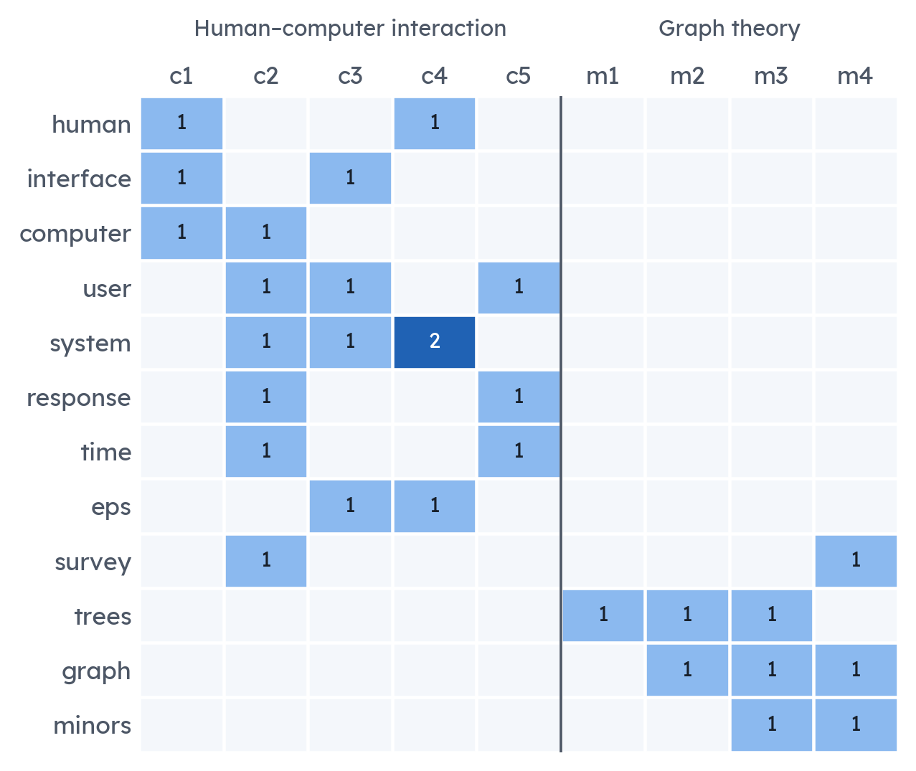
Documents become columns of a sparse term–document matrix A
Each entry is the weight of word i in document j:
Frequent in this document: larger tf.
Rare in the collection: larger idf.
Every column scaled to length 1, so long and short articles are comparable.
99.0%
72%
of the 1,404 × 400 news matrix is zero
of same-section article pairs share no word at all
Step 1 of 5: Words
5
Notes:
On the left is the full term–document matrix of the classic example: twelve words by nine titles, raw counts. Five titles are about human–computer interaction, four about graph theory.
For real text we weight the counts with TF-IDF: a word counts more when it is frequent in this document and rare across the collection. Then every column is scaled to unit length. Our implementation is written out by hand and a test checks it matches scikit-learn exactly.
The key fact is sparsity: 99% of the news matrix is zero, and 72% of pairs of articles from the same section have no word in common. Comparing columns of A directly cannot work.

Slide 6
The SVD splits A into word concepts, strengths and document concepts
A
U
Σ
V^{T}
U: each column is a concept written as word weights. Orthonormal: UᵀU = I.
Σ: singular values σ₁ ≥ σ₂ ≥ … ≥ 0, how much of A each concept explains.
V: row j says how strongly document j uses each concept. Orthonormal: VᵀV = I.
·
·
=
r × r
r × 400
1,404 × 400
1,404 × r
Why these are the right directions:
V holds the eigenvectors of the document–document matrix AᵀA and U those of the word–word matrix AAᵀ. Verified numerically to about 10⁻¹⁴ in the app.
Step 2 of 5: SVD
6
Notes:
The singular value decomposition writes any real matrix as U Σ Vᵀ. Unlike an eigendecomposition it works for rectangular matrices, which is exactly what a words-by-documents matrix is.
U's columns are concepts expressed as word weights. Σ is diagonal and holds the singular values in decreasing order: the strength of each concept. V's rows place each document on the concepts.
Why are these meaningful? Multiply out AᵀA and the U's cancel because UᵀU is the identity: AᵀA = V Σ² Vᵀ. So V contains the eigenvectors of the document similarity matrix and σᵢ² its eigenvalues. Likewise U for the word co-occurrence matrix AAᵀ. In the app we check each of these properties numerically on the real matrix.

Slide 7
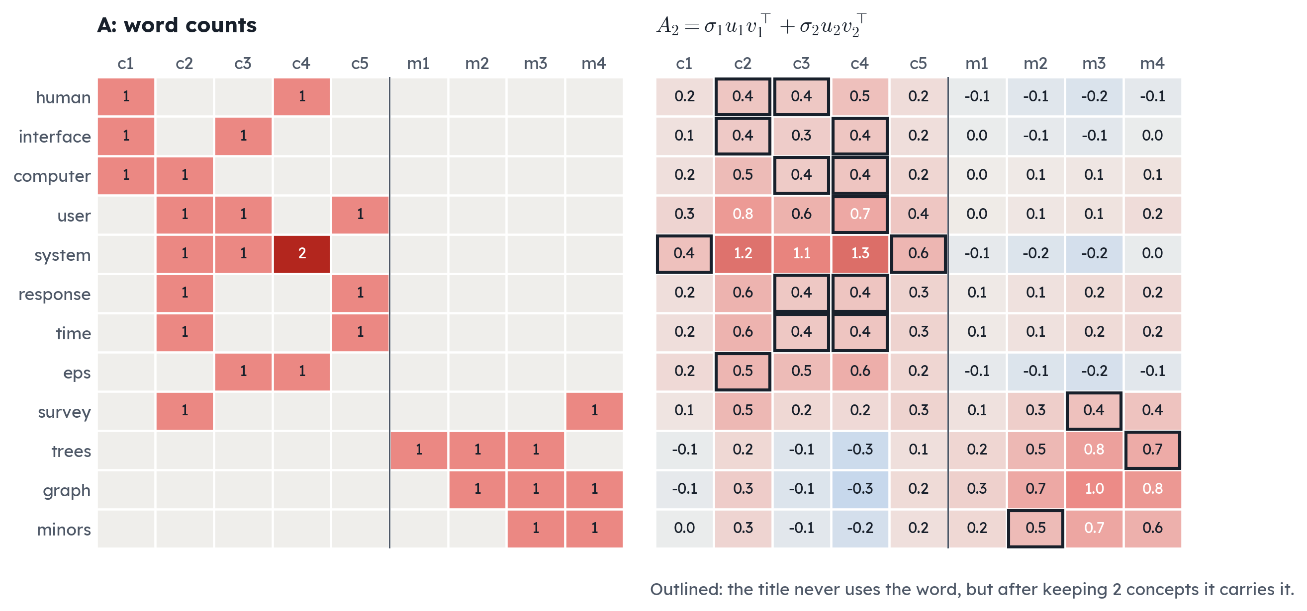
Two rank-1 layers already rebuild the structure of the 1990 example
Step 2 of 5: SVD
7
Notes:
Another way to read the SVD: A is a sum of rank-one layers, σᵢ uᵢ vᵢᵀ, strongest first.
On the left is the original count matrix, on the right the sum of just the first two layers. Two layers already capture 57% of the energy, and the block structure is clear: computer-interaction words light up in the c-titles, graph words in the m-titles.
The outlined cells are the interesting part. For example, title c3 never contains the word "human", but after compression it gets a positive weight for it, because it uses "user", "interface" and "system", which co-occur with "human" elsewhere. That is LSA filling in what a document is about.

Slide 8
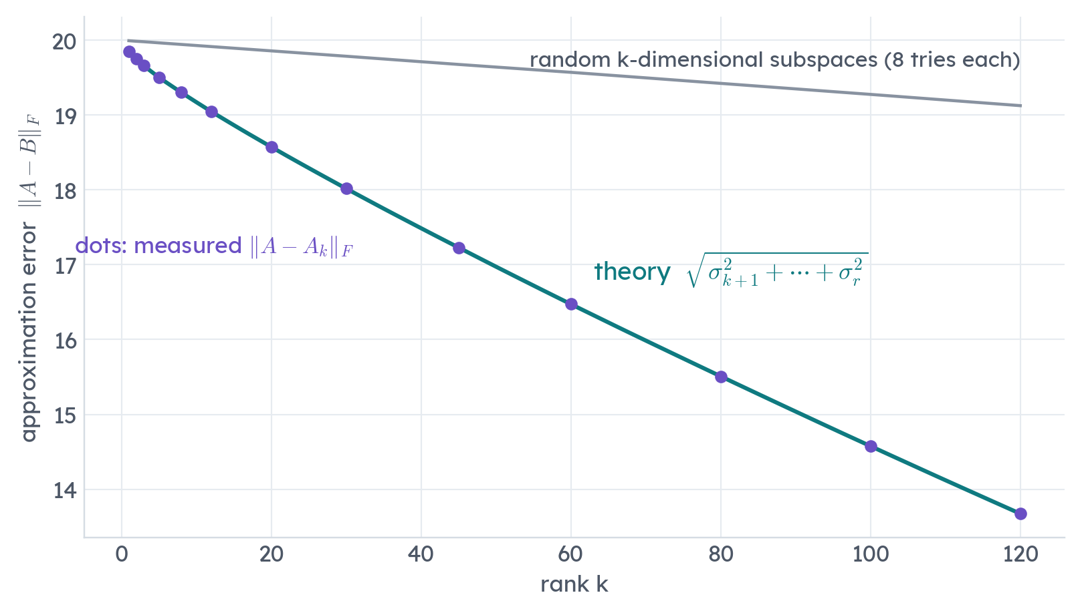
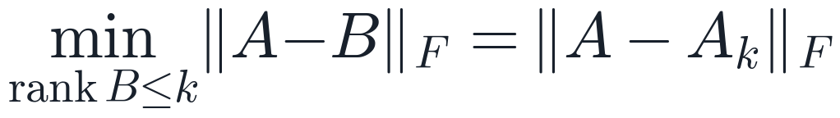
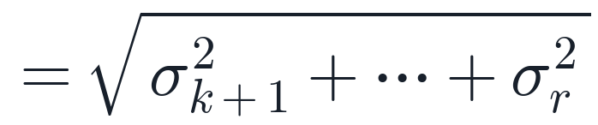
The truncated SVD is provably the best rank-k approximation
Eckart–Young–Mirsky theorem (1936)
Checked on the news matrix at k = 5:
measured 19.5045
theory 19.5045
spectral 1.6417 = σ₆
Random k-dimensional subspaces always do worse (grey band).
Step 3 of 5: Keep k
8
Notes:
Why is throwing away all but k layers the right thing to do? The Eckart–Young–Mirsky theorem: among all matrices of rank at most k, the truncated SVD A_k is the closest to A in the Frobenius norm, and also in the spectral norm. The error is exactly the square root of the sum of the discarded σᵢ².
We check this on the real data. At k = 5 the measured error is 19.5045 and the formula gives 19.5045. The spectral error equals σ_(k+1) = 1.6417.
The chart shows the error for every k, with the theory line through the measured dots, and the grey band is the error of projecting onto random subspaces of the same dimension: always worse, as the theorem promises.

Slide 9
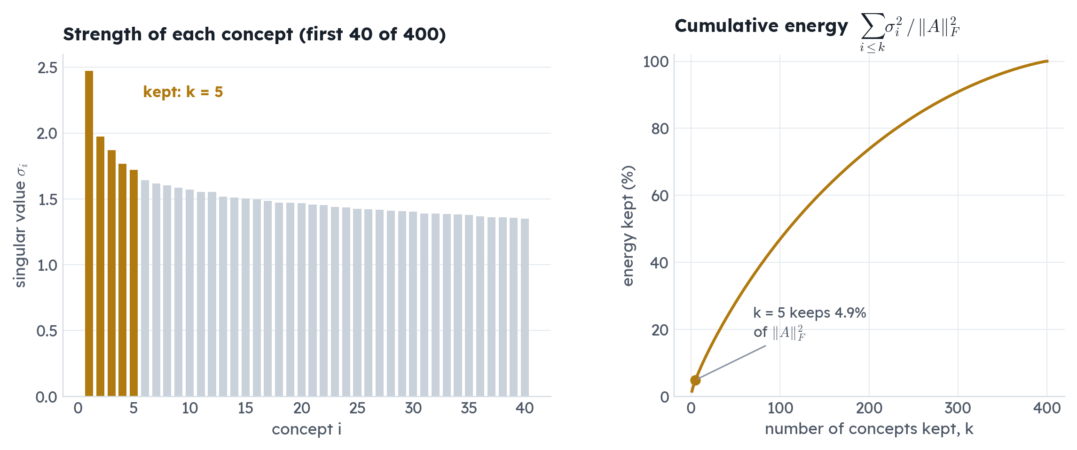
Real text has a few strong concepts and a long flat tail
k = 5 keeps only 4.9% of the energy, yet it gives the best clusters. The tail is mostly the particular wording of single articles.
Step 3 of 5: Keep k
9
Notes:
These are the singular values of the news matrix. The first five stand above a long, slowly decaying tail; there are 399 non-zero values in total.
Keeping k = 5 concepts keeps only 4.9% of the energy, the squared Frobenius norm. As a reconstruction of A that is terrible. But reconstruction is not our goal. The tail describes what is unique to individual articles: names, numbers, one-off phrasing. The strong concepts describe the vocabulary that many articles share, which is what topics are made of. We will see that this k gives the best clustering.

Slide 10
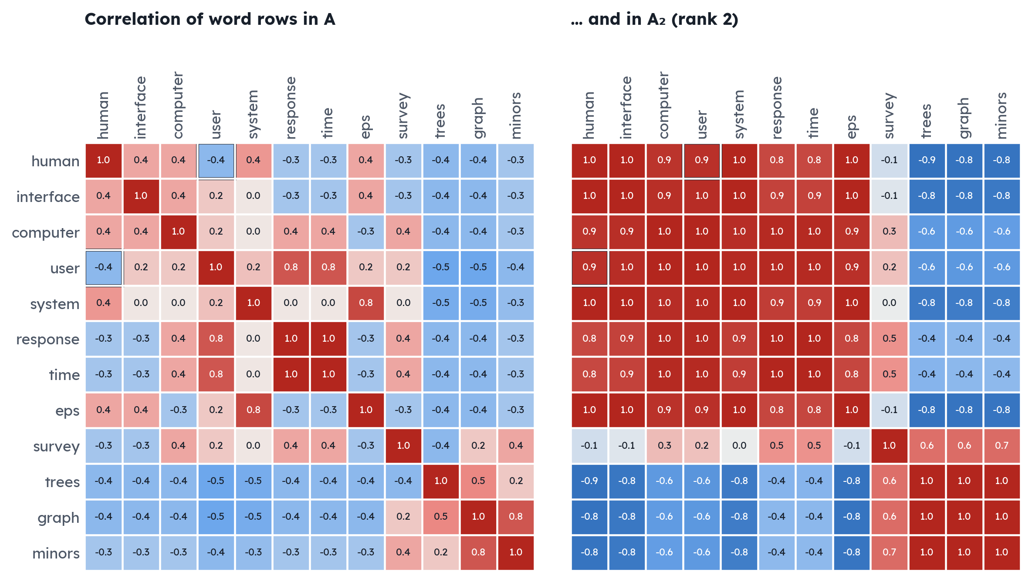
LSA learns that “human” and “user” are related, though they never appear together
-0.38 → +0.94
correlation of “human” and “user”, before and after keeping 2 concepts
-0.29 → -0.83
“human” and “minors”: unrelated words are pushed apart
Exactly the values published by Deerwester et al. (1990). A test checks them.
Step 3 of 5: Keep k
10
Notes:
This is the result that made LSA famous, the synonymy problem. "Human" and "user" never appear in the same title, so in the original matrix their rows have correlation -0.38.
But both co-occur with computer, interface and system. After keeping two concepts, their rows in A₂ have correlation +0.94. Meanwhile "human" and "minors", from the graph-theory titles, go from -0.29 to -0.83.
The heatmaps show all word pairs: after compression the matrix splits cleanly into two blocks, one per topic. These numbers match the original paper exactly, and our test suite checks them.

Slide 11
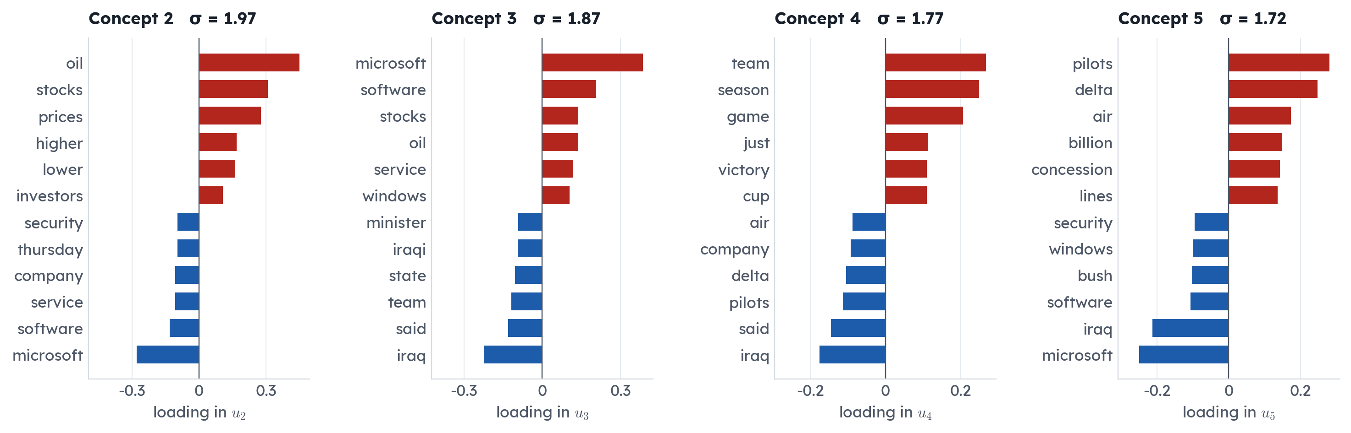
Each concept is a contrast between two groups of words
Concept 2: oil, stocks, prices versus microsoft, software, service Concept 3: microsoft, software, stocks versus iraq, said, team
Concept 4: team, season, game versus iraq, said, pilots Concept 5: pilots, delta, air versus microsoft, iraq, software
Step 3 of 5: Keep k
11
Notes:
Each column of U is a concept: one weight per word. Concept 1 has only positive weights; because A has no negative entries its strongest direction is roughly the average article. The interesting concepts are the next ones, which are contrasts.
Concept 2 separates markets words, oil, stocks and prices, from software and Microsoft. Concept 3 separates technology from world politics: Iraq, minister. Concept 4 is sports versus airline and Iraq news. A topic shows up as one end of one or more of these axes, and a document's coordinates say how much it leans each way.
Signs are arbitrary in the SVD; we fix them so the largest weight is positive, so the output is reproducible.

Slide 12
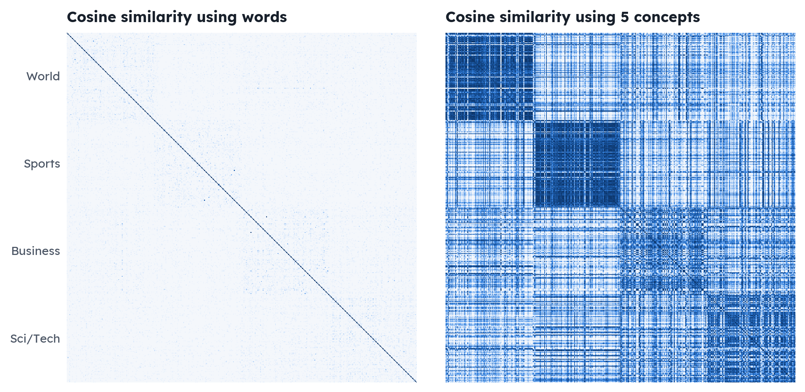
Compared through 5 concepts, each news section lights up as a block
400 × 400 cosine similarities, articles sorted by section. Same colour scale, from 0 (white) to 1 (dark).
Step 4 of 5: Cluster
12
Notes:
This picture is the whole project in one slide. Both panels show the cosine similarity between every pair of the 400 articles, sorted by section: World, Sports, Business, Sci/Tech.
On the left we compare word vectors. Apart from the diagonal, where each article is compared with itself, almost everything is white, because most pairs share no words.
On the right we compare the same articles through their 5 concept coordinates. Four blocks appear along the diagonal, one per section. Business and Sci/Tech overlap a little, which is honest: many technology stories are about companies.

Slide 13
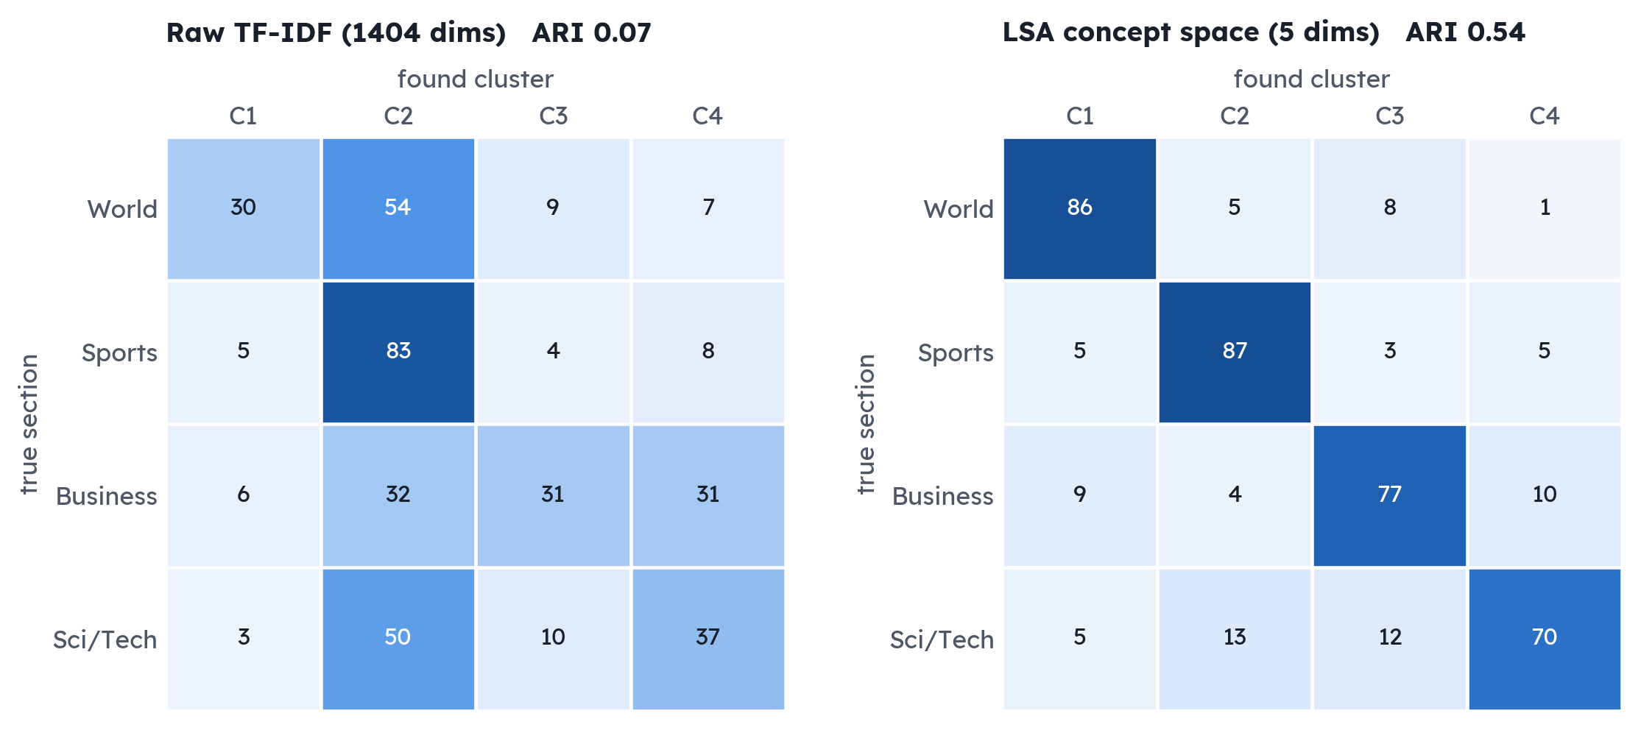
Same k-means, 8× better agreement with the true sections
0.07 → 0.54
adjusted Rand index, raw TF-IDF → LSA (0 = chance, 1 = perfect)
0.12 → 0.50
normalised mutual information
Mean of 10 k-means runs with different seeds.
Both use unit-length vectors, so distance means cosine.
Only the representation changes: 1,404 words or 5 concepts.
Step 4 of 5: Cluster
13
Notes:
Now the actual clustering. Same algorithm, k-means with four clusters, same documents, run ten times with different random starts. The only difference is the representation: each article's 1,404-dimensional TF-IDF column, or its 5 concept coordinates.
On raw TF-IDF the clusters barely agree with the real sections: adjusted Rand index 0.07, where 0 is chance. In concept space it is 0.54, about 8 times higher, and NMI goes from 0.12 to 0.50.
The confusion matrices show why: raw TF-IDF piles most articles into a couple of clusters, while LSA recovers a clear diagonal. The remaining mistakes are mostly Business and Sci/Tech, which really do overlap.
We deliberately do not compare silhouette scores between the two spaces: distances in 1,404 dimensions and in 5 dimensions are not comparable, and the earlier version of this project made that mistake.

Slide 14
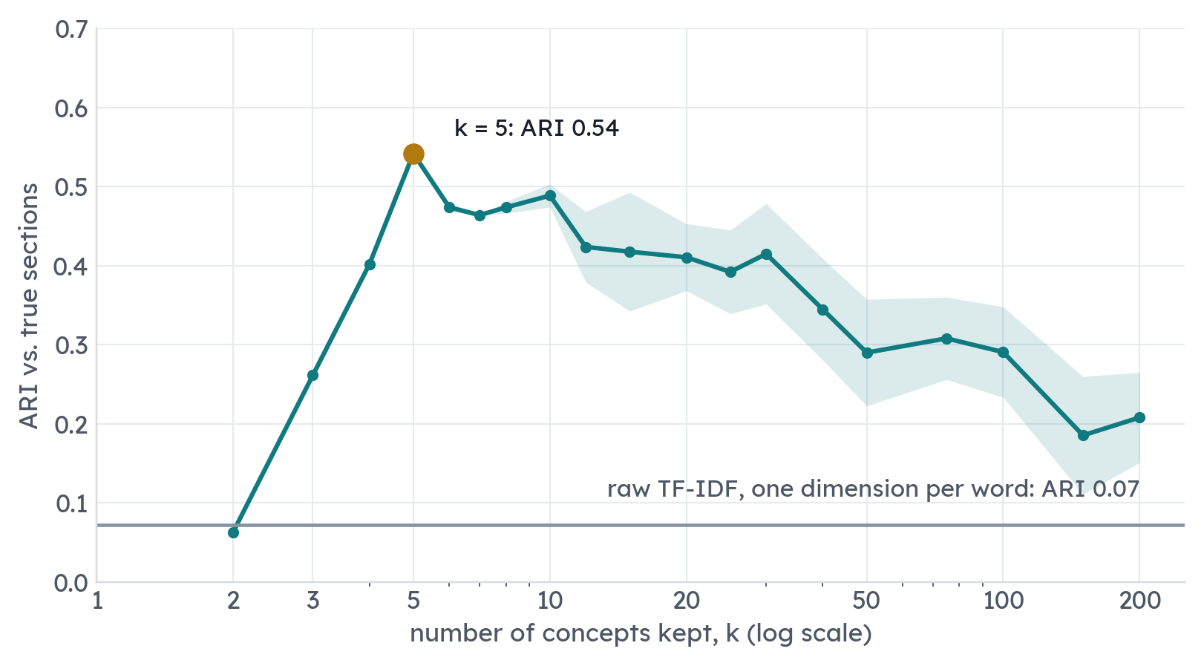
Too few concepts merge topics; too many bring the noise back
Rising: each new concept separates another real topic.
Peak at k = 5: ARI 0.54.
Falling: extra concepts describe single articles, and the space drifts back towards raw TF-IDF.
Without labels: choose k at the elbow of the singular values, or where the clusters are stable across seeds.
Step 3 of 5: Keep k
14
Notes:
How do we pick k? This curve shows clustering quality for every k from 2 to 200, each point the mean of ten runs, with the shaded band one standard deviation.
It rises while new concepts separate real topics, peaks at k = 5, and then slowly falls: the extra concepts describe individual articles rather than topics, and as k grows the concept space becomes a rotated copy of the original word space, so it converges to the raw TF-IDF result.
Honest caveat: we used the labels to draw this curve. Without labels you would look at the elbow of the singular values, which here is also around five, or at how stable the clusters are across random seeds.

Slide 15
Folding in a query finds relevant articles that share none of its words
Query: computer virus (“virus” is not in the vocabulary)
Article | Shared words | Keyword score | LSA score
SBC Gives Microsoft $400 Mln Internet TV Deal | none | 0.00 | 0.97
Microsoft To OK One License for Multicore Chips | none | 0.00 | 0.96
NHS signs nine-year extension with Microsoft | none | 0.00 | 0.95
IBM reported to be exiting PC business | computer | 0.24 | 0.94
Business News for Technology Leaders Microsoft … | none | 0.00 | 0.94
8
articles contain a query word: all keyword search can find
9 of 10
top LSA results share no word with the query
Step 5 of 5: Search
15
Notes:
The same machinery gives search. A query is just a short document, so we weight it like one and fold it in: multiply by U_kᵀ to get its concept coordinates, and compare by cosine with every article. No new SVD is needed; it is one matrix–vector product. We check in the tests that folding in an existing document gives back exactly its own coordinates.
For the query "computer virus", "virus" is not even in our vocabulary. Keyword search can only find the 8 articles that contain "computer". LSA ranks Microsoft and software stories at the top, and 9 of its top ten share no word with the query at all. The highlighted rows were found by meaning alone.
The limitation is also visible: a word LSA has never seen contributes nothing.

Slide 16
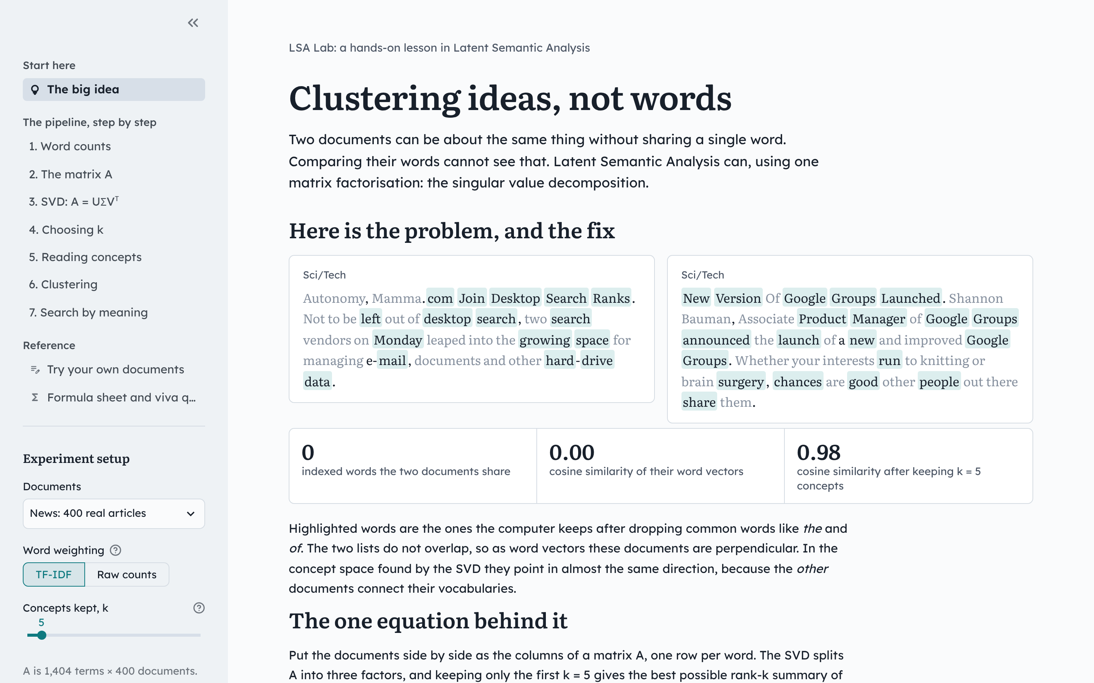
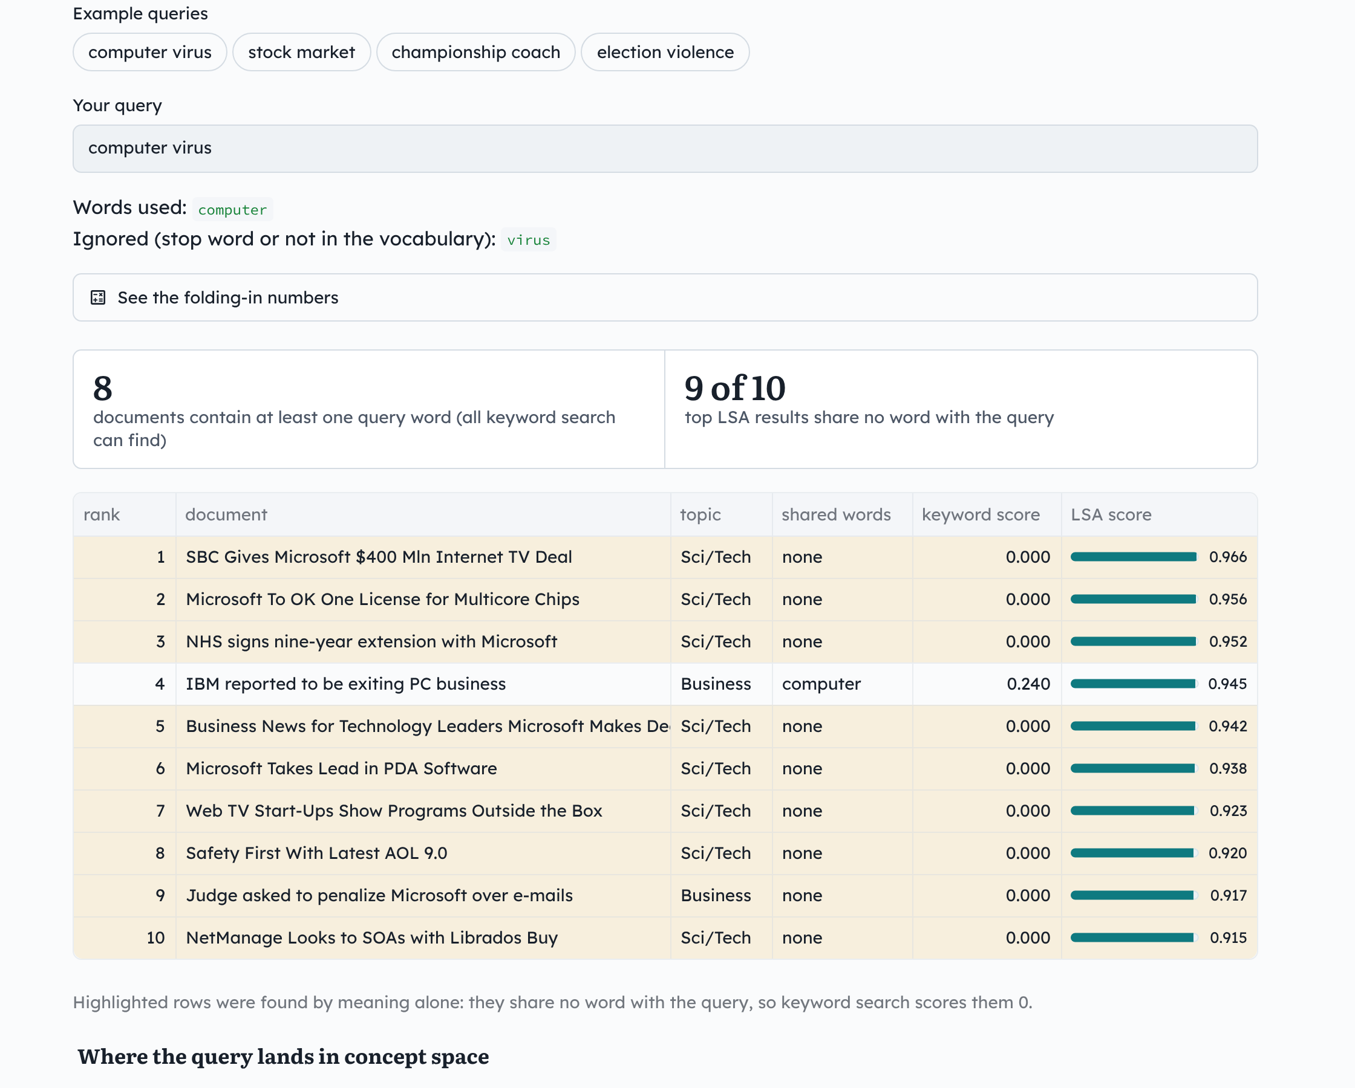
An interactive lab teaches every step live
streamlit run app.py Seven chapters with live charts, worked examples, a quiz in each, your own documents, and a formula sheet.
16
Notes:
Everything in this talk is also an interactive lab, built with Streamlit. It is organised as seven short chapters, one per step, each with live charts, a worked example and a check-yourself question. You can switch between the three collections, change the weighting and k, and the whole lesson recomputes.
It also accepts your own documents, one per line, and has a formula sheet with the questions we expect in a viva. We will demo it now if there is time.

Slide 17
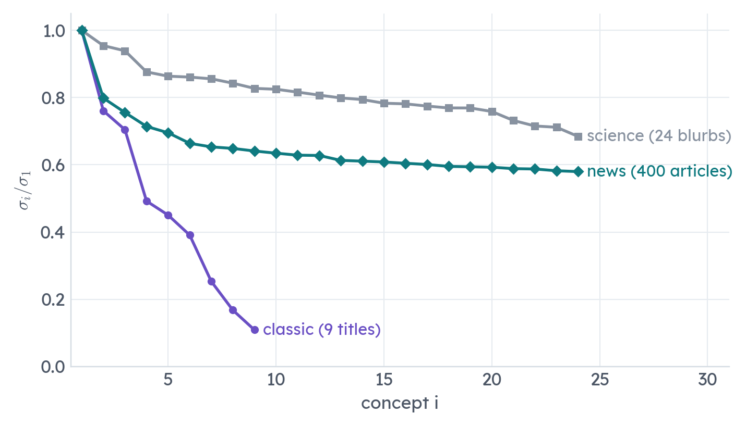
What we learned, and where LSA stops working
Limitations
Bag of words. Order and negation are lost: “not good” looks like “good”.
Hard to interpret. Concepts have negative weights, unlike the probabilities of LDA or the parts of NMF.
One vector per word. Polysemy is only averaged: “bank” gets one position.
Frozen vocabulary. New words and topics need a new SVD.
Cost. A full SVD is O(mn·min(m, n)); large collections need truncated or randomised SVD.
Our first version used 24 one-sentence blurbs. They share almost no words, so the spectrum is flat: 4 concepts kept only 22% of the energy. LSA needs shared vocabulary.
17
Notes:
Two lessons. First, about our own first attempt: the 24 science blurbs were each written with their own vocabulary, so the term–document matrix had almost no co-occurrence structure. The chart shows normalised singular values: the classic example drops quickly, the news collection has a clear gap after the first few, and the science blurbs are nearly flat. Four concepts kept only 22% of the energy. LSA can only find structure that repetition puts there.
Second, the limits of the method. It is a bag of words; concepts mix positive and negative weights so they are not probabilities; each word has a single vector, so multiple meanings are averaged; the vocabulary is frozen; and a full SVD is expensive, though only the top k singular vectors are ever needed.

Slide 18
Three things to remember
The SVD finds concepts.
A = UΣVᵀ turns word co-occurrence into orthogonal concepts: U for words, V for documents, Σ for strength.
Truncation is the point.
Eckart–Young makes the truncated SVD the best rank-k summary. On news, k = 5 keeps 5% of the energy and gives the best clusters.
Concepts beat words.
Clustering agreement rises from ARI 0.07 to 0.54, and search finds articles that share no words with the query.
Questions?
Run it: python main.py app
Notes:
To sum up. The SVD turns patterns of word co-occurrence into orthogonal concepts. Truncating it, which Eckart–Young tells us is the optimal rank-k approximation, removes the noise of individual wording. And comparing documents through those concepts instead of their raw words makes clustering agree with the true sections 8 times better, and lets search find documents that share no words with the query.
Thank you. We are happy to take questions, or to show any step live in the app.

