Slide 1
Sentiment Analysis on Financial Microblogs and News
Venkatesh and Sreevatsan

Slide 2
Task 1: Sentiment Analysis of Microblogs:
Dataset :
Training Set – 1204
Test Set – 335
Validation Set -134
Approach
Using Gensim WordVectors:
Using Lexicon Features

Slide 3
Data Processing
Pre-Processing:
Removal of special characters, punctuations and numbers.
Removal of URLs, user names mentioned in a tweet message.
Removal of words with length less than three in order to reduce the dimensionality of feature space.
Conversion of tweet text into lower case.
Concatenation of spans to form a unified string. For the empty spans field, we considered the whole preprocessed message text for feature extraction.
Features:
Word2Vec genism model built using Finance model (all_fin_model_lower) which had collection of 189,206 financial articles.
Average Weighted vectors built by combination of above word2vec model and tf-idf vector calculated from the dataset.
The span column is the only text data fed as input.

Slide 4
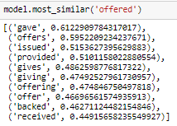
Gensim – Word Similarity

Slide 5
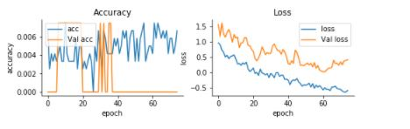
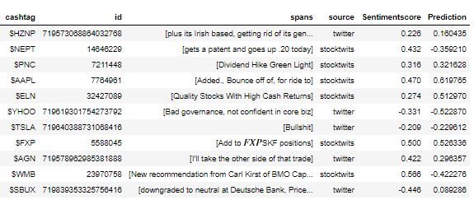
Gensim – With original sentiment

Slide 6
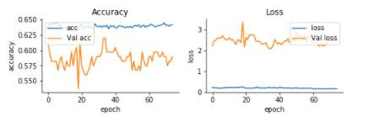
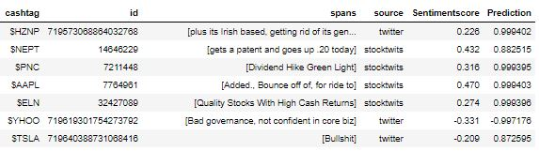
Gensim –With converted sentiment

Slide 7
Gensim
With original sentiment
Accuracy : Less than 1%
Cosine_Similarity: 0.46058743
With converted sentiment
Accuracy: 55.2238812198
Cosine_Similarity: 0.55062247

Slide 8
Using Lexicon Features - MLP
http://www.aclweb.org/anthology/S17-2140
http://www.aclweb.org/anthology/S17-2140
Sequential layer followed by dense layers and dropout of 0.2 and 0.5 respectively.
Tanh activation function is used .
RmsProp optimizer is used, with binary_cross_entropy as loss function.
epochs=75, batch_size=120
DENSE
Accuracy : 0.5880597052289479
Cosine_Similarity: 0.81846746
CNN
Accuracy: 0.6507462666995489
Cosine_Similarity: 0.80668845

Slide 9
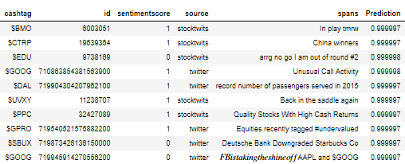
Prediction CCN Converted Sentiment

Slide 10
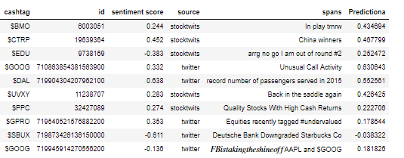
Prediction-CCN–Original Sentiment

Slide 11
Task 2: News Headlines
Pre-Processing and Features:
Glove 100 dimensional vector data is used for embedding layer creation.
The text data is tokenized and converted into sequence using keras tokenizer and text_to-Sequence function.
The padding is done obtaining the maximum length of each sentence using pad_sequences function.
Data is divided into training and test data with test size of 0.2.
Pre-trained word embeddings is used to build the embedding layer along with the word index.

Slide 12
MLP
The embedding layer is fed as input to the sequential model after reshaping the training data.
The flattening layer is added to flatten the embedding sequence.
Dense layer with 256 hidden units added followed by dropouts
The output dense layer is added with tanh activation function.
Adam optimizer is used along with cosine_proximity loss function.
10 epochs are run with batch size of 64
Model is fit with Accuracy: 59.83%
Cosine_Similarity: 0.668845

Slide 13
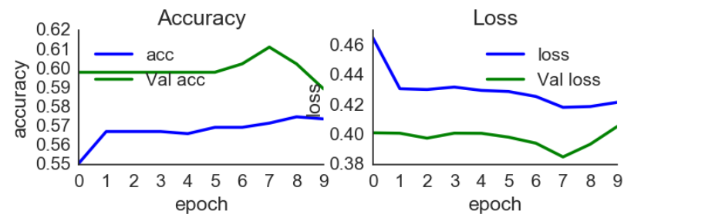
MLP - GRAPH

Slide 14
CNN
Embedding layer is added as input layer and tanh activation is used as the activation function.
Convolutional 1-D layers with linear activation is added next
Dropout layers are added in between the conv layers.
Then model is flattened with flattening layer
Dense layer with tanh activation is added as output layer.
Adam optimizer is used along with cosine_proximity loss function.
20 epochs are run with batch size of 64.
Accuracy: 0.60
Cosine_Similarity: 0.77342538

Slide 15
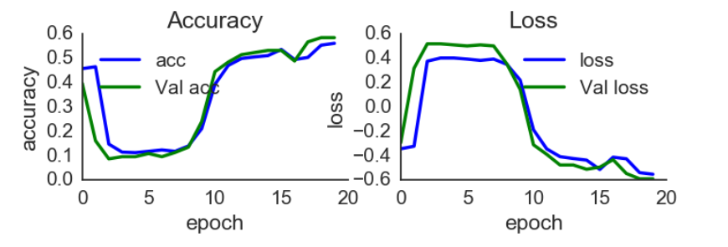
CNN- GRAPH

Slide 16
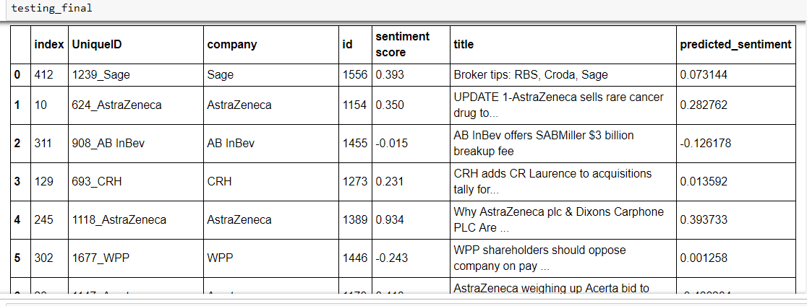
MLP- PREDICTION
Cosine_Similarity: 0.36

Slide 17
Conclusion
http://www.aclweb.org/anthology/S17-2140
For TASK 1, CCN model with Original Sentiment worked better when compared with reset of the model.
TASK 2, MLP worked better when compared with reset of the model

