Slide 1



Farrin Reid
Web & Internet Programming Group
Diana, Aren, Beau, Jeff, & Adam
CS 331

Slide 2
python
Simple
  Python is a simple and minimalistic language in nature
  Reading a good python program should be like reading English
  Its Pseudo-code nature allows one to concentrate on the problem rather than the language
Easy to Learn
Free & Open source
  Freely distributed and Open source
  Maintained by the Python community
High Level Language –memory management
Portable – *runs on anything c code will
CS 331

Slide 3
python
Interpreted
  You run the program straight from the source code.
  Python program →Bytecode →a platforms native language
  You can just copy over your code to another system and it will auto-magically work! *with python platform
Object-Oriented
  Simple and additionally supports procedural programming
Extensible – easily import other code
Embeddable –easily place your code in non-python programs
Extensive libraries
  (i.e. reg. expressions, doc generation, CGI, ftp, web browsers, ZIP, WAV, cryptography, etc...) (wxPython, Twisted, Python Imaging library)
CS 331

Slide 4
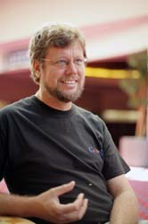
python Timeline/History
Python was conceived in the late 1980s.
  Guido van Rossum, Benevolent Dictator For Life
  Rossum is Dutch, born in Netherlands, Christmas break
  bored, big fan of Monty python’s Flying Circus
  Descendant of ABC, he wrote glob() func in UNIX
  M.D. @ U of Amsterdam, worked for CWI, NIST, CNRI, Google
  Also, helped develop the ABC programming language
In 1991 python 0.9.0 was published and reached the masses through alt.sources
In January of 1994 python 1.0 was released
  Functional programming tools like lambda, map, filter, and reduce
  comp.lang.python formed, greatly increasing python’s userbase
CS 331

Slide 5
python Timeline/History
In 1995, python 1.2 was released.
By version 1.4 python had several new features
  Keyword arguments (similar to those of common lisp)
  Built-in support for complex numbers
  Basic form of data-hiding through name mangling (easily bypassed however)
Computer Programming for Everybody (CP4E) initiative
  Make programming accessible to more people, with basic “literacy” similar to those required for English and math skills for some jobs.
  Project was funded by DARPA
  CP4E was inactive as of 2007, not so much a concern to get employees programming “literate”
CS 331

Slide 6
python Timeline/History
In 2000, Python 2.0 was released.
  Introduced list comprehensions similar to Haskells
  Introduced garbage collection
In 2001, Python 2.2 was released.
  Included unification of types and classes into one hierarchy, making pythons object model purely Object-oriented
  Generators were added(function-like iterator behavior)
Standards
  http://www.python.org/dev/peps/pep-0008/
CS 331

Slide 7
Python types
Str, unicode – ‘MyString’, u‘MyString’
List – [ 69, 6.9, ‘mystring’, True]
Tuple – (69, 6.9, ‘mystring’, True) immutable
Set/frozenset – set([69, 6.9, ‘str’, True])
frozenset([69, 6.9, ‘str’, True]) –no duplicates & unordered
Dictionary or hash – {‘key 1’: 6.9, ‘key2’: False} - group of key and value pairs
CS 331

Slide 8
Python types
Int – 42- may be transparently expanded to long through 438324932L
Float – 2.171892
Complex – 4 + 3j
Bool – True of False
CS 331

Slide 9
Python semantics
Each statement has its own semantics, the def statement doesn’t get executed immediately like other statements
Python uses duck typing, or latent typing
  Allows for polymorphism without inheritance
  This means you can just declare
  “somevariable = 69” don’t actually have to declare a type
  print “somevariable = “ + tostring(somevariable)”
  strong typing , can’t do operations on objects not defined without explicitly asking the operation to be done
CS 331

Slide 10
Python Syntax
Python uses indentation and/or whitespace to delimit statement blocks rather than keywords or braces
if __name__ == "__main__":
print “Salve Mundo"
# if no comma (,) at end ‘\n’ is auto-included
CONDITIONALS
if (i == 1): do_something1()
elif (i == 2): do_something2()
elif (i == 3): do_something3()
else: do_something4()
CS 331

Slide 11
Conditionals Cont.
if (value is not None) and (value == 1):
print "value equals 1”,
print “ more can come in this block”
if (list1 <= list2) and (not age < 80):
print “1 = 1, 2 = 2, but 3 <= 7 so its True”
if (job == "millionaire") or (state != "dead"):
print "a suitable husband found"
else:
print "not suitable“
if ok: print "ok"
CS 331

Slide 12
Loops/Iterations
sentence = ['Marry','had','a','little','lamb']
for word in sentence:
print word, len(word)
for i in range(10):
print I
for i in xrange(1000):# does not allocate all initially
print I
while True:
pass
for i in xrange(10):
if i == 3: continue
if i == 5: break
print i,
CS 331

Slide 13
Functions
def print_hello():# returns nothing
print “hello”
def has_args(arg1,arg2=['e', 0]):
num = arg1 + 4
mylist = arg2 + ['a',7]
return [num, mylist]
has_args(5.16,[1,'b'])# returns [9.16,[[1, ‘b’],[ ‘a’,7]]
def duplicate_n_maker(n): #lambda on the fly func.
return lambda arg1:arg1*n
dup3 = duplicate_n_maker(3)
dup_str = dup3('go') # dup_str == 'gogogo'
CS 331

Slide 14
Exception handling
try:
f = open("file.txt")
except IOError:
print "Could not open“
else:
f.close()
a = [1,2,3]
try:
a[7] = 0
except (IndexError,TypeError):
print "IndexError caught”
except Exception, e:
print "Exception: ", e
except: # catch everything
print "Unexpected:"
print sys.exc_info()[0]
raise # re-throw caught exception
try:
a[7] = 0
finally:
print "Will run regardless"
Easily make your own exceptions:
class myException(except)
def __init__(self,msg):
self.msg = msg
def __str__(self):
return repr(self.msg)
CS 331

Slide 15
Classes
class MyVector: """A simple vector class."""
num_created = 0
def __init__(self,x=0,y=0):
self.__x = x
self.__y = y
MyVector.num_created += 1
def get_size(self):
return self.__x+self.__y
@staticmethod
def get_num_created
return MyVector.num_created
#USAGE OF CLASS MyVector
print MyVector.num_created
v = MyVector()
w = MyVector(0.23,0.98)
print w.get_size()
bool = isinstance(v, MyVector)
Output:
0
1.21
CS 331

Slide 16
I/O
import os
print os.getcwd() #get “.”
os.chdir('..')
import glob # file globbing
lst = glob.glob('*.txt') # get list of files
import shutil # mngmt tasks
shutil.copyfile('a.py','a.bak')
# read binary records from a file
from struct import *
fin = None
try:
fin = open("input.bin","rb")
s = f.read(8)#easy to read in
while (len(s) == 8):
x,y,z = unpack(">HH<L", s)
print "Read record: " \
"%04x %04x %08x"%(x,y,z)
s = f.read(8)
except IOError:
pass
if fin: fin.close()
import pickle # serialization logic
ages = {"ron":18,"ted":21}
pickle.dump(ages,fout)
# serialize the map into a writable file
ages = pickle.load(fin)
# deserialize map from areadable file
CS 331

Slide 17
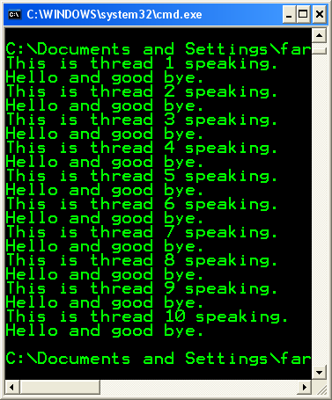
Threading in Python
import threading
theVar = 1
class MyThread ( threading.Thread ):
def run ( self ):
global theVar
print 'This is thread ' + \
str ( theVar ) + ' speaking.‘
print 'Hello and good bye.’
theVar = theVar + 1
for x in xrange ( 10 ):
MyThread().start()
CS 331

Slide 18
So what does Python have to do with Internet and web programming?
Jython & IronPython(.NET ,written in C#)
Libraries – ftplib, snmplib, uuidlib, smtpd, urlparse, SimpleHTTPServer, cgi, telnetlib, cookielib, xmlrpclib, SimpleXMLRPCServer, DocXMLRPCServer
Zope(application server), PyBloxsom(blogger), MoinMoin(wiki), Trac(enhanced wiki and tracking system), and Bittorrent (6 no, but prior versions yes)
CS 331

Slide 19
Python Interpreters
http://www.python.org/download/
http://pyaiml.sourceforge.net/
http://www.py2exe.org/
http://www.activestate.com/Products/activepython/
http://www.wingware.com/
http://pythonide.blogspot.com/
Many more…
CS 331

Slide 20
Python on your systems
  Its easy! Go to http://www.python.org/download/
  Download your architecture binary, or source
  Install, make, build whatever you need to do… plenty of info on installation in readmes
  Make your first program! (a simple on like the hello world one will do just fine)
  Two ways of running python code. Either in an interpreter or in a file ran as an executable
CS 331

Slide 21
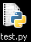
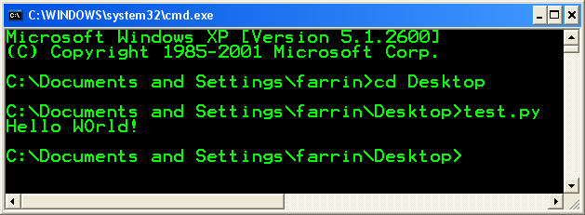
Running Python
Windows XP – double click the icon or call it from the command line as such:
CS 331

Slide 22
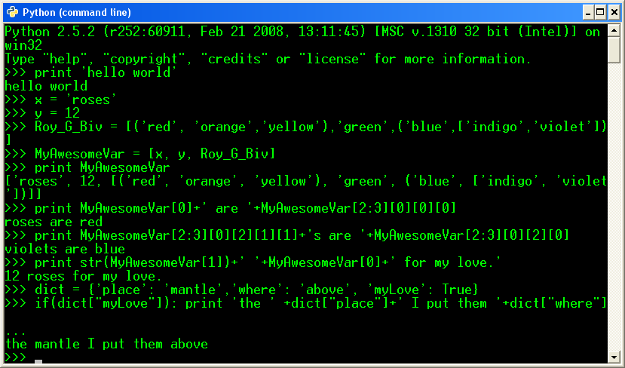
Python Interpreter
CS 331

Slide 23
Python for the future
Python 3.0
  Will not be Backwards compatible, they are attempting to fix “perceived” security flaws.
  Print statement will become a print function.
  All text strings will be unicode.
  Support of optional function annotation, that can be used for informal type declarations and other purposes.
CS 331

Slide 24
Bibliography
http://it.metr.ou.edu/byteofpython/features-of-python.html
http://codesyntax.netfirms.com/lang-python.htm
http://www.python.org/
Sebesta, Robert W., Concepts of Programming Languages: 8th ed. 2007
http://www.python.org/~guido/
CS 331

