Slide 1
Workforce scorecard, FY2025
16 NYC agencies, public payroll records (NYC Open Data). Generated 2026-09-24.
End-of-year headcount was 151,087 in FY2025 (-0.7% vs FY2024). Turnover was 11.3% (-0.2 pts vs FY2024). 4 of 16 agencies have at least one red scorecard metric.

Slide 2
Headline indicators
FY2025 vs FY2024, all agencies in scope
Headcount (end of year)
Turnover rate
Same-year new-hire attrition
Overtime hours per worker
Median base salary (annual)
151,087
11.3%
16.2%
229.0 hours
$81,154
-0.7% vs FY2024
-0.2 pts vs FY2024
+0.5 pts vs FY2024
+0.5% vs FY2024
+1.3% vs FY2024
Parks & Recreation has the highest turnover at 39.1%, 3.5x the overall rate of 11.3%. Within Parks & Recreation, turnover was 74.3% for per Hour employees vs 7.9% for per Annum employees.

Slide 3
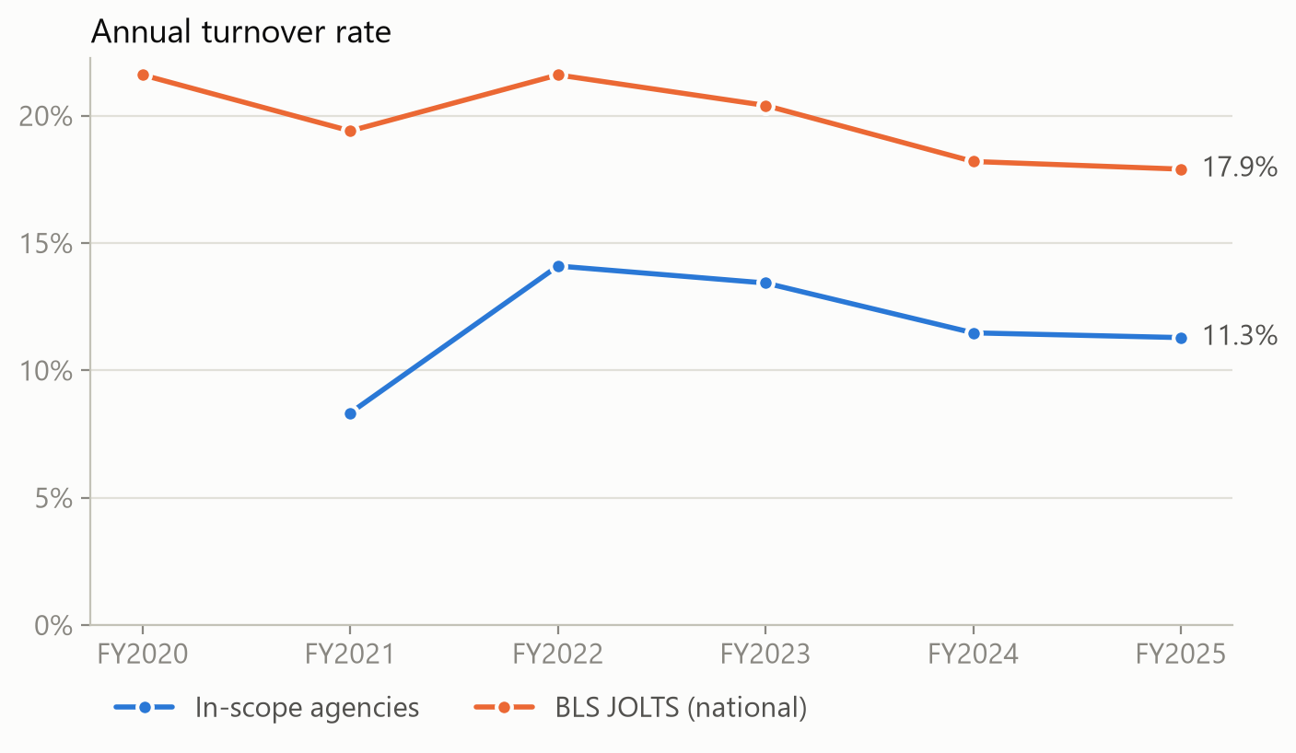
Turnover trend vs national benchmark
In-scope turnover (separations / average headcount) and BLS JOLTS total separations rate for state & local government excl. education, summed over July-June. Context, not a like-for-like comparison.

Slide 4
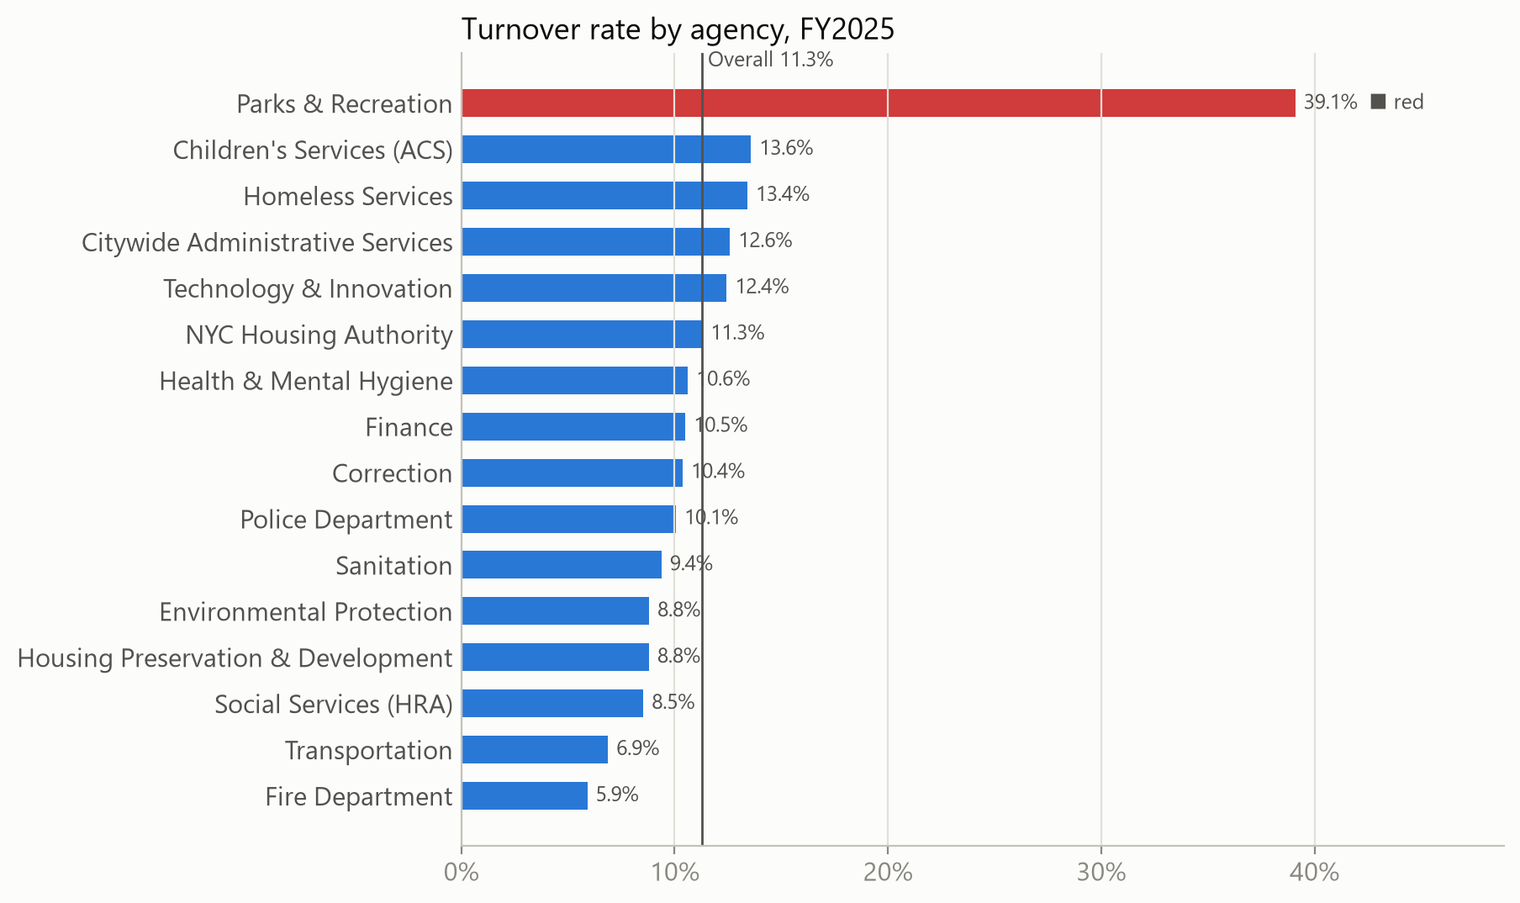
Where turnover is concentrated
Parks & Recreation has the highest turnover at 39.1%, 3.5x the overall rate of 11.3%. Within Parks & Recreation, turnover was 74.3% for per Hour employees vs 7.9% for per Annum employees.

Slide 5
Agency scorecard
Status compares each agency with the all-in-scope value (red >= 1.25x).
Agency | Headcount | Turnover | Status | New-hire attrition | Status | OT hrs / worker | Status
Police Department | 48,573 | 10.1% | ● Green | 7.0% | ● Green | 273.5 | ▲ Amber
Fire Department | 17,649 | 5.9% | ● Green | 10.5% | ● Green | 386.6 | ■ Red
NYC Housing Authority | 12,456 | 11.3% | ● Green | 15.7% | ● Green | 231.9 | ● Green
Social Services (HRA) | 11,083 | 8.5% | ● Green | 10.0% | ● Green | 136.8 | ● Green
Sanitation | 9,947 | 9.4% | ● Green | 16.3% | ● Green | 230.7 | ● Green
Parks & Recreation | 8,740 | 39.1% | ■ Red | 34.7% | ■ Red | 35.5 | ● Green
Correction | 7,571 | 10.4% | ● Green | 11.3% | ● Green | 505.5 | ■ Red
Children's Services (ACS) | 6,738 | 13.6% | ▲ Amber | 18.8% | ▲ Amber | 135.5 | ● Green
Health & Mental Hygiene | 6,538 | 10.6% | ● Green | 13.3% | ● Green | 44.4 | ● Green
Transportation | 6,078 | 6.9% | ● Green | 7.1% | ● Green | 203.8 | ● Green
Environmental Protection | 5,893 | 8.8% | ● Green | 4.2% | ● Green | 139.6 | ● Green
Housing Preservation & Development | 2,446 | 8.8% | ● Green | 9.0% | ● Green | 27.8 | ● Green
Citywide Administrative Services | 2,161 | 12.6% | ▲ Amber | 13.0% | ● Green | 216.0 | ● Green
Finance | 1,851 | 10.5% | ● Green | 9.3% | ● Green | 65.2 | ● Green
Homeless Services | 1,793 | 13.4% | ▲ Amber | 19.3% | ▲ Amber | 221.4 | ● Green
Technology & Innovation | 1,570 | 12.4% | ▲ Amber | 25.8% | ■ Red | 21.7 | ● Green
All in scope | 151,087 | 11.3% |  | 16.2% |  | 229.0

Slide 6
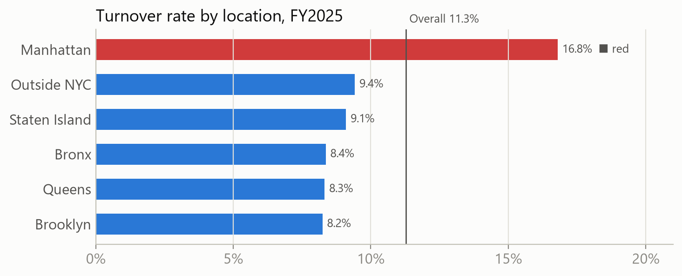
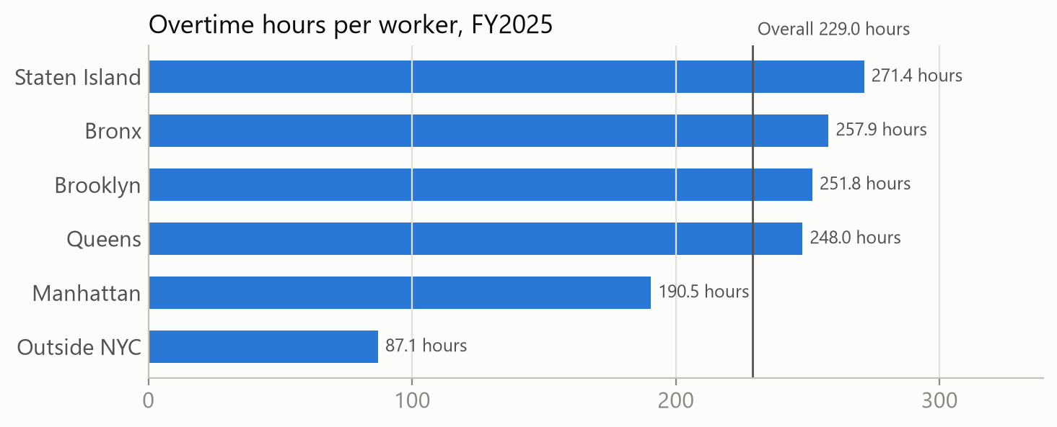
Location view
Turnover and overtime by work location (multi-site view).

Slide 7
Separations outlook, FY2026 (workforce planning)
Backtest FY2022-FY2025, each year predicted from earlier years only, 16 agencies. Mean absolute percentage error: last-year rate 23.7%, trailing 3-year rate 26.8%, naive same count as last year 24.0%. The projection uses the lowest (end-of-year headcount x last year's turnover rate); error of this size means it is a planning baseline, not a precise forecast.
Agency | Headcount FY2025 | Projected separations FY2026
Police Department | 48,573 | 4,887
Parks & Recreation | 8,740 | 3,417
NYC Housing Authority | 12,456 | 1,407
Fire Department | 17,649 | 1,042
Social Services (HRA) | 11,083 | 946
Sanitation | 9,947 | 933
Children's Services (ACS) | 6,738 | 915
Correction | 7,571 | 785
Health & Mental Hygiene | 6,538 | 694
Environmental Protection | 5,893 | 519
Method: end-of-year headcount x last year's turnover rate, chosen because it had the lowest backtest error. A planning baseline for whole agencies, not a prediction about any individual.

Slide 8
Definitions and data notes
Separations: Count of records with June 30 status CEASED and regular hours > 0 in the fiscal year. Turnover rate: Separations / ((prior-FY end-of-year headcount + current-FY end-of-year headcount) / 2). Same-year new-hire attrition: Records that are both new hires and separations / new hires, same fiscal year.
Separations exclude CEASED records with zero regular hours (residual payments to earlier leavers).
Source does not distinguish voluntary from involuntary exits, and has no engagement, performance, or demographic data.
Privacy: names are never downloaded; any cell with fewer than 10 employees is suppressed.
Data: NYC Citywide Payroll Data (NYC Open Data); BLS JOLTS via the BLS public API.

