Slide 1
HACKORBIT 2K26
SMART SERVE — Canteen Waste Forecasting
TEAM DETAILS
TEAM NAME
TEAM LEADER
TEAM MEMBERS
CODETITANS
RANJITHKUMAR M
7376252IT298
IT
SREHARI B S POOVENDRA A
1

Slide 2
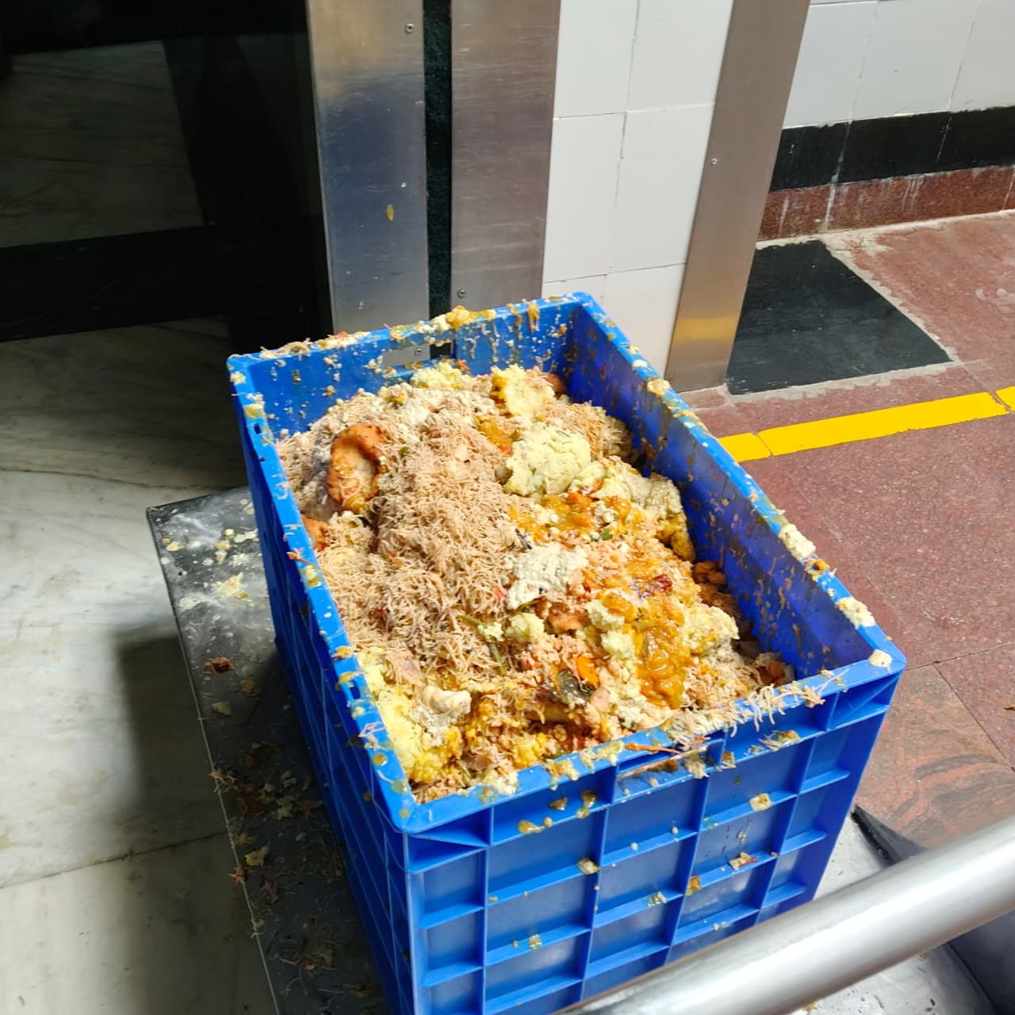
HACKORBIT 2K26
PROBLEM STATEMENT
Define the problem clearly and concisely
THE PROBLEM
VISUAL / EVIDENCE
Food waste in hostel canteens is a hidden, untracked cost — decisions on how much to cook are made by habit, not data. • Over-prepared food is thrown away daily, wasting the mess’s raw-material budget. • Every hostel canteen and mess — the institution absorbs the cost, and the environment absorbs the waste. • Discarded food rots in landfills and generates methane; without records, nobody sees which meals waste the most. • Paper registers, if kept, are rarely reviewed — there’s no historical record, so overproduction is never measured.
3

Slide 3
HACKORBIT 2K26
PROPOSED SOLUTION
Explain your idea in one clear flow
01 PROBLEM
02 SOLUTION
03 TECHNOLOGY
04 OUTCOME
Waste tracked by habit, not data
Smart Serve: a log-and-forecast web app
React + Supabase (PostgreSQL) + Chart.js, with moving-average forecasting
Less waste, lower cost, data-backed prep quantities
Smart Serve replaces guesswork with a simple, database-backed way to decide how much food to prepare. Staff log daily waste in seconds; the system aggregates history and forecasts tomorrow’s expected waste, turning it into a clear “cook this much less” decision — cutting waste without cutting service quality.
4

Slide 4
HACKORBIT 2K26
INNOVATION & USP
What makes your solution different?
SMART FORECASTING
REAL-TIME
COST EFFECTIVE
Moving-average trend forecasting turns logged history into next-meal prep quantities
Averages and forecasts update automatically the moment a new entry is logged
Built on Supabase’s free tier + Chart.js — no paid infrastructure required
SCALABLE
USER FRIENDLY
Database-backed design keeps forecasts accurate as history and mess count grow
A simple daily form — logging waste takes seconds, not minutes
5

Slide 5
HACKORBIT 2K26
SYSTEM ARCHITECTURE
Replace the placeholders with your architecture diagram
USER
FRONTEND
BACKEND
DATABASE
Mess Staff (Kitchen)
React +CSS+HTML waste-entry form & charts
Supabase client (JS)
Supabase PostgreSQL — entries, items, dates
FORECASTING
VISUALIZATION
Moving average / trend extrapolation
Chart.js trend & forecast charts
Data flows: Entry → Storage → Processing → Forecasting → Visualization → Action
6

Slide 6
HACKORBIT 2K26
TECHNOLOGY STACK
Show only technologies actually used
FRONTEND
BACKEND
DATABASE
React HTML CSS
Vanilla JavaScript Supabase client SDK
Supabase (PostgreSQL)
FORECASTING
DEPLOYMENT
Moving average Trend extrapolation
NETLIFY AND GITHUB
7

Slide 7
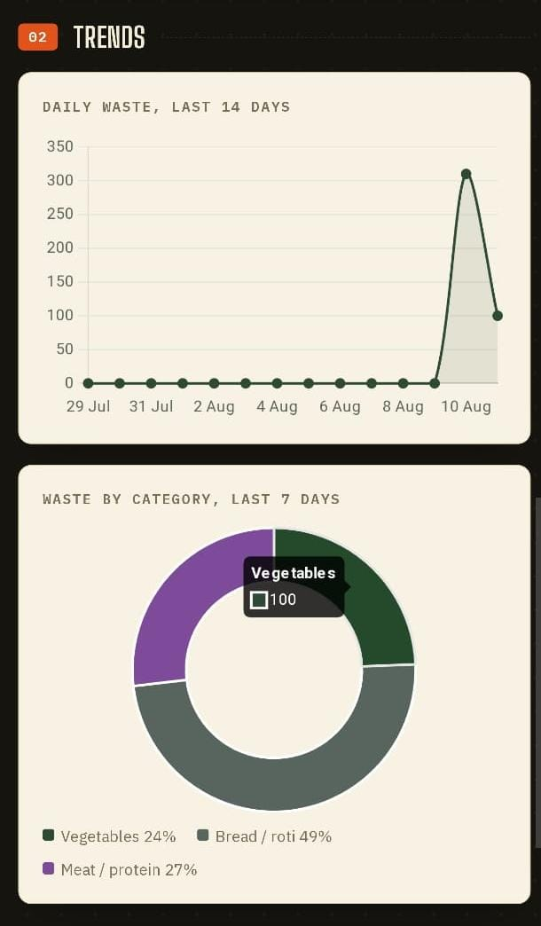
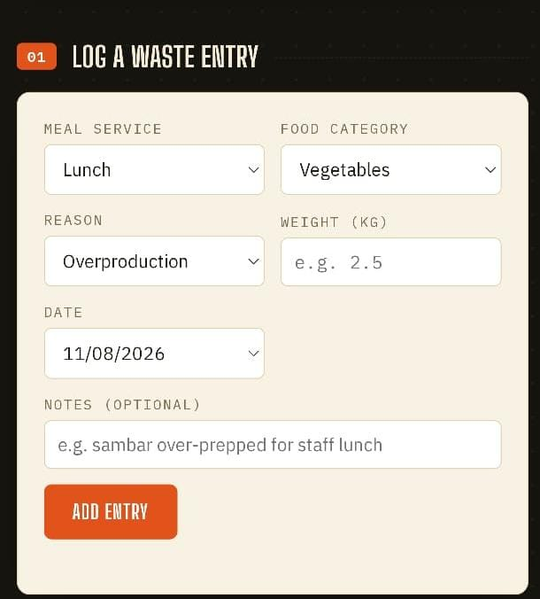
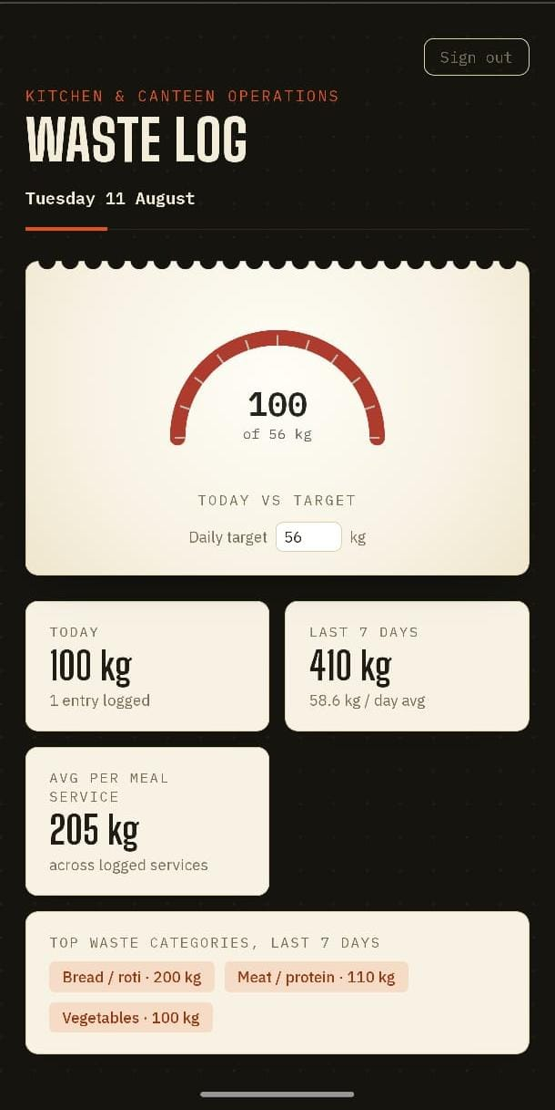
HACKORBIT 2K26
PROTOTYPE / WORKING MODEL / IMPLEMENTATION PLAN
Insert screenshots of the actual implementation
WASTE ENTRY
FORECAST DASHBOARD
TREND CHARTS
The prototype demonstrates the full loop: staff log daily waste, the system aggregates history and forecasts tomorrow’s expected waste, converting it into a clear next-meal preparation quantity.
8

Slide 8
HACKORBIT 2K26
IMPACT & BENEFITS
Quantify the expected value wherever possible
Seconds
Lower
All
24/7
per waste log entry
raw-material spend
meals covered
dashboard access
SOCIAL IMPACT
ECONOMIC IMPACT
SCALABILITY
Less discarded food means less landfill methane and a smaller environmental footprint
Lower over-preparation cuts raw-material spend, meal after meal
Database-backed design keeps forecasts accurate as more meals, items, and history are logged
9

Slide 9
HACKORBIT 2K26
FUTURE SCOPE & CONCLUSION
End with a clear vision
FUTURE SCOPE
CONCLUSION
• Smarter forecasting — seasonal and machine-learning-based models as more data is logged • A dedicated mobile app for faster daily logging from the kitchen floor • Real-time billing integration to auto-populate served quantities • Offline logging support for when there’s no internet connection • Expand from one mess to multiple institutions
Smart Serve replaces guesswork with a simple, database-backed way to decide how much food to prepare — cutting waste and cost without cutting service quality. Every future feature builds on the database that’s already logging entries today. OUR VISION A canteen that never over-cooks, because every prep decision is backed by data, not habit.
THANK YOU
10

