Slide 1


  Security Infrastructure Lab
  Complete Virtual Environment
  Stephen Reilly

Slide 2
What is it?
It’s a completely virtualized network environment
Can be used to simulate most real world networks (financial, medical, corporate...)
Full security suite included
We would have to build it, brick by brick
Blue Team creates scopes, Red Team attacks,
we fix holes, repeat and improve as we learn

Slide 3
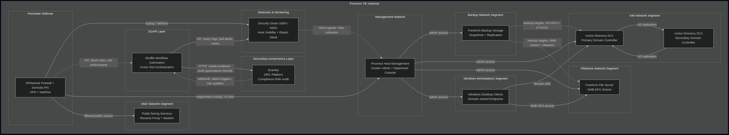
An entire network in a box example:

Slide 4
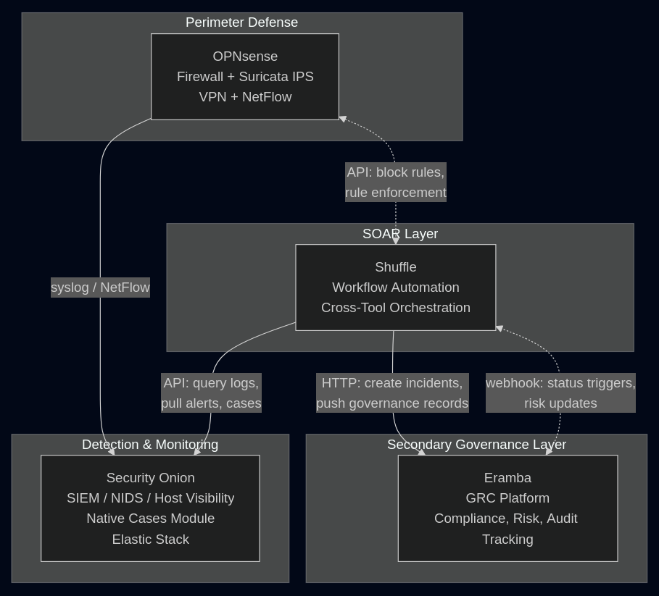
Security Infra Alone

Slide 5
Some ideas on what to deploy
Security Tech
Business Tech
Firewall
SIEM
IDS/IPS
SOAR
WAF
VPN
etc...
AIM
DBs
Backup
Fileshare
WebApps
Auditing
etc...

Slide 6
Why get involved?
It would look good on our CV

Slide 7
More info can be found here:
https://github.com/sreilly1977/dlh-cyber_security/blob/main/notes/Open-Source_Security_Stack.md

